Slide 1
Practical aspects and methodological challenges in research using linked data
James Doidge | J.Doidge@ucl.ac.uk
Administrative Data Research Centre for England
University College London
With contributions from Dr Katie Harron

Slide 2
Practical aspects
Part 1
  What is data linkage?
  What can linked data be used for?
  How are records linked?
  How to access linked data?

Slide 3
What is data linkage?
A statistical definition
“a merging that brings together information from two or more sources of data with the object of consolidating facts concerning an individual or an event that are not available in any separate record”
Organisation for Economic Co-operation and Development (OECD) Glossary of Statistical Terms
Notes:
What could those two sources be? – two secondary files; one secondary file; one primary and one secondary file; multiple files

Slide 4
What is linkage used for?
To merge information from one or more datasets: when info is not recorded in the same place
To evaluate data quality by triangulating corresponding information from different sources
For service provision & core business activities
To address new research questions, avoiding the need to set up expensive cohort studies

Slide 5
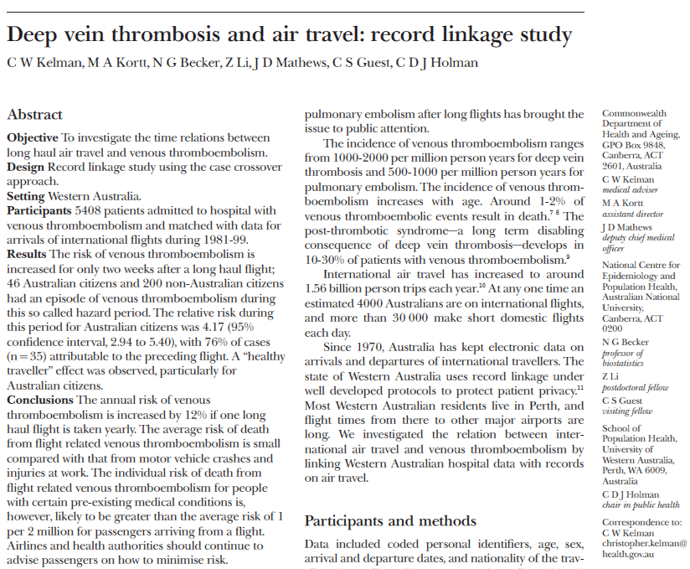
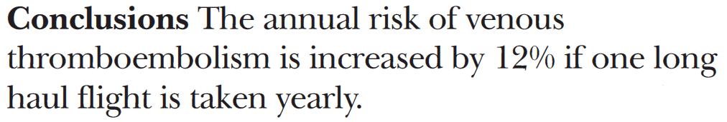
Answering research questions
Electronic data on flight arrivals and departures
Hospitalisations data

Slide 6
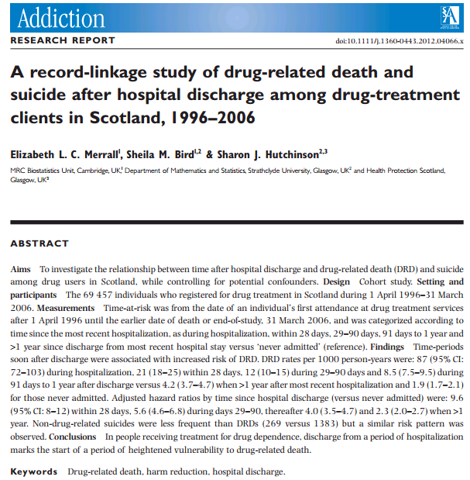
Answering research questions
Drug treatment registrations (Scottish Drug Misuse Database)
Conclusions: In people receiving treatment for drug dependence, discharge from a period of hospitalization marks the start of a period of heightened vulnerability to drug-related death.
Deaths (ISD) hospital episodes (GROS), hepatitis C diagnoses (Health Protection Scotland)

Slide 7
How are data linked?
Deterministic linkage
  Based on rules, e.g. IF records agree on NHS number and date of birth THEN consider them a match (‘link’ them)
  May include many rules, often sequential from ‘highest’ quality to ‘lowest’ quality
Probabilistic linkage
  For each pattern of agreement, estimate the likelihood that the record pair is a match. Then, either:
    If expecting only one match (one:one linkage), select the record with the highest likelihood (above some minimum threshold if there may not be a match)
    If allowing for multiple matches (one:many linkage), set a threshold beyond which all pairs are linked. Sometimes, two thresholds are chosen and records between these subjected to clerical review.
    Or, employ imputation-based analyses

Slide 8
Deterministic vs. Probabilistic Record Linkage
Deterministic linkage is generally simpler
  Easier to implement and interpret
  Less computation-intensive (faster, cheaper)
…but probabilistic linkage is more flexible
  Easier to accommodate large numbers of matching variables
  Easier to accommodate distance measures of partial agreement, e.g. ‘John’ vs ‘Jon’ ~ 75% agreement
  Easier to accommodate frequency-based weighting, e.g. ‘Smith’ vs ‘Doidge’ (agreement on a rare value is more likely to mean that records are a match)
PRL is therefore generally more sensitive than deterministic linkage (produces fewer missed matches)

Slide 9
How to access linked data
Who own the data?
  Different data providers have different legal and administrative requirements for data sharing.
Have the data already been linked? If not,
  Who will link it? (generally requires access to identifiable data – names, addresses, etc.)
  How will it be linked? Good quality linkage can require significant expertise and computing resources.
Where will the data be stored during analysis?
  Researcher’s own institution
  Data provider safe haven (VPN or local access)
  Third party safe haven, e.g. ADRN, ONS

Slide 10
Routine vs ad hoc data linkage
Ad hoc linkage
Project-by-project
Linkage usually conducted by a data provider or trusted third party
Routine ongoing linkage systems
Can leverage information from multiple linkages
Economies of scale
Streamlined applications
e.g.
  SAIL (Wales)
  Scottish Record Linkage System (now SILC)
  International examples
In England, only small examples, mostly within health, e.g.
  ORLS
  CPRD
  HES-ONS mortality

Slide 11
Trusted third party model
Data custodian 1
Data custodian 2
Identifiers 1
Local ID 1
Identifiers 2
Local ID 2
Linkage unit
(trusted third party)
Clinical data 1
Identifiers 1
Local ID 1
Identifiers 2
Local ID 2
Clinical data 2
Study ID
Study ID
Study ID
Research group
Study ID
Clinical data 1
Study ID
Clinical data 2

Slide 12
Approvals
At least:
Data providers
  Caldicott guardian/committee/data release office
    IGARD (NHS Digital)
  Data processing team
  +/- data rel
Data linkers (if separate from providers)
+/- :
Ethics committees (may be different requirements for different data sources)
Confidentiality Advisory Group (CAG; health data without consent… soon to be education data too)
Data protection officers
Etc.

Slide 13
Timescales
Anywhere from 3 months (simple project using already-linked data) to 6 years (multiple stakeholders, new linkages, bureaucratic hiccups)
Common causes of delay include changes to
  administrative processes
  administrative personnel
  data security requirements
  legislation
  agreements between data providers
  scope of data request
  expiration of existing approvals and certifications before others are in place/data can be provided!

Slide 14
Costs
Anywhere from nil to £200,000 per annum
Generally increase with size of data requested and complexity of processing (including linkage) required
Generally higher for ad hoc linkage

Slide 15
Methodological challenges
Part 2
  Administrative data
    Data quality
    Population coverage
  Linkage error
    Understand it
    Assess it
    Address it

Slide 16
What is administrative data?
Routinely-collected data, electronic records
Information collected for specific purposes, e.g.
  financial management (hospital admissions)
  clinical management or audit
  registration (births and deaths)
  service evaluation and delivery
  government departments…
Primary purpose is not research (or linkage)

Slide 17
Questions to consider when using secondary/administrative data
Why were the data collected?
  Which data had to be collected for this purpose?
  Which data were collected but not required? (may be poorer quality)
  Which relevant data were not collected?
What unit were the data recorded in?
  People? Events? Claims?
  If not your intended unit of analysis, how was the dataset ‘internally linked’?
How are the data recorded?
  Text fields vs drop down boxes?
  Any validation or quality assurance?
  Has recording changed over time?

Slide 18
Questions (cont’d)
Are there differences in recording practices or quality across contributors to a dataset?
  Between hospitals/general practices/service providers, etc.
What triggers data to be recorded?
  Is recording related to your variables of interest? e.g. ↑ measurement of weight in people with weight problems or diabetes
What is the coverage of the dataset in terms of the target population for your analysis?
  Has the coverage changed over time?

Slide 19
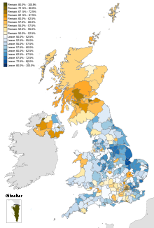
Population coverage
Most administrative data requires:
  Access to service, which can be limited by
    Geography
    Language
    Disability
    Lifestyle/work
  Utilisation of the service, which can be affected by
    Competing services
    Local variation in (perceived) quality of the service
    Cultural factors
This Photo by Unknown Author is licensed under CC BY-SA

Slide 20

Population dynamics
Entry and exit from the coverage of an administrative data source is often not recorded
  Birth & death
  Immigration & emigration (interregional or international)
Denominators (e.g. persons or person-time at risk) are therefore often unknown or approximate
  Special study designs may be required
  e.g. dynamic cohort designs
Some exposures and outcomes may not be observed
  Misclassification
  Measurement error
This Photo by Unknown Author is licensed under CC BY

Slide 21

Implications for analysis
Most of these phenomena result in either
Information bias
  Misclassification and measurement error
Selection bias
  Bias arising from differences in the probability of inclusion in a dataset
Epidemiological techniques available for addressing these
  Sensitivity analysis
  Quantitative bias analysis
Lash TL, Fox MP, MacLehose RF, et al. Good practices for quantitative bias analysis. Int J Epidemiol 2014 doi: 10.1093/ije/dyu149
Lash TL, Fox MP, Fink AK. Applying Quantitative Bias Analysis to Epidemiologic Data. New York: Springer 2009.

Slide 22

Linkage error
Missed links between records that belong to the same entity.
  Primarily caused by:
  Errors and missing data in matching variables
  Variation in the values of matching variables over time, e.g. changes of name or address
False links between records that belong to different entities.
  Primarily caused by:
  Lack of discriminatory power (‘uniqueness’) of matching
  variables
This Photo by Unknown Author is licensed under CC BY-SA

Slide 23
Classification of links
 |  | Match status
 |  | Match (pair from same subject) | Non-match (pair from different subjects)
Link status | Link | A Identified match | B False match
 | Non-link | C Missed match | D Identified non-match
Sensitivity
= A / (A+C)
Specificity
= D / (B+D)

Slide 24
QUESTION:
Linkage error can cause…
Misclassification
Measurement error
Missing data
Selection bias
Loss of power
ANSWER: all of the above
BONUS: Anything else?
Splitting & merging
This Photo by Unknown Author is licensed under CC BY-SA
Notes:
First ask people to explain these terms

Slide 25
Useful questions to ask
Is the presence of absence of a link meaningfully interpreted?
  If yes, then what would be the implications of linkage error?
  If no, how will you handle missed links (missing data)?
Does inclusion in your analysis (selection) depend on successful linkage?
Is there possible splitting and merging?
  If one:many or many:many, or more than two files, then yes.
Is linkage error likely to be related to variables of interest?
  Are there any ways that you can test this?

Slide 26
Assessing linkage quality
Comparisons with a ‘gold-standard’ subset
  Requires a representative subset of known links (rare)
  Allows full adjustment for linkage error bias
Comparison with external reference statistics
  Nearly always possible. Be wary of other causes of differences (selection and recording)
Procedural sensitivity analysis
  e.g. use different rules or match score thresholds (requires information to be shared by data linker)
Comparison of linked / unlinked data
  Only possible when linkage is not meaningfully interpreted, and requires access to unlinked records
  Good for analysing distribution of missed links
Identification of unlikely/implausible data
  Good for analysing distribution of false links

Slide 27
Addressing linkage error
Informal discussion
  Acknowledge and unpick the potential implications for your analysis
Formal sensitivity/quantitative bias analysis
  Requires estimates of error rates (or plausible limits)
  Forthcoming framework for identifying the effects of linkage error in terms of information bias, selection bias and missing data (then use methods described by Lash)
Imputation-based approaches to analysis of linked data
  Requires probabilistic linkage
  Goldstein H, Harron K, Wade A. The analysis of record-linked data using multiple imputation with data value priors. Stat Med. 2012;31(28):3481-93.

Slide 28
Resources
Training
  ADRC-E short course: Introduction to data linkage (soon to include second day on analysis of linked data)
Textbooks
  Harron K, Goldstein H, Dibben C, editors. Methodological developments in data linkage. Chichester, UK: John Wiley & Sons, Ltd.; 2016.
  Lash TL, Fox MP, Fink AK. Applying Quantitative Bias Analysis to Epidemiologic Data. New York: Springer 2009.
Articles
  Harron K. An introduction to data linkage. Administrative Data Research Network; 2016. https://adrn.ac.uk/media/1324/datalinkage.pdf
  Sayers A, Ben-Shlomo Y, Blom AW, Steele F. Probabilistic record linkage. Int J Epidemiol. 2016;45(3):954-64.
  Harron KL, Doidge JC, Knight HE, Gilbert RE, Goldstein H, Cromwell DA, et al. A guide to evaluating linkage quality for the analysis of linked data. Int J Epidemiol. 2017.
  Goldstein H, Harron K, Wade A. The analysis of record-linked data using multiple imputation with data value priors. Stat Med. 2012;31(28):3481-93.
Coming soon
  Doidge & Harron. Demystifying probabilistic linkage: Common myths and misconceptions
  Doidge et al. Linkage error bias and a framework for classifying studies of linked data.

