Slide 1

Developing the NatCen Panel
August 2015 – July 2017
(and then a little bit after)
Notes:
Hi, my name’s Curtis Jessop, I’m a Research Director working for the National Centre for Social Research where I work in the Longitudinal Studies team and manage the NatCen Panel
Today I’m going to talk about how we developed the NatCen Panel – the methodology involved, some evaluation of the sample quality it produces, and some of the measures we’re starting to introduce to improve it as we develop our understanding

Slide 2
Background
1
Notes:
But before I do that, to make sure we’re all on the same page, I’ll give a bit of background

Slide 3
What is the NatCen Panel?
  First probability-based panel in Great Britain that is open to be used by anyone for social research
  Offers a representative sample of people living in Britain
  Comprised of c.3,500 adults, aged 18+
  Run a c.15 minute survey every 1-2 months
  c.2,000+ completed interviews per wave
  c. 8 weeks from questionnaire sign-off to data delivery
Notes:
Firstly, the NatCen Panel is the first probability-based research panel in Great Britain that is open to be used for data collection by the social research community.
As it stands, it has around 3,500 active members which will translate into a little over 2,000 interviews at any given wave, but this will shortly be increasing to around 5,500 members following some fresh recruitment
It is designed to be representative of the adult population in Britain and allow researchers to produce reliable estimates of people’s opinions and behaviours in a shorter time-frame and at a lower cost than the ‘traditional’ probability-based approaches currently available.

Slide 4
Research Context
The ‘gold standard’ is not always appropriate
The quality of alternatives
International development of open probability-based panels
Notes:
To put that in context, in Great Britain, the ‘gold-standard’ for social research surveys is to conduct them face-to-face, randomly selecting households (and individuals within them), and having trained interviewers making multiple visits to households over fieldwork periods spanning months in order to maximise the likelihood of people taking part and therefore minimising non-response bias.
However, although this approach provides high quality estimates, the lengthier fieldwork periods, and the costs of paying interviewers may not always be appropriate for a given project – research budgets may not stretch to cover the costs of face-to-face fieldwork, or a project may wish to respond quickly to events as they unfold.
As response rates drop and fieldwork costs rise, alternative methodologies have become more appealing. For example, web panels and RDD surveys have found popularity in the market research industry.
However, there are still unanswered questions on the quality of these alternatives. The use of self-selecting samples, quotas, and very short fieldwork periods can lead to hidden biases in samples, while web-only fieldwork excludes a sizeable whose experience of society is very different to the rest of the population.
There is evidence that these theoretical concerns translate into practical ones: the British Polling Council’s inquiry into the 2015 General Election polling miss concluded that “the primary cause of the polling miss in 2015 was unrepresentative samples”, and a number of studies have demonstrated that probability sample surveys are consistently more accurate than non-probability surveys.
Finally, although probability-based panels do exist in Great Britain (for example Understanding Society), these are mostly large-scale (and therefore relatively slow and expensive) or are dedicated to a specific research project rather than being open to the social research community as a whole. Internationally, however, this is not the case and in recent years a number of open probability-based panels have been developed (for example the GESIS panel in Germany or the AmeriSpeak panel in the United States). Although varied in their specific methodologies, these studies have demonstrated the feasibility of setting up and maintaining a probability-based panel infrastructure open to the social research community, and a template for doing so.

Slide 5

Feasibility study
  In 2015, approached by Joseph Rowntree Foundation
  Wanted to explore attitudes of people living in poverty
  Required a reliable quantitative understanding in cost-effective & quick timeframe
  Commissioned us to conduct a feasibility study into developing a random-probability panel
Notes:
It was within that context in 2015 that the Joseph Rowntree Foundation, having considered existing non-probability online access panels, approached NatCen to propose an approach to establishing the feasibility of a bespoke panel with a high-quality, probability-based, sample design to be used to explore the attitudes of people living in poverty in a quantitative manner
This feasibility study ran a total of six surveys from August to November 2015, ranging from short, web-only ‘polls’ with a one-week fieldwork period to larger 15-minute surveys with web/CATI fieldwork lasting a month. As well as establishing the feasibility of setting up the panel, the study aimed to experiment with different approaches to investigate the best approach to maintaining the panel in longer term, for example:
The impact of different wording of recruitment questions (which I will talk more about later)
Comparing the impact of no incentives, £1 donations to charity, £5, and £10 incentives
Comparing the impact of the number, timing and mode of reminder communications
The role of the telephone unit and the relative impacts of them not being included, encouraging web completion, or pushing for telephone interviews
The feasibility of short (1 week) web-only fieldwork designs
Following the conclusion of the study, NatCen took the decision in early 2016 to maintain, open up, and expand the panel – identifying that this was a useful piece of research infrastructure currently missing in Great Britain.

Slide 6
Methodology
2
Notes:
Following the decision to maintain the panel, we then developed a ‘standard’ methodology based on the findings of the feasibility study. What I’m going to do now is outline that ‘standard’ approach, though we have deviated from it in order to meet specific collaborator requirements or experiment with developments to improve the efficiency or quality of the study overall.

Slide 7
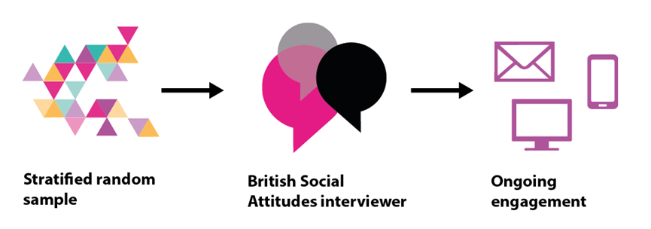
Recruitment & sampling
  Recruitment through BSA fieldwork
Notes:
The first question to address when setting up the study was how to recruit people to the panel, with the following key goals:
A random-probability design to avoid biases of self-selection and ‘convenience’ samples and enable the application of common statistical tests such as confidence intervals and significance tests
High recruitment rates to minimise non-response bias and provide a larger sample size for analysis of sub-groups
Low costs to keep the infrastructure accessible to a wider range of researchers
We initially considered fresh recruitment (as used by the GESIS panel), but fresh face-to-face recruitment was considered too costly and we were concerned that using fresh telephone, paper or web methods would attract low recruitment rates and it would be difficult to monitor whether protocols were being followed in self-completion modes, undermining the quality of the panel at the first stage
We therefore decided to use a ‘piggy-back’ approach – recruiting panellists off the back of the BSA survey. This approach had recently been used to develop Pew’s American Trends Panel , and has since been implemented in the development of the CROss-National Online Survey Panel (or CRONOS) at City University
The BSA is a probability-based, face-to-face survey of people aged 18+ in Great Britain: this means that households and individuals are selected at random, and then considerable effort is expended by field interviewers to achieve an interview including visiting the selected addresses multiple times. By recruiting from the BSA survey, we were able to:
Maintain a probability-based recruitment design
Produce higher recruitment rates then with alternative modes
Keep recruitment costs low as the only costs were the ‘marginal’ costs of asking additional questions
Obtain a large amount of background data on the panellists
Those interviewed as part of the BSA were asked to join the panel at the end of the interview, and those that agreed asked to provide contact details. The recruitment question wording has varied (I will talk about that later), and interviewers were briefed and provided with additional materials to help them answer any questions that participants might have.
Those who agreed to join the panel were then sent an information leaflet and letter confirming that they had joined the panel, and providing more detailed information on what taking part would involve.
At any given Panel fieldwork wave following the NatCen Panel’s ‘standard’ design, all active panellists (or a random sub-sample) are invited to take part in that month’s survey - no quotas are used. By doing so, we sustain the principle that the population has a known and non-zero chance of being selected and thus maintain the random probability design.

Slide 8
Questionnaire development
  c.15 minute questionnaire
  Modular approach – multiple sets of questions in one questionnaire
  Consideration of mode & device effects
    Web vs Phone; Web-PC vs Web-Smartphone
    Mode-optimisation vs mode-neutral
Notes:
Questionnaire length & structure
In line with best-practice guidelines, surveys run on the NatCen Panel will typically last for around 15 minutes, although this will vary by mode and an individual’s circumstances. Although we have done, we try to avoid making the surveys much longer to minimise burden on panellists and negative effects that may have on data quality and panel attrition. Were a longer interview required, it may make sense to split it out across multiple waves
The questionnaires are broken up into ‘modules’ with questions from multiple research projects asked in one survey. This allows us to be more efficient in terms of the number of invite letters sent/phone calls made/incentives sent per question, and also makes sense logistically – we don’t have to manage multiple live surveys simultaneously, and panellists can keep easy track of what they’re being asked to do
Question design & testing
Due to its mixed-mode design, a key consideration in questionnaire design and development is addressing the potential for mode effects – including how questions may appear on smartphones.
The approach to this will vary depending on the question and its background - for example is it a new question, or is the aim to make it comparable to an existing question?
For example, we might take a ‘Mode optimisation’ approach – designing different versions of the questions so that they are optimised to a given mode (e.g. not using grids on smartphones)
Alternatively, a ‘Mode neutral’ approach would involve designing single versions of questions to keep the experience as similar across modes (e.g. removing visual cues on scale questions)
Where appropriate, other techniques are used to address the impact of mode effects, such as randomising/reversing answer option order to counter-act varying primacy/recency effects in different modes.

Slide 9
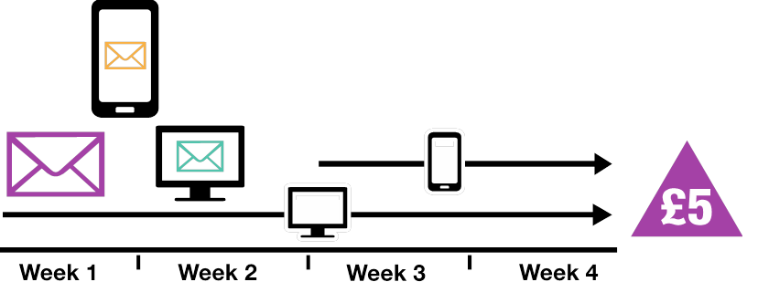
Fieldwork structure
  Sequential mixed-mode fieldwork
Notes:
The NatCen Panel employs a ‘sequential mixed-mode’ fieldwork design, lasting for slightly over four weeks.
At the start of fieldwork, all active panel members are sent a link and unique log-in to the survey and are invited to take part in online. After two weeks , all those who have not taken part in the survey online, and for whom we have a phone number, are issued to our specialist Telephone Unit to follow-up by phone and either support them to take part online or complete an interview over the phone.
Considerable effort is put into contacting eligible panel members and all are called a minimum of 6 times, at a variety of times of the day and days of the week, before being coded out
By employing this sequential mixed-mode design with a four week fieldwork period, we aim to strike a balance between maximising quality and efficiency:
By issuing all cases to web first, we maximise the number of cases completing online, minimising (telephone) interviewer costs
A four-week fieldwork period strikes a balance between allowing all types of people an opportunity to take part (to minimise bias towards ‘early responders’), while still providing data in a timely fashion
Following up with telephone fieldwork helps to boost response rates, and crucially, allows us to include in our survey sample those who are not comfortable with/do not have access to the internet

Slide 10
Participant materials
  Invites and reminders in multiple modes
    Letters
    Emails
    Text messages
  Thank-you mailings & incentives
  Inter-wave mailings
  Panellist website
Notes:
Once fieldwork begins, panellists are contacted multiple times to provide them with the required information and encourage them to take part in the live survey. Multiple modes of contact are used (letters, emails, text messages) on different days of the week in order to maximise the chances of reaching different groups. We send these during first two weeks of fieldwork to maximise the number of people completing the questionnaire online before the start of telephone fieldwork.
All participants that complete the questionnaire are sent a thank-you letter and email to acknowledge receipt of their data, and including a £5 gift-card as a ‘thank-you’ for their time.
As well as these, panellists are sent feedback in the form of summary findings from the surveys they take part in via updates to the website and bi-annual inter-wave mailings. These communications are designed to be informative and emphasise the importance of taking part, while avoiding influencing behaviour, or suggesting any preferred opinion.

Slide 11
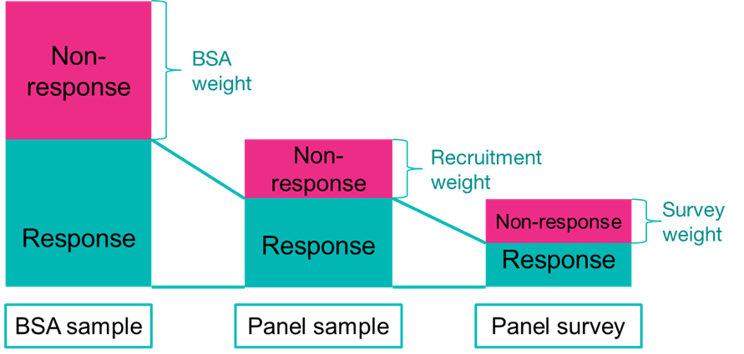
Weighting
Notes:
As with any survey, despite the efforts we go to, the NatCen Panel will suffer from non-response bias, so once the data are collected, we need to adjust for this.
In our design, non-response can occur at four stages:
At the BSA survey
Refusal to join the panel
Leaving the panel once joined
Non-response at any given wave
To account for non-response at each of these stages, we compute a weight to adjust the sample to look like the population. One of the key advantages of recruiting the Panel from the BSA survey is that all panellists have a large amount of consistently-collected background information, so we can model, and adjust for, non-response at each stage very effectively.

Slide 12
Outcome and sample quality
3
Notes:
So, that’s a summary of our ‘standard’ or ‘core’ design. What I’ll look at now is how that approach has panned out

Slide 13
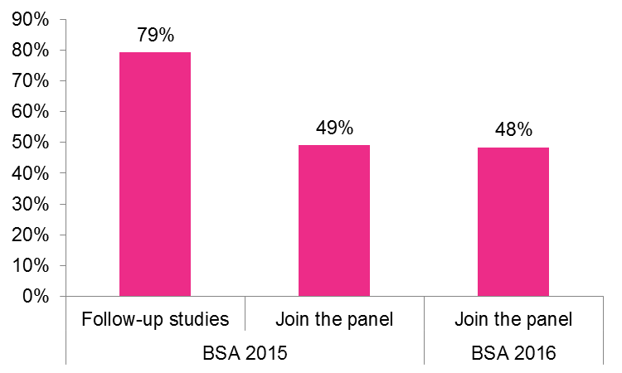
Recruitment to the Panel
Notes:
Overall, a total of 4,205 people out of the 7,270 who were interviewed as part of the 2015 and 2016 BSA surveys agreed to join the NatCen panel, representing a 58% recruitment rate.
As I mentioned earlier, we have varied the way we asked people to join – in 2015 we asked a random half of the sample if it would be okay to contact them for ‘follow-up studies’, and the other half if it would be okay to contact them as part of a research panel, which was the approach we repeated in 2016.
This chart shows BSA participants were substantially more likely to agree to be contacted for ‘follow-up studies’, than specifically as part of a research panel.

Slide 14
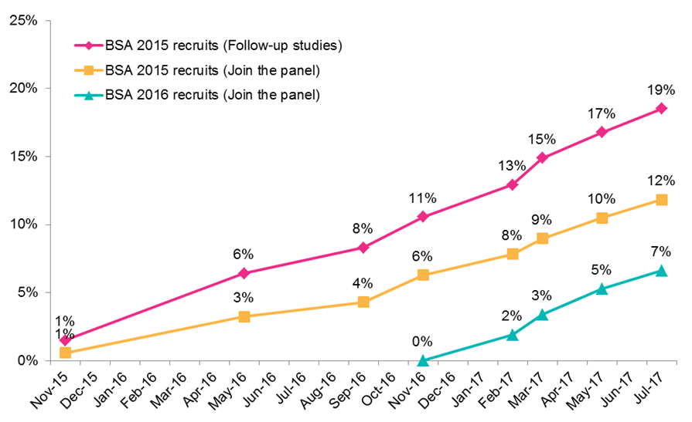
Panel attrition
Notes:
However, this large difference is somewhat off-set by the fact that participants that agreed to be contacted as part of the panel are significantly less likely to subsequently ask to leave the panel, and significantly more likely to take part in any given wave of panel fieldwork.
Looking firstly at attrition, as with all longitudinal samples, the NatCen Panel is subject to panellists either deciding that they wish to leave the panel or becoming ineligible (for example by leaving the country). As of July 2017, a total of 3,666 people were still members of the NatCen panel – an overall attrition rate of 13%. Interestingly, this chart suggests that rates of attrition do not seem to slow, and although they are starting to now, attrition is definitely an ongoing process – perhaps due to the high levels of contact
This chart also shows that that attrition rate varies by invite group, with those recruited to ‘follow-up studies’ far more likely to attrit than those explicitly asked to ‘join the panel’ – countering the higher recruitment rate we saw at the previous slide

Slide 15
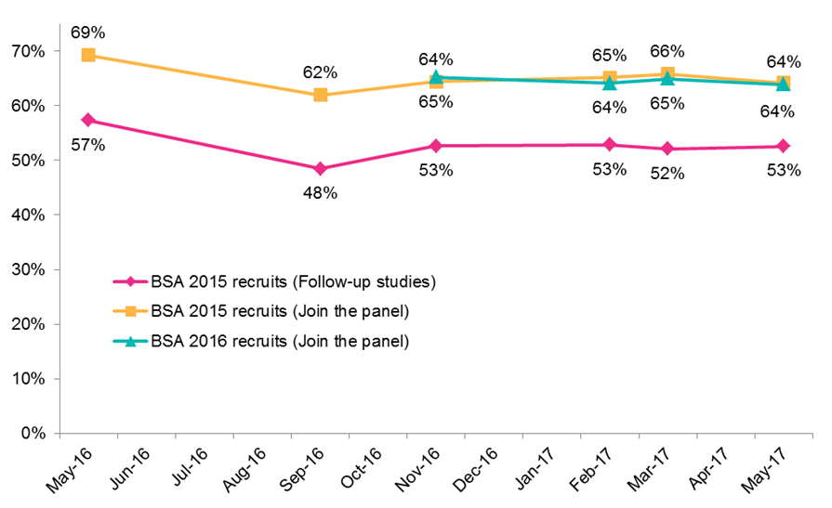
(Survey) Response rates
Notes:
As well as this, the recruitment rate is balanced somewhat by differential survey response rates.
The NatCen Panel uses two response rates to track fieldwork:
Firstly, a survey response rate which looks at the proportion of participants invited to take part in a survey that do so
Secondly, an overall response rate which goes back to the original sample frame, and looks at the proportion of participants eligible to be interviewed for BSA that take part in a given wave
The former of these is useful for understanding how response rates are changing between surveys. Typically at c. 60%, these have remained very stable across waves.
This chart uses these survey response rates to show that participants recruited to join the panel consistently have survey response rates of c. 64%, while those agreeing to follow-up studies typically have survey response rates of c. 53%

Slide 16
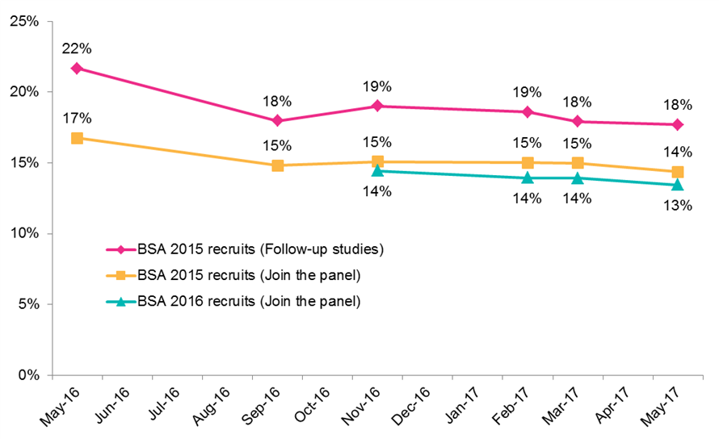
(Overall) Response rates
Notes:
To see the cumulative effects of all these different points of non-response, we can use the overall response rates which account for non-response that occurs at each stage of the panel recruitment: BSA participation, recruitment to the panel, attrition, and non-response at a given panel survey wave.
These ‘overall’ panel response rates are broadly consistent at waves where the ‘standard’ design have been used, at around 15-16%. However this chart also suggests that, while the survey response rates have remained stable, the overall response rates are actually very gradually declining (by c. 0.4 pp per wave).
That this pattern is not seen in the survey response rates tell s us that this is being driven by attrition. However, the level attrition seen is higher than the decline in overall response rates suggests. This is because c. 2/3 of those that attrit never took part in a panel survey – i.e. many of those that have left the panel were not taking part in the surveys anyway, so their leaving is only having a minimal impact on the overall response rate
Going back to the variation between invite groups, this chart shows that, while it varies from wave to wave, the overall response rates for those agreeing to be contacted for follow-up studies are consistently higher than for those agreeing to join the panel, suggesting that this produces a better sample quality, and that we made the wrong decision for how to approach 2016 recruitment!
However, this higher response rate needs to be balanced against managing a panel that is 1 ½ times as large (which leads to higher costs due to, for example, larger volumes invite and reminder letters, and issuing a larger number of cases to telephone interviewers), and whether this difference in overall response rates translates into a difference in sample profile.

Slide 17
Sample composition
  Unweighted sample differs from the population in similar ways seen on other surveys
    Sex, age, social class, education, number of people in household
  Some biases carried on from BSA, but others added to
  Non-response weights are highly effective at removing this bias
Notes:
Although response rates are a helpful proxy for sample quality (assuming that as response rates decrease, non-response bias increases), they do not actually show if, or how, the underlying sample is biased.
Looking in detail, we can see there are a number of places where the unweighted panel survey sample differs from the population as a whole. For example, people that take part in panel surveys are more likely to be women, older, in managerial and professional occupations, have a degree, live in a single-person household, and own their own home
For the most part, these reflect the kinds of biases often seen in survey samples, and are actually continuations of biases picked up in the original BSA survey. In some instances the bias seen is reduced (e.g. household type). However, there are a few instances where the additional non-response of the panel stages adds to the bias seen in the demographic profile – social classification, levels of education, and tenure are all more biased in the panel survey sample than the BSA survey sample.
However, while these biases exist in the underlying sample, the non-response weights are very effective at removing this bias from the sample, and the weighted population estimates from the panel sample are very similar to the weighted population estimates based on the BSA sample.

Slide 18
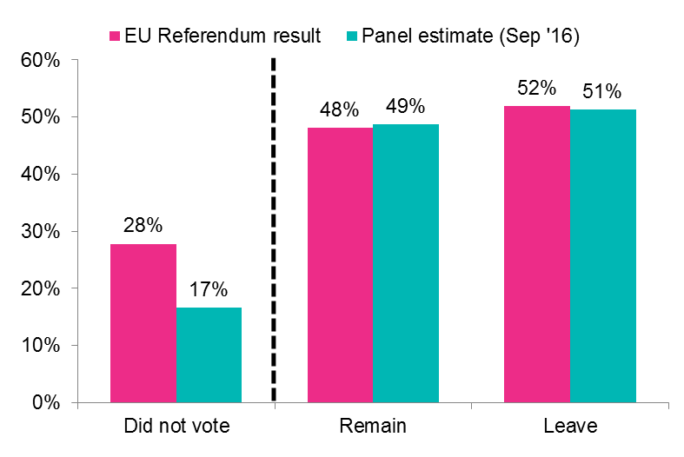
Sample composition
Notes:
While demographics are important, we also try to look at non-demographic variables related to survey outcomes. This will clearly vary from wave to wave – for example were the survey focussed on health we might look at the profile in terms of whether participants have a long-standing health condition, or for research on political attitudes we might look at interest in politics.
Unfortunately, population figures for non-demographic (i.e. census) variables are relatively rare, but a reasonable proxy for attitudes for which population data are available is how people vote.
This chart shows how weighted estimates from a panel survey compare to the actual results from the 2016 EU referendum. Here we can see the panel estimates for the direction of voting are close to the actual figures for the population, but levels of not voting are significantly under-estimated. This reflects an established bias in surveys that those who take part are more likely to be engaged in society/want to have their opinions heard.
For context, the British Election Survey run on the YouGov panel produced post-vote non-voter estimates of 7% for the 2016 EU referendum, suggesting that the effort we put in may be effective at helping us to represent this group relative to non-probability approaches, though the 2017 GE estimates for non-voters were much closer.

Slide 19
Adjusted R-indicators
  Measures of representativeness
  Single figure summarising bias across a range of variables
  Allow for effective understanding of sample bias:
    Monitoring of change over time
    Where does bias occur?
    What impact do experiments have on sample profile?
Notes:
Clearly, looking at every single socio-demographic characteristic, at every single wave, to try to understand the bias in a sample isn’t the most convenient way to work.
To make things slightly more accessible we are currently developing ‘Adjusted R-indicators’ which produce a score between 0 and 1 to show how the unweighted Panel sample compares to the population (in this case assumed to be the weighted BSA estimates) across a range of socio-demographic variables
The idea is that this will give us a simple metric that we (and people using our data) can use to monitor the sample quality in a more informative manner than, but still alongside, response rates.
However, we will also be using them for more in-depth understanding of non-response bias. For example, we can apply them to the sample at different stages of non-response (recruitment to BSA, recruitment to the panel, post-attrition, or at a particular survey), to see where bias comes from, and where we can more effectively target it.
We can also analyse sub-groups to, for example, understand the impact of experiments we run on the sample profile – so do the slightly higher overall response rates for those invited to take part in ‘further research’ actually translate into a more representative sample?

Slide 20
Targeted design
4
Notes:
In this context of focusing on the representativeness of the survey sample, since the initial feasibility study we’ve continued to embed experiments at multiple waves of fieldwork – for example the impact of inter-wave mailings, the design and structure of communications, or question and weighting design
I’m not going to go into any of these now, but one area we’ve been focusing on more recently is targeted design – using the survey & para- data we’ve collected from previous waves to target our fieldwork approach in a more efficient way.

Slide 21


Targeting mode approach
Issue those that only take part on
the phone to NatCen TU early
Additional web reminders for
those without phone numbers
Notes:
This can be fairly simple.
For example, after c. 4 waves, we have a fairly good idea of the people who aren’t going to take part online. So while we still always invite them to take part online first, we now start telephone fieldwork for this group a little earlier to give them more chance to take part in the mode they prefer, and take some pressure off our TU so they can better cover the rest of sample
Alternatively, there is a small proportion of our sample (c.7%), who do not provide us with a telephone number, so our telephone unit cannot contact them. With our ‘standard’ design this would essentially leave them for 2 weeks without contact while the questionnaire is still available, which feels a little wasteful. We therefore now send an extra reminder letter and email to this group prompting them to take part online during this time.

Slide 22
Improving representativeness
Use fed-forward data from BSA and previous survey waves to identify panel members that are over- or under- represented
Move fieldwork resources away from over-represented panel members to under-represented ones
Cost- & response rate- neutral
Profile improving
Notes:
However, we’re also using targeted design in a more sophisticated manner to try and improve the representativeness of the sample
After a few waves of fieldwork, we can use the background information from BSA to understand the biases that exist in our sample – such as some of those I talked about earlier
By using this information we can target resources away those that are over-represented, and towards those that are under-represented, decreasing and increasing their response rates respectively and therefore balancing the sample profile
However, this must be done within the following constraints:
Overall response rates must remain stable. If we didn’t do this then we could just ‘cheat’ and lower our coverage of those that are over-represented and measures of representativeness would improve, but the sample wouldn’t actually be improved
The approach should also be cost neutral. If costs weren’t an issue, we’d be able to just improve effort for everyone – this is a targeted approach designed to enable a more efficient allocation of resources

Slide 23
Implementation
Under-represented
Over-represented
1
2
3
4
5
6
7
8
Always
take part
Sometimes take part
Never
take part
Notes:
To implement this, the first thing we did was model the extent to which an individual sample member had characteristics which are over- or under-represented in a panel survey. This model gave all participant a score, with those greater than 1 indicating people with characteristics that are over-represented and those less than 1 indicating that type of person is under-represented
For simplicity, we then grouped the sample at pre-determined cut-off points into 8 different groups, from ‘most over-represented’ to ‘most under-represented’, indicating where we wanted to move resources from and to
However, simply moving resources in this way is not actually that efficient. To make this approach more effective, we also incorporated information on past participation – grouping panel members into those that never take part, sometimes take part, and always take part. While the two measures are inevitably related, they don’t quite measure the same thing.
By combining the two measures together, we are making sure that our resources are being focused on individuals where it is more likely to make difference, and taken away from those where it won’t.
For example, we don’t want to spend additional resources on people who always take part anyway, or those who are never going to take part, as it is unlikely to have much of a positive effect.
Likewise, we don’t want to take resources away from those who are only sometimes taking part – as it is more likely to harm response rates overall. However, taking away resources from those who never take part or always take part carries less risk
This chart shows how we used these two variables together to identify five priority groups:
Highest – people who sometimes take part and are most under-represented
High – people who sometimes take part and are under-represented
Medium – people who always take part and are under-represented, and people who sometimes take part and are over-represented
Low – people who never take part and are under-represented, and people who always take part and are over-represented
Lowest – people who never take part and are over-represented

Slide 24
Variations in approach
Priority group | Incentive | Reminders | CATI
Highest | £10 | 2L 2E 2T | 8 calls
High | £5 | 1L 2E 2T | 8 calls
Neutral | £5 | 1L 2E 2T | 6 calls
Low | £5 | 0L 2E 2T | 4 calls
Lowest | £5 | 0L 2E 2T | 0 calls
Notes:
This table summarises how we have been varying the fieldwork design for those five groups
The ‘neutral’ group, also the largest, keeps the ‘core’ design with a £5 on-completion incentive, one reminder letter, two reminder emails, and a minimum of 6 calls from the telephone unit
We then change these by varying degrees. So far, the highest and lowest groups receive the most extreme changes – the highest group’s incentives being raised to £10 and receiving an additional reminder letter, and the lowest group not being issued to CATI at all and receiving no reminder letter
The higher and lower groups also receive some variation but it is less extreme – more or fewer calls from the TU and no reminder letter for the low group
In case you’re wondering, we manually move all those who say they don’t have access to the internet out of the two lower priority groups to ensure they get a reasonable number of call from the TU and have the opportunity to take part

Slide 25
Impact
 | Jul-17 | Aug-17 | Oct-17
Survey response rate
Overall | 60% | 60% | 61%
Highest priority (Aug 17) | 35% | 42% | -
Highest priority (Oct 17) | 38% | 41% | 48%
Representativeness indicators
Overall response rate | 15% | 14% | 15%
Adjusted R-indicator* | 0.53 | 0.54 | 0.55
DEFF | 1.99 | 1.92 | 1.85
Notes:
So what impact has this targeting had?
This table shows figures for the last wave where we didn’t use targeted design, and the first two waves where we have.
Firstly, as we’d expect, we can see that the survey response rates for those identified as the ‘highest priority’ during the August and October waves are lower than the sample as a whole. However, we can also see that they increase when the targeted design is implemented, suggesting that our efforts worked
As well as this, we can see the impact on the representativeness of the sample overall.
Firstly, we can see that the removal of effort from elsewhere has not harmed the overall response rates which have remained fairly stable
Secondly, the adjusted R-indicators seem to have moved slightly upwards, though not dramatically
Since we’re still developing the adjusted R-indicators, I’ve also included the DEFF to corroborate this change, and this also indicates that the weights are having to do less work suggesting the sample profile is more balanced
So, I’d say our initial analysis is suggesting that this certainly isn’t doing harm, and may be improving the sample quality without harming costs of response rates. However, the impact seems to be of relatively low magnitude
This may be because we are focusing more on the extremes of the sample. While this is where we’ll have the most impact, it is also a relatively small group so the effects may be being muted
Alternatively, this may reflect that the intervention is taking place quite late in the non-response process. If a lot of the loss of representativeness is occurring at an earlier stage, then interventions at the survey stage may only have a limited effect, and we may want to move interventions ‘up-stream’

Slide 26
Additional applications
  Based on interactions with communications
    Focus on reminder emails/text messages
  Based on expressed preferences/motivations
    Target advance letter messages
    Target incentives
Notes:
We are also now looking at potential ways to further leverage our available paradata and target our fieldwork design to individuals
For example, we collect a huge amount of individual-level paradata on if and when people open and click on emails. This information could be used to focus on electronic communications (rather than more costly letters) for those who use them, or change how and when we send them – although where we have looked at this in the past the evidence has suggested that it is important to still send letters as they seem to interact with the other communications, and the timign s don’t make that much difference
Alternatively, we have previously asked participants for feedback on their experiences of the panel – what they like/dislike, and what motivates them to take part. Again, we could target our communications strategy based on what motivates people to participate – if it’s civic engagement we can focus on the impact that the research is making; if it’s incentives we can raise the incentive levels, or cut them for those that say they’re not that important.

Slide 27
Impact of telephone fieldwork
5
Notes:
One of the key features of the NatCen Panel is its use of telephone fieldwork after an initial period of web fieldwork. This has two purposes:
To improve response rates by engaging the disengaged
To give those who do not use the internet the opportunity to take part
Analysis from the feasibility study demonstrated that the use of telephone interviewing was effective at boosting response rates and including those without internet access, improving the sample profile overall.
This improvement in the sample was not only due to including those without internet access, but those who were under-represented more broadly, hence why part of our ‘targeted design’ is not to only issue those cases without internet access to telephone fieldwork
I’ll also note here that we found that ‘telephone chasing’ – having our telephone unit call people up to encourage online completion - had minimal effect on either the response rates or the sample profile, again hence why we haven’t implemented this as part of our core design

Slide 28
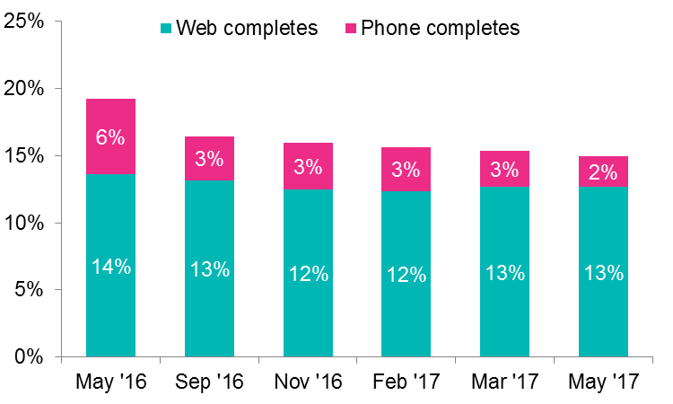
Response rates
Notes:
So what impact is the telephone fieldwork having as part of the core design?
This chart shows that the level of impact of telephone fieldwork on the overall response rates varies from wave to wave, but it generally adds c. 3 percentage points at any given survey wave.
Interestingly, we find that those recruited to ‘join the panel’ are less likely to complete on the phone, perhaps reflecting the higher level of engagement and therefore web survey completion of that group, but we don’t know
However, this chart also gives some indication that this iimpact s declining over time.
We believe that this may be due to panel members becoming more engaged and used to the process of accessing a questionnaire online over time, pushing web completions up.
Alternatively, it may be a reflection of the less-engaged participants (who are more likely to take part on the phone) attriting, therefore gradually changing the profile
Or finally it may also reflect that once a person has taken part, we are more likely to have more contact details for them (email address, mobile phone numbers), so they are more likely to receive reminders and be ‘pushed to web’.

Slide 29
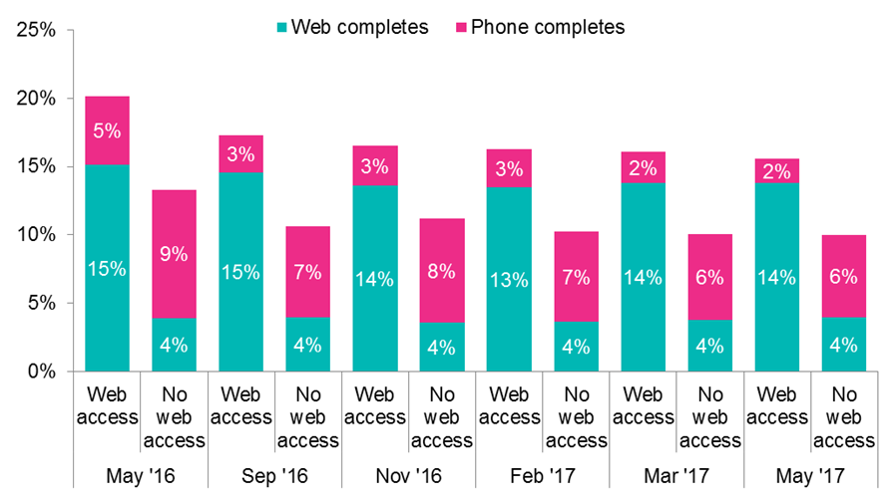
Including ‘digitally excluded’
Notes:
Although boosting the response rates is important, and the reason we issue all cases that don’t take part online to our TU, methodologically, a fundamental role of the telephone fieldwork is to include people without access to the internet
Overall, 11% of those recruited to the NatCen Panel reported not personally having access to the internet – a group significantly different to the rest of the population in terms of demographics (e.g. in terms of age, income, and levels of education), but also attitudes and behaviours (e.g. they are more likely to think Britain should leave the EU and less likely to say the highest priority for government spending should be education).
This chart shows the overall response rates for surveys using the ‘standard’ design by whether a respondent reported personally having internet access during their recruitment interview, broken out into web and telephone completions.
This demonstrates that those with web access are significantly more likely to take part in a panel survey than those that reported not having web access – not particularly surprising given the web-first nature of the design.
However, it also demonstrates the effectiveness of the telephone fieldwork in lifting the response rates for those without internet access. For this group, although some do complete online, the majority complete on the phone, and in a significantly higher proportion compared to those with access to the internet.

Slide 30
Mode effects?
  Increase in mode effects vs decrease in sample bias
  Alternatives…
    Face-to-face?
    Paper?
    Web-enabled?
  Consider mode when designing questions
  Future experimentation
Notes:
I personally think that one of the key unanswered questions for probability panels is how to include the ‘offline’ population
Our current opinion on this is that, within a Total Survey Error framework, the benefits to sample representativeness created by using telephone fieldwork is greater than the costs of measurement error. To be completely open, this is very much a judgment call, and will of course vary by question
Looking at alternatives:
Face-to-face (perhaps self-administered) is of course appealing but would end up being too expensive
Paper was historically used by Pew on the ATP, but creates limitations in terms of dependent interviewing and slows down fieldwork turnaround
Web-enabled, where you provide a tablet, is where things seem to be heading – this is currently used by Pew and the CRONOS panel I mentioned earlier
This approach is great because it is cost effective, quick, and removes mode effects. However, this only helps where the problem is internet access, not an unwillingness to use the internet, which it is for a lot of people, and it doesn’t have the added bonus of an interviewer engaging people.
I suspect we may end up going this route as well, but for now we are focusing on ensuring that our questions are designed to minimise mode effects (for example randomly inverting scales to address primacy/recency effects) and conducting further experimentation to measure the actual impact mode has on survey estimates

Slide 31
Applications of the panel
6

Slide 32
Cross-sectional research
  Political attitudes
  Grammar schools
  Mental health
  Well-being
  Transport
  Experience of hot weather
  Sharing economy
  Housing policy
  Attitudes to disability
  Experiences of prejudice
Notes:
When we first decided to develop and expand the panel, we envisioned that it would operate fairly simply as a cross-sectional survey vehicle, and the for the most part that is what it has done, along with various types of analysis that go with it – descriptive, bivariate, regression, segmentation, creating indicies, etc.
We have found a wide range of collaborators have been keen to use this new approach – academics, charities, and government department.
I would say the majority of the work has focused on attitudinal research, but there’s been plenty of behavioural stuff too.
Certainly, with the EU referendum and this year’s General Election, we’ve had a lot of demand for research into political attitudes, and we’ve worked a lot with John Curtice in this area.
However outside of that we’ve included questions on a range of topics from very specific things such as experiences of hot weather or views on selective education, to broader topics such as well-being or attitudes to transport

Slide 33
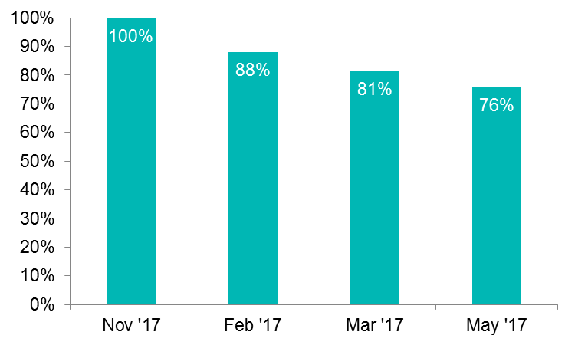
Longitudinal research
Notes:
However, I didn’t include this section to talk about the things that we were expecting to be doing!
So, although the NatCen Panel was designed with cross-sectional research in mind, as you’ll have hopefully picked up its design is actually more akin to a longitudinal study as we maintain a panel of the same people over time.
As such, longitudinal analysis is possible. However, for this to work a high ‘re-interview’ rate is required to ensure estimates are representative of the general population.
Looking at NatCen panel survey waves conducted with both the BSA 2015 and 2016 sample, around 85 – 90% of those that took part in the first wave also took part in any given other wave. This reflects the fact that we have relatively high ‘within-panel’ response rates, and a section of panellists who almost always take part, a group who never take part, and a relatively small group in between.
This chart shows how this re-interview rate accumulates should longitudinal analysis be required across multiple waves of panel surveying – so 76% of people who took part in Nov ‘16 also took part in February AND March AND MAY 2017. If I were to extend that all the way up to October 2017 that figure would be around 60% - or around 1,500 people with 7 uninterrupted panel data
So far we’ve used the panel longitudinally in a few different contexts:
Firstly, we’ve used it pre- and post- the EU referendum and General Election to understand swing, who did and did not vote, and to evaluate the effectiveness of turnout weights
Secondly, we’ll be using it for the wellbeing study to try to understand drivers of changes in wellbeing, and seeing what short-term changes in individuals’ circumstances affect it
Finally, we’ve used it to recruit individuals to qualitative fieldwork where we’re able to delve more deeply into the answers they provided in the survey
So we haven’t used the panel in this way a huge amount so far, but I think the ability to get at that very short-term longitudinal change is a potentially powerful tool and one we want to investigate further

Slide 34
Experimental design
  Randomly varying inputs to infer causal relationships with outputs
  Can be used in a huge range of situations
    Methods work
    Online cognitive testing
    Vignettes for drivers of attitudes
    Policy preferences
Notes:
The second way it’s been used that I’d like to talk about is in implementing experimental designs. By that I mean (and this is not a formal definition!) randomly allocating participants to different treatment groups, where they experience different inputs, and then get asked for output measures. By doing so in a controlled way you can infer that the variations in the output measures may be caused by the variations in the inputs
We’ve used this in a few ways – obviously a lot of the methodological work we’re doing falls into this category, but in terms of survey content….
Firstly, questionnaire testing – we randomly split the sample into two presenting each half with different versions of the same question (for example different wording/answer option order), before asking a number of follow-up probes. We then compared the results of the two questions to measure the impact of the design, and looked at the follow-up probes to understand the differences and how the questions may be improved
We have also presented participants with vignettes, randomly varying elements and then asking follow up questions to understand how varying different features might affect people’s attitudes
Finally we’ve done work presenting participants with random combinations of Brexit deals to understand at a deeper level what people’s policy preferences are
One of the advantages of using the NatCen panel is that because we have so much background information from the recruitment interview, we can stratify the random allocation so you can be, for example, sure that each half of your split has an even mix of ‘Remain’ and ‘Leave’ voters

Slide 35
Data linkage
  Asking consent to link survey and social media data
  Difficulties in online context
    Is consent informed?
    Lower consent rates
Notes:
The final thing I’ll mention that we’ve done, although it’s by no means a unique feature of the panel, is ask participants for consent to link their survey data to social media data
This was a pilot study to test the feasibility of doing so and run some initial analysis of how different voter groups (identified using survey data from the panel) talked differently about parties and policy on Twitter in the run-up to the general election
It was a very interesting process to go through, but the reason I’m mentioning it is that, even with an engaged panel sample, the consent rates to data linkage for those taking part online were quite low – a feature across online studies. And if on the one hand the social research community is moving increasingly towards online surveys, but also increasingly looking to rely on (linked) admin data, this may prove a really important nut to crack

Slide 36
Summary & next steps
7

Slide 37
Summary
  Context of lack of high-quality, quick, affordable research platform in the UK
  ‘Piggy-back’ recruitment from BSA
  Sequential mixed-mode fieldwork approach
  Overall response rates of c. 15-16%, remaining stable
  Targeted design may play a role in improving sample quality
  The panel can be used for a range of different types of projects
Notes:
So that is very much an over-view of the development of the NatCen Panel, and a little insight into how we’re using it and some of the work we’re currently doing to try to improve it
In summary:
The NatCen Panel was set up in the context of what we identified as a lack of a high-quality, probability-based solution to projects with smaller budgets or requiring a faster turnaround for research
The panel was recruited off the back of the BSA survey to keep a probability design, and high recruitment rates, without costing the earth
It uses a sequential mixed-mode design to keep costs low and speed up fieldwork, but also ensure everyone has an opportunity to take part – in particular those without internet access
However, there are question-marks over the impact of mode effects on the overall quality of estimates
Surveys seem to produce robust estimates, with much of the bias accounted for by weighting
We are developing adjusted R-indicators to improve our ability to monitor sample quality, and targeted design approaches to improve it
Generally, the panel can be used for a wide range of different types of project, and we are exploring how we can exploit it further, in particular with regards to longitudinal projects
One of the things that I haven’t really touched upon at all is that there is a huge amount of logistical and systems stuff going on in the background.
We typically work to a timetable of going from a signed off questionnaire specification to clean weighted dataset in about 8 weeks – if you’ve worked on other probability-based surveys you’ll know how quick that is
The only way that is possible is due to very efficient systems and processes that we set up to manage sample, send out reminders, clean the data etc. and actually a huge amount of the innovation in this project has been around the development of those bits rather than the stuff that we might typically consider ‘methodological’

Slide 38
Future development
  Continued experimentation
  Adjusted R-indicators
  Targeted design
  Understanding mode/device effects
  Understanding attrition and conditioning
  Making the most of infrastructure
  Expansion
Notes:
So, what about the future?
Clearly, we very much want to continue with the experimental work we’re doing (and write up what we’ve done so far) – it’s a great opportunity for us to develop our methodological understanding to apply to a range of different types of surveys that we run at NatCen.
We’re going to be experimenting with things like the impact of inter-wave mailings, different fieldwork lengths, or web-only fieldwork, but also with infrastructural development such as things like a web portal for participant
A big part of that experimental work will be finalising the Adjusted R-indicators we’re developing, to help us to thoroughly evaluate the work that we’ve done and guide where we want to target improvements next
The targeted design is something we are particularly keen to develop – for example how we can make it more impactful – should we increase the interventions or move them ‘upstream’? How can we use paradata in other ways such as to target comms strategies based on people’s previous behaviour
We are also keen to develop our understanding of mode effects. Currently, we think that including people who do not use the internet via telephone fieldwork makes more sense than the alternatives, but we need to investigate this thoroughly – running experiments to evaluate the impact of mode effects, but also working closely with City University to see how their ‘web-enabled’ approach pans out
We are also planning more analysis on the impact of ‘conditioning’ on survey estimates. The analysis suggests that attrition doesn’t seem to be affecting the sample profile too much, but does being on the panel change people? For example does asking people their views on Brexit change their views on Brexit? Do they get ‘better’ at satisficing? Or do they actually get better at answering questions thoroughly?
We’re also trying to expand our thinking about how we use the panel. As I just talked about, we started off thinking about this as a simple cross-sectional survey sample, but since then we have used it for Longitudinal research, Experimental designs, Cognitive testing, Qualitative recruitment, and Data linkage. We want to continue to explore these avenues, but also continue to innovate in how we might use it
Finally, we’re thinking about how we can expand the panel to provide larger sample sizes and more robust analysis of smaller groups. We have, for example, set up a similar panel for people in Scotland, and are looking into what we can do in Northern Ireland and Wales to better represent the different countries of the UK, but we are also looking into if we want to grow the ‘core’ of the panel at a greater rate than new BSA waves can contribute. If we do, we need to think carefully about how we can do that in a way that remains cost-effective but maintains quality

Slide 39
Questions?
More information:
http://www.natcen.ac.uk/media/1484228/Developing-the-NatCen-Panel-V2.pdf
Curtis Jessop
curtis.jessop@natcen.ac.uk

