Slide 1
NCRM Summer School 2019 Building quality in inclusive, participatory and emancipatory research Some cautionary tales
Melanie Nind & Ros Edwards

Slide 2
A lesson from Mabel Cooper
There are different ways to know a thing

Slide 3
A cautionary tale from the funding world
Up until the time when the LDRI studies were commissioned, the Department of Health had adopted four broad criteria to judge the suitability and standards of research proposals: scientific rigour, fit with research brief, policy relevance and value for money. To this, therefore, a fifth was added: user involvement.
Notes:
We wish to highlight the inclusive research agenda here because, like the fashioning of Valuing People itself, which was informed very strongly by the voices of service users, the LDRI presented an opportunity to include people with learning disabilities in research commissioning processes and in the implementation of the research programme.
‘Inclusive research can be looked upon as having reached the end of a first phase in which it has established its credentials in process terms. By this is meant that we now know a considerable amount about how to put it into practice. The second phase is more likely to be concerned with outcomes – what kinds of knowledge are attributable to inclusive research, how knowledge claims of inclusive research can be assessed and authenticated, what the benefits of the experience are to individual service user researchers (individual capital) and to project teams, what forms of partnership make inclusive research effective, and whether good science and good inclusive research practice can be brought together.’

Slide 4
A cautionary tale from experience
There is so much to get wrong
There is so much passion
There is politics all around

Slide 5
A cautionary tale about hierarchies
We can challenge hierarchies in research
And replace them by new hierarchies

Slide 6
A possible way forward
Notes:
Quality and capacity building in research with people with learning disabilities

Slide 7
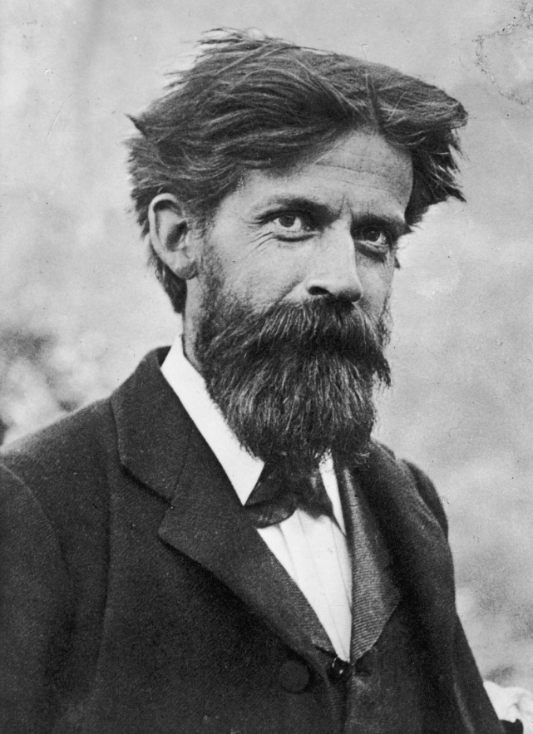
Researching with peer/community researchers – new?
PATRICK GEDDES
1854-1932
Marginalised should be involved in studying their own communities
Community self-survey movement
Notes:
Quality and capacity building in research with people with learning disabilities

Slide 8
COMMUNITY?
Vignette 1 – stigmatising within a ‘community’
Vignette 2 – community suspicions and internal divisions

Slide 9
GETTING BETTER DATA?
Vignette 3 – lack of trust between peer researcher and academic researcher
Vignette 4 – discomfort in asking questions and probing

Slide 10
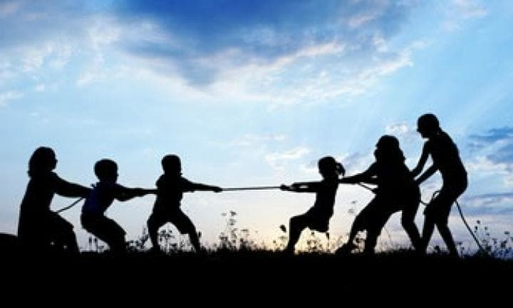
Steps in working with peer researchers
Employing peer researchers as research assistants
Arranging for the work to be accredited
Pre-project briefing and training
Ongoing mentoring
Involvement in analysis and writing up
Final debriefing

