Slide 1
Socio-economic Classifications
Supplemental:
Deriving the NS-SEC

Slide 2
Data – minimum requirement. SOC 2020 to Occupational Unit Group (OUG) level. Four digits.
Three derivation methods depending on what level of information in the data on employment status.
Full method – data available to create a seven-category employment status variable.
Reduced method – data available to create a five-category employment status variable.
Simplified method – no data available on employment status.
Seven-category
Self-employed with 25 or more employees
Self-employed with less than 25 employees
Self-employed, no employees
Manager in establishment with 25 or more employees
Manager in establishment with less than 25 employees
Supervisor
Employee
Five-category
Self-employed with employees
Self-employed, no employees
Manager
Supervisor
Employee

Slide 3
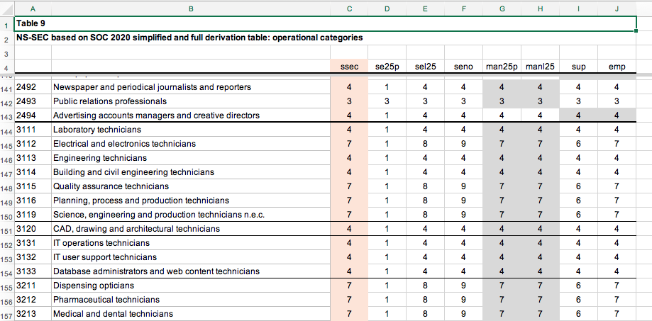

Slide 4
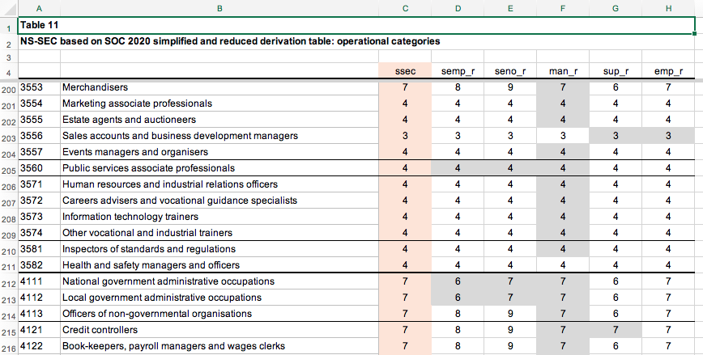

Slide 5
The full method derivation matrix is then matched onto your data by the SOC Occupational Unit Group (OUG) at the individual level in your main data and in each row of the derivation matrix. The matrix has the OUG title included but this column can be deleted prior to merging.
The merge will create eight new variables in your data – ssec, se25p, sel25, seno, man25p, manl25, sup, and emp.
To use these new variables to create a NS-SEC value for each case then:
if empstat_7=1 then nssec=se25p
if empstat_7=2 then nssec=sel25
if empstat_7=3 then nssec=seno
if empstat_7=4 then nssec=man25p
if empstat_7=5 then nssec=manl25
if empstat_7=6 then nssec=sup
if empstat_7=7 then nssec=emp
If for an individual you do not have data to make the empstat_7 variable then nssec=ssec – the simplified method when only SOC OUG is known.

Slide 6
The reduced method derivation matrix is then matched onto your data by the SOC Occupational Unit Group (OUG) at the individual level as for the full method.
The merge will create six new variables in your data – ssec, semp_r, seno_r, man_r, sup_r, and emp_r.
To use these new variables to create a NS-SEC value for each case then:
if empstat_5=1 then nssec=semp_r
if empstat_5=2 then nssec=seno_r
if empstat_5=3 then nssec=man_r
if empstat_5=4 then nssec=sup_r
if empstat_5=5 then nssec=emp_r
If for an individual you do not have data to make the empstat_5 variable then nssec=ssec – the simplified method when only SOC OUG is known.

