Slide 1
Socio-economic Classifications
Part 1: An Abridged History

Slide 2
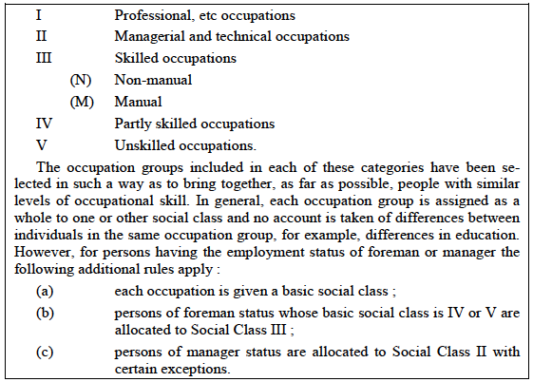
Registrar General’s Social Class (RGSC)
1913
First introduced
1921
Substantively
modified
1951
1961
Name changed to: Social Class based on Occupation (SC)
1990
2000
2001
Discontinued
2010
2020

Slide 3
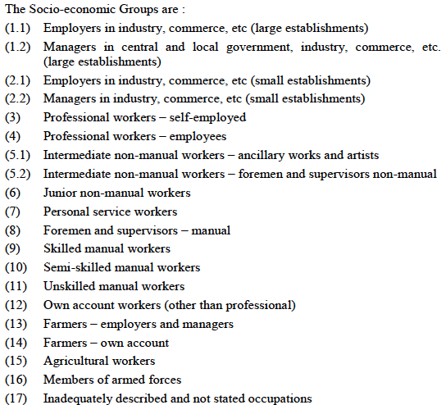
1913
1921
Socio-economic Groups (SEG)
1951
First introduced
1961
Extensively
amended
Registrar General’s Social Class (RGSC)
1990
2000
2001
Discontinued
2010
2020

Slide 4
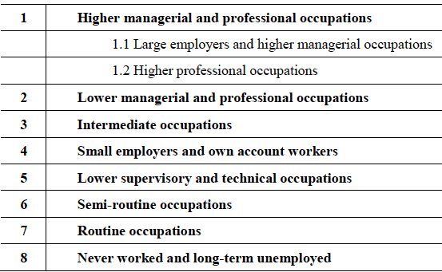
1913
1921
1951
1961
Registrar General’s Social Class (RGSC)
Socio-economic Groups (SEG)
National Statistics Socio-economic Classification (NS-SEC)
1990
2000
First introduced on SOC 2000
2001
2010
Re-based on SOC 2010
2020
Re-based on SOC 2020

Slide 5
1913
1921
1951
1950 – Hall-Jones Scale
1961
Registrar General’s Social Class (RGSC)
1974 – Hope-Goldthorpe Scale
Socio-economic Groups (SEG)
1979 – Goldthorpe/EGP Schema
1980 – Cambridge Scale
1990
1992 – revised Goldthorpe Schema
2000
2001
National Statistics Socio-economic Classification
(NS-SEC)
2010
2013 – Great British Class Survey
2020

Slide 6
Registrar General’s Social Class (RGSC)
1913
First introduced
1921
Substantively
modified
Socio-economic Groups (SEG)
1951
First introduced
1961
Extensively
amended
National Statistics Socio-economic Classification (NS-SEC)
Name changed to: Social Class based on Occupation (SC)
1990
2000
First introduced on SOC 2000
2001
Discontinued
Discontinued
2010
Re-based on SOC 2010
2020
Re-based on SOC 2020

