Slide 1
Ordinal regression
Part 3: Proportional odds assumption
Dr Heini Väisänen
University of Southampton

Slide 2
Outline
Proportional odds assumption
  Meaning
  Testing
A comparison of multinomial and ordinal logistic regression models

Slide 3
The proportional odds assumption
The assumption of a common slope b implies that the effect of x is the same for each cumulative logit, i.e. regardless of k.
We can test this assumption. If we find it does not hold, we should treat y as nominal and use the multinomial logit model: ‘test of parallel lines’
  H0: The slopes do not differ.
  H1: The slopes are different.

Slide 4
The proportional odds assumption: test of parallel lines
H0: The slopes do not differ.
  If we fail to reject the H0 (i.e. if the p-value is large), we conclude that the proportional odds assumption is reasonable and we can use the ordinal model.
H1: The slopes are different.
  If we do reject the H0 (i.e. if the p-value is small), we conclude that the proportional odds assumption is not reasonable and we cannot use the ordinal model.

Slide 5
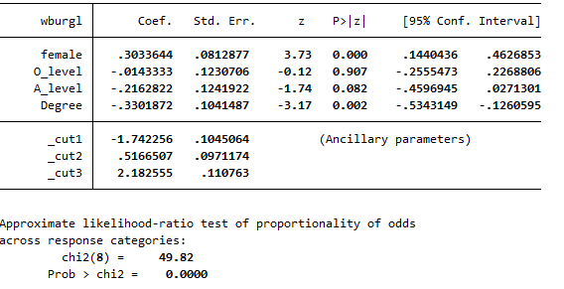
The proportional odds assumption: test of parallel lines using ‘omodel’ in Stata
H0: The slopes do not differ.
H1: The slopes are different.

Slide 6
The proportional odds assumption: test of parallel lines using ‘omodel’ in Stata
H0: The slopes do not differ.
H1: The slopes are different.
NB! Not everyone is a fan of this test. I will show you an alternative albeit ‘informal’ way of examining the assumption using a multinomial model.

Slide 7
Comparing Multinomial and Ordinal Logistic Regression
In a multinomial logit model, we model the response probabilities.
We take one category as the reference.
We then estimate pairwise contrasts between each response category and this reference.
Unlike in an ordinal model we are not making the proportional odds assumption, so the results will always be more precise when using a multinomial model

Slide 8
Why Not Always Use the Multinomial Logit for Categorical Responses?
Having a different set of coefficients in each equation, the number of parameters will be larger (i.e. less parsimonious).
Interpretation-wise, there are no common ‘effects’ across the level of the covariates.
If the response is ordinal start with the cumulative logit model.
  Only consider the multinomial logit model if the proportional odds assumption is invalid.

Slide 9
Multinomial vs. ordinal and the proportional odds assumption
Not very vs. not at all worried | OR | P-value
Men (ref.) | 1.00
Women | 1.22 | 0.114
No education (ref.) | 1.00
O-level/GCSE | 1.88 | 0.002
A-level | 1.61 | 0.012
Degree or diploma | 1.85 | <0.001
Fairly vs. not at all worried | OR | P-value
Men (ref.) | 1.00
Women | 1.56 | 0.002
No education (ref.) | 1.00
O-level/GCSE | 1.58 | 0.033
A-level | 1.32 | 0.177
Degree or diploma | 1.30 | 0.130
Very vs. not at all worried | OR | P-value
Men (ref.) | 1.00
Women | 1.66 | 0.005
No education (ref.) | 1.00
O-level/GCSE | 1.13 | 0.614
A-level | 0.63 | 0.079
Degree or diploma | 0.47 | 0.001

Slide 10
Multinomial vs. ordinal and the proportional odds assumption using predicted probabilities
Multinomial model, probabilities for women
Ordinal model, probabilities for women
 | Not at all | Not very | Fairly | Very worried
No education | 16.4% | 36.8% | 28.7% | 18.1%
O-level | 10.8% | 45.7% | 29.9% | 13.5%
A-level | 13.1% | 47.4% | 30.4% | 9.1%
Degree | 12.6% | 52.2% | 28.6% | 6.7%
 | Not at all | Not very | Fairly | Very worried
No education | 11.4% | 43.9% | 31.4% | 13.2%
O-level | 11.6% | 44.1% | 31.2% | 13.1%
A-level | 13.8% | 46.7% | 28.5% | 11.0%
Degree | 15.2% | 48.0% | 26.8% | 9.9%

Slide 11
Example from video 1 – a well fitting ordinal model
Predicted probabilities from a multinomial model
(and an ordinal model in parentheses)
Likelihood to apply for PG | Unlikely | Somewhat likely | Very likely
Parents not educated | 0.59 (0.59) | 0.33 (0.33) | 0.08 (0.08)
Parents educated | 0.32 (0.32) | 0.48 (0.43) | 0.21 (0.25)

Slide 12
Summary
You can use either ordinal or multinomial models for ordered multi-category outcome variables
Ordinal model is more parsimonious than the multinomial model, but makes the proportional odds assumption
  If this assumption is not met, you will have to use a multinomial model
  If the assumption is met, it is better to use the more parsimonious ordinal model
  You can formally test the assumption and/or compare predicted probabilities between multinomial and ordinal models

Slide 13
Thank you!

