Slide 1
Ordinal regression
Part 2: Multiple ordinal regression
Dr Heini Väisänen
University of Southampton

Slide 2
Outline
Multiple ordinal regression model
Statistical significance
Interpretation of the results
  Cumulative odds ratios
  Predicted probabilities

Slide 3
Multiple ordinal regression models
Like other regression models, ordinal regression can include many explanatory variables
You might want to ‘control for’ some variables when investigating the associations of others
Interpretation slightly different from other regression models due to the cumulative nature of the model

Slide 4
Example: Fear of crime
How worried are people in England and Wales about their homes being broken into?
  Does this vary by gender and education?
Data source: Crime Survey for England and Wales
  Office for National Statistics, University of Manchester. Cathie Marsh Institute for Social Research (CMIST). UK Data Service. (2016). Crime Survey for England and Wales, 2013-2014: Unrestricted Access Teaching Dataset. [data collection]. UK Data Service. SN: 8011, http://doi.org/10.5255/UKDA-SN-8011-1

Slide 5
Descriptive statistics: how worried about burglary
Category | % | N
1) Not at all worried | 15.2 | 331
2) Not very worried | 47.5 | 1036
3) Fairly worried | 27.1 | 590
4) Very worried | 10.3 | 224
TOTAL | 100.0 | 2181

Slide 6
Descriptive statistics: gender and education
Category | % | N
Men | 45.3 | 988
Women | 54.7 | 1193
TOTAL | 100.0 | 2181
Category | % | N
None | 25.7 | 561
O-level/GCSE | 18.6 | 406
A-level | 18.4 | 401
Degree or diploma | 37.3 | 813
TOTAL | 100.0 | 2181

Slide 7
Ordinal regression results (CORs)
Variable | COR | P-value | CI 95%
Men (ref.) | 1.00
Women | 1.35 | <0.001 | 1.15-1.59
No education (ref.) | 1.00
O-level/GCSE | 0.99 | 0.907 | 0.77-1.25
A-level | 0.81 | 0.082 | 0.63-1.03
Degree or diploma | 0.72 | 0.002 | 0.59-0.88
Cutpoint 1 | -1.74
Cutpoint 2 | 0.52
Cutpoint 3 | 2.18

Slide 8
Statistical significance: Wald-test
Variable | COR | P-value | CI 95%
Men (ref.) | 1.00
Women | 1.35 | <0.001 | 1.15-1.59
No education (ref.) | 1.00
O-level/GCSE | 0.99 | 0.907 | 0.77-1.25
A-level | 0.81 | 0.082 | 0.63-1.03
Degree or diploma | 0.72 | 0.002 | 0.59-0.88
Cutpoint 1 | -1.74
Cutpoint 2 | 0.52
Cutpoint 3 | 2.18

Slide 9
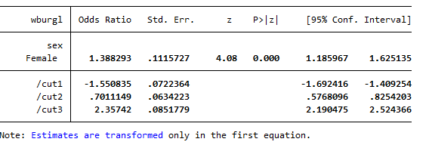

Statistical significance: Likelihood ratio test

Slide 10
Interpretation: cumulative odds ratios
Variable | COR
Men (ref.) | 1.00
Women | 1.35
No education (ref.) | 1.00
O-level/GCSE | 0.99
A-level | 0.81
Degree or diploma | 0.72
Women have 35% higher odds of being in higher rather than lower categories of the outcome, that is they are more likely to be worried, when controlling for education.

Slide 11
Interpretation: cumulative odds ratios
Variable | COR
Men (ref.) | 1.00
Women | 1.35
No education (ref.) | 1.00
O-level/GCSE | 0.99
A-level | 0.81
Degree or diploma | 0.72
More educated groups are less likely to be in the higher rather than lower categories of the outcome, that is they are less likely to be worried, when controlling for gender.
E.g. odds are 28% lower among those with a degree than those without education.

Slide 12
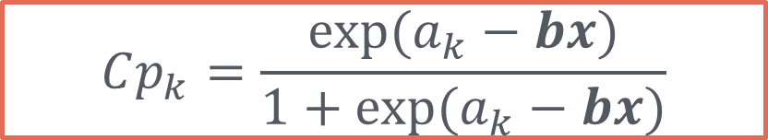
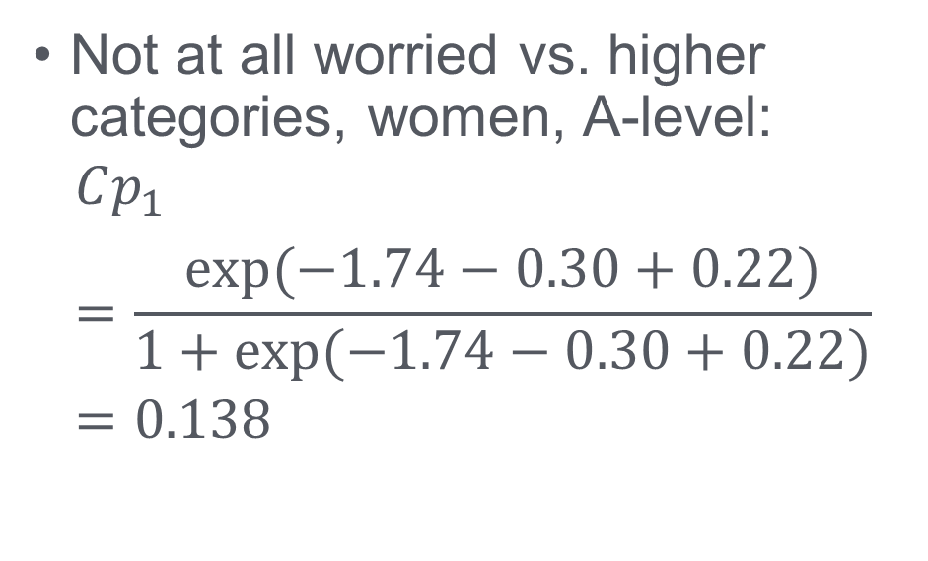
Interpretation: predicted probabilities
$$Cp_{k}=\frac{exp⁡(a_{k}−bx)}{1+exp⁡(a_{k}−bx)}$$
Variable | Cumulative logit
Men (ref.) | 0.00
Women | 0.30
No education (ref.) | 0.00
O-level/GCSE | -0.01
A-level | -0.22
Degree or diploma | -0.33
Cutpoint 1 | -1.74
Cutpoint 2 | 0.52
Cutpoint 3 | 2.18
Not at all worried vs. higher categories, women, A-level:
$$Cp_{1}=\frac{exp⁡(−1.74−0.30+0.22)}{1+exp⁡(−1.74−0.30+0.22)}=0.138$$

Slide 13
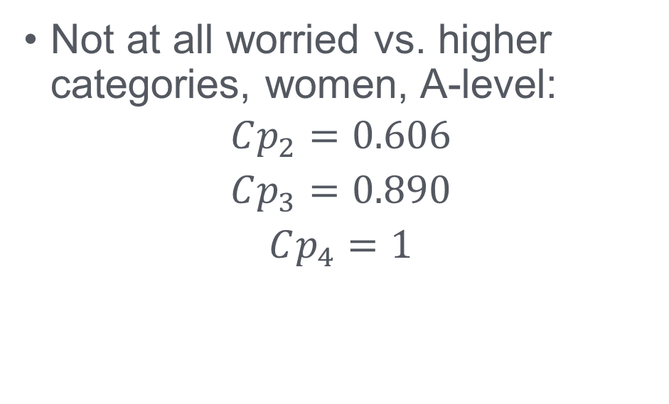
Interpretation: predicted probabilities
$$Cp_{k}=\frac{exp⁡(a_{k}−bx)}{1+exp⁡(a_{k}−bx)}$$
Variable | Cumulative logit
Men (ref.) | 0.00
Women | 0.30
No education (ref.) | 0.00
O-level/GCSE | -0.01
A-level | -0.22
Degree or diploma | -0.33
Cutpoint 1 | -1.74
Cutpoint 2 | 0.52
Cutpoint 3 | 2.18
Not at all worried vs. higher categories, women, A-level:
$$Cp_{2}=0.606$$
$$Cp_{3}=0.890$$
$$Cp_{4}=1$$

Slide 14
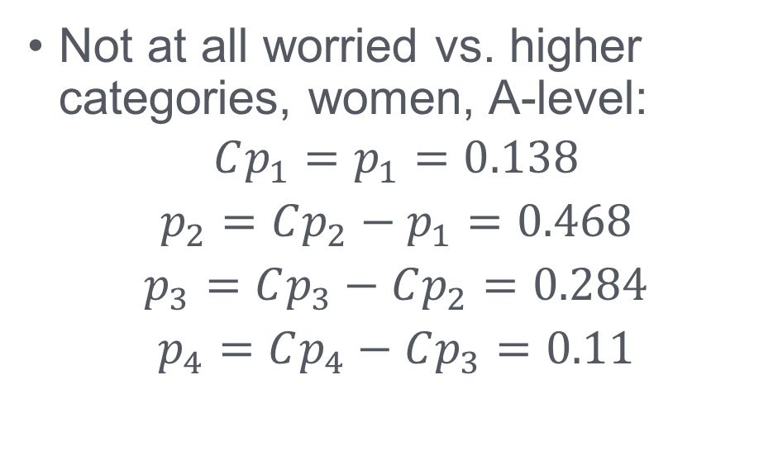
Interpretation: predicted probabilities
$$Cp_{k}=\frac{exp⁡(a_{k}−bx)}{1+exp⁡(a_{k}−bx)}$$
Variable | Cumulative logit
Men (ref.) | 0.00
Women | 0.30
No education (ref.) | 0.00
O-level/GCSE | -0.01
A-level | -0.22
Degree or diploma | -0.33
Cutpoint 1 | -1.74
Cutpoint 2 | 0.52
Cutpoint 3 | 2.18
Not at all worried vs. higher categories, women, A-level:
$$Cp_{1}=p_{1}=0.138$$
$$p_{2}=Cp_{2}−p_{1}=0.468$$
$$p_{3}=Cp_{3}−Cp_{2}=0.284$$
$$p_{4}=Cp_{4}−Cp_{3}=0.11$$

Slide 15
Interpretation: predicted probabilities of being (a) not at all worried or (b) very worried by gender

Slide 16
Thank you!

