Slide 1
Ordinal regression
Part 1: Introduction
Dr Heini Väisänen
University of Southampton

Slide 2
Outline
Ordinal response variables
Cumulative odds and probabilities
Ordinal regression a.k.a. proportional odds model a.k.a. cumulative logit model

Slide 3
Ordinal response variables
Many categorical variables have a natural ordering.
Examples are:
Severity of symptoms (low, medium and high).
Attitude to a social question (in favour, indifferent, against).
By using ordinal information a more informative and powerful analysis may be possible.

Slide 4
Cumulative probabilities - notation
Notes:
Cp_{k} = p₁ + p₂ + . . . + p_{k}
p₁=Cp₁, p_{k}=Cp_{k} – Cp_{k-1} (k=2, . . ., K-1), and p_{K} = 1-Cp_{K-1}
P_{k} | Probability of being in category k
C_{pk} | Cumulative probability of being in category k or lower
1-C_{pk} | Probability of being above category k

Slide 5
Cumulative probabilities - example
Suppose we have K=3 ordinal categories, with:
p₁ = 0.5, p₂ = 0.3 and p₃ = 0.2
Then what is C_{pk} for k = 1,2,3?
Cp₁= Pr(y ≤ 1) = p₁ = 0.5
Cp₂= Pr(y ≤ 2) = p₁ ₊ p₂ = 0.5+0.3 = 0.8
Cp₃= Pr(y ≤ 3) = 1, (the probability of being in the largest group or lower must be 100%)

Slide 6
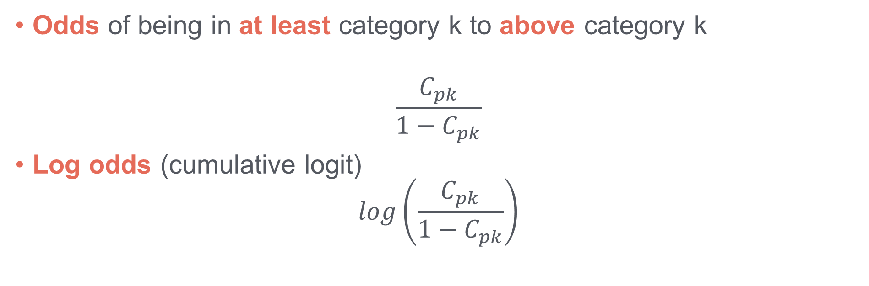
Cumulative odds and log-odds
Odds of being in at least category k to above category k
$$\frac{C_{pk}}{1−C_{pk}}$$
Log odds (cumulative logit)
$$log\left(\frac{C_{pk}}{1−C_{pk}}\right)$$

Slide 7
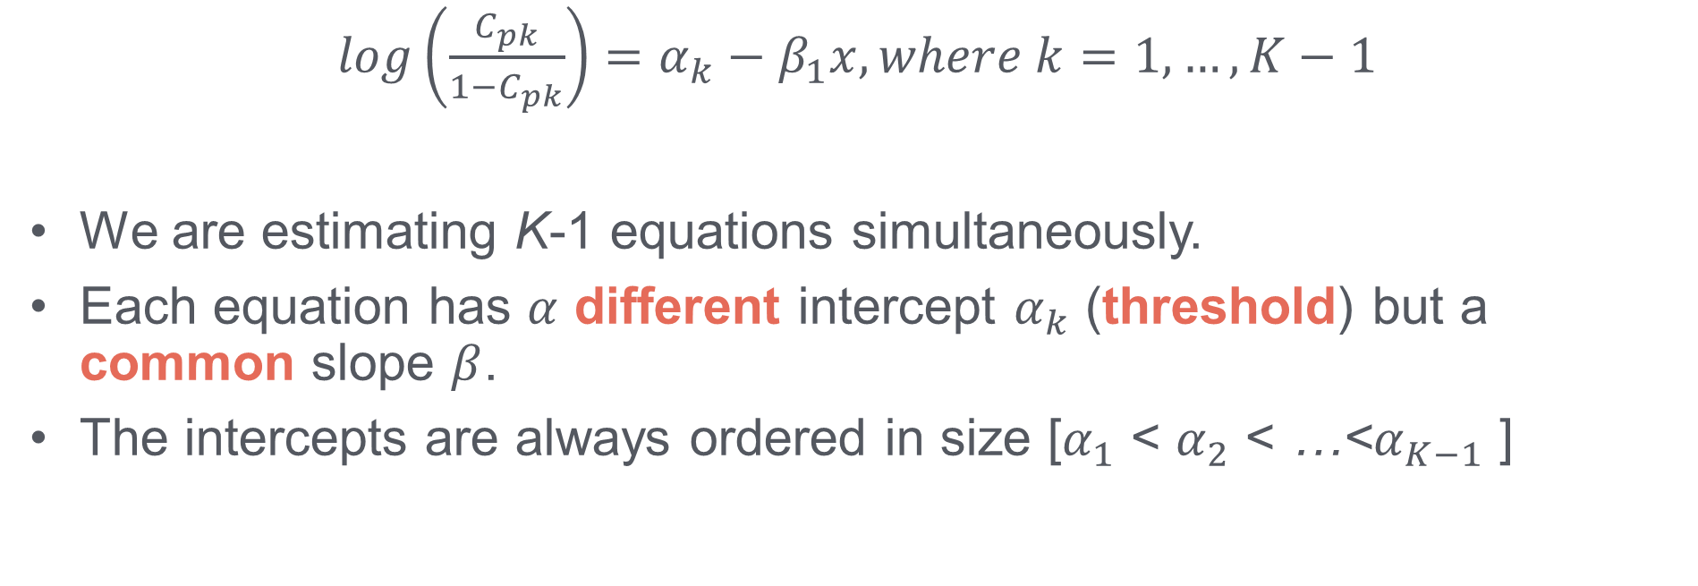
Ordinal regression model
$log\left(\frac{C_{pk}}{1−C_{pk}}\right)=α_{k}−β_{1}x, where k=1, …, K−1$
We are estimating K-1 equations simultaneously.
Each equation has $α$ different intercept $α_{k}$ (threshold) but a common slope $β$.
The intercepts are always ordered in size [$α_{1}$ < $α_{2}$ < …<$α_{K−1}$ ]

Slide 8
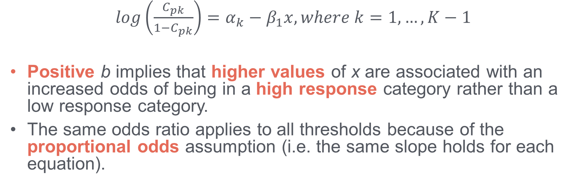
Ordinal regression model
$log\left(\frac{C_{pk}}{1−C_{pk}}\right)=α_{k}−β_{1}x, where k=1, …, K−1$
Positive b implies that higher values of x are associated with an increased odds of being in a high response category rather than a low response category.
The same odds ratio applies to all thresholds because of the proportional odds assumption (i.e. the same slope holds for each equation).

Slide 9
Example: postgraduate school applications
Undergraduate students reported how likely they were to apply for postgraduate study: “Unlikely”, “Somewhat likely” or “Very likely”.
Is parents’ educational status (at least one graduate vs. none) associated with likelihood of applying?
Data source: https://stats.idre.ucla.edu/stata/dae/ordered-logistic-regression/
Postgraduate application | N | %
Unlikely | 220 | 55.0
Somewhat likely | 140 | 35.0
Very likely | 40 | 10.0
Total | 400 | 100.0

Slide 10
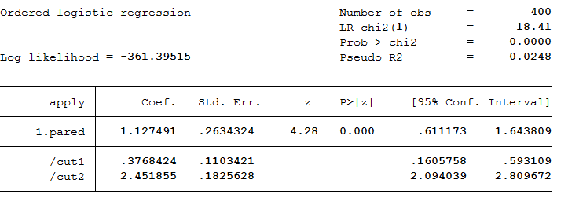
Example: results (Stata)

Slide 11
Example: results (Stata)
For students with educated parents, the odds of very likely versus the combined somewhat and unlikely categories are exp(1.127)=3.09 greater.
Likewise, the odds of being in the combined very and somewhat likely categories versus unlikely are 3.09 times greater for those with educated parents.
That is, the odds for being in a higher rather than a lower category of the outcome are higher for students with educated parents.

Slide 12
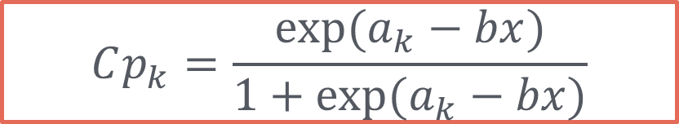
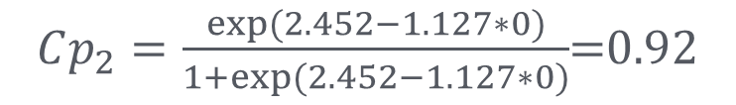
Calculation of probabilities (model with explanatory variables)
$$Cp_{k}=\frac{exp⁡(a_{k}−bx)}{1+exp⁡(a_{k}−bx)}$$
Parents not educated (PARED=0):
$$Cp_{1}=p_{1}=\frac{exp⁡(0.377−1.127∗0)}{1+exp⁡(0.377−1.127∗0)}=0.59$$
$Cp_{2}=\frac{exp⁡(2.452−1.127∗0)}{1+exp⁡(2.452−1.127∗0)}$=0.92

Slide 13

Calculation of probabilities (model with explanatory variables)
$$Cp_{k}=\frac{exp⁡(a_{k}−bx)}{1+exp⁡(a_{k}−bx)}$$
Parents not educated (PARED=0):
$$p_{2}={Cp}_{2}−{Cp}_{1}=0.92−0.59=0.33$$
$$p_{3}={1−Cp}_{2}=1−0.92=0.08$$

Slide 14
Table of response probabilities
Likelihood to apply for PG | Unlikely | Somewhat likely | Very likely
Parents not educated | 0.59 | 0.33 | 0.08
Parents educated | 0.32 | 0.43 | 0.25

Slide 15
Thank you!
Aknowledgements: the postgraduate school application slides developed originally by David Dawber.

