Slide 1
Introduction to Latent Class Analysis
Dr Oliver Perra
o.perra@qub.ac.uk

Slide 2
Outline
Example of a problem
Main characteristics of Latent Class Analysis (LCA)
Latent Class Analysis main goals and research questions
Main assumptions

Slide 3
Low mood | ☒
Loss of interest | ☒
Fatigue | ☒
Sleep problems | ☒
Low mood | ☒
Loss of interest | ☒
Fatigue | ☑
Sleep problems | ☑
Low mood | ☑
Loss of interest | ☑
Fatigue | ☑
Sleep problems | ☑
Low mood | ☒
Loss of interest | ☒
Fatigue | ☑
Sleep problems | ☒
Low mood | ☒
Loss of interest | ☒
Fatigue | ☒
Sleep problems | ☑
Low mood | ☒
Loss of interest | ☒
Fatigue | ☒
Sleep problems | ☒
Low mood | ☑
Loss of interest | ☑
Fatigue | ☑
Sleep problems | ☑
Low mood | ☒
Loss of interest | ☑
Fatigue | ☑
Sleep problems | ☑
Low mood | ☑
Loss of interest | ☒
Fatigue | ☑
Sleep problems | ☑
Low mood | ☑
Loss of interest | ☒
Fatigue | ☒
Sleep problems | ☑
Notes:
Let’s start with an example: We observe a series of people, and for the sake of the example, let’s assume they fall into two genders.
We observe these people over two 2 weeks to check if they experienced any of these issues.
The four issues are some of the symptoms of Major Depression.

Slide 4
Low mood | ☒
Loss of interest | ☒
Fatigue | ☒
Sleep problems | ☒
Low mood | ☒
Loss of interest | ☒
Fatigue | ☑
Sleep problems | ☑
Low mood | ☑
Loss of interest | ☑
Fatigue | ☑
Sleep problems | ☑
Low mood | ☒
Loss of interest | ☒
Fatigue | ☑
Sleep problems | ☒
N = 195
N = 103
N = 186
N = 59
Low mood | ☒
Loss of interest | ☒
Fatigue | ☒
Sleep problems | ☑
Low mood | ☒
Loss of interest | ☒
Fatigue | ☒
Sleep problems | ☒
Low mood | ☑
Loss of interest | ☑
Fatigue | ☑
Sleep problems | ☑
N = 162
N = 176
N = 36
Low mood | ☒
Loss of interest | ☑
Fatigue | ☑
Sleep problems | ☑
Low mood | ☑
Loss of interest | ☒
Fatigue | ☑
Sleep problems | ☑
Low mood | ☑
Loss of interest | ☒
Fatigue | ☒
Sleep problems | ☑
N = 56
N = 65
N = 78
Notes:
Let’s assume every individual in the figure represents a number of individuals that report the same pattern of answers.
In this simplified example, there is heterogeneity: people report different responses.
We want to make sense of the variability we observe in these answers, and find ways to categorise people into few groups. For example a group of people likely to meet criteria for depression.

Slide 5
Low mood | ☒
Loss of interest | ☒
Fatigue | ☒
Sleep problems | ☒
Low mood | ☒
Loss of interest | ☒
Fatigue | ☑
Sleep problems | ☑
Low mood | ☑
Loss of interest | ☑
Fatigue | ☑
Sleep problems | ☑
Low mood | ☒
Loss of interest | ☒
Fatigue | ☑
Sleep problems | ☒
N = 195
N = 103
N = 186
N = 59
Low mood | ☒
Loss of interest | ☒
Fatigue | ☒
Sleep problems | ☑
Low mood | ☒
Loss of interest | ☒
Fatigue | ☒
Sleep problems | ☒
Low mood | ☑
Loss of interest | ☑
Fatigue | ☑
Sleep problems | ☑
N = 162
N = 176
N = 36
Low mood | ☒
Loss of interest | ☑
Fatigue | ☑
Sleep problems | ☑
Low mood | ☑
Loss of interest | ☒
Fatigue | ☑
Sleep problems | ☑
Low mood | ☑
Loss of interest | ☒
Fatigue | ☒
Sleep problems | ☑
N = 56
N = 65
N = 78
Notes:
We could devise different rules for categorising these individuals in groups, e.g. if they show all the symptoms they are more likely to be depressed.

Slide 6
Low mood | ☒
Loss of interest | ☒
Fatigue | ☒
Sleep problems | ☒
Low mood | ☒
Loss of interest | ☒
Fatigue | ☑
Sleep problems | ☑
Low mood | ☑
Loss of interest | ☑
Fatigue | ☑
Sleep problems | ☑
Low mood | ☒
Loss of interest | ☒
Fatigue | ☑
Sleep problems | ☒
N = 195
N = 103
N = 186
N = 59
Low mood | ☒
Loss of interest | ☒
Fatigue | ☒
Sleep problems | ☑
Low mood | ☒
Loss of interest | ☒
Fatigue | ☒
Sleep problems | ☒
Low mood | ☑
Loss of interest | ☑
Fatigue | ☑
Sleep problems | ☑
N = 162
N = 176
N = 36
Low mood | ☒
Loss of interest | ☑
Fatigue | ☑
Sleep problems | ☑
Low mood | ☑
Loss of interest | ☒
Fatigue | ☑
Sleep problems | ☑
Low mood | ☑
Loss of interest | ☒
Fatigue | ☒
Sleep problems | ☑
N = 56
N = 65
N = 78
Notes:
We can arbitrarily decide to divide people in two categories (depressed vs. not depressed) or 3 categories (most likely depressed, unlikely to be depressed, certainly not depressed). Ideally we want a method that is more robust than just arbitrary choices.
Latent class analysis provides a method to decide how many categories we need to make sense of the observed heterogeneity in people’s behaviour. Furthermore, LCA allows to categorise individuals according to their observed behaviour. Rather than arbitrary rules, LCA uses probability rules, providing more robust, systematic and transparent methods to categorise individuals into groups, based on the behaviour we observe.

Slide 7
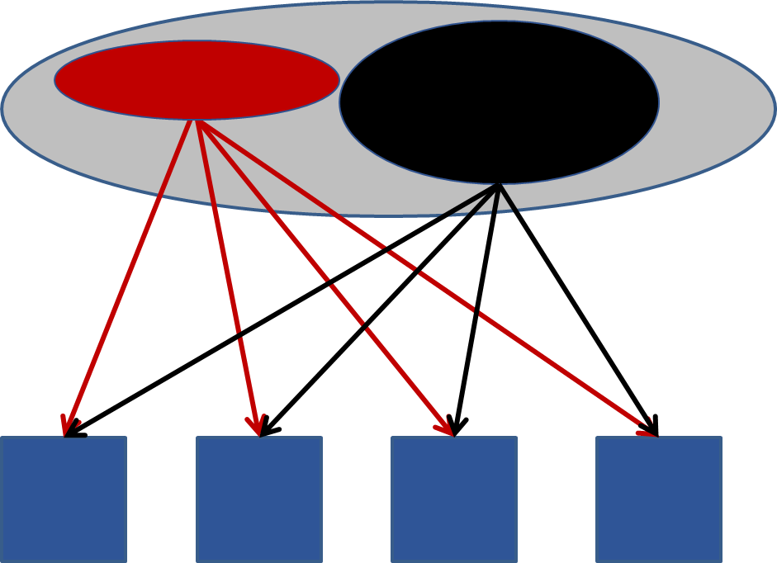
Main Characteristics of Latent Class Analysis (LCA)

Slide 8
Main characteristics of Latent Class Analysis (LCA)
Person-centred approach:
Notes:
I used the example of different classes of depression to highlight LCA is a person-centred approach: it assumes that the pool of people we observe…

Slide 9
Main characteristics of Latent Class Analysis (LCA)
Person-centred approach:
Notes:
…is made up of a mixture of individuals, categories of individuals that differ in distinct ways each from the other.

Slide 10
Main characteristics of Latent Class Analysis (LCA)
Person-centred approach
Measurement model
Low mood | ☑
Loss of interest | ☑
Fatigue | ☑
Sleep problems | ☑
Low mood | ☒
Loss of interest | ☒
Fatigue | ☒
Sleep problems | ☒
Notes:
LCA is a measurement model. What does it mean? The example of symptoms of depression highlights that LCA assumes that what explains the differences we observe in behaviour patterns are some unobservable, latent, characteristics…

Slide 11
Main characteristics of Latent Class Analysis (LCA)
Person-centred approach
Measurement model
Low mood | ☑
Loss of interest | ☑
Fatigue | ☑
Sleep problems | ☑
Low mood | ☒
Loss of interest | ☒
Fatigue | ☒
Sleep problems | ☒
Status: Depression
Status: No Depression
Notes:
The underlying depression status explains why some people report low mood, loss of interest, fatigue and sleep problems over a period of time, and why other people do not. We cannot observe depression directly, but we can infer the latent status of being depressed or not by observing symptoms of depression.
LCA conceptually is very similar to factor analysis: the key difference is that in LCA the underlying constructs that explain differences in behaviour are categorical differences, rather than quantitative differences. In this example, rather than representing depression as a continuum where people may be more or less depressed, we are representing the underlying condition as two different categories.
Whether we should represent the underlying depression condition as categorical or continuous, is probably a question that we should answer considering theory and substantive knowledge, not just statistics. However, if we think it makes sense to suggest a categorical underlying variable to explain individual differences in behaviour, LCA is the approach for us.

Slide 12
Correlated indicators
U1
U2
U3
U4
Notes:
So, the basic situation in the example is observing participants’ behaviours in a set of variables. We observe these variables are correlated.

Slide 13
Correlated indicators
Low Mood
Lack of Pleasure
Sleep probs
Fatigue
Notes:
In the example, that these correlations mean that people who are in low mood most of the time tend to also report loss of pleasure, etc. (conversely, if they are not in low mood they are less likely to report loss of pleasure, etc.). We called these behaviours “indicators” as we assume they are “signs” of some underlying construct (e.g. depression).
Note that in many examples Latent Class is applied to ordered categorical variables. However, LCA can be applied to any type of variables, from nominal variables to continuous variables. For example, we could look at the number of days a person was in low mood over a 14-day period.

Slide 14
Latent Class Model
No Depression
Depression
Low Mood
Lack pleasure
Sleep probs
Fatigue
Notes:
Let’s stick to categorical variables for simplicity. The latent class model assumes that what explains the correlation between these indicators is the underlying construct: in the example, the categorical dimension of being depressed or not.

Slide 15
Latent Class Model
No Depression
Depression
Conditional independence: Observed variables are independent given latent class affiliation.
Low Mood
Lack pleasure
Sleep probs
Fatigue
Notes:
Note that when I introduced the latent classes in the frame, I have removed the correlations between symptoms. This is to represent one of the main assumptions of LCA, that of conditional independence. This means that we assume that the variables we observe are conditionally independent of each other given the level of the latent variable. Put it another way, the associations between being in low mood most of the time, inability to experience pleasure etc. happen because these behaviours are caused by an underlying status, that of being depressed. If we control for the underlying status, we should not observe residual associations between these variables.

Slide 16
Latent Class Analysis: Main goals and research questions

Slide 17
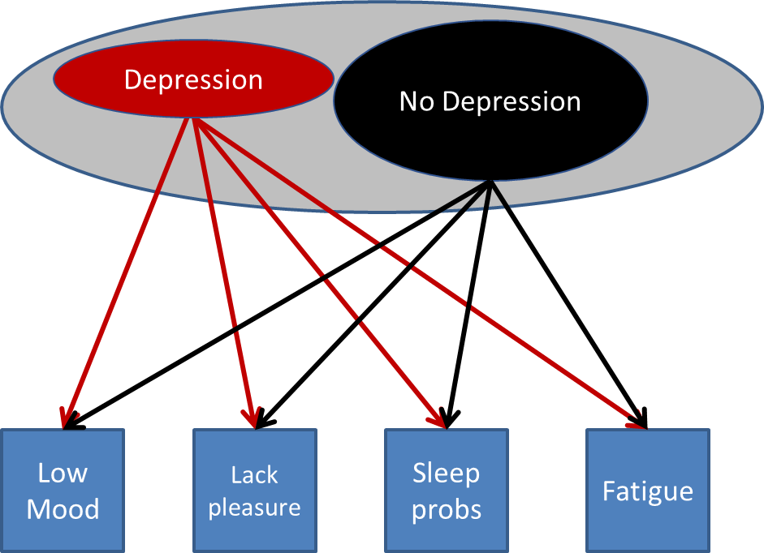
Main Goals of Latent Class Analysis
Identify the number of categories necessary to explain differences in behaviour patterns
Characterise these underlying categories based on their associations with observed behaviours

Slide 18
Example of Research: Grunow, Begall, & Buchler (2018). Gender Ideologies in Europe: A multidimensional framework. Journal of Marriage and Family (80), 42-60. DOI:10.1111/jomf.12453
Data from 2008 European Values Study (8 Countries; Over 5,000 participants)
7 Items:
E.g.: Preschool child suffers with working mother → Agree / Disagree
Identified classes beyond unidimensional Egalitarian vs. Traditional distinction:
E.g.: Egalitarian essentialists:
Advocate similar roles for men and women
But agree with Being housewife as fulfilling as paid job and Women really want home & children
“Ideologies mixing gender essentialist and egalitarian views appear to have replaced traditional ideologies, even in countries offering some institutional support for gendered separate spheres.”
Notes:
Let’s see an example of research, which I have selected to emphasise the categorical nature of the underlying variables.
These researchers used data from the European Values study to investigate citizens’ views about gender roles. Respondents reported how much they agreed with statements such as “preschool children suffer if the mother works). The answers were dichotomised into two categories of response, Agree vs. Disagree.
The researchers expected people to differ along the dimension of traditional vs. egalitarian attitudes to gender roles. But the researchers also hypothesised that more nuanced attitudes may emerge. Indeed, the study identified 3 additional groups of individuals beyond those with Egalitarian or Traditional views on gender role. For example the Egalitarian essentialists, who, despite agreeing that women and men can have similar roles, believe that women mostly aspire to dedicate themselves to the home and children.
The researchers highlighted how more nuanced views have emerged even in countries where policies still endorse separate roles for males and females.

Slide 19
Example of Research: Grunow, Begall, & Buchler (2018). Gender Ideologies in Europe: A multidimensional framework. Journal of Marriage and Family (80), 42-60. DOI:10.1111/jomf.12453
Further questions LCA can answer:
Egalitarian Essentialist
Egalitarian
Traditionalist
Intensive parenting
Moderate Traditionalist
Notes:
The LCA approach can be extended to answer more questions about the precursors and consequences of latent classes. Here I report the 5 classes of attitudes to gender roles identified by Grunow et al.

Slide 20
Example of Research: Grunow, Begall, & Buchler (2018). Gender Ideologies in Europe: A multidimensional framework. Journal of Marriage and Family (80), 42-60. DOI:10.1111/jomf.12453
Further questions LCA can answer:
Factors influencing individuals’ affiliation to different classes:
Does class affiliation vary by country?
Does it vary according to Socio-Economic Status?
Egalitarian Essentialist
Country
Egalitarian
Traditionalist
SES
Intensive parenting
Moderate Traditionalist
Notes:
We can investigate what are the factors that influence individuals’ affiliation to different classes: For example, are there significant differences across countries, or across SES?

Slide 21
Example of Research: Grunow, Begall, & Buchler (2018). Gender Ideologies in Europe: A multidimensional framework. Journal of Marriage and Family (80), 42-60. DOI:10.1111/jomf.12453
Further questions LCA can answer:
Factors that influence the probability of being in different classes
Do latent classes relate to other behaviours?
E.g. Do attitudes to gender roles predict intentions to vote in referenda on issues such as abortion regulations?
Egalitarian Essentialist
Country
Egalitarian
Traditionalist
SES
Intensive parenting
Vote in referendum
Moderate Traditionalist
Notes:
We can also investigate if class affiliation is related to, or predicts other behaviours. For example, do attitudes to gender roles influence intentions to vote in referenda, for example referenda on abortion laws?

Slide 22
Main assumption of LCA

Slide 23
Main assumption of LCA
Latent classes:
Mutually exclusive: an individual belongs to just one class;
Exhaustive: All individuals belong to one class.
Status:
Not Depressed
Status: Depressed
Notes:
The first is that latent classes are mutually exclusive: each individual in our sample belongs to only one of the underlying class, e.g. either Depression or No Depression.
The classes are exhaustive, so each individual in our sample belongs to one of the classes identified.

Slide 24
Main assumption of LCA
Individuals within each class have the same propensity to display indicator behaviours
Observed intra-classes differences due to ‘error’ variation
Intra-group homogeneity
Inter-group heterogeneity
Status:
Not Depressed
Status: Depressed
Low mood | ☑
Loss of interest | ☑
Fatigue | ☑
Sleep problems | ☑
Low mood | ☒
Loss of interest | ☒
Fatigue | ☒
Sleep problems | ☒
Notes:
Individuals within each class are supposed to behave in the same way, or in other words, there are supposed to be no differences in the level of behaviour between individuals in the same class.
The differences we observe in the behaviour of people in the same class is due to errors in measuring the behaviour.
Namely, the assumption of a latent class model is that individuals within one class are homogeneous in their behaviour, and they differ from individuals in the other classes.
More formally, individuals in each class have the same parameters.
The association between indicator behaviours and the underlying classes is therefore probabilistic, not deterministic: we estimate the probability that people in one class display a specific pattern of behaviour.

Slide 25
Main assumption of LCA
Membership to latent classes is assessed with uncertainty
Status:
Not Depressed
Status: Depressed
66%
96%
89%
82%
63%
84%
97%
56%
57%
78%
72%
58%
82%
Notes:
Since the association between indicators and underlying classes is probabilistic, class affiliation is also estimated with error: individuals’ class membership is not certain but estimated as a probability of belonging to a latent class, based on the pattern of behaviour observed. Therefore, there is uncertainty about membership to latent classes, and models can vary in their degree of uncertainty concerning latent class membership.

Slide 26
Summary: Latent Class Analysis (LCA)
Person centred-approach
Investigates mixture of individuals in a sample:
How many categories adequately explain observed behaviour variation
Categorise individuals into only one category
Measurement model:
Observed behaviours are causally related to underlying categorical differences, e.g.
Disordered / Non-Disordered;
Egalitarian / Egalitarian Essentialist / Traditionalist / …
Allows identification of qualitative differences between individuals:
E.g.: Multi-dimensional gender ideologies beyond the Egalitarian / Traditionalist views
Notes:
To summarise:
LCA is a person centred approach: it uses probability to estimate the number of underlying categorical types that can explain variability in behaviour patterns we observe in our participants.
LCA also allows to assign individuals to these underlying latent classes or categories, but this assignment is probabilistic, not certain.
LCA is a measurement model: it assumes that the patterns of behaviour we observe in our participants is explained by the fact participants belong to different classes or categories.
Since the underlying latent variables that explain participants’ behaviour are categorical, LCA also allows to identify inter-individual differences that may go beyond uni-dimensional differences: Individuals can differ in ways that are, as it is, categorical, quite distinct. Our participants can differ in qualitative way across different dimensions, as the example of a study before illustrated.

