Slide 1
Principles of
data visualisation
Sophie Lee, PhD
https://www.ncrm.ac.uk/resources/online/all/?id=20844

Slide 2
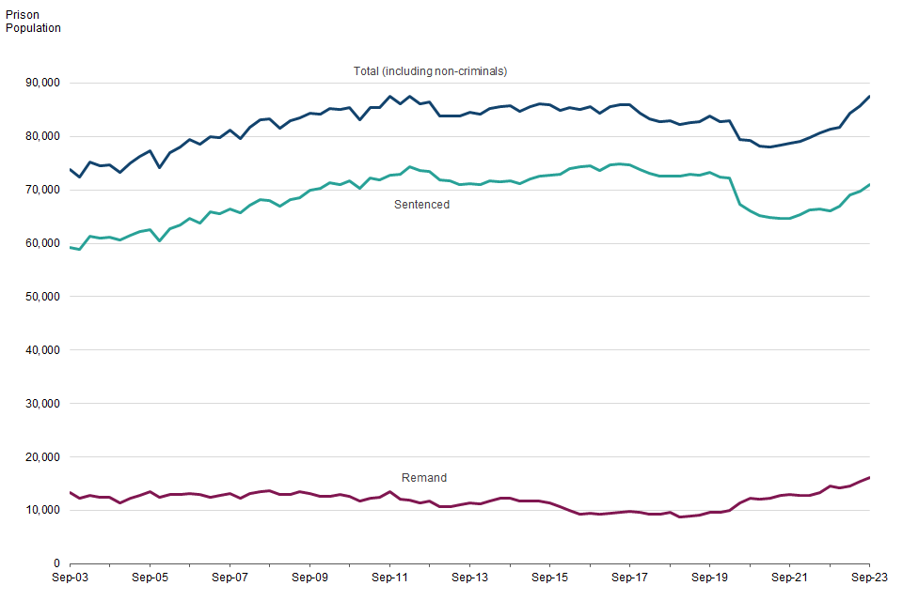
Notes:
This line graph was taken from the Offender Management Statistics report in 2023. It shows the prison populations between 2003 and 2023, split by those who are sentenced and those on remand.
Good things about this graph is it is simple and has a clear message: populations were relatively stable until 2020 when the number of sentenced dropped (probably due to closure of courts during COVID). Following this, the number of prisoners increased, including both the number sentenced and on remand.
Issues with this plot are that the differences between groups are so large it is hard to see differences in trends. Possible a stacked bar chart would be better, this would still include the total but make the differences easier to spot. The graph could also be separated, with the sentenced and remand numbers given separately. Annotations to indicate important events, such as court closures or policy changes would help add context to the graph. The text is very small and should be increased.

Slide 3
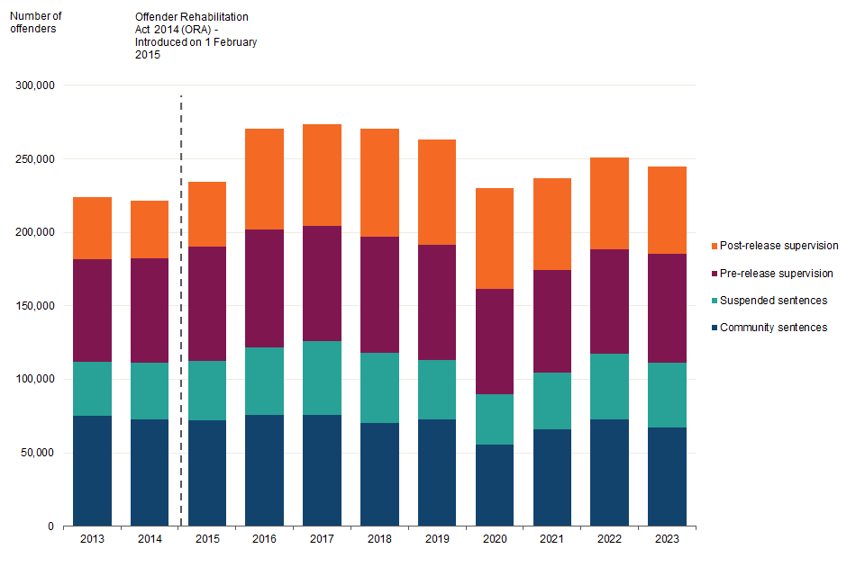
Notes:
This is also taken from the Offender Management Statistics report in 2023. Shows the Number of offenders under Probation Service supervision, 31 December 2013 to 2023.
Useful annotation, showing the introduction of a policy that adjusted numbers. Clear colour scheme.
Text is very small, the differences across time within groups is difficult to interpret as the total numbers differ. Potentially a line graph would be more helpful here, particularly as the values are closer than the previous plot

Slide 4
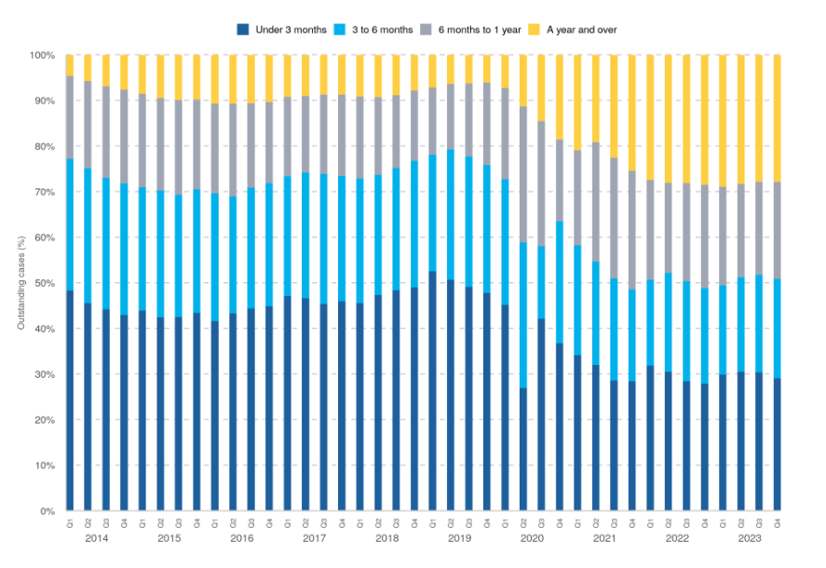
Notes:
Example taken from the Criminal court statistics quarterly, Proportion of outstanding cases at the Crown Court by grouped age, Q1 2014 – Q4 2023
Can see a clear trend in the data with older cases becoming more common after 2020, cases clearly taking longer to get to court. The use of bars creates a Moire effect, making the bars look as though they are moving. This is quite unpleasant for some people (me included), making it hard to look at the plot too long and interpret it. Consider joining the bars into a stacked area plot to remove this unpleasant pattern. Text needs to be larger

Slide 5
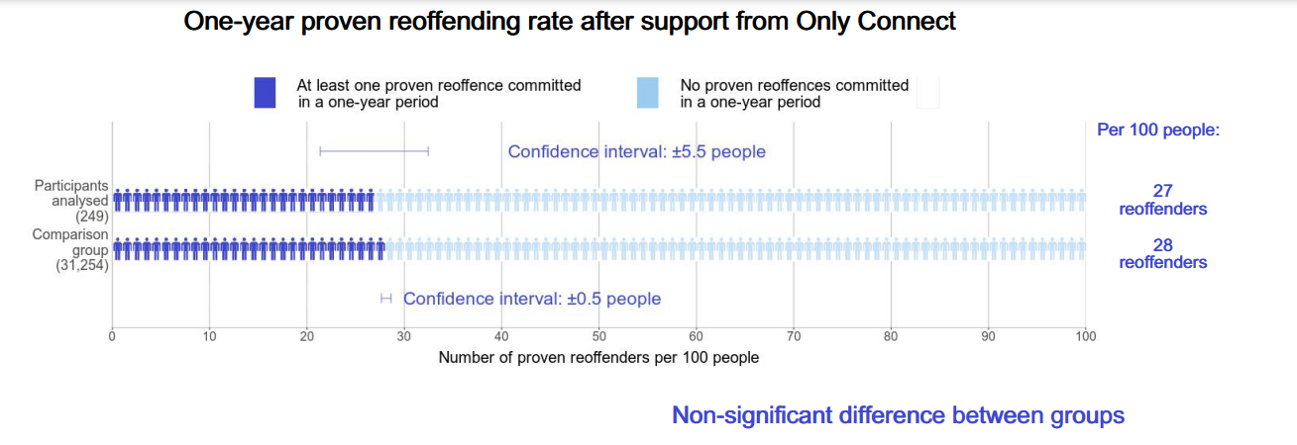
Notes:
The following examples are taken from the Justice Data Lab analysis: Reoffending behaviour after support from Only Connect
Shows a comparison of the one-year proven re-offending rate between those who had received support through the Only Connect scheme and a control group that had not
The use of people rather than bars makes it more compelling and interesting than a standard bar chart, there are many annotations that help convey the message clearly, including results from tests. The light colour is a little hard to see but it is not completely an issue

Slide 6
www.ncrm.ac.uk

