Slide 1
Using Consumer Data in Research 2. What can we do with Consumer Data?
Dr Nick Bearman
@nickbearmanuk | github.com/nickbearman
geospatialtrainingsolutions.co.uk
ucl.ac.uk/geospatial-analytics/people/nick-bearman
Notes:
Three short videos and reading list
1 – What is consumer data?
2 – What can we do with consumer data? - Examples
3 – What skills do we need to work with Consumer Data? - Methods

Slide 2
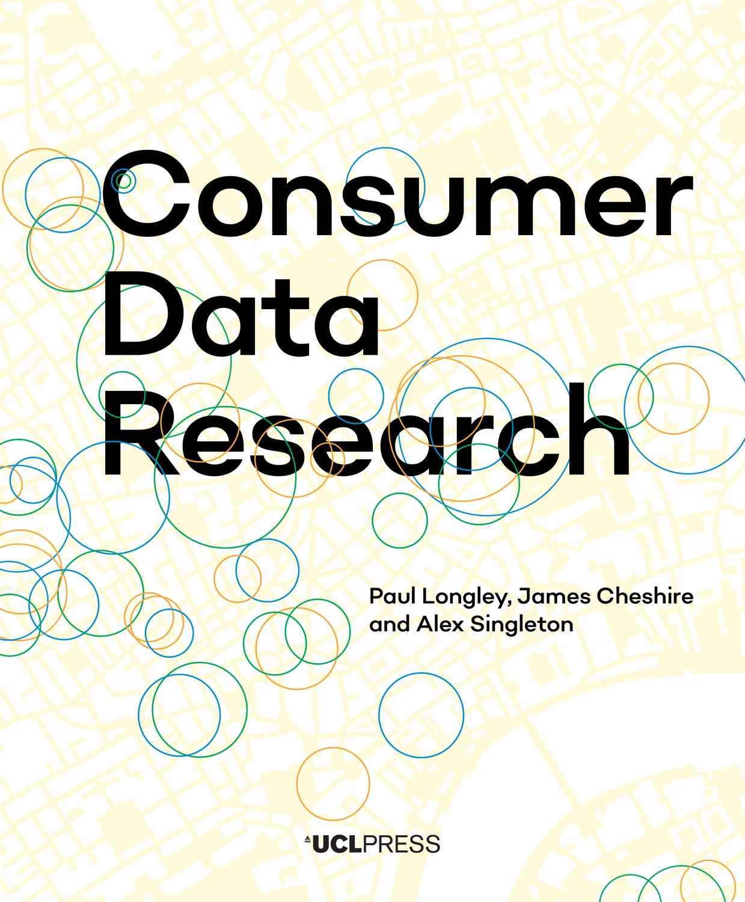
What can we do with consumer data?
‘arise out of every-day transactions for goods and services, carried out between individuals and organisations’ (Longley et al. 2018, p8)
What type of analysis can we do with consumer data?
'Consumer data' is an umbrella term
Lots of potential data out there, today we leave digital traces from nearly everything that we do in our lives.
Notes:
- 'Consumer data' is an umbrella term
- Lots of potential data out there, today we leave digital traces from nearly everything that we do in our lives.
- Included in this video are a few examples

Slide 3
What can we do with consumer data?
Mostly data about people (consumers)
Often restricted because it contains personal information
Transaction based
Always secondary data
so not collected with research in mind
Administrative data, can be really useful (Sexton et al. 2017).
sometimes included as consumer data, sometimes not
Photo by Clay Banks on Unsplash
Notes:
Mostly data about people (consumers)
Often this is the most restricted data because it can contain personal information
Often transaction based, which is a great data source
Is always secondary data - so not collected with research in mind
Related - also administrative data, can be really useful (Sexton et al 2017).
sometimes included as consumer data, sometimes not

Slide 4
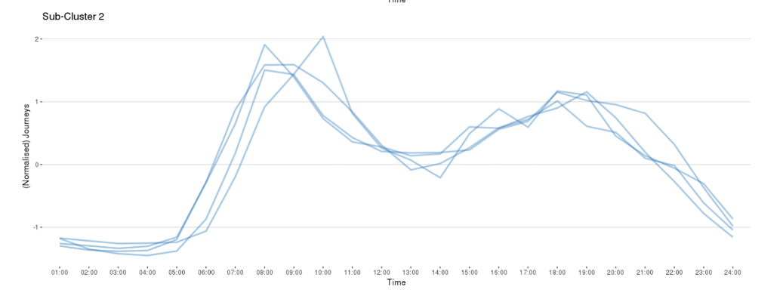
Travel Data
Transaction based travel data
Bike data
Often need large amount of analysis
e.g. bike data have departure and arrival stand, but nothing about journey or route
journey can work out (know start and end, date and time)
don't know about route
Sometimes someone else has done the heavy lifting, and the data is available as an analysis ready product
Todd et al. (2021)
Fig 7. (Todd et al., 2021)

Slide 5
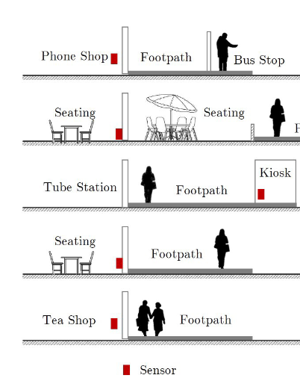
Footfall Data: Counting People
Numbers of people at any one point in time
Footfall in Shopping Centers
busy times of day, days of week
Covid - Google Trends graphs
Trasberg & Cheshire (2021)
Fig 6a (Soundararaj et al., 2020)

Slide 6
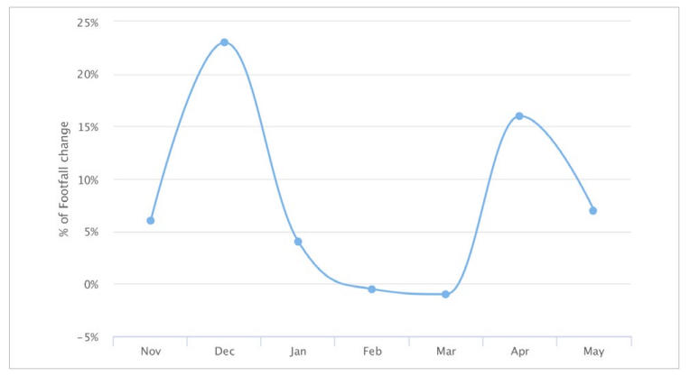
Footfall Data: Counting People
Numbers of people at any one point in time
Footfall in Shopping Centers
busy times of day, days of week
Covid - Google Trends graphs
Trasberg & Cheshire (2021)
Fig 6.2 (Longley et al., 2018)

Slide 7
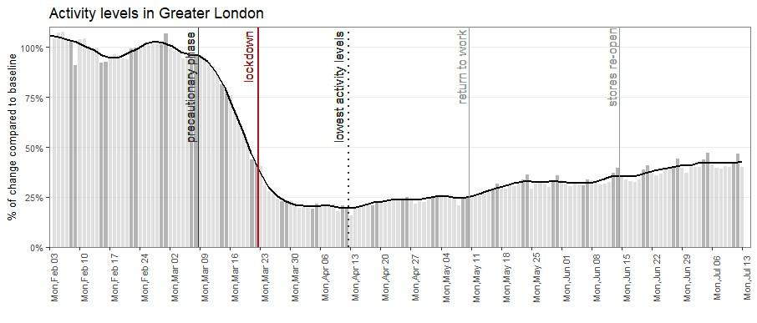
Footfall Data: Counting People
Numbers of people at any one point in time
Footfall in Shopping Centers
busy times of day, days of week
Covid - Google Trends graphs
Fig 3a (Trasberg and Cheshire, 2021)

Slide 8
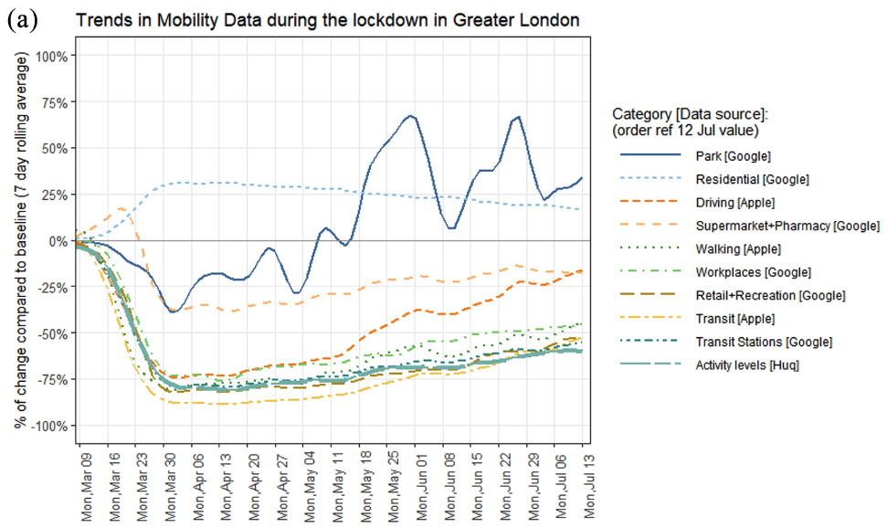
Footfall Data: Counting People
Numbers of people at any one point in time
Footfall in Shopping Centers
busy times of day, days of week
Covid - Google Trends graphs
Fig 3a (Trasberg and Cheshire, 2021)
Fig 1a (Trasberg and Cheshire, 2021)

Slide 9
Footfall Data: Counting People
Technology constantly evolving
WiFi & MAC addresses to count/identify phones and filter out long stayers
Issue iOS update and move to dynamic MAC addresses – to address privacy concerns
Android phones were fine, but Apple were not.
Lose half the data, are iPhones and Android phones equally representative?
Now moved on to in app GPS locations (HUQ)
Different technology, same output
Constantly changing – comparable?
Chapter 6 in Longley et al., (2018), Soundararaj et al. (2020)
Notes:
Technology constantly evolving
WiFi & MAC addresses to count/identify phones and filter out long stayers
Issue iOS update and move to dynamic MAC addresses – to address privacy concerns
Andriod phones were fine, but Apple were not.
Lose half the data, -- are iPhones and android phones equally representative? (I would argue no, because of who buys which phone)
Constantly changing - - how comparable are these data?
- how do they compare to the real world?

Slide 10
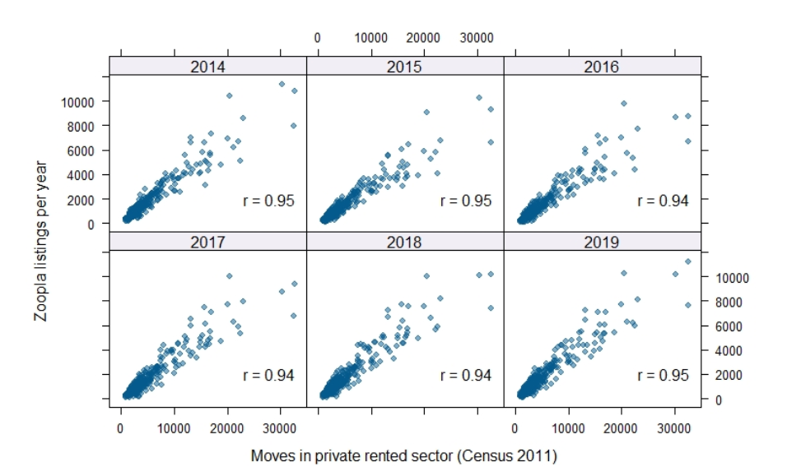
Housing
Interested in housing and migration
where to people move to?
Zoopla data shows sales and rentals
Kuleszo et al., 2021
tells us about the property, not the people
We know someone moved into here, but where did they move from?
Linked Consumer Register (Lansley et al., 2019, van Dijk et al., 2021)
Electoral Roll data - names and addresses
EPC Energy Performance Certificates
Can link these movements and look at housing and migration as a whole
Figure 1, Kuleszo et al., 2021
Notes:
- e.g. Zoopla sales data tells us about house sales.
- combined with Zoopla renting data allows us to look at the hosing market more broadly.
- and linked with EPC and electoral roll allows us to look at the wider migration.
Shows the housing market as a whole, and wider migration

Slide 11
Hospital Admission Rates
HES Hospital Episode Statistics
NHS Hospital Admission Rates by Ethnic Group and other Characteristics
HES + Ethnicity (NHS, missing 9.7%)
+ Ethnicity Estimator (NHS missing now 0.3%)
Petersen et al. (2021) – Ethnic inequalities in hospital admissions
Large scale health data analysis key to this work

Slide 12
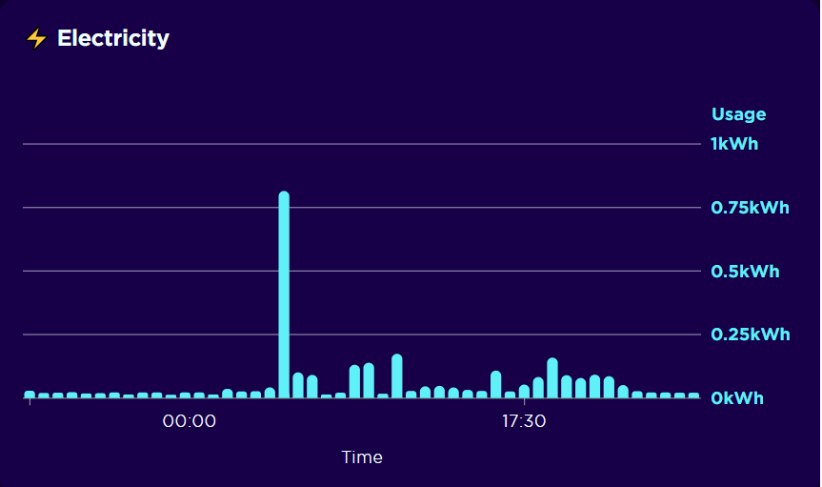
Smart Energy Meter Readings
Smart meters
Energy usage information at 30 min intervals
Clustering methods can group this information into typical 'user profiles' which can help us understand the patterns of usage seen
Ushakova and Mikhaylov (2020)
This can help target initiatives to improve efficiency, and provide new insights into the temporal nature of energy usage
Evaluation of the feasibility of using wind farms to generate power for every UK home and the storage challenges
https://data.cdrc.ac.uk/stories/could-wind-farms-power-every-uk-home-2030
Even more important with the recent increases in gas prices

Slide 13
High Street Retailer
Loyalty card data can generate some really useful insights
But data is not representative:
Notes:
Loyalty card data can generate some really useful insights
- About customers, purchases, travel, etc.

Slide 14
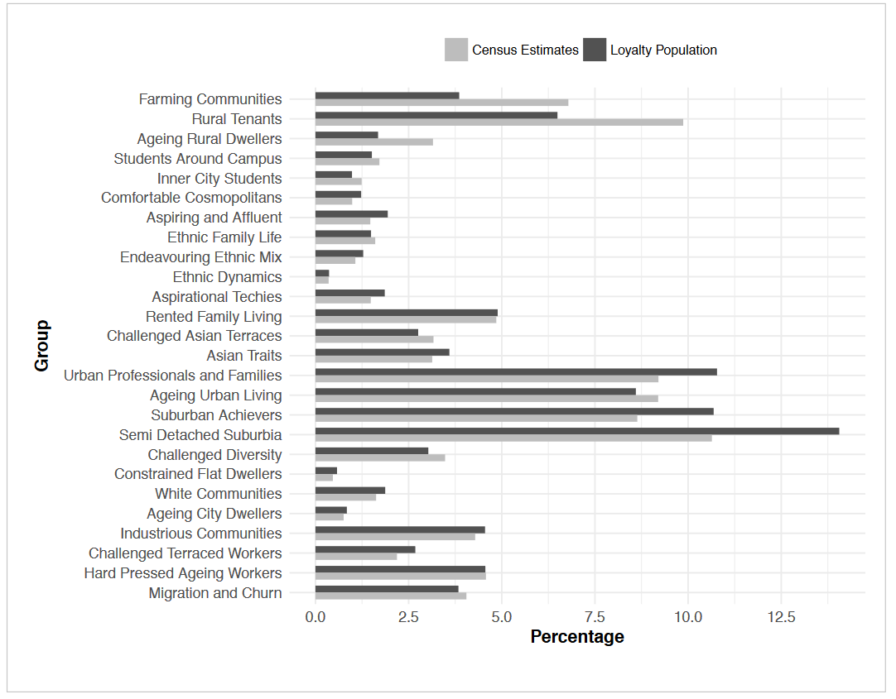
High Street Retailer
Loyalty card data can generate some really useful insights
But data is not representative:
Fig 2.4, Longley et al., 2018)
Notes:
But data is not representative:
Variation between loyalty card population and census data#
Some over represented (semi detached suburbia) and some under represented (rural tenants)

Slide 15
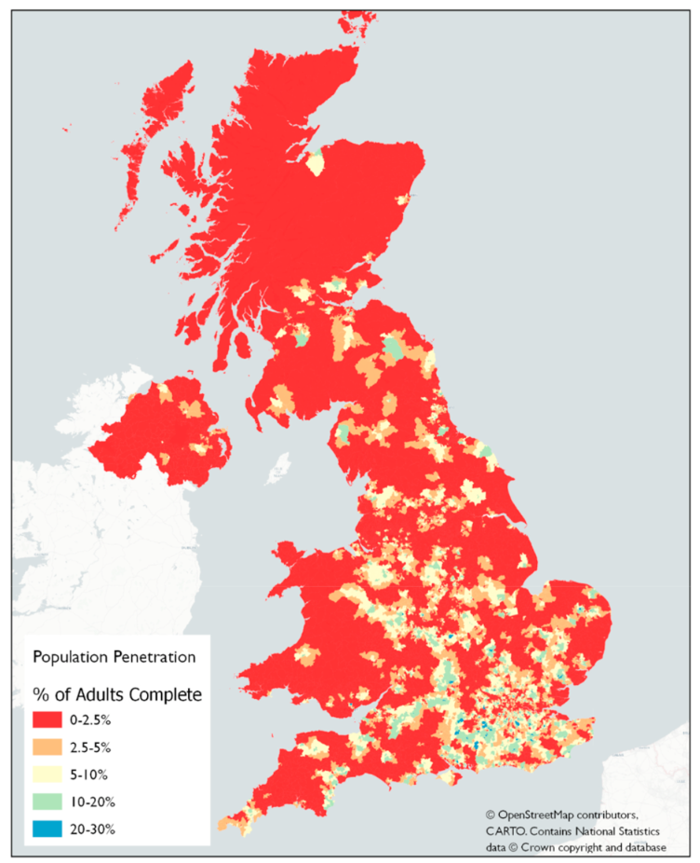
High Street Retailer
Loyalty card data can generate some really useful insights
But data is not representative
Fig 4, Rains and Longley, 2021
Notes:
It is not geographically representative either

Slide 16
High Street Retailer
Loyalty card data can generate some really useful insights
But data is not representative
Many useful analysis can still be done
Behavior Purchase of Ovarian Cancer Patients before Diagnosis
Flanagan et al. (2019), Brewer et al. (2020)
Photo by James Yarema on Unsplash
Notes:
Flanagan et al. (2019) proof of concept
- Pain and indigestion medication
Brewer et al. (2020) protocol

Slide 17
County Court Judgements
A key measure of financial health, including bankruptcies
Links between health and financial wellbeing (Coreless, 2020)
Who is impacted the most?
Economic Health Indicators
Research on politics of indebtedness
Develop work on Financial Stress Tracker
https://www.cdrc.ac.uk/data-news-county-court-judgements-new-dataset-available/
Notes:
Work on a way to derive and publish a set or range of economic health indicators
Look at the effect of politics on indebtedness – what relationships are there between Government, national political representation, local representation and indebtedness?
Develop the Financial Stress Tracker produced by Registry Trust, to include the self-employed, those on low income, those who have been impacted by COVID and other factors.

Slide 18
Limitations
‘Raw’ consumer data can be hard to analyse
Some data already prepared: CDRC ARD (Analysis Ready Data)
Need to represent results fairly
Singleton, A. and Arribas-Bel, D. (2019)
Spatial Data Science Conference? Keynote by Dani Arribas-Bel: What is spatial data science? https://darribas.org/gds_course/content/bA/concepts_A.html
Notes:
Consumer data can be hard to analyse, particularly in ‘raw’ format
Some data is already prepared CDRC ARD (Analysis Ready Data), some is not
You need to represent the results fairly, and in a way that can be understood (both what you found, and the limitations)

Slide 19
What can we do with consumer data?
Travel data – bike data
Footfall data
Housing data – migration
Hospital Admission Rates
Smart Meter Energy Readings
High Street Retailer Loyalty Card Data
County Court Judgments
Many other potential sources
Plus some of the limitations and potentials

Slide 20
Next videos
What is Consumer Data?
What can we do with Consumer Data?
What skills do we need to work with Consumer Data?

Slide 21
References
Brewer, H.R., Hirst, Y., Sundar, S., Chadeau-Hyam, M. and Flanagan, J.M. (2020), “Cancer Loyalty Card Study (CLOCS): protocol for an observational case–control study focusing on the patient interval in ovarian cancer diagnosis”, BMJ Open, British Medical Journal Publishing Group, Vol. 10 No. 9, p. e037459.
Corless, M. (2020), A Spatio-Temporal Investigation into the Effect of General Health on Consumer Financial Vulnerability, through the Indicator of County Court Judgements (CCJs), Geographic Data Science MSc, University of Liverpool, available at: https://www.registry-trust.org.uk/blog/welcome-to-registry-trusts-new-data-analyst/ (accessed 1 April 2022).
Flanagan, J.M., Skrobanski, H., Shi, X. and Hirst, Y. (2019), “Self-Care Behaviors of Ovarian Cancer Patients Before Their Diagnosis: Proof-of-Concept Study”, JMIR Cancer, Vol. 5 No. 1, p. e10447.
Kuleszo, J., Coulter, R., van Dijk, J. and Longley, P. (2021), “Linking consumer datasets to chart residential moves in private rental housing in England and Wales”, In: Proceedings of the 29th Annual GIS Research UK Conference (GISRUK). Zenodo (2021), Proceedings paper presented at the 29th Annual GIS Research UK Conference (GISRUK), Zenodo, 6 April, available at:https://doi.org/10/1/GISRUK2021_paper_50.pdf.
Lansley, G., Li, W. and Longley, P.A. (2019), “Creating a linked consumer register for granular demographic analysis”, Journal of the Royal Statistical Society: Series A (Statistics in Society), Vol. 182 No. 4, pp. 1587–1605.
Lloyd, A. and Cheshire, J. (2019), “Detecting Address Uncertainty in Loyalty Card Data”, Applied Spatial Analysis and Policy, Vol. 12 No. 2, pp. 445–465.
Longley, P.A., Cheshire, J. and Singleton, A.D. (2018), “Consumer Data Research”, UCL Press, available at: https://www.uclpress.co.uk/products/114094 (accessed 24 September 2021).

Slide 22
References
Petersen, J., Kandt, J. and Longley, P.A. (2021), “Ethnic inequalities in hospital admissions in England: an observational study”, BMC Public Health, Vol. 21 No. 1, p. 862.
Rains, T. and Longley, P. (2021), “The provenance of loyalty card data for urban and retail analytics”, Journal of Retailing and Consumer Services, Vol. 63, p. 102650.
Sexton, A., Shepherd, E., Duke-Williams, O. and Eveleigh, A. (2017), “A balance of trust in the use of government administrative data”, Archival Science, Vol. 17 No. 4, pp. 305–330.
Singleton, A. and Arribas-Bel, D. (2019), “Geographic Data Science”, Geographical Analysis, Vol. 53 No. 1, pp. 61–75.
Soundararaj, B., Cheshire, J. and Longley, P. (2020), “Estimating real-time high-street footfall from Wi-Fi probe requests”, International Journal of Geographical Information Science, Taylor & Francis, Vol. 34 No. 2, pp. 325–343.
Todd, J., O’Brien, O. and Cheshire, J. (2021), “A global comparison of bicycle sharing systems”, Journal of Transport Geography, Vol. 94, p. 103-119.
Trasberg, T. and Cheshire, J. (2021), “Spatial and social disparities in the decline of activities during the COVID-19 lockdown in Greater London”, Urban Studies, SAGE Publications Ltd, p. 00420980211040409.
van Dijk, J.T., Lansley, G. and Longley, P.A. (2021), “Using linked consumer registers to estimate residential moves in the United Kingdom”, Journal of the Royal Statistical Society: Series A (Statistics in Society), Vol. 184 No. 4, pp. 1452–1474.

Slide 24
comprehensive training in research methods
www.ncrm.ac.uk

Slide 25
Using Consumer Data in Research 3. What skills do we need?
Dr Nick Bearman
@nickbearmanuk | github.com/nickbearman
geospatialtrainingsolutions.co.uk
ucl.ac.uk/geospatial-analytics/people/nick-bearman
Notes:
Three short videos and reading list
1 – What is consumer data?
2 – What can we do with consumer data? - Examples
3 – What skills do we need to work with Consumer Data? - Methods

Slide 26
What skills do we need?
‘arise out of every-day transactions for goods and services, carried out between individuals and organisations’ (Longley et al. 2018, p8)
What skills to we need for analysis?
Can focus on substantiative findings or methodical advances
Either is fine – both is very hard work!
Working in a team can give you the best of both worlds
Notes:
There are two approaches you can take to working with Consumer Data:
- focus on substantive findings
- focus on methodological advances
Either is fine - but doing a good job on both is a lot of work!
- focusing on substantive findings - then the analysis ready forms of consumer data are they way to do
- focus on methodological advances - analysing raw data to create new methods and analysis ready data is a fertile area of geographic data science.
Ultimately you need to focus on one or the other - or work in a team where different people are focusing on different aspects.

Slide 27
Methods
working with consumer data often needs a variety of different methods
some big data / data science methods
some GIS / geographical information science methods
some data modelling methods (big or small data)
some GDS / geographic data science methods
some secure data methods
Notes:
We’re going to look at each of these

Slide 28
Data Triangulation
Data triangulation is also important
Do the findings from your consumer data match traditional data sources?
is the consumer data representative? | who is missing?
E.g. housing data, covers 2014 onwards. What about people who haven't moved in 12+ years? How many of them are there?
What is the bias? Think about who is missing
Notes:
Do the findings from your consumer data match more traditional data sources?

Slide 29
GIS is often a key element of Consumer Data
Consumer Data
Geospatial Data
Big Data
Location is most frequent way of linking Consumer Data
by address, by presence/absence, by geodemographic
Some areas this is key (migration, footfall, retail)
Others less so, but still important (hospital admissions, access)
Some much less so (energy use)
GIS training is available
Sometimes combined with some big data, database or GDS tools
Notes:
- most frequent way of linking Consumer Data to other data is by location
- by address, by presence/absence, by geodeomgraphic
- some areas this is key, e.g. migration, footfall, retail (who shops where?)
- others less so, but still important (hospital admissions, access)
- some much less so (energy use)
- GIS training is available.
- sometimes need to be combined with some big data, database or GDS tools

Slide 30
Big Data / Data Science
Some consumer data are big data (>~ 1m rows)
Specific tools for working with this size of data
HPC / MapReduce / cloud processing
Databases
Scripting / coding (R, Python)
Often termed data science

Slide 31
Data Modelling / Statistical Modelling
How do we make sense of this large data set?
Stats also a key element
Sometimes very detailed, sometimes not
Modelling can fill gaps in raw data (van Dijk, J.T. et al. 2021)
Notes:
Stats also a key element –
sometimes very detailed, sometimes not
Descriptive Stats, correlation, PCA, spatial stats, GWR,

Slide 32
Geographic Data Science
Mix of GIS, Data Science and Modelling
All of the above!
Combing methods, creating new methods
Scripting tools
Most novel applications combine one or more of the above
not to be under-estimated!
new methods being developed all the time

Slide 33
Data Governance is also important
Often working with individual level, personal and/or confidential data
Varies a lot by area
Need to consider the individuals who provided this data
GDPR requires us to handle this data responsibly
Data minimization – what data do we actually need?
Training is key
Notes:
GDPR requires us to handle this data responsibly and there are rules and processes in-place for this

Slide 34
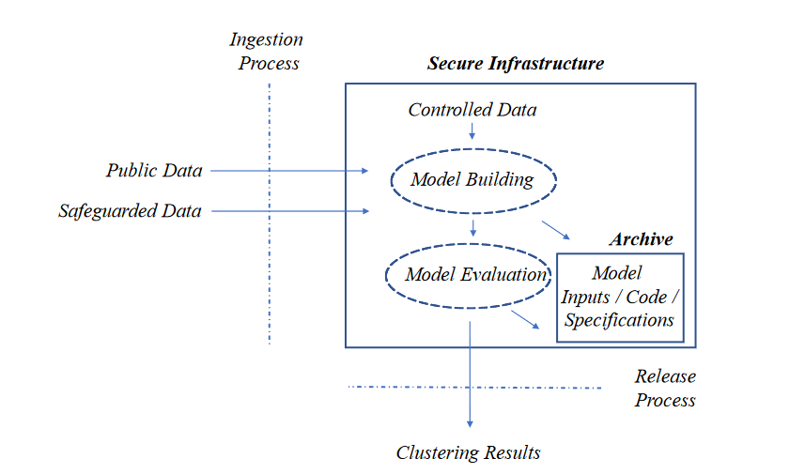
Secure data infrastructure – Trusted Research Environments (TRE)
Secure / Safeguarded data
UKDS, UK Data Archive, ONS, CDRC
An application process - time
Sometimes you get the data
Sometimes you work in a secure environment
It takes time!
Output checks
Figure 1. Singleton & Longley (2019)
Notes:
- secure data / safeguarded data - offered by UKDS, UK Data Archive, ONS, CDRC, etc.
- usually an application process - can take time.
- sometimes you get data, sometimes you work in a secure environment (VPN or physical)
- it takes time!
- output checks when removing data from the secure environment

Slide 35
Reproducible Research
Good science is reproducible research
Post data and code with your paper
Scripting / version control
In direct conflict with keeping secure data secure
Still easy to document methods / code - much the same process
Reference which data you are using - ideally using a Data DOI
May also be appropriate to provide sample data - depending on the situation
And/or publish your output data / analysis ready data products
Notes:
- Good science is reproducible research
- Ideally post the data and code with your paper so others can replicate it.
- In direct conflict with keeping secure data secure.
- Have to balance this.
- Still easy to document methods / code - much the same process.
- Reference which data you are using - ideally using a Data DOI, which references a specific snapshot of the data
- May also be appropriate to provide sample data - depending on the situation
- and/or publish your output data / analysis ready data products

Slide 36
What skills do we need?
working with consumer data often needs a variety of different skills
some big data / data science methods
some GIS / geographical information science methods
some data modelling methods (big or small data)
some GDS / geographic data science methods
some secure data methods
Notes:
working with consumer data often needs a variety of different skills
some big data / data science methods
some GIS / geographical information science methods
some data modelling methods (big or small data)
some GDS / geographic data science methods
some secure data methods
Scripting | Databases | HPC / GPUs / cloud processing
Secure data / environments | Presentation

Slide 37
Videos
What is Consumer Data?
What can we do with Consumer Data?
What skills do we need to work with Consumer Data?

Slide 38
References
Singleton, A.D. and Longley, P.A. (2019), “Data infrastructure requirements for new geodemographic classifications: The example of London’s workplace zones”, Applied Geography, Vol. 109, p. 102038.
van Dijk, J.T., Lansley, G. and Longley, P.A. (2021), “Using linked consumer registers to estimate residential moves in the United Kingdom”, Journal of the Royal Statistical Society: Series A (Statistics in Society), Vol. 184 No. 4, pp. 1452–1474.

