Slide 1
Using Consumer Data in Research 2. What can we do with Consumer Data?
Dr Nick Bearman
@nickbearmanuk | github.com/nickbearman
geospatialtrainingsolutions.co.uk
ucl.ac.uk/geospatial-analytics/people/nick-bearman
Notes:
Three short videos and reading list
1 – What is consumer data?
2 – What can we do with consumer data? - Examples
3 – What skills do we need to work with Consumer Data? - Methods

Slide 2
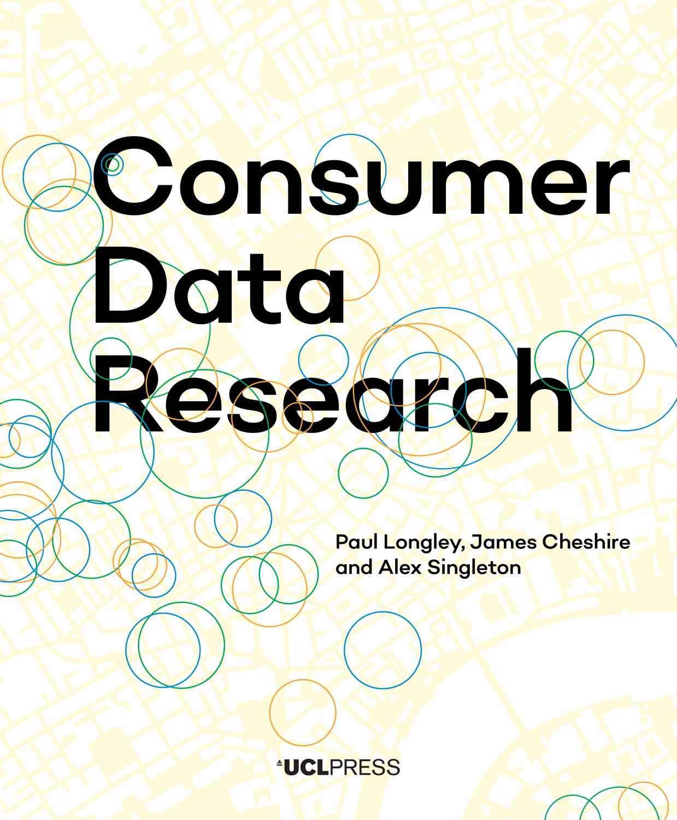
What can we do with consumer data?
‘arise out of every-day transactions for goods and services, carried out between individuals and organisations’ (Longley et al. 2018, p8)
What type of analysis can we do with consumer data?
'Consumer data' is an umbrella term
Lots of potential data out there, today we leave digital traces from nearly everything that we do in our lives.
Notes:
- 'Consumer data' is an umbrella term
- Lots of potential data out there, today we leave digital traces from nearly everything that we do in our lives.
- Included in this video are a few examples

Slide 3
What can we do with consumer data?
Mostly data about people (consumers)
Often restricted because it contains personal information
Transaction based
Always secondary data
so not collected with research in mind
Administrative data, can be really useful (Sexton et al. 2017).
sometimes included as consumer data, sometimes not
Photo by Clay Banks on Unsplash
Notes:
Mostly data about people (consumers)
Often this is the most restricted data because it can contain personal information
Often transaction based, which is a great data source
Is always secondary data - so not collected with research in mind
Related - also administrative data, can be really useful (Sexton et al 2017).
sometimes included as consumer data, sometimes not

Slide 4
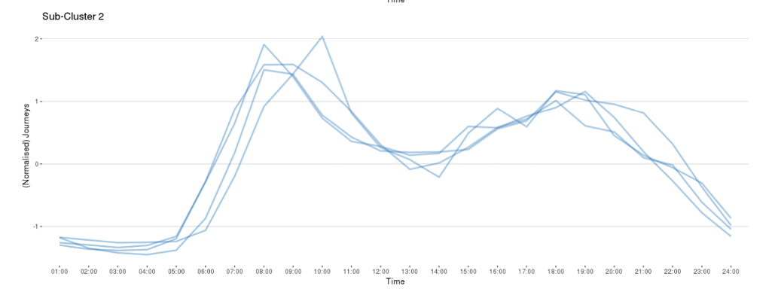
Travel Data
Transaction based travel data
Bike data
Often need large amount of analysis
e.g. bike data have departure and arrival stand, but nothing about journey or route
journey can work out (know start and end, date and time)
don't know about route
Sometimes someone else has done the heavy lifting, and the data is available as an analysis ready product
Todd et al. (2021)
Fig 7. (Todd et al., 2021)

Slide 5
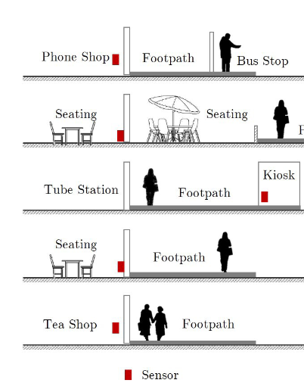
Footfall Data: Counting People
Numbers of people at any one point in time
Footfall in Shopping Centers
busy times of day, days of week
Covid - Google Trends graphs
Trasberg & Cheshire (2021)
Fig 6a (Soundararaj et al., 2020)

Slide 6
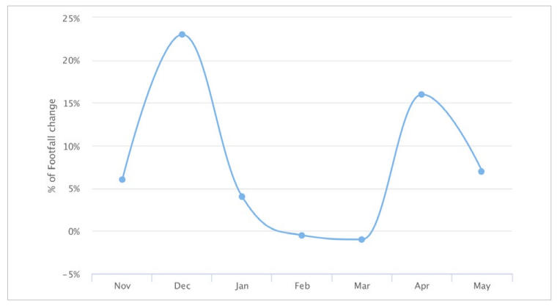
Footfall Data: Counting People
Numbers of people at any one point in time
Footfall in Shopping Centers
busy times of day, days of week
Covid - Google Trends graphs
Trasberg & Cheshire (2021)
Fig 6.2 (Longley et al., 2018)

Slide 7
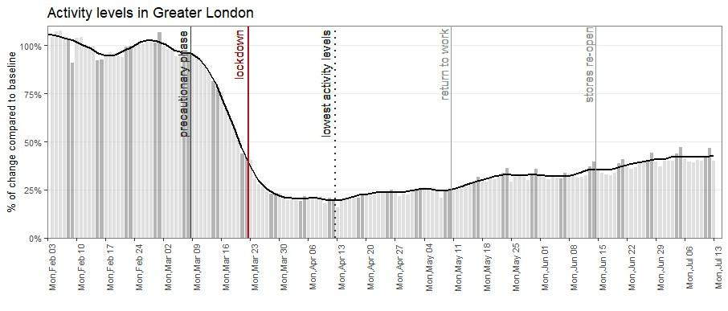
Footfall Data: Counting People
Numbers of people at any one point in time
Footfall in Shopping Centers
busy times of day, days of week
Covid - Google Trends graphs
Fig 3a (Trasberg and Cheshire, 2021)

Slide 8
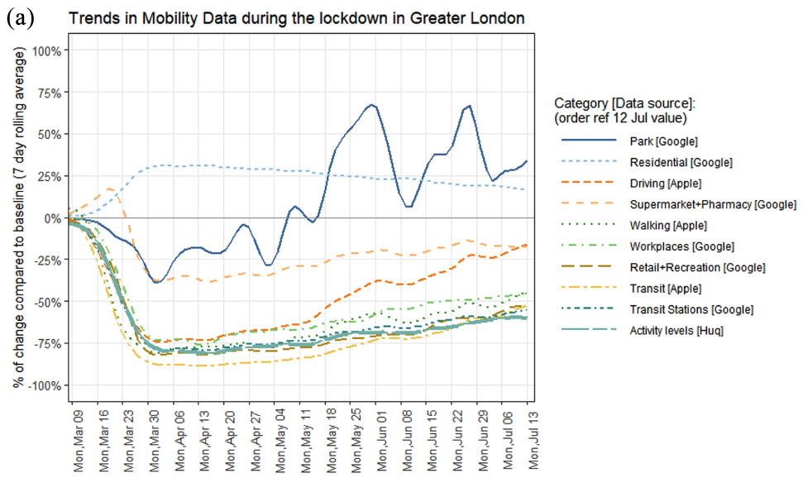
Footfall Data: Counting People
Numbers of people at any one point in time
Footfall in Shopping Centers
busy times of day, days of week
Covid - Google Trends graphs
Fig 3a (Trasberg and Cheshire, 2021)
Fig 1a (Trasberg and Cheshire, 2021)

Slide 9
Footfall Data: Counting People
Technology constantly evolving
WiFi & MAC addresses to count/identify phones and filter out long stayers
Issue iOS update and move to dynamic MAC addresses – to address privacy concerns
Android phones were fine, but Apple were not.
Lose half the data, are iPhones and Android phones equally representative?
Now moved on to in app GPS locations (HUQ)
Different technology, same output
Constantly changing – comparable?
Chapter 6 in Longley et al., (2018), Soundararaj et al. (2020)
Notes:
Technology constantly evolving
WiFi & MAC addresses to count/identify phones and filter out long stayers
Issue iOS update and move to dynamic MAC addresses – to address privacy concerns
Andriod phones were fine, but Apple were not.
Lose half the data, -- are iPhones and android phones equally representative? (I would argue no, because of who buys which phone)
Constantly changing - - how comparable are these data?
- how do they compare to the real world?

Slide 10
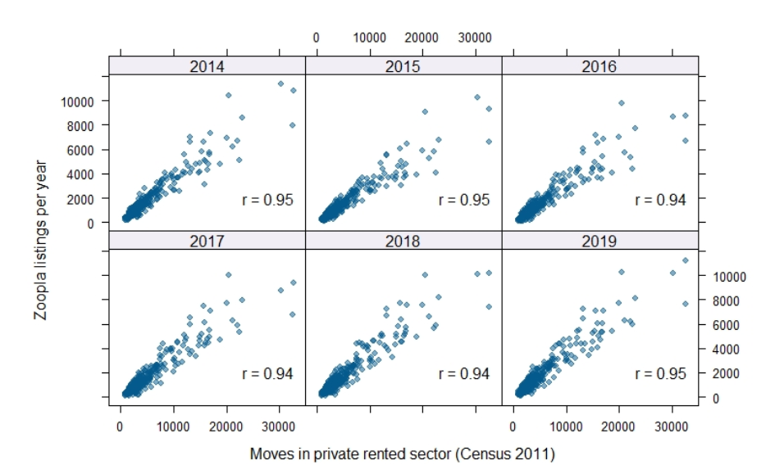
Housing
Interested in housing and migration
where to people move to?
Zoopla data shows sales and rentals
Kuleszo et al., 2021
tells us about the property, not the people
We know someone moved into here, but where did they move from?
Linked Consumer Register (Lansley et al., 2019, van Dijk et al., 2021)
Electoral Roll data - names and addresses
EPC Energy Performance Certificates
Can link these movements and look at housing and migration as a whole
Figure 1, Kuleszo et al., 2021
Notes:
- e.g. Zoopla sales data tells us about house sales.
- combined with Zoopla renting data allows us to look at the hosing market more broadly.
- and linked with EPC and electoral roll allows us to look at the wider migration.
Shows the housing market as a whole, and wider migration

Slide 11
Hospital Admission Rates
HES Hospital Episode Statistics
NHS Hospital Admission Rates by Ethnic Group and other Characteristics
HES + Ethnicity (NHS, missing 9.7%)
+ Ethnicity Estimator (NHS missing now 0.3%)
Petersen et al. (2021) – Ethnic inequalities in hospital admissions
Large scale health data analysis key to this work

Slide 12
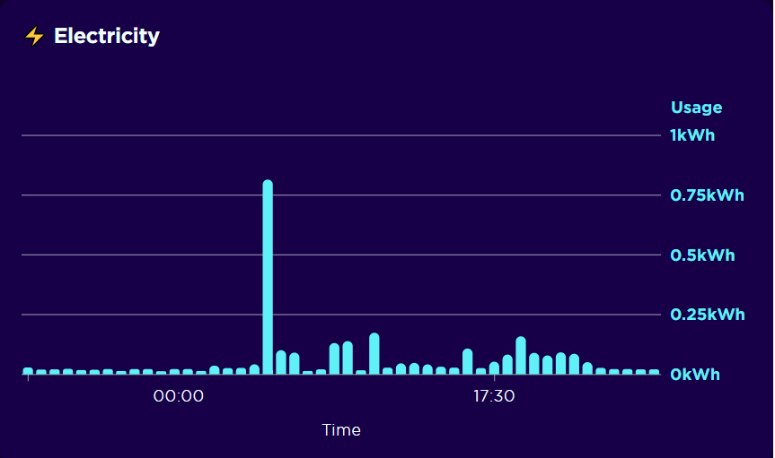
Smart Energy Meter Readings
Smart meters
Energy usage information at 30 min intervals
Clustering methods can group this information into typical 'user profiles' which can help us understand the patterns of usage seen
Ushakova and Mikhaylov (2020)
This can help target initiatives to improve efficiency, and provide new insights into the temporal nature of energy usage
Evaluation of the feasibility of using wind farms to generate power for every UK home and the storage challenges
https://data.cdrc.ac.uk/stories/could-wind-farms-power-every-uk-home-2030
Even more important with the recent increases in gas prices

Slide 13
High Street Retailer
Loyalty card data can generate some really useful insights
But data is not representative:
Notes:
Loyalty card data can generate some really useful insights
- About customers, purchases, travel, etc.

Slide 14
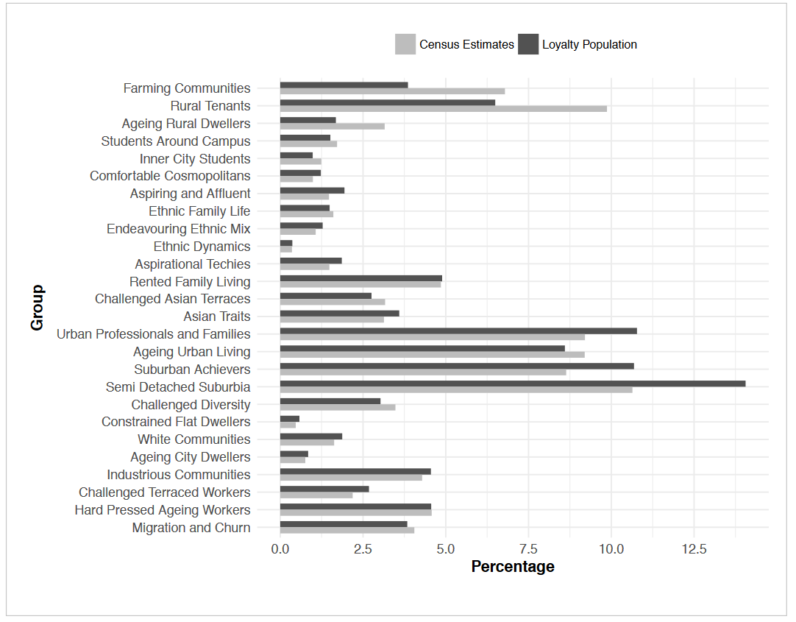
High Street Retailer
Loyalty card data can generate some really useful insights
But data is not representative:
Fig 2.4, Longley et al., 2018)
Notes:
But data is not representative:
Variation between loyalty card population and census data#
Some over represented (semi detached suburbia) and some under represented (rural tenants)

Slide 15
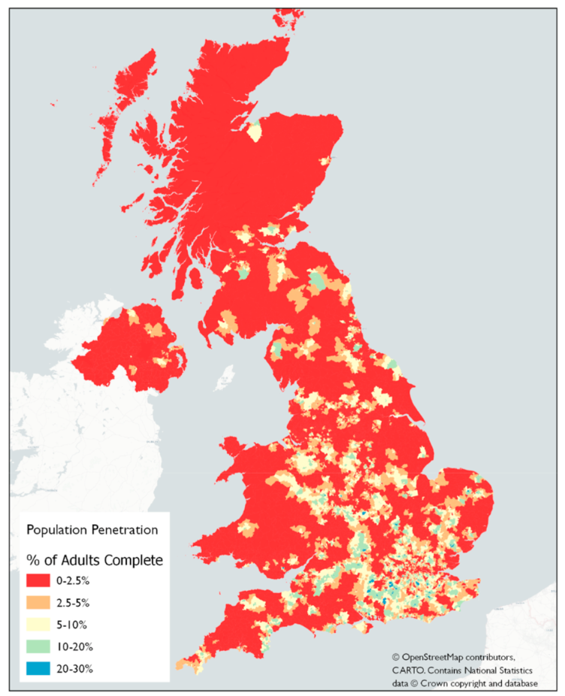
High Street Retailer
Loyalty card data can generate some really useful insights
But data is not representative
Fig 4, Rains and Longley, 2021
Notes:
It is not geographically representative either

Slide 16
High Street Retailer
Loyalty card data can generate some really useful insights
But data is not representative
Many useful analysis can still be done
Behavior Purchase of Ovarian Cancer Patients before Diagnosis
Flanagan et al. (2019), Brewer et al. (2020)
Photo by James Yarema on Unsplash
Notes:
Flanagan et al. (2019) proof of concept
- Pain and indigestion medication
Brewer et al. (2020) protocol

Slide 17
County Court Judgements
A key measure of financial health, including bankruptcies
Links between health and financial wellbeing (Coreless, 2020)
Who is impacted the most?
Economic Health Indicators
Research on politics of indebtedness
Develop work on Financial Stress Tracker
https://www.cdrc.ac.uk/data-news-county-court-judgements-new-dataset-available/
Notes:
Work on a way to derive and publish a set or range of economic health indicators
Look at the effect of politics on indebtedness – what relationships are there between Government, national political representation, local representation and indebtedness?
Develop the Financial Stress Tracker produced by Registry Trust, to include the self-employed, those on low income, those who have been impacted by COVID and other factors.

Slide 18
Limitations
‘Raw’ consumer data can be hard to analyse
Some data already prepared: CDRC ARD (Analysis Ready Data)
Need to represent results fairly
Singleton, A. and Arribas-Bel, D. (2019)
Spatial Data Science Conference? Keynote by Dani Arribas-Bel: What is spatial data science? https://darribas.org/gds_course/content/bA/concepts_A.html
Notes:
Consumer data can be hard to analyse, particularly in ‘raw’ format
Some data is already prepared CDRC ARD (Analysis Ready Data), some is not
You need to represent the results fairly, and in a way that can be understood (both what you found, and the limitations)

Slide 19
What can we do with consumer data?
Travel data – bike data
Footfall data
Housing data – migration
Hospital Admission Rates
Smart Meter Energy Readings
High Street Retailer Loyalty Card Data
County Court Judgments
Many other potential sources
Plus some of the limitations and potentials

Slide 20
Next videos
What is Consumer Data?
What can we do with Consumer Data?
What skills do we need to work with Consumer Data?

Slide 21
References
Brewer, H.R., Hirst, Y., Sundar, S., Chadeau-Hyam, M. and Flanagan, J.M. (2020), “Cancer Loyalty Card Study (CLOCS): protocol for an observational case–control study focusing on the patient interval in ovarian cancer diagnosis”, BMJ Open, British Medical Journal Publishing Group, Vol. 10 No. 9, p. e037459.
Corless, M. (2020), A Spatio-Temporal Investigation into the Effect of General Health on Consumer Financial Vulnerability, through the Indicator of County Court Judgements (CCJs), Geographic Data Science MSc, University of Liverpool, available at: https://www.registry-trust.org.uk/blog/welcome-to-registry-trusts-new-data-analyst/ (accessed 1 April 2022).
Flanagan, J.M., Skrobanski, H., Shi, X. and Hirst, Y. (2019), “Self-Care Behaviors of Ovarian Cancer Patients Before Their Diagnosis: Proof-of-Concept Study”, JMIR Cancer, Vol. 5 No. 1, p. e10447.
Kuleszo, J., Coulter, R., van Dijk, J. and Longley, P. (2021), “Linking consumer datasets to chart residential moves in private rental housing in England and Wales”, In: Proceedings of the 29th Annual GIS Research UK Conference (GISRUK). Zenodo (2021), Proceedings paper presented at the 29th Annual GIS Research UK Conference (GISRUK), Zenodo, 6 April, available at:https://doi.org/10/1/GISRUK2021_paper_50.pdf.
Lansley, G., Li, W. and Longley, P.A. (2019), “Creating a linked consumer register for granular demographic analysis”, Journal of the Royal Statistical Society: Series A (Statistics in Society), Vol. 182 No. 4, pp. 1587–1605.
Lloyd, A. and Cheshire, J. (2019), “Detecting Address Uncertainty in Loyalty Card Data”, Applied Spatial Analysis and Policy, Vol. 12 No. 2, pp. 445–465.
Longley, P.A., Cheshire, J. and Singleton, A.D. (2018), “Consumer Data Research”, UCL Press, available at: https://www.uclpress.co.uk/products/114094 (accessed 24 September 2021).

Slide 22
References
Petersen, J., Kandt, J. and Longley, P.A. (2021), “Ethnic inequalities in hospital admissions in England: an observational study”, BMC Public Health, Vol. 21 No. 1, p. 862.
Rains, T. and Longley, P. (2021), “The provenance of loyalty card data for urban and retail analytics”, Journal of Retailing and Consumer Services, Vol. 63, p. 102650.
Sexton, A., Shepherd, E., Duke-Williams, O. and Eveleigh, A. (2017), “A balance of trust in the use of government administrative data”, Archival Science, Vol. 17 No. 4, pp. 305–330.
Singleton, A. and Arribas-Bel, D. (2019), “Geographic Data Science”, Geographical Analysis, Vol. 53 No. 1, pp. 61–75.
Soundararaj, B., Cheshire, J. and Longley, P. (2020), “Estimating real-time high-street footfall from Wi-Fi probe requests”, International Journal of Geographical Information Science, Taylor & Francis, Vol. 34 No. 2, pp. 325–343.
Todd, J., O’Brien, O. and Cheshire, J. (2021), “A global comparison of bicycle sharing systems”, Journal of Transport Geography, Vol. 94, p. 103-119.
Trasberg, T. and Cheshire, J. (2021), “Spatial and social disparities in the decline of activities during the COVID-19 lockdown in Greater London”, Urban Studies, SAGE Publications Ltd, p. 00420980211040409.
van Dijk, J.T., Lansley, G. and Longley, P.A. (2021), “Using linked consumer registers to estimate residential moves in the United Kingdom”, Journal of the Royal Statistical Society: Series A (Statistics in Society), Vol. 184 No. 4, pp. 1452–1474.

