Slide 1
Binary logistic regression
Part 1: Introduction
Dr Heini Väisänen
University of Southampton

Slide 2
Outline
Binary response
Link functions
Logistic regression model
Parameter interpretation

Slide 3
Binary response & regression models
Often in social science we are interested in relationships between categorical variables.
E.g. absence/presence of a disease, voting intention, Likert-scale…
This session introduces binary logistic regression, which can be used to study the association between:
A binary outcome (dependent) variable; and
Explanatory (independent) variable(s) of any kind

Slide 4
Binary response & regression models
We have a binary (dichotomous) response variable Y defined as
Y = 1 if “success” (“yes”)
0 if “failure” (“no”)
We want to model the probability Π that Y=1

Slide 5
Why not linear regression?
Predicted values may lie outside the interval [0, 1].
Assumption of constant variance is violated as variance depends on x through its influence on п.
var(ε) = п_{i}(x)[1 – п_{i}(x)]
Standard errors not valid, and conclusions from them misleading.

Slide 6
Solution: Link Functions
Good news: we can keep
п_{i} (x) = β₀ +β₁x_{1i} +β₂x_{2i} + … +β_{k}x_{ki}
…if we model a transformation of п_{i}:
η_{i} = g(п_{i}) = β₀ +β₁x_{1i} +β₂x_{2i} + … +β_{k}x_{ki}
where g(.) is the link function.
Notes:
We want to find a transformation of phi (the probability of success) such that we can express it as a linear function of the explanatory variables.
In other words, in the equation of the model, we want to keep the part on the right-hand-side of the equality sign as it is in the linear regression, and we want to find an expression for what is on the left-hand side which allows us to write the model in this way.

Slide 7
What is a ‘link function’?
We require a link transformation that ensures our fitted values vary between 0 and 1
The link function ensures that the expected value of the probability is between 0 and 1
When the linear prediction decreases, the probability goes closer to 0
When the linear prediction increases, the probability goes closer to 1

Slide 8
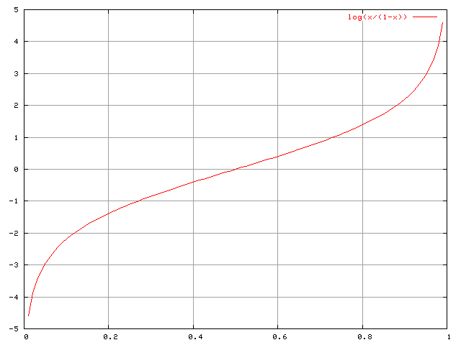
Predictor
Logit link function → logistic regression
Transformation:
log[п/(1-п)]
Fundamental concepts:
probability = п
odds = п/(1-п)
logit(п) = log(odds) = log[п/(1-п)]
Probability
Fig. source: https://commons.wikimedia.org/wiki/File:Logit.png

Slide 9
Characteristics of logits and probabilities
If Π = 0.5
then odds = 0.5/(1-0.5) = 1
and logit = log(1) = 0
If Π > 0.5, then Odds > 1 and logit > 0.
If Π < 0.5, then Odds < 1 and logit < 0.
Logit can take any values but Π is constrained between 0 and 1.
Π can never be exactly 0 or 1.
Notes:
1. Thus when the probability of an event happening is equal to the probability of the event not happening, the odds are one and the logit is zero.
2. Thus the logit is positive when the probability of an event happening is greater than the probability of the event not happening.
3. Thus the logit is negative when the probability of an event happening is smaller than the probability of the event not happening.

Slide 10
Example: Birth Weights
Is the probability of a normal birth weight, associated with gestational age?
Response: Birth weight (BWGHT: 1 = normal, 0 = low).
Explanatory: Gestational age in weeks (GAGE).
Low birthweight has been defined by WHO as weight at birth of less than 2,500 grams (5.5 pounds).

Slide 11
Descriptive statistics: birth weight
 | N | %
Normal birth weight | 17 | 70.8
Low birth weight | 7 | 29.2
Total | 24 | 100.0
Notes:
In this table, the probability (pi) that a given individual in the dataset has Y=1 is equal to their proportion in the dataset. That’s what we want to model in logistic regression. The probability of Y=0 is 1-(p | y=1), bc Y can only be 0 or 1. Suppose we want to model the association between bw and gestational age. What should we do?

Slide 12
Results: Birth Weights (example)
The fitted model with one explanatory variable gestational age (GAGE) is:
$$logit \left(\hat{Π}\right)=−48.9+1.31∗GAGE$$
How is gestational age associated with low birth weight?

Slide 13
Interpretation on logit scale
A unit increase in x₁ increases the logit (log of the odds) by β₁ units.
For a one week increase in gestational age the log of the odds of a normal birth weight increases by 1.31.
$$logit \left(\hat{Π}\right)=−48.9+1.31∗GAGE$$

Slide 14
Interpretation on probability scale
Predicted probabilities can be computed for any value of GAGE.
For example, the estimated probability of a baby with gestational age 39 weeks having a normal birth weight is:
$$\hat{π}=\frac{exp⁡(−48.9+1.31∗39)}{1+exp⁡(−48.9+1.31∗39)}=0.9$$
The predicted probability of normal birth weight at week 39 is 0.9 (90%)

Slide 15
Interpretation in the odds scale
The effects of explanatory variables are multiplicative on the odds scale. A unit increase in x₁ multiplies the odds by exp(β₁).
So, a one week increase in gestational age multiplies the odds of a normal birth by 3.71 [i.e. exp(1.31)].
Alternatively, a one week increase in gestational age increases the odds of a normal birth weight by
100 × [3.71 - 1] = 271%

Slide 16
How to report results?
Rarely used (not intuitive)
For a one week increase in gestational age the log of the odds of a normal birth weight increases by 1.31.
The predicted probability of normal birth weight at week 36 was 0.15, whereas at week 39 it is 0.9.
Each additional week of gestation increased the odds of normal birth weight by 271%.
OR: Each additional week of gestation multiplied the odds of normal birth weight by 3.71.
Absolute level of risk /
Example at a specific value of X
Relative level of risk /
Applies to the entire scale of X

Slide 17
Thank you!

