Slide 1
An Introduction to Bayesian Regression
Part #2
Dr Oliver Perra
Full resource: https://www.ncrm.ac.uk/resources/online/all/?id=20843

Slide 2
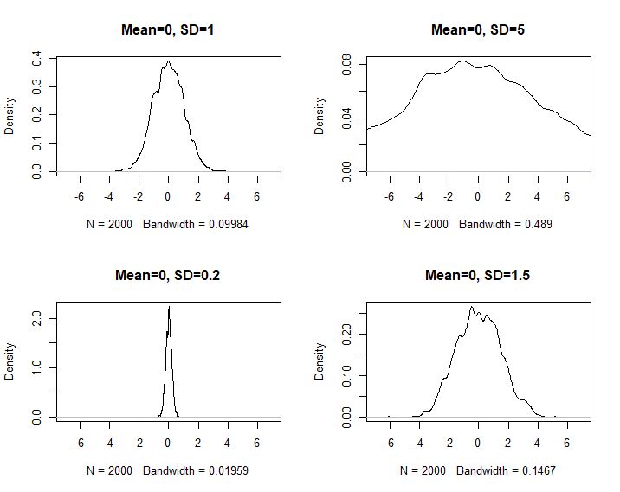
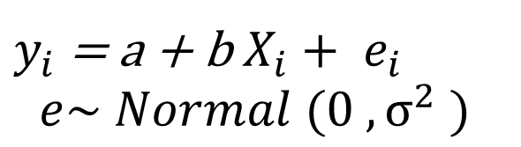
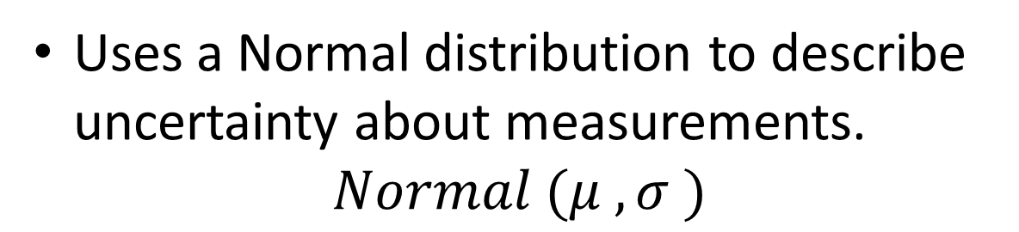
Linear Regression
Models that estimate mean and variance of measurement using an additive combination of other measurements.
$y_{i}$ = a + b $X_{i}+ e_{i}$
$$e\sim Normal (0 , σ^{2} )$$
Uses a Normal distribution to describe uncertainty about measurements.
$$Normal (μ , σ )$$
Notes:
Firstly, just a quick reminder of what we mean by linear regression. These are models that basically try to learn about the mean and variance of a measurement variable using an additive combination of other measurements.
The basic formula is in fact this one, where the value of an outcome variable y for each individual “i” will be equal to the sum of parameter “a” and the product of parameter “b” by a predictor X, and the sum of an element “e” that represents individual variation from the predicted scores.
Parameter “a” represents the value that Y takes when predictor X is equal to 0, so it is called the intercept.
Parameter “b” represents the change in Y associated with a 1-unit increase in predictor X. It is also called the slope.
The parameter “e” is supposed to be normally distributed with mean 0 and a variance that we can estimated from the data.
One important point is that linear regression uses normal distributions to describe uncertainty about measurements. Most of you are probably familiar with a normal distribution, which is “bell-shaped” and symmetrical, and is defined by two parameters, the mean indicated by the Greek letter mu, and the standard deviation, indicated by the Greek letter lower case sigma. In the graph I have put different examples of random normal distributions: all have the same mean mu=0, but the SD varies.

Slide 3
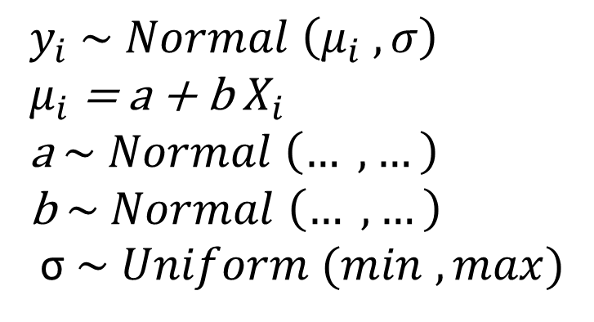
Linear Regression
$y_{i}$ $\sim Normal \left(μ_{i} , σ\right)$
$μ_{i}$ = a + b $X_{i}$
a $\sim Normal \left(… , …\right)$
b $\sim Normal \left(… , …\right)$
σ $\sim Uniform (min , max)$
Notes:
However, in running a linear regression using Bayesian methods, the regression model can be described in a slightly different way. This may seem a bit bizarre, certainly it appears more cryptic. However, there are many advantages in using this alternative description. One is, for example, that many of the assumptions of linear regression such as homoskedacticity , are more explicitly read from this notation. It also provides a more flexible notation, which allows to specify different assumptions.
I will provide an example that should make this notation clearer

Slide 4
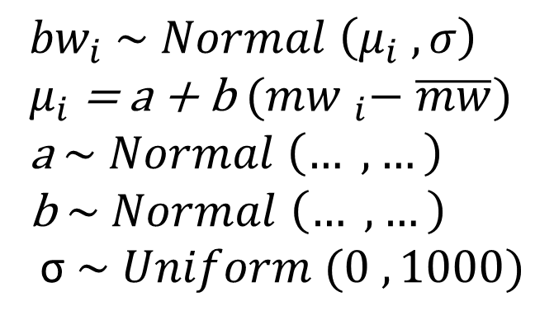
Example of Linear Regression
$y_{i}$ $\sim Normal \left(μ_{i} , σ\right)$
$μ_{i}$ = a + b $X_{i}$
a $\sim Normal \left(… , …\right)$
b $\sim Normal \left(… , …\right)$
σ $\sim Uniform (min , max)$
${bw}_{i}$ $\sim Normal \left(μ_{i} , σ\right)$
$μ_{i}$ = a + b ${(mw }_{i}− \overline{mw})$
a $\sim Normal \left(… , …\right)$
b $\sim Normal \left(… , …\right)$
σ $\sim Uniform (0 , 1000)$
Example: Fictional data on newborn’s birthweight (bw) in grams by maternal weight (mw) in Kg and newborn’s sex.
Notes:
The data for this example are fictional, and you can find them with the material for this course. In this example I have a dataset that represents newborns’ birthweight in grams by maternal weight in Kg. Studies have indicated that there is an association between maternal weight and the newborn’s birth weight, and this is the regression model I will develop.
To start the analyses, I need a prior, a model that represents the plausibility of parameters before I see the data. Before I see the data, I can safely assume that the distribution of birth weights is going to be approximately normal, with a mean mu and a standard deviation sigma. This is circled in green here.
As I showed in the first presentation, a Bayesian approach allows to rank the plausibility of different values parameters based on data that have been collected. These relative plausibilities are the posterior probabilities of parameters mu and sigma, relative because they are proportional to the data collected and the model.

Slide 5
Example of Linear Regression
$y_{i}$ $\sim Normal \left(μ_{i} , σ\right)$
$μ_{i}$ = a + b $X_{i}$
a $\sim Normal \left(… , …\right)$
b $\sim Normal \left(… , …\right)$
σ $\sim Uniform (min , max)$
${bw}_{i}$ $\sim Normal \left(μ_{i} , σ\right)$
$μ_{i}$ = a + b ${(mw }_{i}− \overline{mw})$
a $\sim Normal \left(… , …\right)$
b $\sim Normal \left(… , …\right)$
σ $\sim Uniform (0 , 1000)$
Example: Fictional data on newborn’s birthweight (bw) in grams by maternal weight (mw) in Kg and newborn’s sex.
Notes:
I move to this equation in orange now. In linear regression, I assume the mean “mu” of the distribution of birth weight will be equal to the sum of an intercept “a” and the product of the slope “b” by the predictor maternal weight. The slope “b” represents the change in newborn’s child birth weight associated with 1-Kg change in maternal weight. It makes it easier to standardise or center predictors. In this case, I centered maternal weight so that maternal weight is expressed as a deviation from the average maternal weight. Which means that the intercept “a” is the expected birth weight when mother has an average birth weight.
Note that by linking the mean mu to this equation, I am making the value of mu dependent on other parameters, “a” and “b”. So, “a” and “b” are measurable properties that are uncertain, and I will need some prior assumptions on these to make the Bayesian analyses start.

Slide 6
Example of Linear Regression
$y_{i}$ $\sim Normal \left(μ_{i} , σ\right)$
$μ_{i}$ = a + b $X_{i}$
a $\sim Normal \left(… , …\right)$
b $\sim Normal \left(… , …\right)$
σ $\sim Uniform (min , max)$
${bw}_{i}$ $\sim Normal \left(μ_{i} , σ\right)$
$μ_{i}$ = a + b ${(mw }_{i}− \overline{mw})$
a $\sim Normal \left(… , …\right)$
b $\sim Normal \left(… , …\right)$
σ $\sim Uniform (0 , 1000)$
Example: Fictional data on newborn’s birthweight (bw) in grams by maternal weight (mw) in Kg and newborn’s sex.
Notes:
In most cases priors are specified independently for different parameters, so here in yellow I specify a prior for the SD of birth weight. Here this means that the standard deviation sigma is approximately distributed following a uniform distribution that ranges from 0 to 1000 grams. This just means that I am considering any SD of newborns BW from 0 to 1kg equally probable. Why I chose 1kg as the upper bound? If BW is normally distributed, 95% of the values will be between – and + 2 SD, thus, I thought sensible to assume that 95% of birth weights will be between 2 kg + - the population average BW. If the average BW is 4 Kg. 95% of babies would have BW between 2 and 6 Kg.

Slide 7
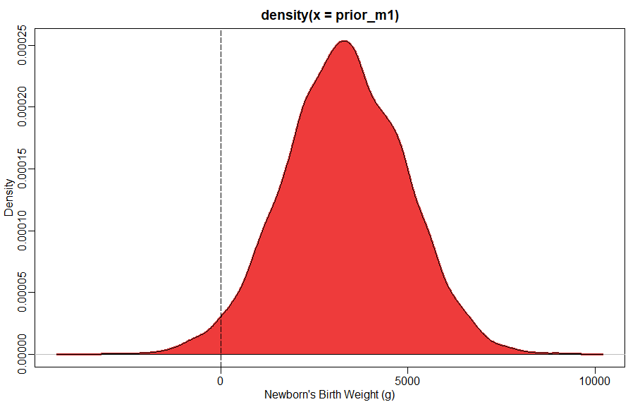
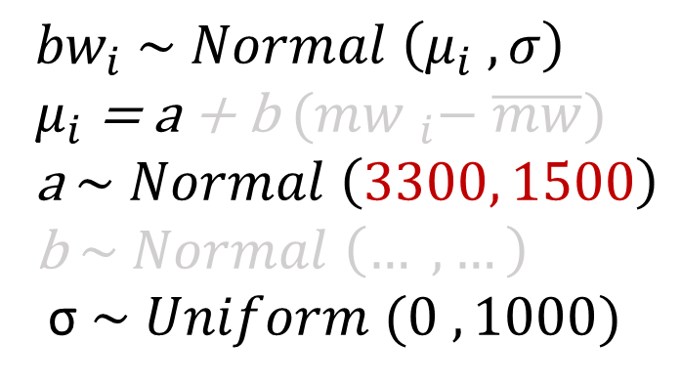
Example of Linear Regression
${bw}_{i}$ $\sim Normal \left(μ_{i} , σ\right)$
$μ_{i}$ = a + b ${(mw }_{i}− \overline{mw})$
a $\sim Normal \left(3300, 1500\right)$
b $\sim Normal \left(… , …\right)$
σ $\sim Uniform (0 , 1000)$
Fictional data on newborn’s birthweight (bw) by maternal weight (mw).
Notes:
Let’s consider first a model with no predictor. Paramater “a” , here highlighted in red, thus represents the distribution of birthweight for mothers of average weight. What priors should we give to this? We know normal birthweight varies between 2500 and 4000 g, so let’s say that we expect average to be –say- 3300 g, i.e. 3.3 Kg. Let’s say the SD is 1500 g, i.e. 1.5 Kg. Since we are assuming a normal distribution, we know 95% of cases fall between -2SD and +2SD: if we take these values as good, we expect that average birthweight has 95% probability of being between 300 and 6.300 g. Note, we are talking about the mean, and we know the average birth weight can hardly be 300 g in a typical population.
It is always a good idea to plot these priors to have an idea of what we are assuming. In the R script attached with the course material, you can see how I created this plot that represents this prior.
We can see that this is not a very good prior. The prior assumes as possible that some averages birth weights will be 0 or even negative!
Shall we care? After all, the model will learn from the data and will update the model considering the data. If we have numerous data, not having a sensible prior will not matter much. But that is not always the case.
So it makes sense to construct sensible priors. AS McElrath says, using substantive scientific knowledge to create sensible priors is not cheating. The important thing is that we not base our priors on the data at hand.

Slide 8
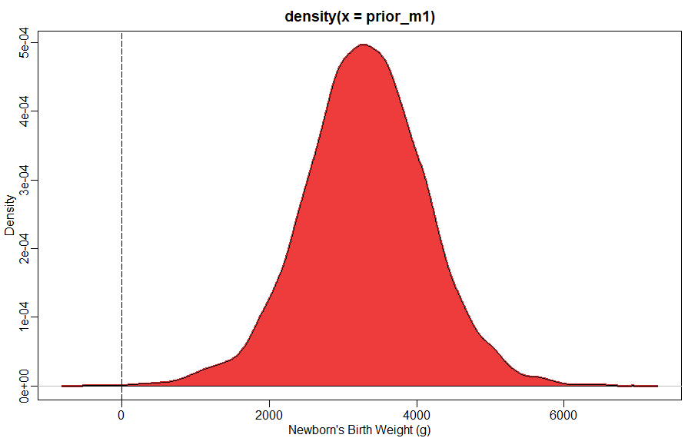
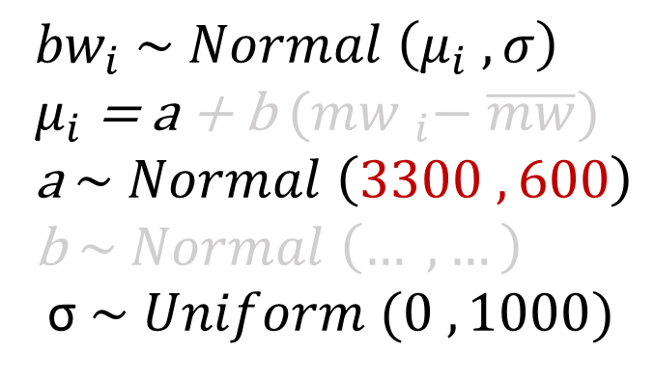
Example of Linear Regression
${bw}_{i}$ $\sim Normal \left(μ_{i} , σ\right)$
$μ_{i}$ = a + b ${(mw }_{i}− \overline{mw})$
a $\sim Normal \left(3300 , 600\right)$
b $\sim Normal \left(… , …\right)$
σ $\sim Uniform (0 , 1000)$
Fictional data on newborn’s birthweight (bw) by maternal weight (mw).
Notes:
Here I assumed a prior for the intercept with the same mean, 3300 g, but SD 600 g. This means that before seeing the data, I am assuming that there is a 95% possibility that the average birthweight of babies of mothers of average weight will range between -1200 and +1200 g of the average. This how a random sample from the prior distribution of the intercept looks like.

Slide 9
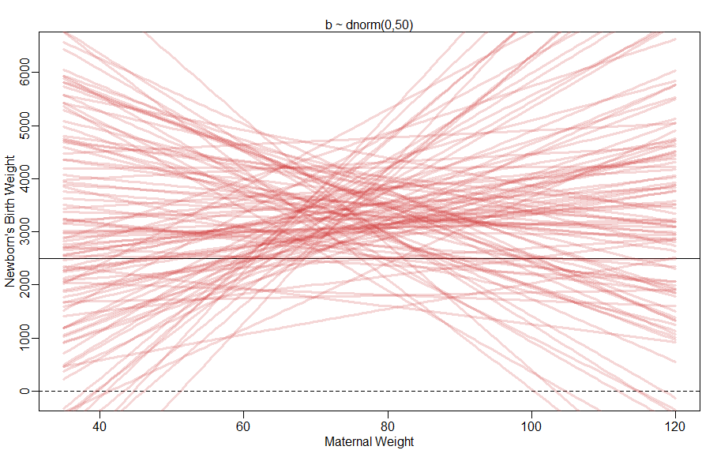
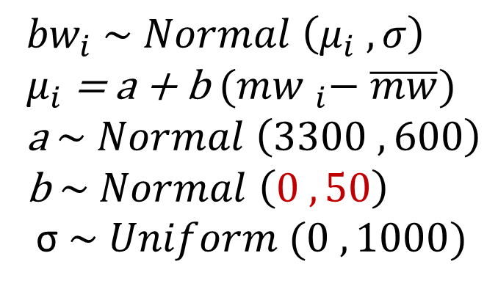
Linear Regression
${bw}_{i}$ $\sim Normal \left(μ_{i} , σ\right)$
$μ_{i}$ = a + b ${(mw }_{i}− \overline{mw})$
a $\sim Normal \left(3300 ,600\right)$
b $\sim Normal \left(0 , 50\right)$
σ $\sim Uniform (0 , 1000)$
Fictional data on newborn’s birthweight (bw) by maternal weight (mw).
Notes:
Here I move to the prior of the slope, that is the rate of change in newborn’s birth weight for a 1-unit increase in maternal weight from the mean weight.
I start by assuming this uncertain parameter has a mean 0 and a SD 50.
Why have a mean 0 for the slope? The distribution is normal, so there is as much probability of the parameter being below as above zero, and if the slope is 0, there is no association between child’s and mother’s weight. It makes sense to choose the least informative distribution consistent with general knowledge about the parameter. A prior that is “skeptical” as to the presence or sign of an association between newborn’s weight and maternal weight is preferable. Since the posterior distribution on which we base our conclusions is estimated by learning from the likelihood of the data, it makes sense to have priors that keep the model’s learning from data in check, that in a sense, regularise the process. In other words, skeptical priors avoids overfitting while still allowing the model to learn from the regularities in the sample data. See Chapter 7 of McElreath.
So, I assume the mean of the slope is 0, and the SD is 50, which means that the 95% of the times the effect of maternal weight will vary reducing baby’s weight100 grams or adding 100 grams for each kg of maternal weight over the mean. This is a large effect, and you can see this by plotting the slopes that this prior implies. See the R script attached to learn how to simulate these data.
The graph represents maternal weight in Kg in the horizontal axis and babies’ birth weight in grams in the vertical one. The horizontal black line represents 2500 grams, which is the threshold where babies are considered to be of low birth weight. The red lines are the slopes representing the association between maternal and babies’ weight. You can see how implausible is the assumption in the model, particularly when you see that for large values of maternal weight below and above the mean the baby’s weight is predicted to become negative or extremely large, over 6 Kg.

Slide 10
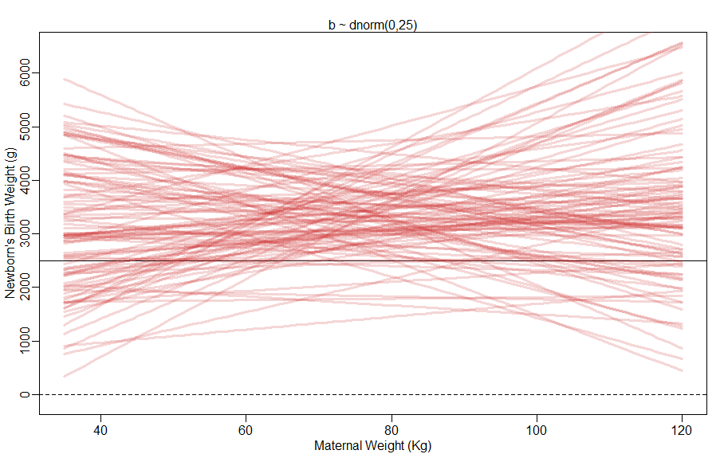
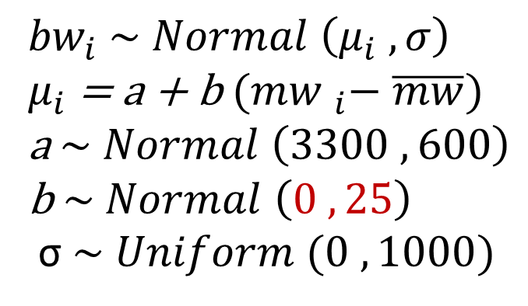
Linear Regression
${bw}_{i}$ $\sim Normal \left(μ_{i} , σ\right)$
$μ_{i}$ = a + b ${(mw }_{i}− \overline{mw})$
a $\sim Normal \left(3300 ,600\right)$
b $\sim Normal \left(0 , 25\right)$
σ $\sim Uniform (0 , 1000)$
Fictional data on newborn’s birthweight (bw) by maternal weight (mw).
Notes:
Let’s assume a lower value of SD of the slope around mean=0. Now we have more plausible values.
The key message is to have sensible priors. At the same time, it is important to have sceptical priors or priors that distribute probabilities more widely. This is important to ensure there is no overfitting, so that the ability of the model to learn from the data is kept in check. However, in some cases one may have reasons to start with an “informed” prior, a prior that specifies an association between variables that has a certain sign and strength.
Some references recommend sensitivity analyses in any case: for example, if –as in this case- I started with a sceptical prior, I could check that other broad priors produce similar results, or else, that the results are not significantly influenced by differences in the priors.

Slide 11
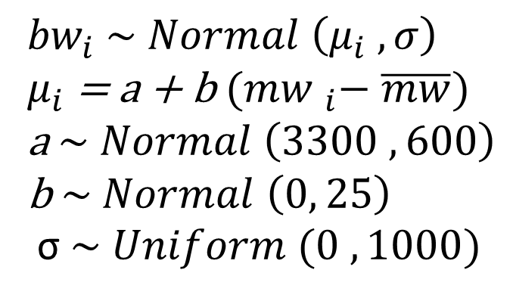
Linear Regression
${bw}_{i}$ $\sim Normal \left(μ_{i} , σ\right)$
$μ_{i}$ = a + b ${(mw }_{i}− \overline{mw})$
a $\sim Normal \left(3300 ,600\right)$
b $\sim Normal \left(0, 25\right)$
σ $\sim Uniform (0 , 1000)$
Likelihood
Linear Model
“a” (intercept) prior
“b” (slope) prior
“sigma” (SD) prior
Fictional data on newborn’s birthweight (bw) by maternal weight (mw).
Notes:
So now we have a model ready to analyse the data.
I have a likelihood function, a function that represents how my data, the observed birth weights, may have come about. The likelihood is saying that the underlying distribution that may have generated the birth weights I am going to observe is normal with mean MU and SD SIGMA.
I have a linear model that is basically making the parameter mu a linear function of the other parameters A and B, intercept and slope. The model is assuming that the predictor variable maternal weight has a constant additive relationship with the mean of the outcome, and will compute the posterior distribution of this relationship conditional on the data. Once again, note that the Mean MU is no longer a parameter here, because it is a function of these other parameters that have been made up to represent the supposed linear association between outcome and predictor.
I have then priors for the parameters.
In the next presentation I will show how to use this model to compute the relative plausibility of parameters given this model specified here and the data that I will collect.

Slide 12
www.ncrm.ac.uk

