Slide 1
Introduction to sociogenomic methods
MethodsCon 2024
Tim Morris - t.t.morris@ucl.ac.uk
Liam Wright – liam.wright@ucl.ac.uk
Isabella Badini – i.badini@ucl.ac.uk
Centre for Longitudinal Studies, University College London

Slide 2
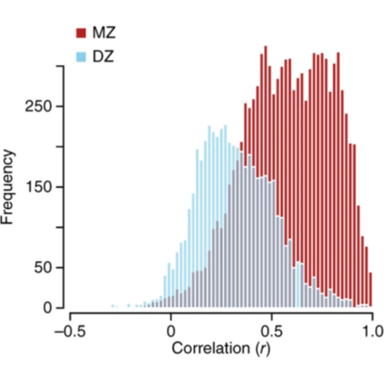
Why genetics?
Formation of human traits are complex
Twin & adoption studies show that genetics are relevant (Turkheimer, 2000)
Heritability: proportion of variation in a trait that can be statistically explained by genetic variation
Large-scale & cheap genotyping led to “the genomics revolution”…
Polderman et al, 2015

Slide 3
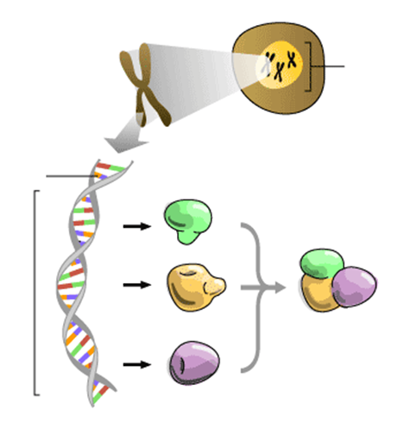
Genetics 101
Genome
DNA contains 3.2 billion base pairs
Base pairs of Adenine, Cytosine, Guanine and Thymine
Variation between people at 1 in 1,000 base pairs
Millions of points of variation
These points of variation are of interest
Chromosome
DNA
Genes
Proteins

Slide 4
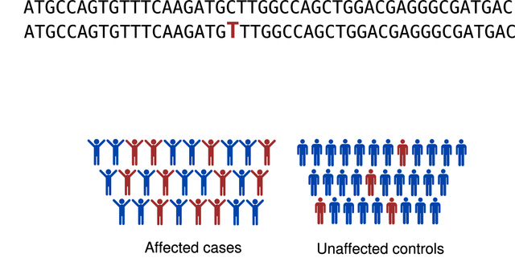
Genomewide Association studies (GWAS)
Estimate associations between trait and genetic markers
Account for multiple testing
Health and social traits GWAS’d
Can inform biological pathways
Huge samples, now in the millions
Low predictive power for individual markers

Slide 5
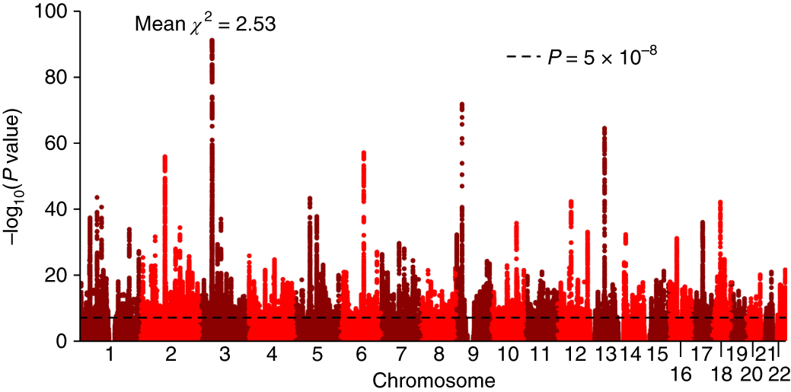
Genomewide Association studies (GWAS)
Estimate associations between trait and genetic markers
Account for multiple testing
Health and social traits GWAS’d
Can inform biological pathways
Huge samples, now in the millions
Low predictive power for individual markers
Lee et al (2018)

Slide 6
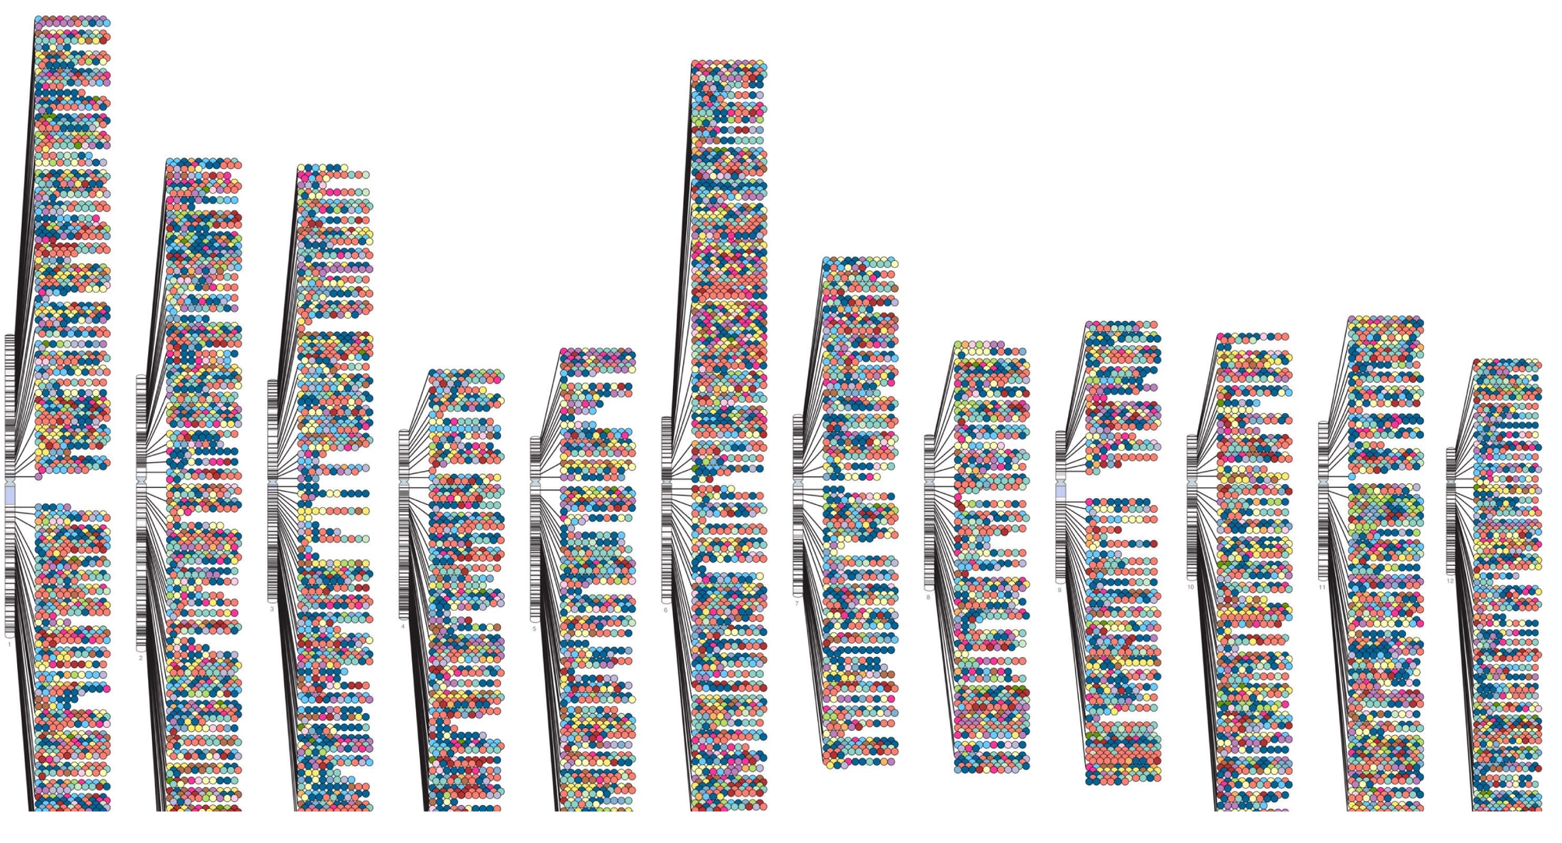
Genomewide Association studies (GWAS)
Estimate associations between trait and genetic markers
Account for multiple testing
Health and social traits GWAS’d
Can inform biological pathways
Huge samples, now in the millions
Low predictive power for individual markers
EMBL-EBI

Slide 7

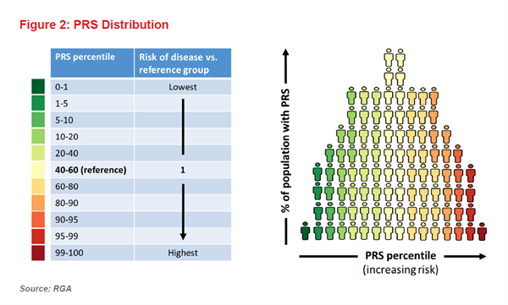
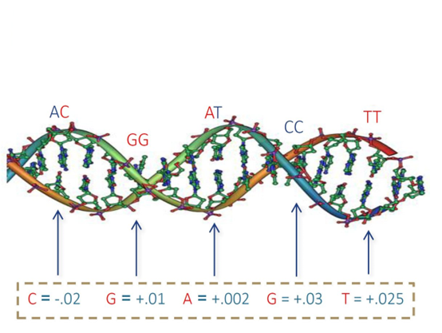
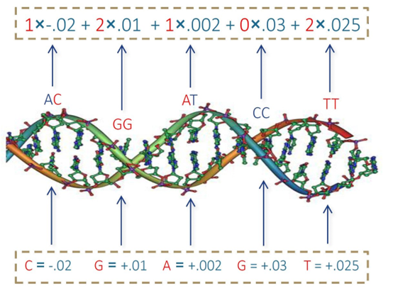
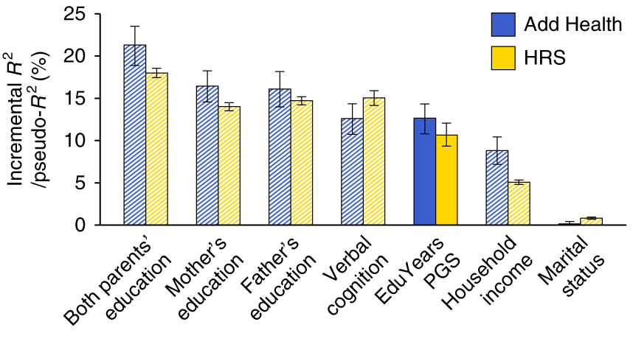
Polygenic indices
A variable designed to summarise the known genetic predisposition for a trait
Calculated as count and effect sizes of individual variants
Dependent on the trait and population measured in the GWAS
Normally distributed in population
Lee et al, 2018

Slide 8
‘Missing heritability’
Twin study heritability consistently higher than molecular genetic ‘SNP’ heritability
Twin studies measures all genetic variation
SNP heritability measures only additive genetic variation for measured markers
With infinite sample sizes, SNP heritability will reach twin heritability
Young, 2019

Slide 9
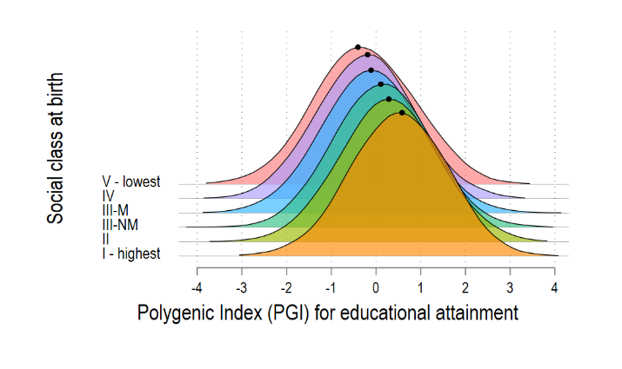
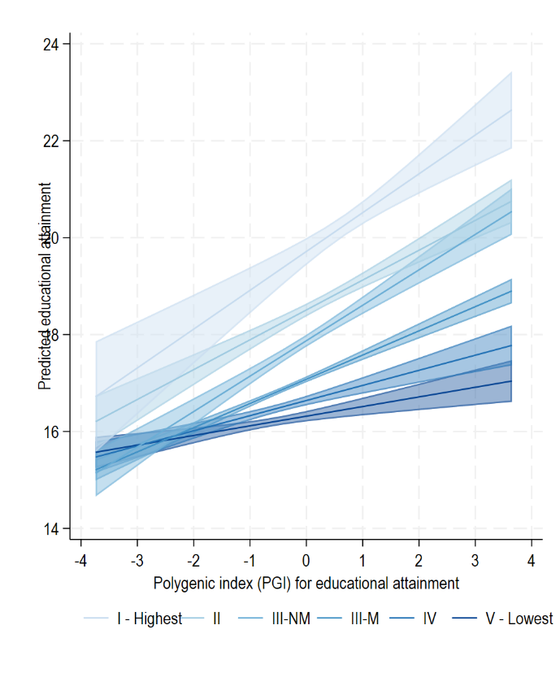
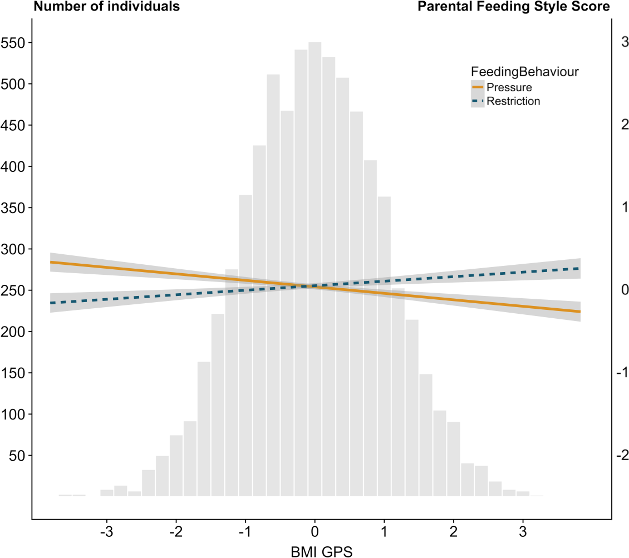
Gene environment correlation & interaction
Genes and environments are not always independent
3 ‘types’ of gene environment correlation (rGE)
    Passive: linked genotype & behaviour are inherited
    Evocative: genotype evokes a response in others
    Active: individual seeks out environment based on genotype
rGE and gene environment interaction (GxE) can be exploited to understand how social and biological processes cooccur

Slide 10
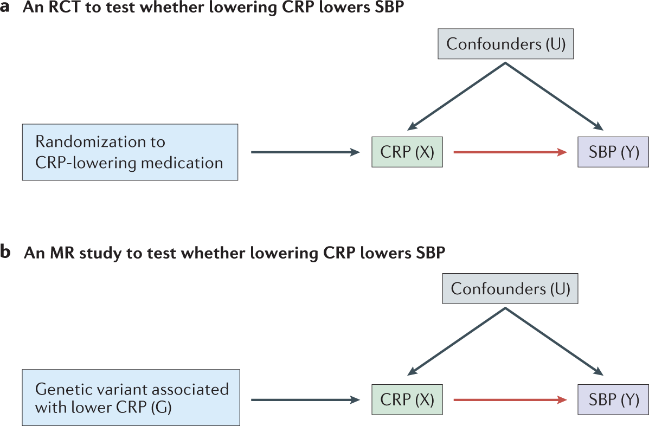
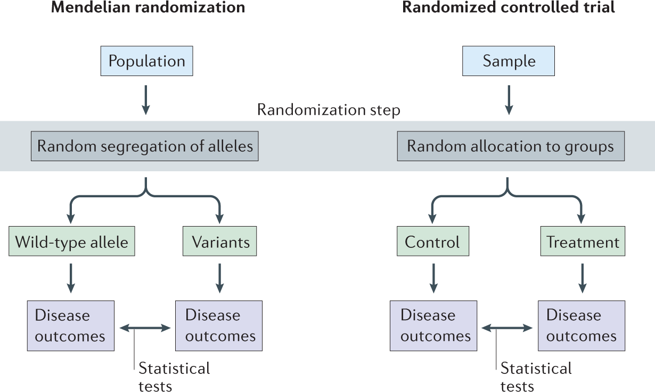
Mendelian randomization (MR)
Instrumental variable (IV) approach using genetic variants
Simulates a randomised controlled trial; randomisation by inheritance
Variants act as causal anchors for exposures
Genotype is unrelated to environmental confounders
Useful where RCTs are impossible…
Sanderson et al, 2022

Slide 11
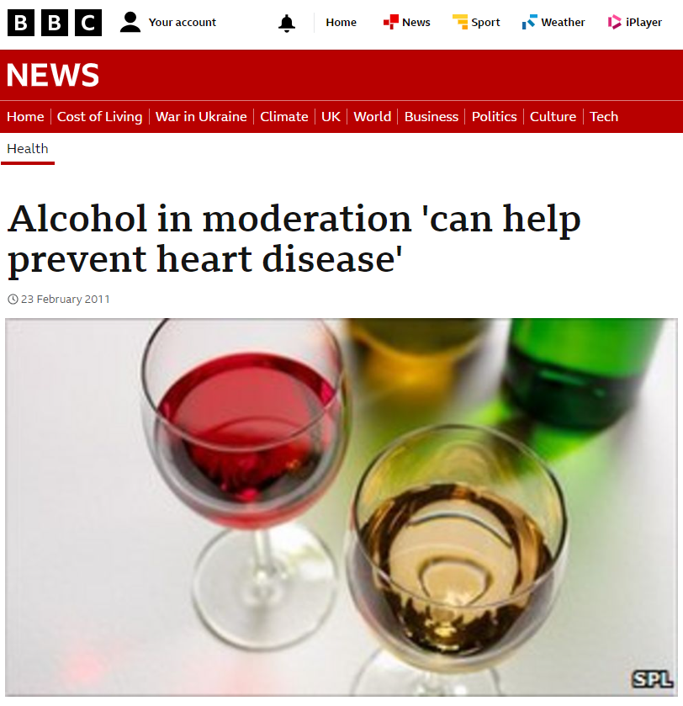
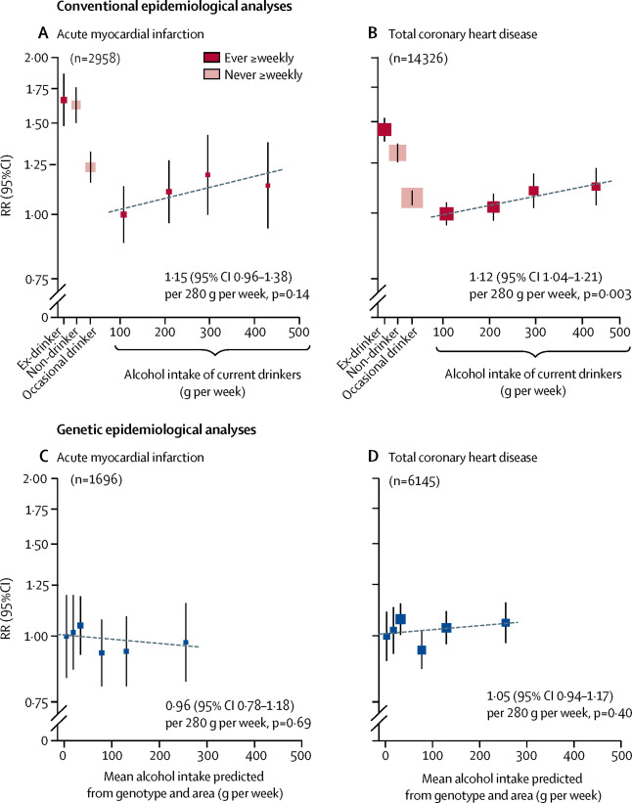
Mendelian randomization (MR)
Millwood et al, 2019

Slide 12
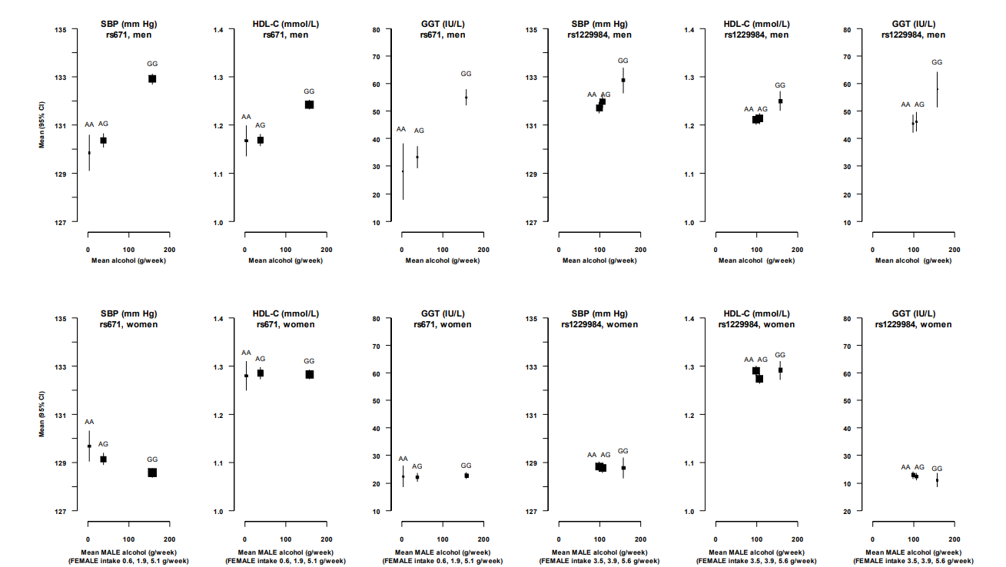
Mendelian randomization (MR)
However, genetic effects can be culturally contingent
No effect of genetic variant on alcohol consumption amongst Asian women
Potential for causal inference designs that combine knowledge of genetic and social processes

Slide 13
Mendelian randomization (MR)
General assumptions:
Relevance: The genetic variant is strongly associated with the exposure
Independence: There are no common causes (confounders) of the genetic variant and the outcome
Exclusion restriction: The genetic variant only influences the outcome through the exposure

Slide 14


Mendelian randomization (MR)
Special mention:
Horizontal pleiotropy: Where a genetic variant is related to two exposures. This is important for MR as it can violate the exclusion restriction.

Slide 15
Mendelian randomization (MR)
Familial and demographic assumptions:
No assortative mating
No ‘indirect’ genetic effects
No population stratification

Slide 16
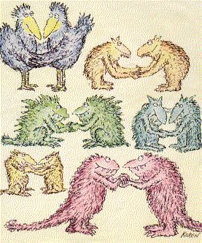
Assortment
People do not partner randomly
Selection on characteristics that induces genetic similarity; strongest for social traits
Assortment can bias MR estimates
Mother
Father
Genotype
Trait
Genotype
Trait

Slide 17
Assortment
Genes are inherited randomly, but this is conditional on parental genotype
Mother
Child
Father
Mother
Child
Father
So across a population, assortative mating will lead to non-random genetic differences in offspring
= Trait increasing allele

Slide 18
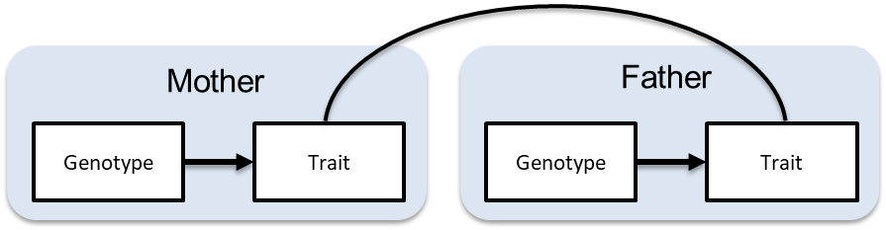
Assortment
Spousal correlations
 | Correlation | Sample
Phenotype
Highest educational attainment | 0.56 (0.01) | 5,353
Linear socioeconomic position | 0.43 (0.01) | 6,858
Binary socioeconomic position | 0.30 (0.01) | 5,737
C-Reactive Protein | 0.00 (0.03) | 1,129
Genotype
Education polygenic index | 0.18 (0.03) | 1,262
CRP polygenic index | -0.01 (0.03) | 1,385
Morris et al 2020b

Slide 19
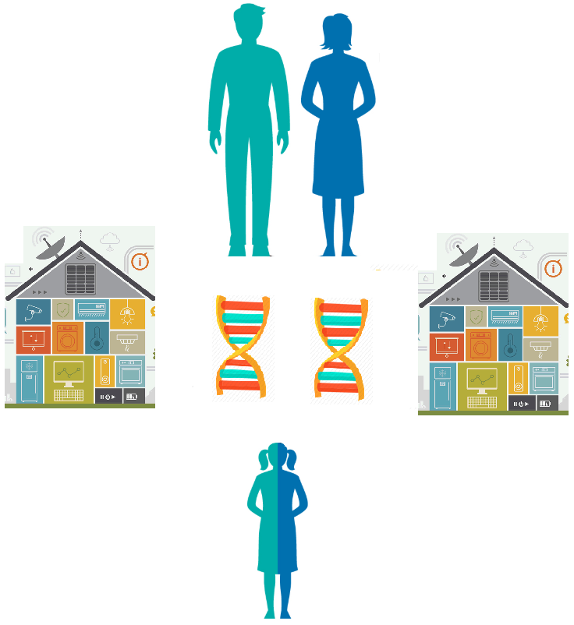
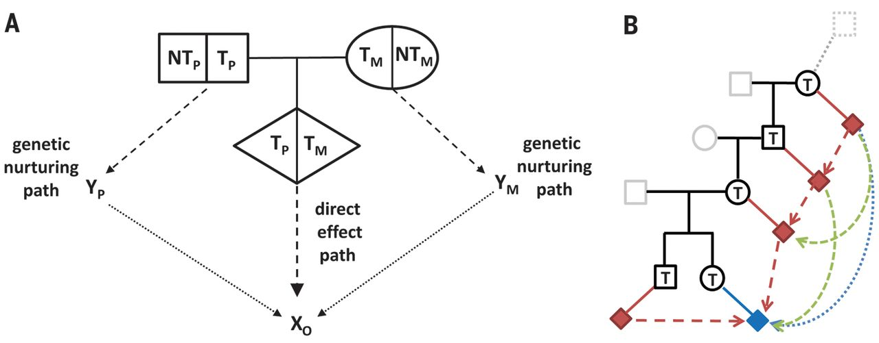

Indirect genetic effects
Kong et al, 2018
Children inherit genes and environment
Environments differ across families
E.g. more educated parents = more books
Genetic effects can be mediated by environment
A
A
A
A
A
A
A
Mother
B
B
B
B
B
B
B
A
B
A
A
B
A
A
B
A
B
B
A
B
B
A
A
A
A
A
A
A
B
A
A
A
B
B
B
A
B
B
B
A
A
A
Father
B
B
B
B
B
B
B
CM (transmitted)
Non-transmitted

Slide 20
0.34
(0.03)
 | Unadjusted | Adjusted | p difference | Attenuation
Education | 0.34 (0.03)
CRP
@bristimtom
Morris et al 2020b

Slide 21
0.10
(0.04)
0.10
(0.04)
0.22
(0.04)
 | Unadjusted | Adjusted | p difference | Attenuation
Education | 0.34 (0.03) | 0.22 (0.04) | <0.001 | 34.4% (16.2, 52.9)
CRP
@bristimtom

Slide 22
0.22
(0.03)
 | Unadjusted | Adjusted | p difference | Attenuation
Education | 0.34 (0.03) | 0.22 (0.04) | <0.001 | 34.4% (16.2, 52.9)
CRP | 0.22 (0.03)
@bristimtom

Slide 23
0.00
(0.04)
0.00
(0.04)
0.19
(0.04)
 | Unadjusted | Adjusted | p difference | Attenuation
Education | 0.34 (0.03) | 0.22 (0.04) | <0.001 | 34.4% (16.2, 52.9)
CRP | 0.22 (0.03) | 0.19 (0.04) | 0.330 | 12.4% (-13.7, 38.5)
@bristimtom

Slide 24
Indirect effects
Trio designs useful for more than removing bias from direct genetic effects
Indirect genetic effects offer insight into social or environmental processes
Comparisons with observational designs (which are blind to direct genetic transmission) are useful
0.10
(0.04)
0.10
(0.04)
0.22
(0.04)

Slide 25
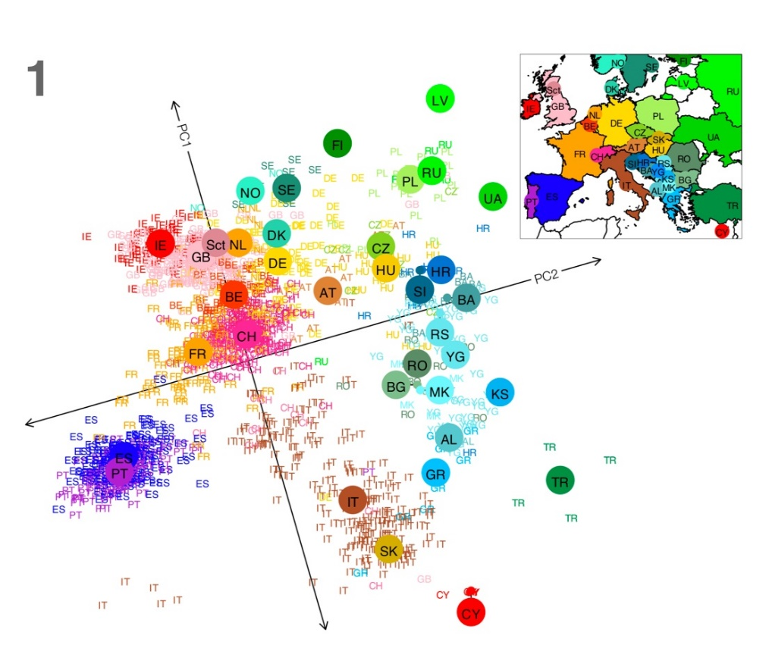
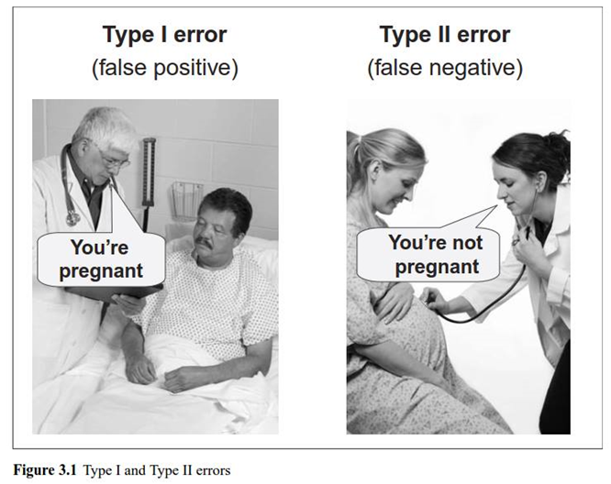

Population structure
Population structure: systematic differences in genotype between sub-populations driven by ancestral migration and spatial isolation
Population stratification: confounding introduced by population structure
Novembre et al, 2008
Hamer & Sirota, 2000

Slide 26
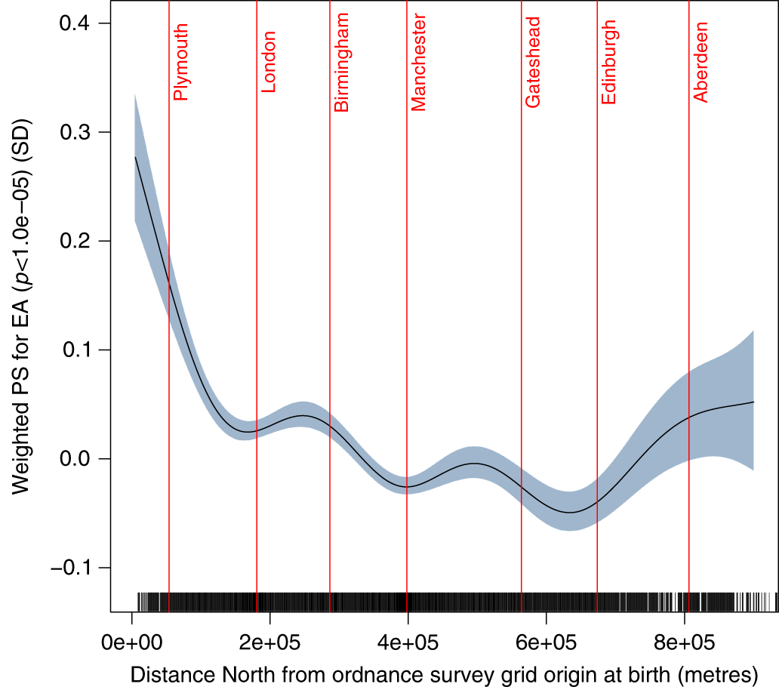
Population structure
Statistically ‘controlled’ for in models by using principal components of population structure:
PC1, PC2, … PC N
But this doesn’t remove all variation that we want it to, and it may remove some that we don’t want it to
Haworth et al, 2018

Slide 27
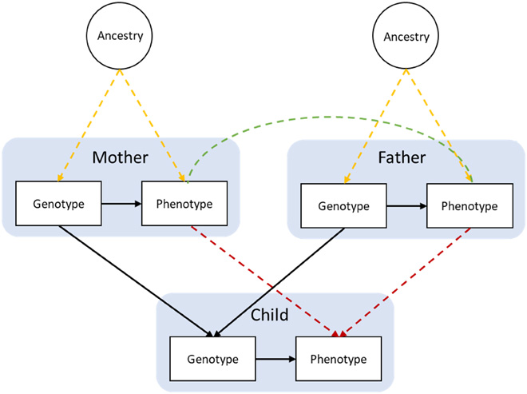
Overcoming these problems
These problems are intergenerational and can be overcome with family data
Mother-father-offspring trio designs allow explicit control for parental genotypes
Sibling designs as siblings share the same upstream population structure, assortative mating and indirect genetic effects
In the practical, we will demonstrate how one can use trio designs

Slide 28
Summary
Polygenic scores summarise genetic predisposition to a trait
Mendelian randomization can facilitate causal inference
Population level MR can suffer from familial and demographic biases
Family-based studies can greatly help to overcome these biases
Must remain mindful of general MR limitations!

Slide 29
Q&A

Slide 30
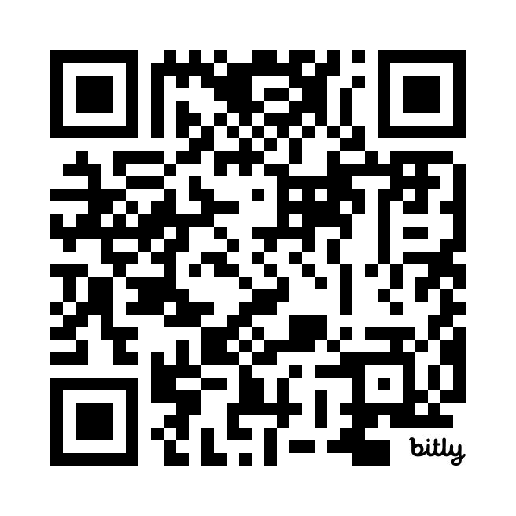
Practical session https://bit.ly/4cTiRVR

Slide 31
References
Davies, N. M. et al. 2023. The causal effects of education on adult health, mortality and income: evidence from Mendelian randomization and the raising of the school leaving age. IJE, 52(6), 1878–1886. https://doi.org/10.1093/ije/dyad104.
Choudhury A. et al. 2020. High-depth African genomes inform human migration and health. Nature. 29;586(7831):741-8.
Ding, Y. et al. 2023. Polygenic scoring accuracy varies across the genetic ancestry continuum. Nature 618, 774–781. https://doi.org/10.1038/s41586-023-06079-4
Duncan, L. et al. 2019. Analysis of polygenic risk score usage and performance in diverse human populations. Nat Commun 10, 3328. https://doi.org/10.1038/s41467-019-11112-0
EMBL-EBI. GWAS diagram. https://www.ebi.ac.uk/gwas/diagram.
Hamer, D. H. & Sirota, L. 2020. Beware the chopsticks gene. Mol. Psychiatry. doi:10.1038/sj.mp.4000662
Haworth, S. et al. 2019. Apparent latent structure within the UK Biobank sample has implications for epidemiological analysis. Nat. Commun. 10, 333.
Howe, LJ., et al. 2022. Within-sibship genome-wide association analyses decrease bias in estimates of direct genetic effects. Nature Genetics, 54(5). https://doi.org/10.1038/s41588-022-01062-7.
Howe, L. J. et al. 2023. Educational attainment, health outcomes and mortality: a within-sibship Mendelian randomization study. IJE, 52(5):1579–1591. https://doi.org/10.1093/ije/dyad079
Kong, A., et al. 2018. The nature of nurture: Effects of parental genotypes. Science, 359(6374), 424–428. https://doi.org/10.1126/science.aan6877
Lee, J. J., et al. 2018. Gene discovery and polygenic prediction from a genome-wide association study of educational attainment in 1.1 million individuals. Nature Genetics. https://doi.org/10.1038/s41588-018-0147-3
Mills, M.C., Rahal, C. 2020. The GWAS Diversity Monitor tracks diversity by disease in real time. Nat Genet 52, 242–243. https://doi.org/10.1038/s41588-020-0580-y
Millwood, I. Y.et al. 2019. Conventional and genetic evidence on alcohol and vascular disease aetiology: a prospective study of 500 000 men and women in China. Lancet. 4;393(10183):1831-42.
Morris, T. T. et al. 2020. Can education be personalised using pupils’ genetic data? eLife 9:e49962.
Morris, T. T. et al. 2020b. Population phenomena inflate genetic associations of complex social traits. Science Advances, 6(16). https://doi.org/10.1126/sciadv.aay0328
Novembre, J. et al. 2008. Genes mirror geography within Europe. Nature. doi:10.1038/nature07331.
Sanderson, E., et al. al 2022. Mendelian randomization. Nat Rev Methods Primers 2, 6. https://doi.org/10.1038/s43586-021-00092-5
Polderman, T. J. C. et al. 2015. Meta-analysis of the heritability of human traits based on fifty years of twin studies. Nat. Genet. 47, 702–709.
Selzam S, et al. (2018) Evidence for gene-environment correlation in child feeding: Links between common genetic variation for BMI in children and parental feeding practices. PLOS Genetics 14(11): e1007757. https://doi.org/10.1371/journal.pgen.1007757
Selzam, S. et al. 2019. Comparing within-and between-family polygenic score prediction. The American Journal of Human Genetics 105.2: 351-363.
Turkheimer, E. 2000. Three laws of behavior genetics and what they mean. Current Directions in Psychological Science. https://doi.org/10.1111/1467-8721.00084

Slide 32
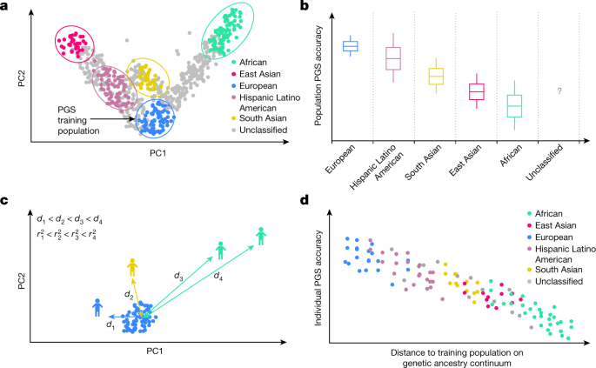
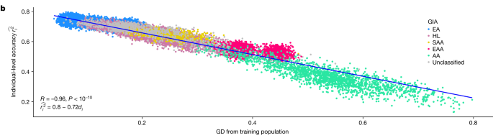
Population structure
Ding et al, 2023

Slide 33
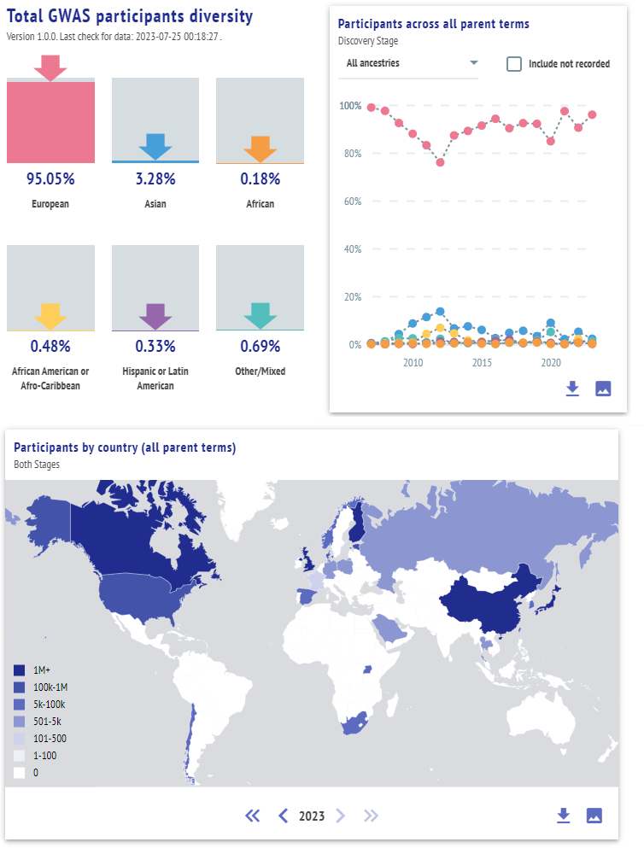
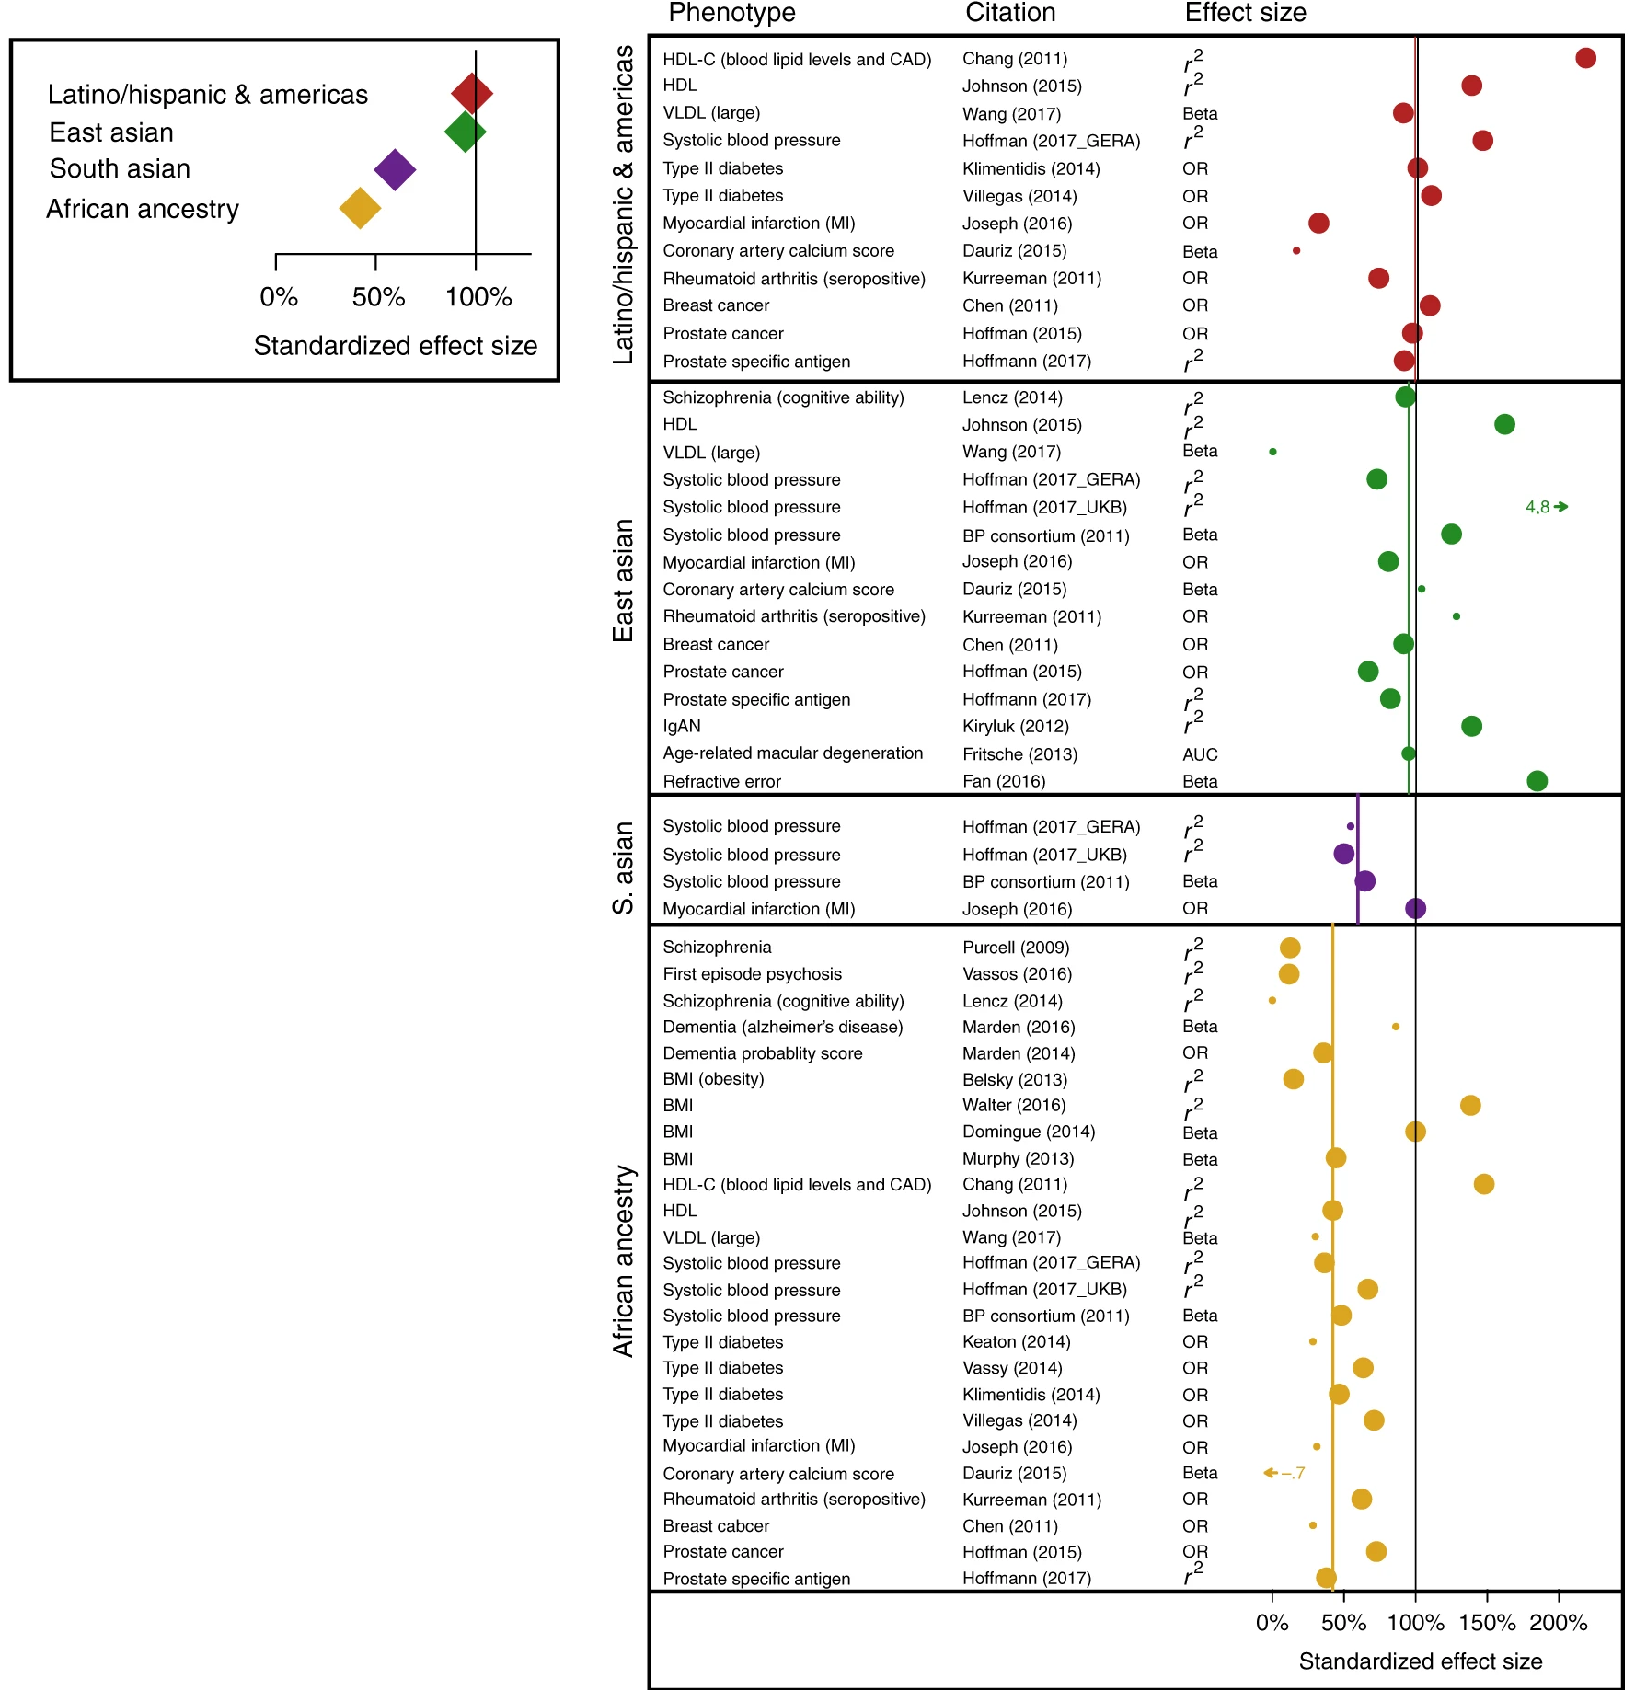
Diversity
Duncan et al, 2019
Studies overwhelmingly based on European ancestry participants (Mills & Rahal, 2020)
Variants still being discovered in diverse ancestry groups (Choudhury et al, 2020)
Polygenic indices don’t port well across diverse ancestries (Duncan et al, 2019)
Lack of diversity due to underlying diversity in research studies and funding
Improving, but long way to go
Mills & Rahal, 2020

