Slide 1
Occupation Coding During the Interview in a Web-First Sequential Mixed-Mode Survey: Evidence from the Next Steps Cohort Study
Darina Peycheva, Joe Sakshaug, Lisa Calderwood

Slide 2
Outline
Occupation coding – general practice
Occupation coding during the interview - past research
Occupation coding during the interview – evidence from the Next Steps Age 25 Survey
Plans for coding occupation in the Next Steps Age 32 Survey

Slide 3
Occupation coding – general practice
  Series of open-ended questions asking participants for their job title and to describe the kind of work they do dominate the research practice
  Enable to collect sufficient detail and assign a code at the most detailed level of the occupational classification
  Administered in both interviewer- and self- administered settings, including mixed mode surveys
  Less often occupation is captured with closed-ended questions offering limited choice of categories and resulting in highly aggregated codes;
  Search tree navigation and semantic text matching techniques, and look-up methods used in web-surveys
  Verbatim responses (to open-ended questions) typically coded post-interview by specialist coders using manual or computer aided (assisted or automated) coding
  Use of manual coding significantly reduced but still complements computer aided coding methods even though the challenges it poses (e.g. time consuming, costly and error prone).

Slide 4
Occupation coding (of open ended questions) during the interview
Previous research has acknowledged the potential of coding occupation during the interview
  Potential for reduction in coding errors as uncertainties likely to arise post-interview, due to insufficient or contradictory information, can be resolved by the interviewer
  Easier for the interviewer to probe for additional information during the interview than it is for any post-interview intervention
  More parsimonious list of best matching occupations to choose from, and allow the coding decision to be confirmed by the respondents themselves
  Assumed that interviewers do not achieve the same levels of accuracy as specialist coders, with increasing experience the interviewer may develop a better idea of what constitutes a good occupational description and probe accordingly
  Expected to reduce costs and processing time since a smaller number of occupation descriptions will require post-interview coding.
  Low maintenance costs as the code frame and search algorithms can be constructed and updated automatically.

Slide 5
What is known about its feasibility (already)
Effective implementation in a few interviewer-administered (telephone and in-person) surveys (Hacking et al. 2006; Brugiavini et al. 2017; Schierholz et al. 2018)
  Coding rates between 72% and 80%
  Limited but positive insights about data quality (agreement between interview and office coded occupations)
  Interview time reduction questionable
Implementation
  Form of computer-assisted coding where the computer suggests the most relevant occupation code(s) to the interviewer
  The interviewer types into the open text field the job title and/or description of the occupational activity
  On the basis of this verbatim text the search engine shows a list of best matching occupations from the code frame to select the most appropriate occupation
  As more input is entered, the search engine adapts the list of best matching occupations and the list becomes smaller
  If the search results do not yield any likely matches, respondents asked to provide further details or referred to a specialist coder post-interview.

Slide 6
What is not known (yet)
The literature on interview-based occupation coding comes primarily from interviewer-administered settings
The feasibility of coding occupations in (probability-based) online and mixed-mode surveys remains unclear
  Applied in non-probability web-based surveys and by some NSOs - but evidence not readily available
  Differences between interviewer- and self- administered surveys for occupation coding likely to impact performance
  In web surveys, occupation coding during the interview is challenging as there is no interviewer to provide assistance or probe for additional information
  Likely to impact coding rates, quality of occupation data (specificity of selected code, quality of verbatim, etc.), participant experience with the coding instrument
  An easy-to-use interface needed to facilitate respondent self-coding of occupation
  Even more challenging in mixed-mode surveys as the interface should be standardized across modes to ensure comparable measurement across all respondents
This study sheds light on these issues …

Slide 7
About Next Steps and the age 25 survey
Follows the lives of around 16,000 people in England born in 1989/1990
Began in 2004 (age 13/14), annual sweeps until 2010 (age 19/20) (sweeps 1-7)
Most recent sweep in 2015/2016 - age 25 survey (sweep 8) (in which the method of interest has been implemented)
Sequential mixed-mode design including web, telephone and face-to-face interviewing
Focus on transitions out of education and into early adulthood, and thus work participation a key theme in the age 25 survey
Occupation captured by a text-based search and coding method during the interview
  Activity data collected in the study since its initial wave at age 14
  Occupation data collected since study members were aged 16 - captured with open-ended questions and coded post-interview by professional coders

Slide 8
Coding occupation at age 25 survey
Respondents first asked about their job title with an open-ended question (‘What is your current job title?’)
Then asked to enter keywords into a search box describing what they mainly do in their job and select the most appropriate response option from a list of occupations generated by the search system
Similar procedure in the interviewer-administered modes, except interviewers entered key words into the search box, read out the list of search results, and selected the most appropriate occupation
Following the entry of key words, the coding tool searched for relevant job titles in the Standard Occupational Classification 2010 (SOC2010) coding index and offered a list of corresponding codes
  The input string of words matched against a concatenated string of the fields describing the job title in the SOC2010 coding index (containing over 27,000 job titles) as a look-up
If the look-up method was not successful, the respondent was asked the traditional open-ended question to describe what they mainly do in their jobs

Slide 9
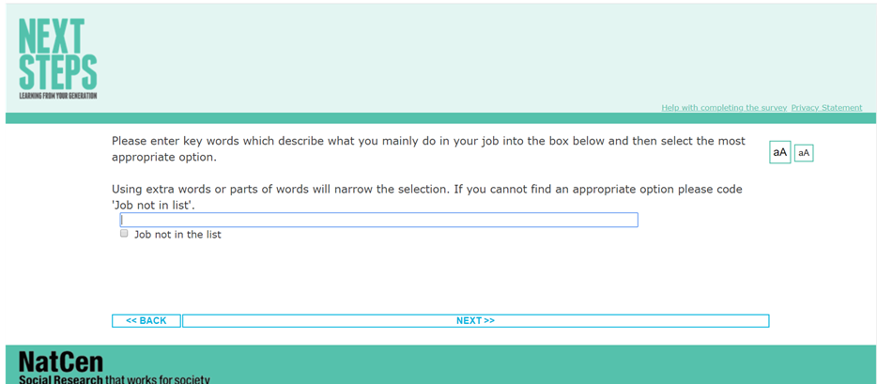
Screenshot of the look-up question in the web survey

Slide 10
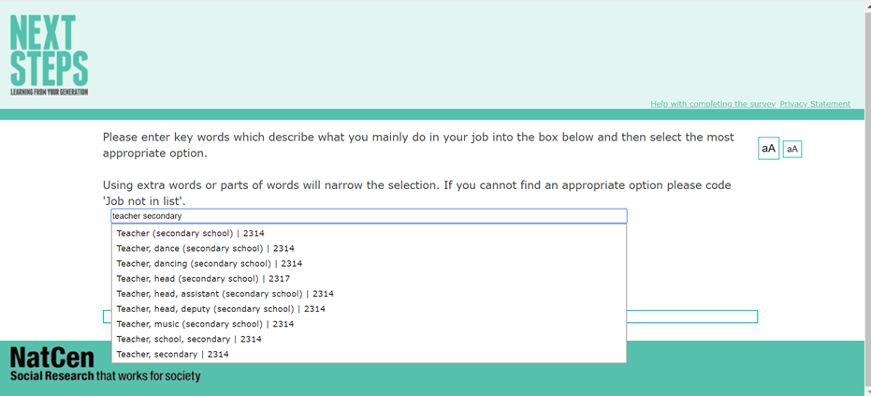
Screenshot of the look-up question and search results for “teacher secondary” in the web survey

Slide 11
Research questions
Assess the feasibility of coding open-ended occupation descriptions during the interview
  To what extent do web respondents use the look-up method to self-code their occupation, and how does this compare to interviewer-administration of the look-up method in the telephone and face-to-face follow-up modes?
  Does the rate of self-coding in the web mode vary by device type (PC, laptop, tablet)?
Assess indicators of performance linked to occupational data quality
  Is the performance of the look-up method (specificity of selected code, time to code occupation) and characteristics of open-ended occupational descriptions (verbatim length) comparable between the three sequential modes (web, telephone, and face-to-face)?
Assess the extent to which respondents and interviewers influence the use of the new coding method
  Do respondent attributes (e.g. sex, ethnicity, education, cohabitation status) and interviewer characteristics (e.g. sex, age, years of interviewing experience) influence the performance of the look-up method during the interview?

Slide 12
Results

Slide 13
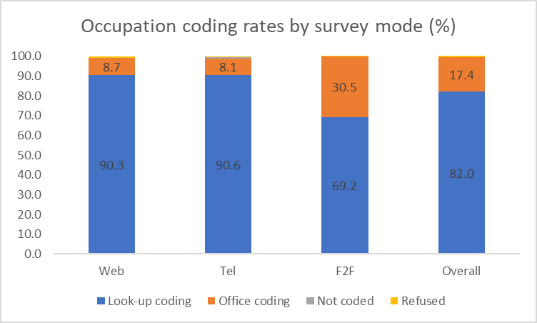
Look-up and office coding rates by survey mode
82% successfully assigned an occupation code using the look-up method
Look-up rates varied significantly by mode
Web look-up rates among the highest with 90% able to self-code their occupation during the interview (comparable to telephone)
Face-to-face look-up rate was significantly lower with only 69% assigned an occupation code during the interview
N=6,195 (Web=3,975; Tel=549; F2F=1,671)
Results account for selection into each of the sequentially-administered modes

Slide 14
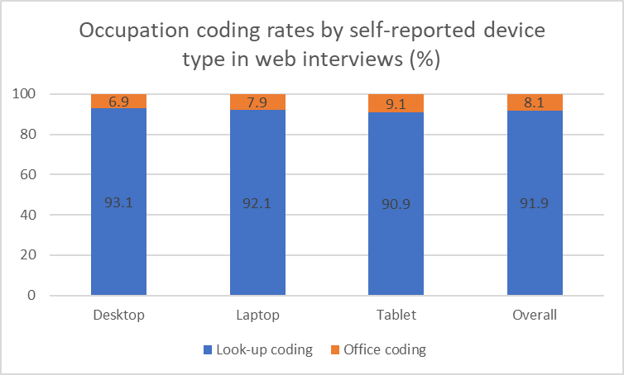
Coding rates by device type
Look-up coding rates slightly higher for desktop computers compared to devices with likely smaller-sized screens
Differences not statistically significant
N= 3,789 (Desktop=745; Laptop=1,974; Tablet=1,070)
Results account for selection into initially-administered web mode

Slide 15
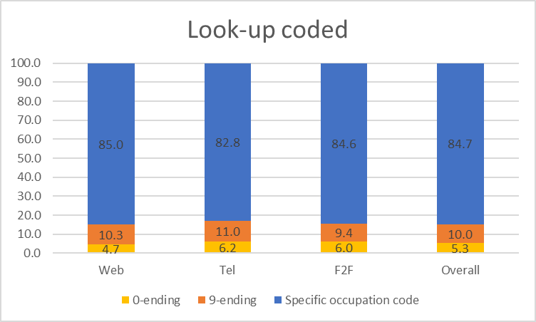
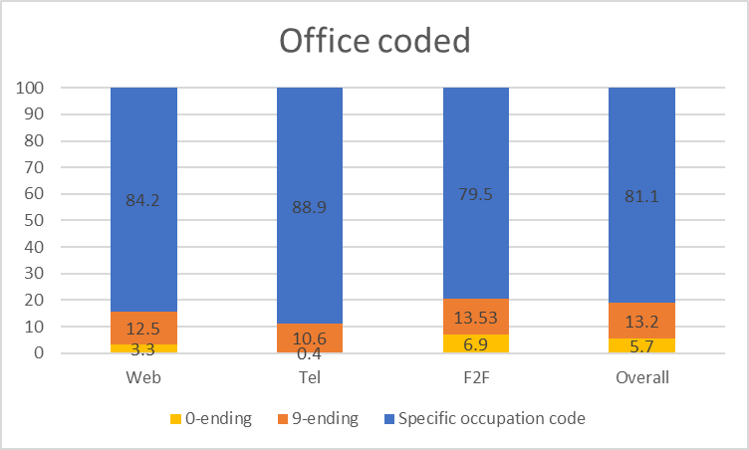
Specific vs generic codes by coding method and survey mode
No differences in the assignment of specific or generic occupation codes by mode for either look-up or office coding
About 85% of web respondents selected a ‘specific’ code using the look-up method (comparable to telephone and face-to-face)
About 84% of web respondents referred to post-interview office coding assigned a specific code (comparable to telephone and face-to-face)

Slide 16
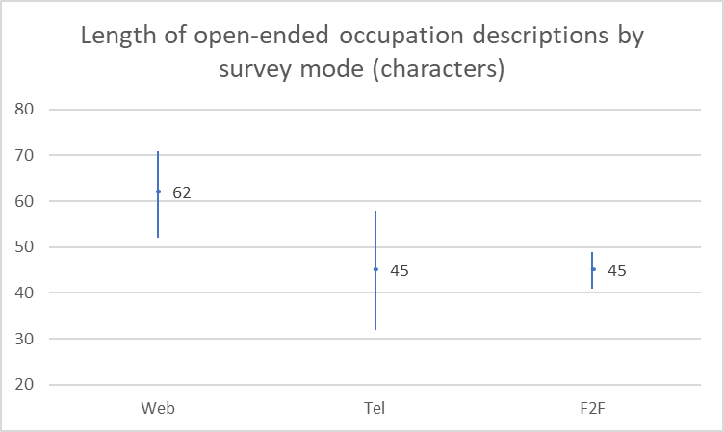
Length of open-text occupation descriptions
Web respondents provided longer descriptions (62 characters) than telephone and face-to-face respondents (both 45 characters)
Significant differences between web and interviewer-administered modes
No difference between the telephone and face-to-face modes

Slide 17
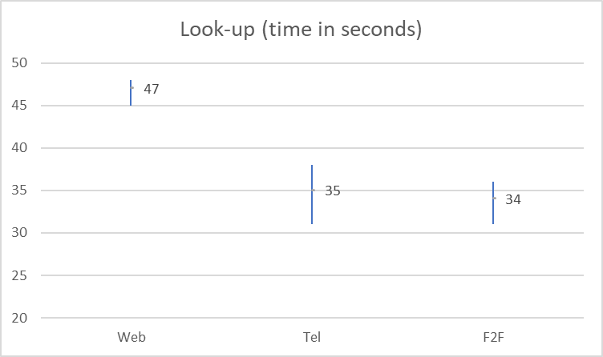
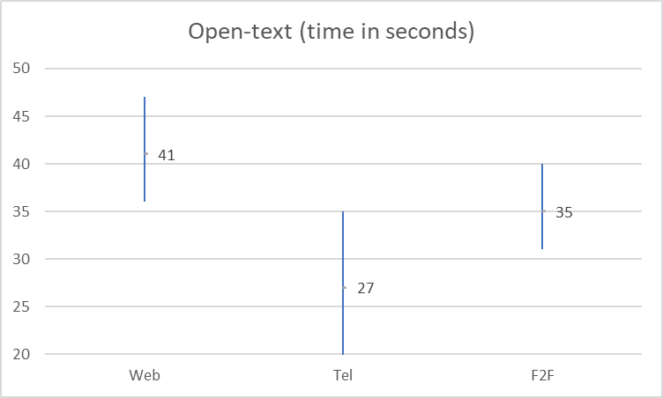
Time to select an occupation or provide an occupation description
Across all modes, the look-up method took on average 43 seconds (regardless of whether an occupation category was chosen)
Timing varied significantly by mode and took longer in web compared to telephone and face-to-face
To describe an occupation in the follow-up question took on average extra 38 seconds
Timing varied by mode and took (significantly) longer in web, followed by face-to-face and telephone

Slide 18
Correlates of occupation coding during the interview
Online model
  Successful coding of occupation during the web interview (via the look-up method) related to respondents’ ethnic background, university participation, and cohabiting status (at age 25).
Telephone model
  No evidence that respondents’ demographics influenced the likelihood of being assigned an occupation code during the interview.
Face-to-face model
  No evidence that study members’ demographics influenced their likelihood of being assigned an occupation code during the face-to-face interview, apart from their cohabitation status.
  Strong evidence that interviewers influenced whether an occupation code was assigned during the face-to-face interviews.
  Males, older, and less experienced interviewers were less likely to successfully assign an occupation code during the interview using the look-up method.

Slide 19
Summary of findings
82% of all respondents were assigned an occupation code during the interview
  This result suggests high potential for cost savings as only 18% required office coding
Look-up coding rates varied significantly by survey mode, achieving a rate of about 90% in the web and telephone interviews, and about 70% in the face-to-face interviews.
  Almost all open-text descriptions successfully coded post-interview indicative for good quality verbatims (but raises concerns about interviewer burden)
Comparable across modes results in terms of specificity of assigned codes
Web respondents were (about 11 and 13 seconds) slower in using the look-up method compared to telephone and face-to-face respondents
Web respondents also took (about 16 and 7 seconds) longer to describe their jobs if they could not successfully use the look-up method
The longer online durations led to (about 17 more characters) longer descriptions compared to those recorded in the telephone and face-to-face interviews
  This result is encouraging noting previous concerns regarding engagement of online respondents in self-coding occupation
Both study members’ and face-to-face interviewers’ characteristics influenced occupation coding during the interview

Slide 20
Implications for self-coding of occupation during the interview
High look-up take-up rates (90%) with only 9 descriptions not coded post-interview, refusal rate <1% (n=30)
No evidence for impact of device type
Specificity of selected during the interview or allocated post-interview codes comparable with interviewer-administered modes
Longer look-up time but comparable or higher coding rates
Longer open-text time and longer descriptions and successful post-interviewer coding
  Indicative of engagement and provision of sufficient detail for successful coding of verbatims post-interview
  Significant reduction of cases requiring post-interview coding, and thus reduction in cost
White study members, educated, in cohabiting relationship, more likely to successfully self-code occupation during the web interview (via the look-up method)

Slide 21
Limitations and Plans for Next Steps Age 32 survey (sweep 9)
  Presented study did not directly assess data quality, typically measured by
      reliability (the extent to which the same occupation code will be repeatedly assigned to the same case) or
      validity (the accuracy of the assigned code).
  Methodological work to inform decisions for Age 32 Survey
      Planned to take place in summer 2021 with a large recruited sample
      Aimed at evaluating accuracy of occupation coding during the interview
      Participants to be asked both questions formats:
      Text-based search and coding using the full SOC codeframe as a look-up file, and
      Standard open question asking to record as much detail as possible on the participants’ job or place of work
      Smart phones included alongside other computer devices.

Slide 22
Thank you
Any questions?

