Slide 1
Maximise your research potential: a beginner's guide to FAIR metadata
Jon Johnson, Becky Oldroyd & Hayley Mills
CLOSER, University College London
MethodsCon 2024

Slide 2
Introduction
Jon Johnson

Slide 3
Intended Learning Outcomes
Demonstrate a firm understanding of what data is and its purpose in research
Define metadata ​
Explain why metadata is important​
Describe the benefits of creating and using metadata​
Define the FAIR principles
Explain why the FAIR principles are important
Illustrate how you can help implement the FAIR principles

Slide 4
Outline
What is data?
What is metadata?
What is FAIR?
Summary

Slide 5
What is data?
Jon Johnson

Slide 6
Intended Learning Outcome
Demonstrate a firm understanding of what data is and its purpose in research

Slide 7
Outline
Exercise 1: Characteristics of data
What is data?
What is data? Examples
Data covered in this course
Data as a research object
Terminology
Summary

Slide 8
Exercise 1: Characteristics of data
What are the characteristics of data that differentiates it from just being numbers?

Slide 9
Exercise 1: Data Discussion
Has a label e.g. column name
Has an
identifier
Can be other things e.g. text
Has a dimension
Consistent type in a column
Can defy mathematics e.g. recode {2=1,3=2}

Slide 10
What is data?
Data is a collection of discrete or continuous values that convey information,
describing the quantity, quality, fact, statistics, or other basic units of meaning, or sequences of symbols that may be further interpreted formally [1]
Notes:
(1) Wikipedia (https://en.wikipedia.org/wiki/Data)

Slide 11
What is data? Examples
Data has meaning and purpose
The values represent something in the (real or imaginary) world
  e.g. size, weight, luminosity etc
Is represented in a way which can be quantified and analysed
  e.g. 0, 1: false, true: ten, twenty: 🦆 (duck), 🐔 (chicken), #000000 (black), #FFFFFF (white)

Slide 12
Data covered in this course
The principles covered in the rest of this course apply to most types of data
Most obviously, it applies to data which has been collected for a specific purpose, through a measurement such as Blood Pressure, a Question in a survey or census, or as part of an administrative process and data captured through a device such as a location
Less obviously it also applies to data such as text, images or sound which is processed into ‘numbers’ for statistical analysis

Slide 13
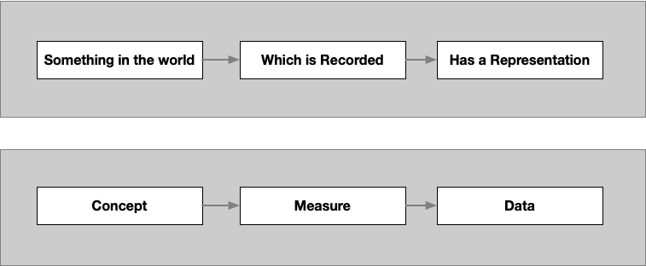
Data as a research object
Notes:
Data is a representation of something in the world, that has been captured in a specific way
Through this course we will use the terms, Concept, Measure and Data

Slide 14
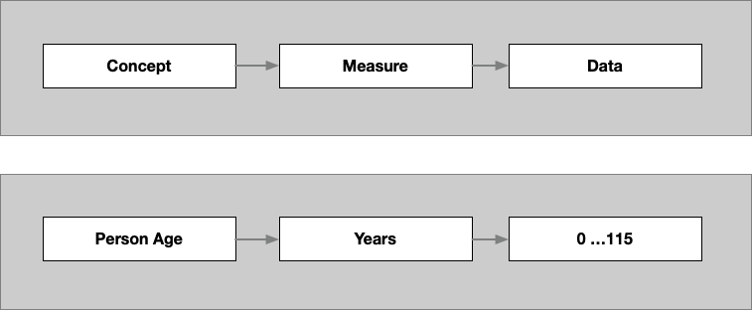
Data as a research object: Examples
Notes:
An example of concept, measure and data are

Slide 15
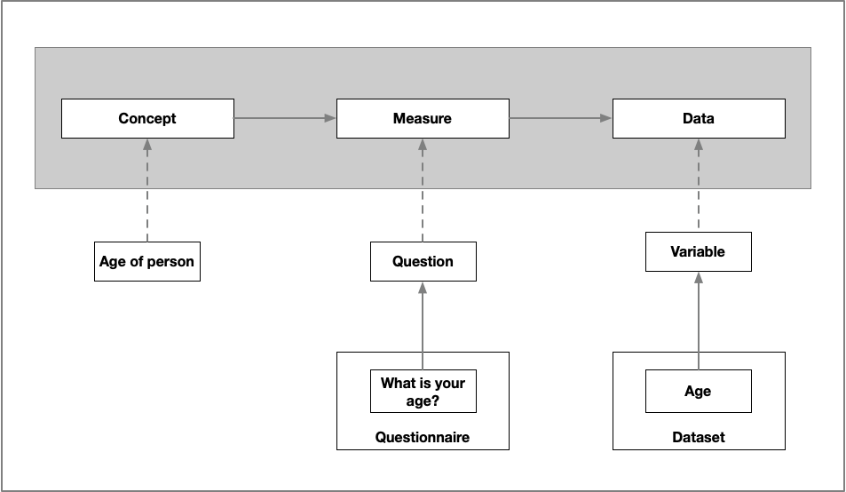
Terminology
Notes:
An example of concept, measure and data are, and the places they exist

Slide 16
Summary
To use data effectively, you will need to understand:
  What concept it is describing
  How it is measured
  How it is represented
  What it represents and how it can be quantified
The purpose of metadata is to provide a framework to describe and understand data, so that it can used in an intelligent and meaningful way

Slide 17
Questions?

Slide 18
What is metadata?
Becky Oldroyd
Notes:
This part of the workshop will explain what metadata is, why it’s important, and what the benefits are to you as a researcher.

Slide 19
Intended Learning Outcomes
Define metadata
Explain why metadata is important
Describe the benefits of creating and using metadata

Slide 20
Outline
What is metadata?
Metadata in everyday life
“Sam1” video
Exercise 2: What information is needed to understand and use data?
Roles of metadata
Why is metadata important?
Benefits of metadata
Summary

Slide 21
What is metadata? (1)
“Data about data”, or “simply data about data” [2]
Wikipedia “data that provides information about other data, but not the content of the data itself” [3]
Parry (2023) writes “metadata is NOT data about data” [4]
Opinions vary, but everyone agrees that metadata has some relationship to data
  Provides a framework to describe and understand data, so that it can be used in an intelligent and meaningful way
Notes:
If you’ve heard of metadata before, you’ll have likely heard the definition “data about data”.
Wikipedia has a slightly different take… (e.g. the date and time of a text message is metadata, but the text of that message is not)
So does a recent paper by Kyle Parry… (it is not just data about data)
Opinions vary, but one thing everyone agrees on is that metadata has a relationship to data – it allows us to make sense of it and use it in an intelligent and meaningful way.
(2) https://dataedo.com/kb/data-glossary/what-is-metadata
(3) https://www.britannica.com/technology/metadata
(4) Parry, K. (2023). Metadata Is Not Data About Data. Decolonizing Data, p15-33

Slide 22
What is metadata? (2)
Is machine-readable, unlike textual metadata like a PDF or journal article or a codebook
  It standardises the content and structure to make it easier for computers to extract information from the metadata
  It must be structured according to a specific set of rules
Tells a computer what something is, how it relates to other things (“objects”), and what to do with it
  Can be provided to researchers to help them discover, understand and access data
Notes:
Metadata is machine-readable…
It categorises things so that computers can understand the meaning of the text - it tells the computer what something is, how it relates to other objects, and what to do with it.
This information or metadata can be provided to researchers to help them discover, understand and access data
Note: A schema is a formal technique for organizing metadata

Slide 23
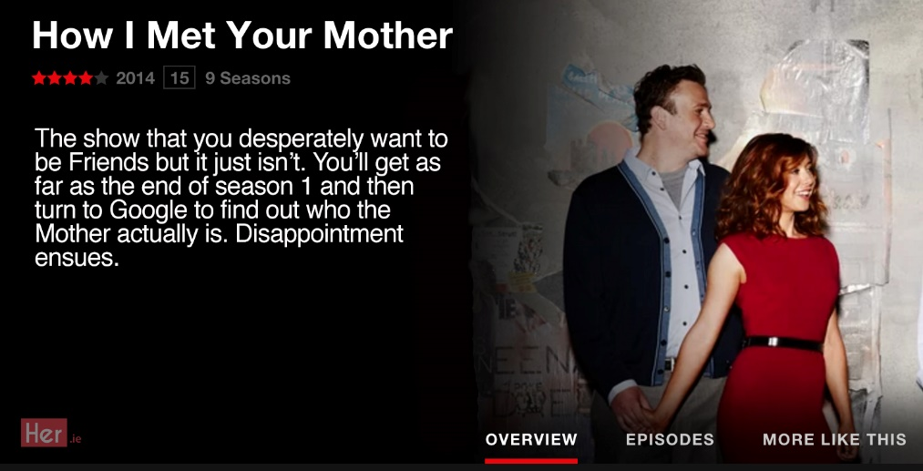
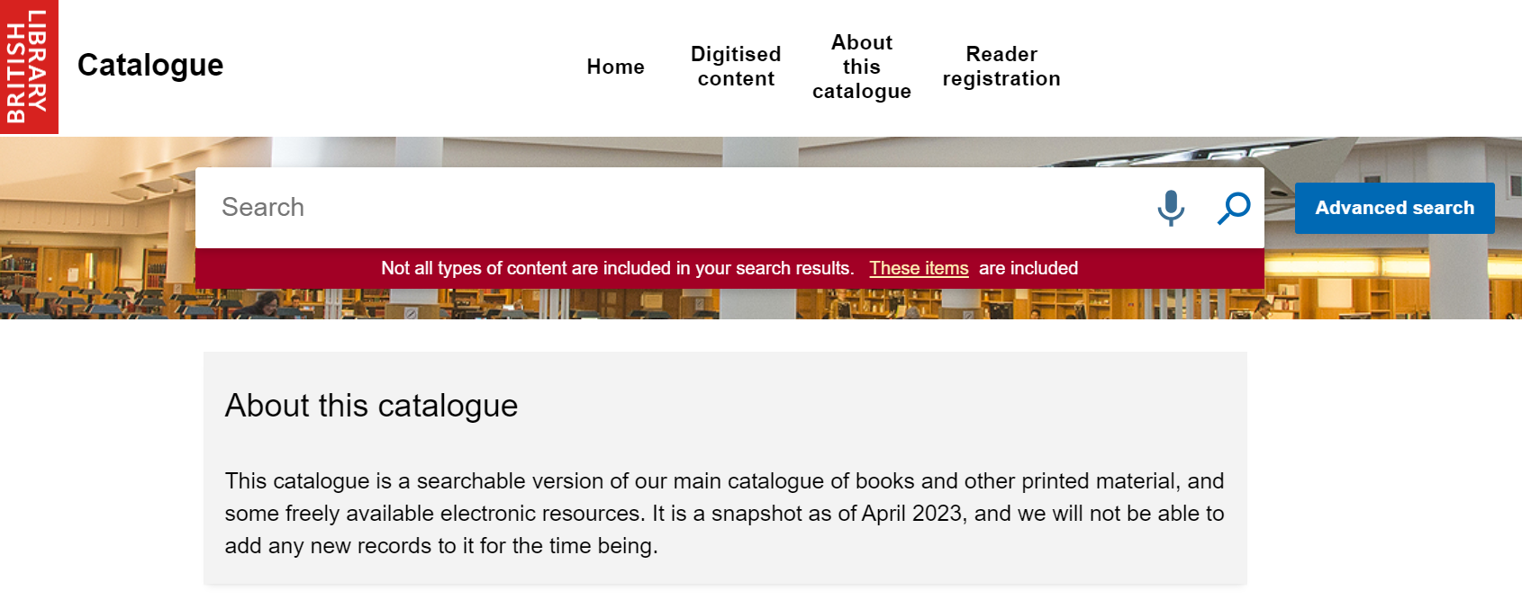
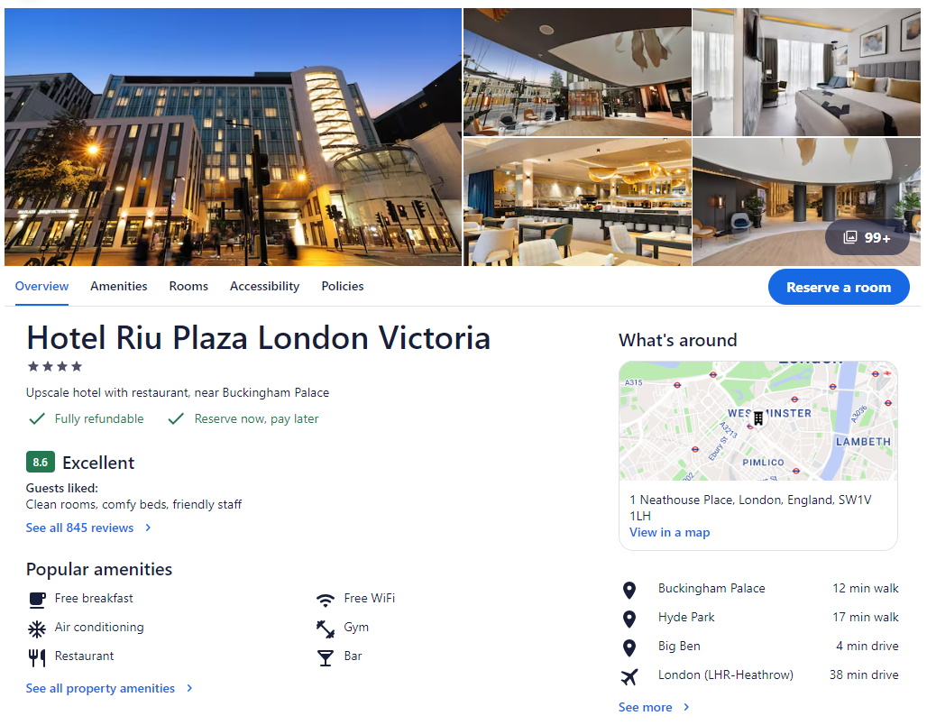
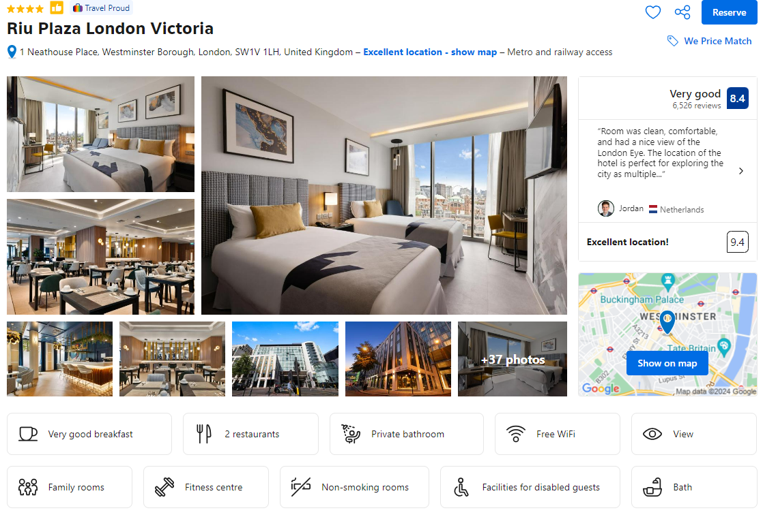
Metadata in everyday life
Metadata is not exclusive to the research/data context
Notes:
We will have all come across metadata in our everyday lives, because it’s also useful outside of the research/data context.
Everything you see on the slide are examples of metadata (travel comparison sites, description of a show on Netflix, an online library), so we use metadata all the time without realising.

Slide 24
Example of a dataset
Person | Sam1 | Sam2 | Sam3 | Sam4 | Sam5
1 | 6 | 170 | 165 |  | 140
2 | 7 | 200 |  | 250 | 180
3 | 18 | 250 | 270 |  | 370
4 | 5 | 125 |  | 190 | 100
5 | 6 | 115 | 140 |  | 275
6 | 5 | 180 | 170 | 190 | 300
Notes:
So now we’ve had a look at examples of metadata in everyday life, let’s have a look at metadata in the context of research data.
On the slide is an example of a dataset with some variables and numbers.
The first thing you might be asking yourself is, what do the variable names “Sam1”, “Sam2” etc stand for?
Dr Judy Benign from NYU also wanted to know the answer to this question, so let’s watch a video to find out how she got on.

Slide 25
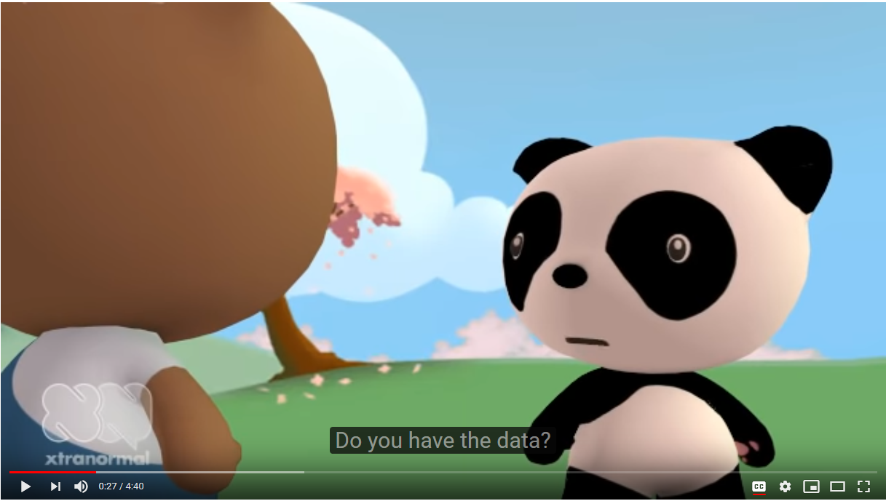
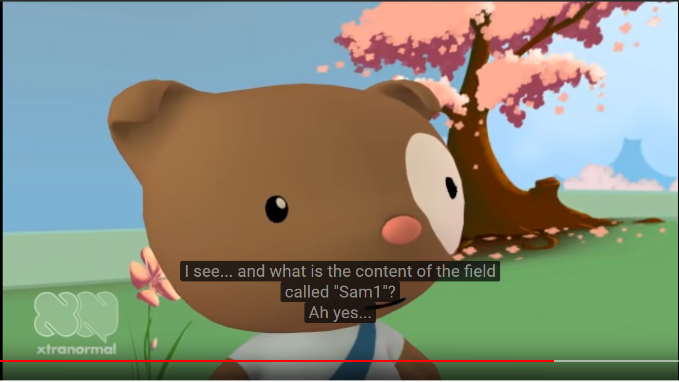
Common issues in (meta)data management
Notes:
https://www.youtube.com/watch?v=66oNv_DJuPc
This scenario might be familiar to you in some way or another, maybe not to this extent, but it highlights some of the key issues in data and metadata management.

Slide 26
Sam1 video reflection
What are some of the key (meta)data management issues that the Sam1 video demonstrates?
Notes:
Feel free to raise your hand or shout out if you have any ideas or thoughts.
In other words, what are some of the problems Dr Judy Benign had when trying to access the data?

Slide 27
Key (meta)data management issues from Sam1 video
Secure data storage
Data not archived
File formats and software
Variable-level information
No researcher identifier
Submitting to an archive
Sharing with your future self
Notes:
The researcher created a dataset, but with no prior thought about how to describe where it is, what it is about, how to use it, or where it came from, to someone else (or themselves!)
Metadata provides the information to do this.

Slide 28
Exercise 2: What information is needed to understand and use this data?
 | n622 | n545 | n1171 | N2REGION | N1112 | N1261
1 | 2 | 4 | 6 | -2 | 1 | 1
2 | 1 | 4 | -1 | 1 | 1 | 1
3 | 1 | 4 | 2 | 1 | 1 | 1
4 | 1 | 4 | 4 | 10 | 1 | 1
5 | 1 | 4 | 4 | 4 | 1 | 1
6 | 2 | 4 | 2 | 1 | 2 | 1
7 | 2 | 4 | 6 | 2 | 1 | -1
8 | 2 | 5 | 2 | 4 | 1 | 1
9 | 1 | 5 | 4 | 1 | 1 | 1
10 | 1 | 5 | 4 | 1 | 1 | 1
11 | 2 | 5 | 3 | 2 | -1 | -1
12 | 2 | 4 | -1 | 1 | -1 | -1
13 | 1 | 4 | 3 | 1 | 1 | 1
14 | 2 | 4 | 2 | 4 | 1 | 1
15 | 2 | 4 | -1 | 7 | 1 | 1
16 | 2 | 4 | 1 | 7 | 1 | 1
17 | 2 | 4 | 3 | 2 | -1 | 1
18 | 2 | 4 | 6 | 2 | 1 | 1
19 | 2 | 4 | 6 | 10 | 1 | 1
Notes:
Let’s have a look at more of a contextualised example of how metadata can help us to understand and use data.
On the slide is a screenshot of a dataset.
With the people on your table, please take a couple of minutes to discuss what information you would need in order to be able to understand and use this data.
Study: National Child Development Study
Sweep: Age 7 Survey (1965)
Data File: NCDS1 Parental Questionnaire (1965) Dataset

Slide 29
Example questions to understand and use the data
What is the study about?
What were the response options?
 | n622 | n545 | n1171 | N2REGION | N1112 | N1261
1 | 2 | 4 | 6 | -2 | 1 | 1
2 | 1 | 4 | -1 | 1 | 1 | 1
3 | 1 | 4 | 2 | 1 | 1 | 1
4 | 1 | 4 | 4 | 10 | 1 | 1
5 | 1 | 4 | 4 | 4 | 1 | 1
6 | 2 | 4 | 2 | 1 | 2 | 1
7 | 2 | 4 | 6 | 2 | 1 | -1
8 | 2 | 5 | 2 | 4 | 1 | 1
9 | 1 | 5 | 4 | 1 | 1 | 1
10 | 1 | 5 | 4 | 1 | 1 | 1
11 | 2 | 5 | 3 | 2 | -1 | -1
12 | 2 | 4 | -1 | 1 | -1 | -1
13 | 1 | 4 | 3 | 1 | 1 | 1
14 | 2 | 4 | 2 | 4 | 1 | 1
15 | 2 | 4 | -1 | 7 | 1 | 1
16 | 2 | 4 | 1 | 7 | 1 | 1
17 | 2 | 4 | 3 | 2 | -1 | 1
18 | 2 | 4 | 6 | 2 | 1 | 1
19 | 2 | 4 | 6 | 10 | 1 | 1
When was the data collected?
What was the intent/concept of the question?
What are the categories?
How was the data collected?
What was the data capture (i.e. the question)?
What are the variables?
Who is the data about?
What type are the data?
What was the previous question?
What are the missing values?
Where was the data collected?
Who created it?
Notes:
Here are just some of the questions we would need to answer to be able to find, understand, and use the data.
First and foremost, we need to know who collected the data? What data did they collect? When was it collected? Where was it collected? And how was it collected? - One way to think about metadata is that it is the who/what/where/when/how of the data.
Having this metadata helps to provide additional context about the data. For example, knowing how the data was collected (for instance, whether the data is a self-report vs. physical measurement) helps us to assess how valid and accurate the data is.
This example shows us how metadata is necessary to understand someone else’s data, but it’s also good to consider how this information might be useful for your future self when working on your own data, so you don’t end up in a Sam1 situation!
Capturing this information (or metadata) means that the data is available for re-use, and it also makes it machine-actionable to make data management easier and more efficient, and the data more discoverable.

Slide 30
Roles of metadata
Metadata supports three main uses:
  Understandability and context - it helps to convey the meaning of resources
  Use and action - it describes the limits of reasonable use or what actions can be taken
  Discovery - it helps people to find relevant resources

Slide 31
Why is metadata important?
Metadata is the core component of Research Data Management (RDM)
  RDM is the “storage, access and preservation of data created or collected in the course of research” [6]
It may be required by...
  Institutes (in your working contract or project agreements)
  Funding agencies (ensure reusability and meet FAIR requirements)
  Journals (as a condition for publishing)
  Supervisors (data citation to enhance researcher reputation)
  Projects (collaboration across agencies/organisations)
Notes:
So far, we’ve described what metadata is. But why is it important?
Metadata is the core component of RDM, which is the …
There are several external reasons why we might be required to document metadata…
(6) CODATA RDM Terminology Working Group. (2024). CODATA RDM Terminology (2023 version): overview (Version 2023). Zenodo. https://doi.org/10.5281/zenodo.10626170

Slide 32
Benefits of metadata for you
Preserves resources
Helps your future self understand and reuse the data
Helps others find, understand, compare, and use your data
More accurate, higher-quality research results
Open science - proof of transparent and valid conduct
Notes:
As well as external factors, metadata is helpful for your future self, to help you understand your data later down the line, and be able to share it in a meaningful way with others.

Slide 33
Summary
Metadata is information that describes data
Metadata is based on a structure that can be processed by a computer
Metadata is important for your future self and others to discover, understand and use data
Metadata allows researchers to use data effectively because it includes the important information needed to exploit the full potential of data

Slide 34
Questions?

Slide 35
What is FAIR?
Hayley Mills

Slide 36
Intended Learning Outcomes
Define the FAIR principles
Explain why the FAIR principles are important
Illustrate how you can help implement the FAIR principles

Slide 37
Outline
Exercise 3: Challenges with re-using data
What is FAIR?
The role of metadata in FAIR
Why is FAIR important?
Why is FAIR important for you?
Your potential responsibilities
Summary

Slide 38
Exercise 3: Challenges with re-using data
Think back to your own experiences and/or the Sam1 video
When trying to find, access and re-use existing data, what made the process difficult or what could have made it easier?

Slide 39
Exercise 3: Research Discussion
Data in unusable or proprietary software
Cannot find the data from a publication
Broken links
Limited information about the data
Multiple places to look
Need to request access before can view the data
Unclear data access process, how long it takes, cost etc.
Limited context to understand the data
Notes:
So most or all of these issues could be resolved through implementing FAIR principles, so we'll go through what they are next.

Slide 40
What is FAIR?
Aims to optimise the reuse of data
Findable
Accessible
Interoperable
Re-usable
Notes:
So you can see how these relate to some of the potential problems that we discussed in the exercise.
(7) Wilkinson MD, Dumontier M, Aalbersberg IJJ, Appleton G, Axton M, Baak A et al. The FAIR Guiding Principles for scientific data management and stewardship. Scientific Data. 2016;3. 160018 https://doi.org/10.1038/sdata.2016.18

Slide 41
What is FAIR? F & A
Findable: Meta(data) should be easy to find for both humans and computers
  e.g. meta(data) platforms for easier discovery
  e.g. use of DOIs
Accessible: Users need to know how the data can be accessed
  e.g. what the access process is

Slide 42
What is FAIR? I & R
Interoperable: Data can be integrated with other data and work with applications or workflows for analysis, storage, and processing
  e.g. standardised technology and available software
  e.g. computers can understand what the data is
Re-usable: Meta(data) should be well-described so that they can be replicated and/or combined
  e.g. metadata to provide context
  e.g. use of standardised terms

Slide 43
The role of metadata in FAIR
The key to FAIR data is metadata
FAIR principles rely on metadata for their implementation
FAIR data does not equal open data, and so FAIR data do not have to be open
For much of the data relating to humans, due to disclosure and sensitivity issues, data cannot be open, so FAIR metadata is even more important

Slide 44
Why is FAIR important?
To meet the expectations of researchers in the 21st century
Speeds up the progress of research
Improves our confidence in data and research
Maximises the value and usefulness of data
Ensures long-term preservation

Slide 45
Why is FAIR important for you?
Helps demonstrate the impact of research when people re-use and cite your dataset, so you get credit for all your outputs
Easier for others to find your data and increases your visibility
Scientific journals and funders now require scientists to share data
Produces quality data and accurate research results
Provides proof of transparent and valid conduct
Easier to search, find, assess and access useable, clear, understandable data in a straightforward and timely way
Notes:
(8)https://www.scinote.net/blog/fair-principles/
(9) https://sites.google.com/sheffield.ac.uk/fair-guidance/home

Slide 46
Implementing FAIR
Infrastructures such as archives and metadata platforms are in the ideal position and have the most responsibility in implementing FAIR
Provide:
  Persistent identifiers e.g. DOIs
  Managing and providing vocabularies
  Platforms to hold discoverable, consistent metadata
  Governance arrangements to access data

Slide 47
Implementing FAIR - Examples
Archives and catalogues which help researchers discover data (e.g. UKDS Data catalogue)
Rich, comprehensive metadata repositories which help researchers discover, assess and understand data (e.g. CLOSER Discovery)
You can help infrastructures provide these services by supplying quality metadata

Slide 48
Your potential responsibilities (1)
Understand the value of sharing and reusing data and FAIR principles
Plan your data management and create a Data Management Plan (DMP) [10]
  Think about and document your plans to prevent future data issues e.g. documentation, storage and preservation
Notes:
(10) https://ukdataservice.ac.uk/learning-hub/research-data-management/plan-to-share/data-management-planning-overview/

Slide 49
Your potential responsibilities (2)
Document your data using metadata
  What metadata is most important to create for own use and use by others
  Create and store your metadata from the start, use and update this throughout the process so it’s ready when needed
Use existing vocabularies, classifications, ontologies etc. when possible
  e.g. Controlled Vocabularies for mode of collection [11]
  e.g. Survey responses Office for National statistics ethnic group classification [12]
Notes:
(11) https://vocabularies.cessda.eu/
(12) https://www.ons.gov.uk/methodology/classificationsandstandards

Slide 50
Your potential responsibilities (3)
Deposit your data in an archive
  If you need to deposit your data, find an appropriate archive e.g. UKDS or your university
  Provide the data in their preferred format
  Seek advice to anticipate what metadata to provide
Link and cite
  Link your publications/data to your ORCID ID [13]
  Cite the data that you have used using a DOI
Notes:
(13) https://orcid.org/

Slide 51
Summary
Findable, Accessible, Interoperable, Re-usable
Aims to optimise and make reuse of data easier
Metadata is key to FAIR
Metadata should ideally be documented from the start and updated throughout to feed into FAIR processes
Infrastructures are best placed to implement FAIR for the benefit of users
Data producers and users need to contribute to create FAIR data

Slide 52
Questions?

Slide 53
Workshop summary
Hayley Mills

Slide 54
Recap of Intended Learning Outcomes
Demonstrate a firm understanding of what data is and its purpose in research
Define metadata ​
Explain why metadata is important​
Describe the benefits of creating and using metadata​
Define the FAIR principles
Explain why the FAIR principles are important
Illustrate how you can help implement the FAIR principles

Slide 55
Key takeaways (1)
Data is a collection of values that convey information, describing units of meaning that may be interpreted formally
Data captures a measurement of a concept which relates to something in the real world
Metadata provides a framework to describe and understand data, so it can be used in an intelligent and meaningful way
Metadata is key to FAIR
FAIR are a set of ‘Guiding Principles’ for scientific data management and stewardship which optimises the reuse of data

Slide 56
Key takeaways (2)
Creating metadata;
  is important for your future self and others to discover, understand and use data
  may be required by external organisations to support FAIR principles
Infrastructures are best placed to implement FAIR for the benefit of users
Data producers and users can contribute to creating FAIR data
Make a plan early in the research process for your data management
Create and store your metadata from the start which can be used and updated throughout the process, and ready when needed

Slide 57
Exercise 4: Your action
Write down one practical action you can do to make your data more FAIR
or
Write down one practical action you can do to incorporate metadata documentation into your research project

Slide 58
Questions?

Slide 59
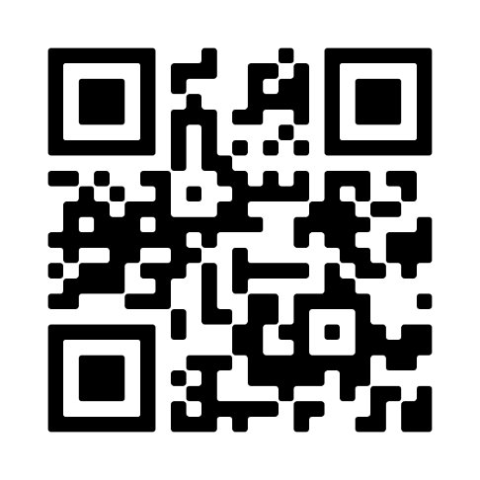
Please provide us with feedback
We would really appreciate it if you could let us know your thoughts on the session. Your comments will help us plan and improve our future events.
​
It should take roughly 2 minutes to complete.
https://qrco.de/methodscon

Slide 61
References and Resources: Data
[1] Wikipedia data definition

Slide 62
References: Metadata
[2] https://dataedo.com/kb/data-glossary/what-is-metadata
[3] https://www.britannica.com/technology/metadata
[4] Parry, K. (2023). Metadata Is Not Data About Data. Decolonizing Data, 15-33
[5] Sam1 YouTube video
[6] CODATA RDM Terminology Working Group. (2024). CODATA RDM Terminology (2023 version) https://doi.org/10.5281

Slide 63
References: FAIR
[7] Wilkinson MD, Dumontier M, Aalbersberg IJJ, Appleton G, Axton M, Baak A et al. The FAIR Guiding Principles for scientific data management and stewardship. Scientific Data. 2016;3. 160018 https://doi.org/10.1038/sdata.2016.18
[8] SciNote blog - FAIR Principles
[9] University of Sheffield - Making research FAIR
[10] UKDS DMP
[11] CESSDA Vocabularies
[12] ONS classificactions
[13] ORCID

Slide 64
Resources: FAIR
GoFAIR - FAIR principles
University of Sheffield - FAIR case studies
FAIRy Tale

