Slide 1
Dr Zoe Handley, Dr Philip Harrison, and Viktor Czyzewski
The University of York
Experience Sampling for Social Research: Setting Up and Validating an Open Source App
Email: zoe.handley@york.ac.uk, philip.harrison@york.ac.uk, viktor.czyzewski@york.ac.uk

Slide 2
Project team and acknowledgements
Co-investigators
Dr Zoe Handley, The University of York
Dr Clare Wright, The University of Leeds
Research Software Engineers
Dr Phil Harrison, The University of York
Dr Stuart Lacy, The University of York
Viktor Czyzewski, The University of York
The project team would like to thank Dr Henriette Arndt and the team at Lund University, Sweden, who developed the Lang Track App which was adapted for use in this project.

Slide 3

Plan
Experience sampling
The LangTrack App
Setting up an open-source app
Approval procedure
The iSpeak project
Discussion

Slide 4
Experience sampling
What is experience sampling?
Benefits over diaries etc.
  Participants are prompted to complete several short surveys per day
  Event-based sampling: Survey is completed every time an event occurs
  Signal-based sampling: Survey is completed at regular intervals
  Used to study current behaviours, moods, thoughts, feelings, social context, etc.
              Immediacy and ecological validity
              Enables tracking over time and context
              Enables estimates of typical behaviour
              Permits analysis of within-participant variation by day and time
  Arndt, H. L., Granfeldt, J., & Gullberg, M. (2023). The Lang‐Track‐App: Open‐Source Tools for Implementing the Experience Sampling Method in Second Language Acquisition Research. Language Learning, 73(3), 869-903.

Slide 5
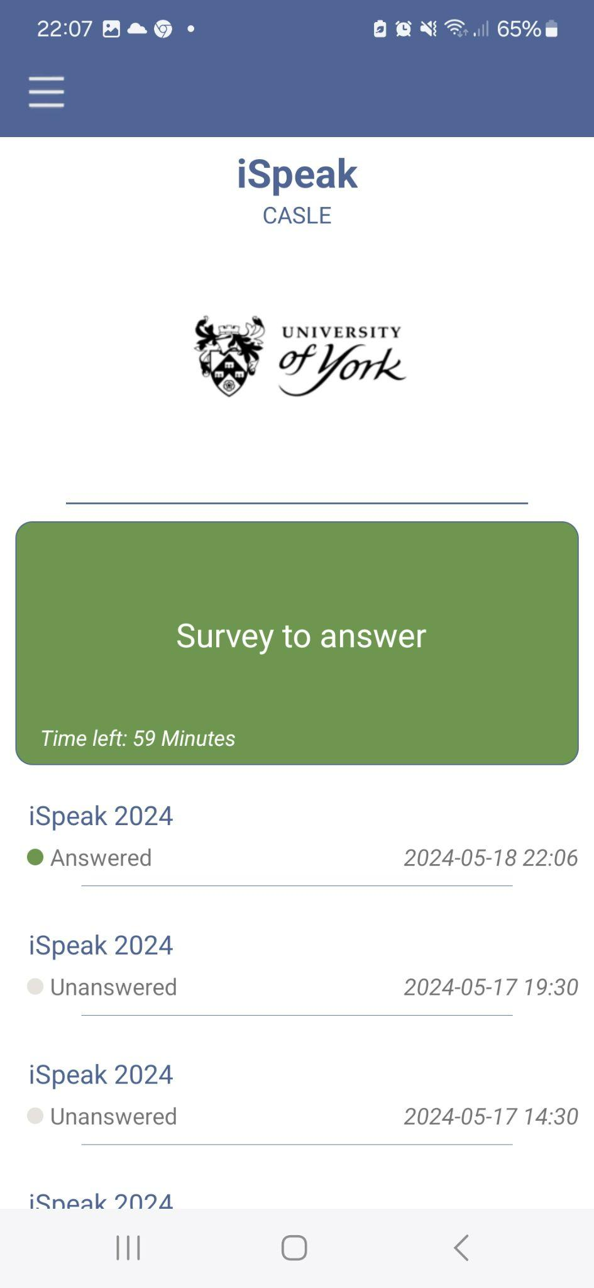
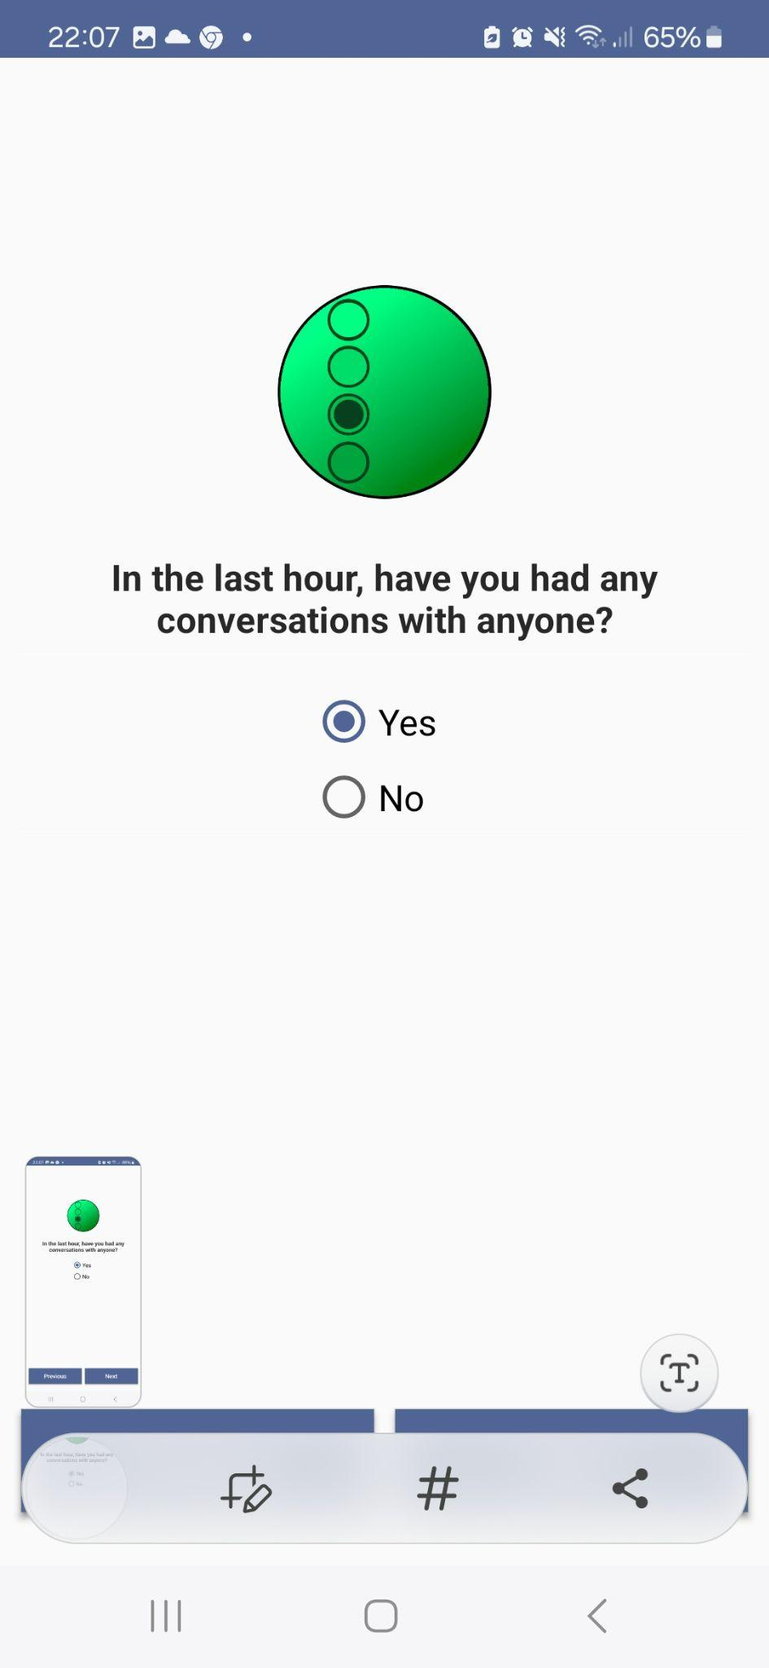
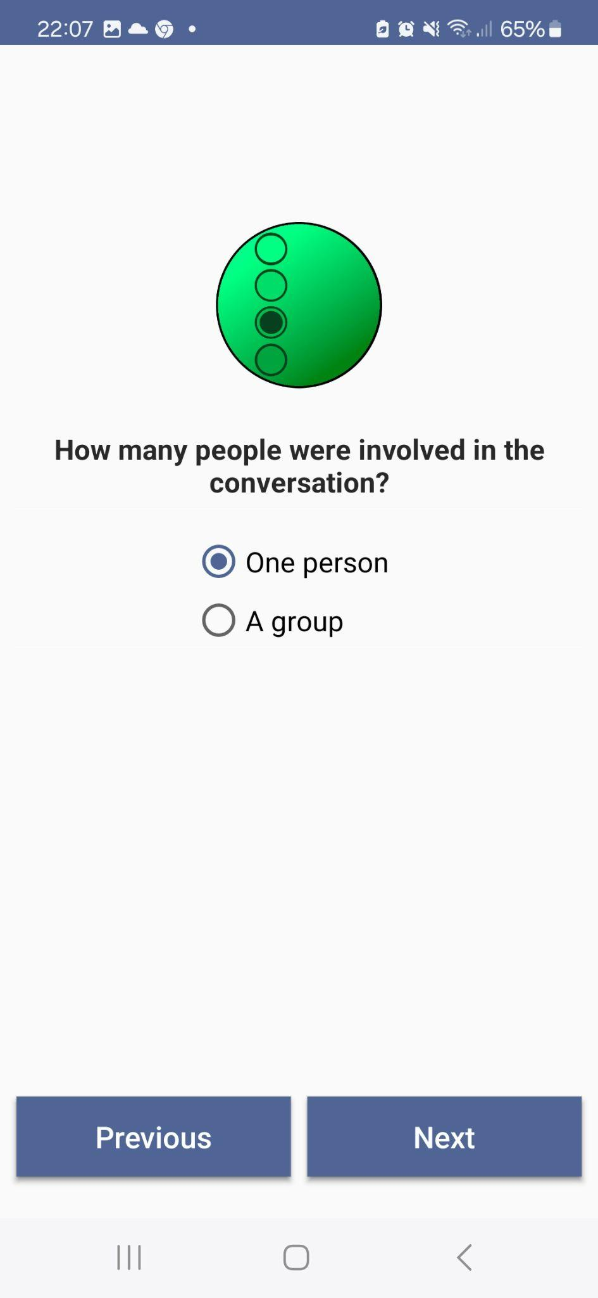
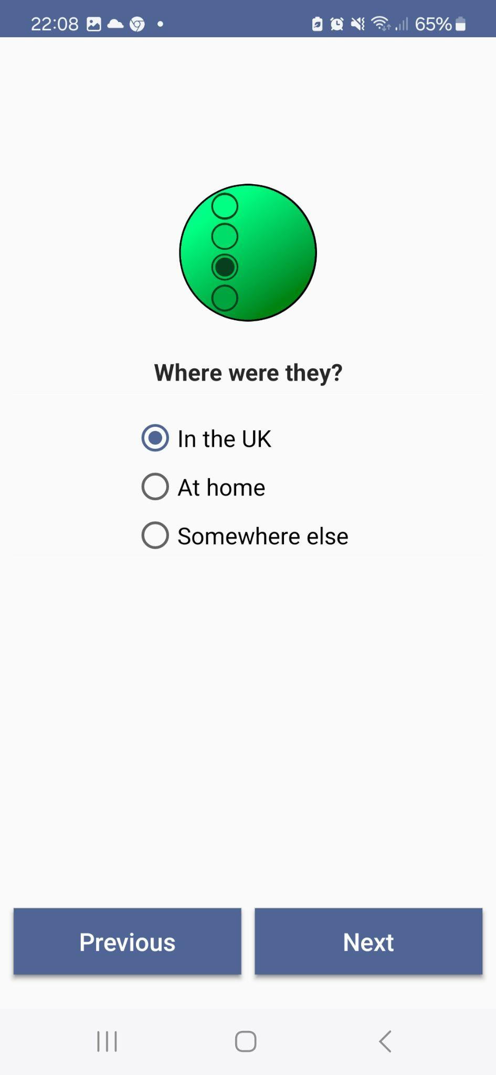
The Lang Track App
Open-source app
Author surveys
Schedule surveys
For language research
Customisable for social research
All original code available at https://github.com/HumlabLu/HumlabLu
User documentation: PDF Handbook
  Arndt, H. L., Granfeldt, J., & Gullberg, M. (2023). The Lang‐Track‐App: Open‐Source Tools for Implementing the Experience Sampling Method in Second Language Acquisition Research. Language Learning, 73(3), 869-903.

Slide 6


Who are Research Software Engineers?
Develop software for research projects
  Create new bespoke code
  Adapt existing code
  Implement other people’s code
Promote software sustainability
  Well written, reusable, modifiable code
  Good documentation
  Version control
Work in collaboration with researchers
Also provide advice, guidance & teaching
Many universities have RSEs available
  Usually pool buyout model for time %FTE
  Write funding into grants (UKRI etc)
  Free consultations
For more information see:
https://society-rse.org/
https://www.software.ac.uk/

Slide 7

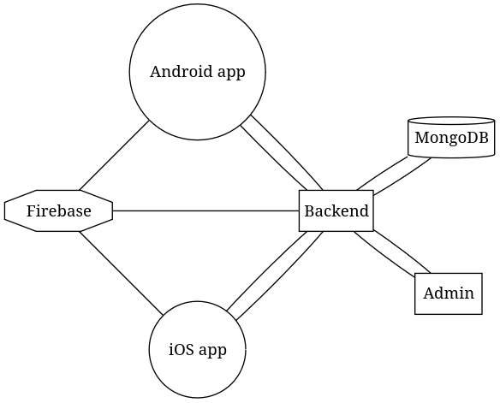



Architecture
Main components:
Backend server (Linux VM)
Web admin interface (Vue)
Database (MongoDB)
Notifications (Firebase)
Authentication (Firebase)
Android app (Kotlin)
iOS app (Swift)

Slide 8
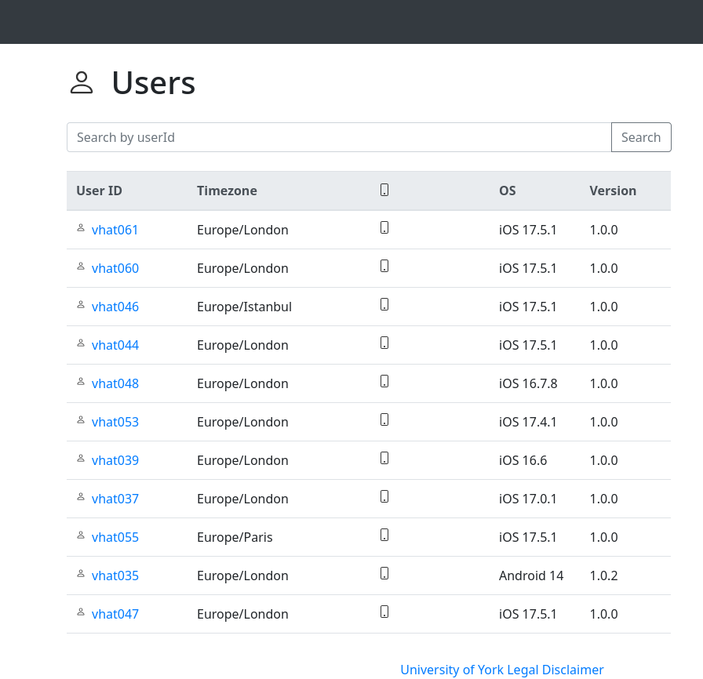
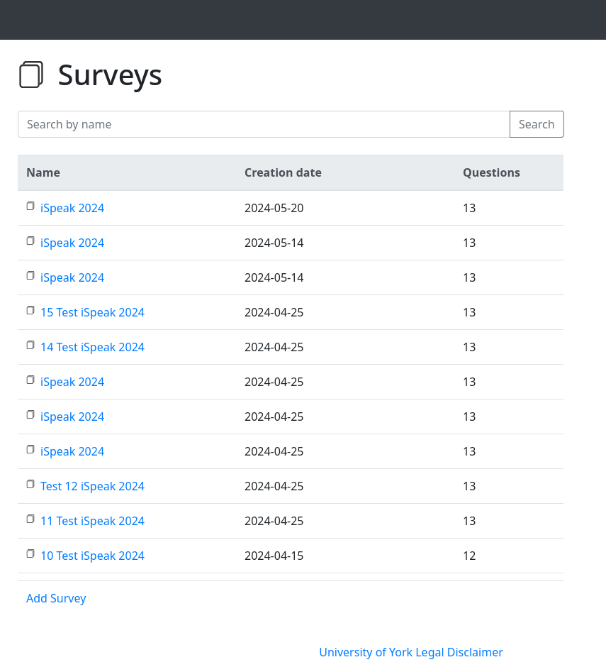
Users & Surveys Lists

Slide 9
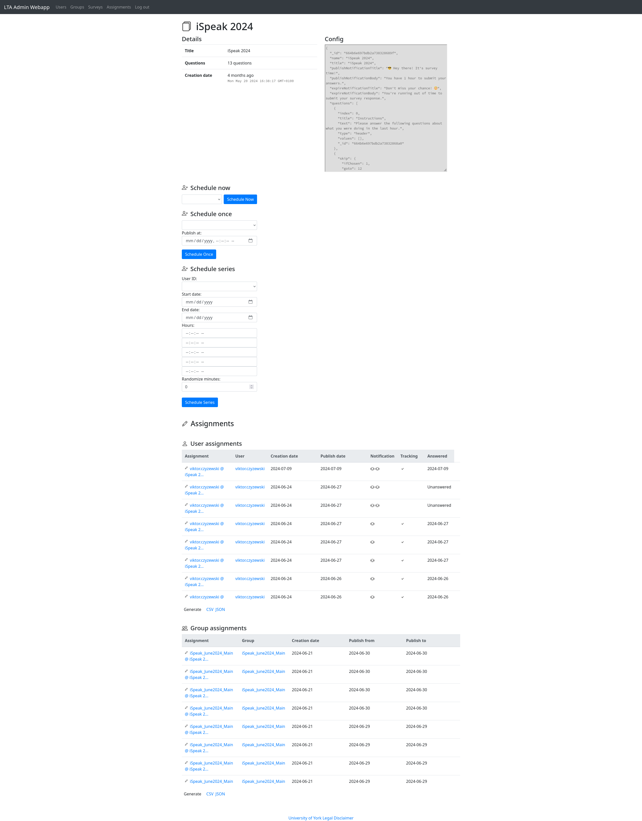
Survey Configuration
Possible question types:
Single-response multiple choice
Multiple-response multiple choice
Fill-in-the-blank
Open-ended text
Questions about time
5-point Likert scale
Slider scale 0 to 100
Survey logic - skip, conditionals (branching)

Slide 10


Slide 11
Scheduling
Schedule now
  Publish survey once, immediately
Schedule once
  Publish survey once, at a specific time
Schedule series
  Schedule recurring surveys

Slide 12
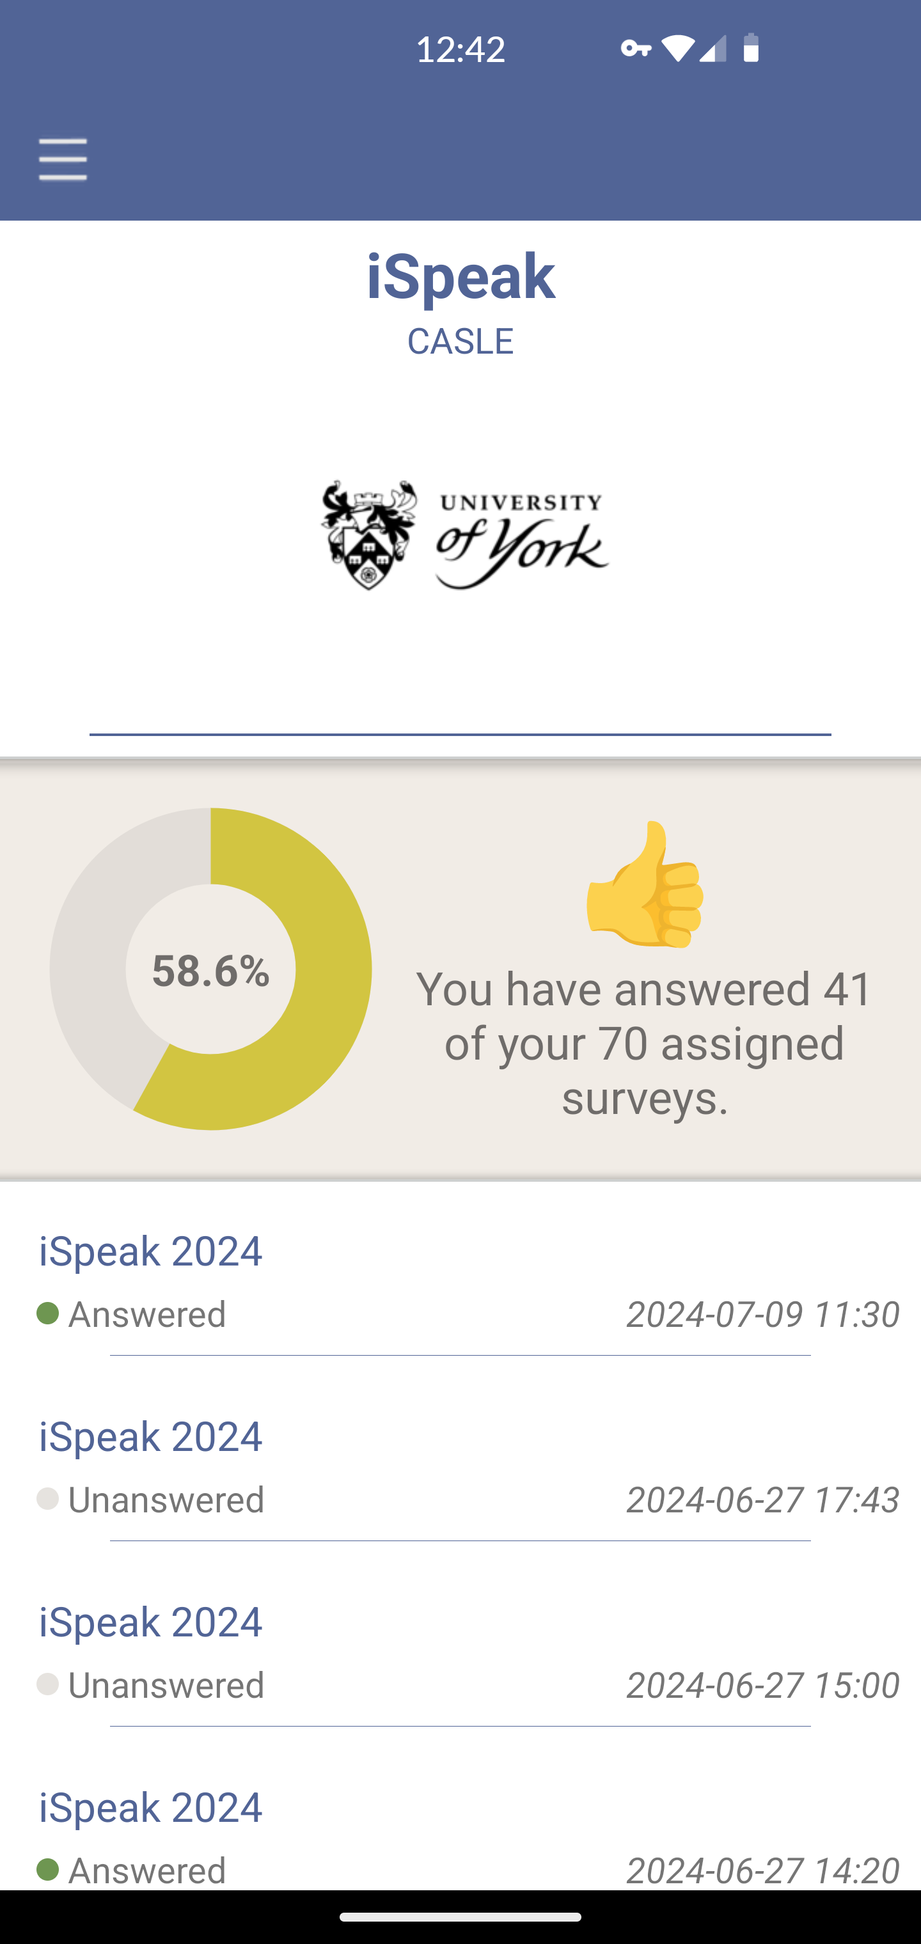
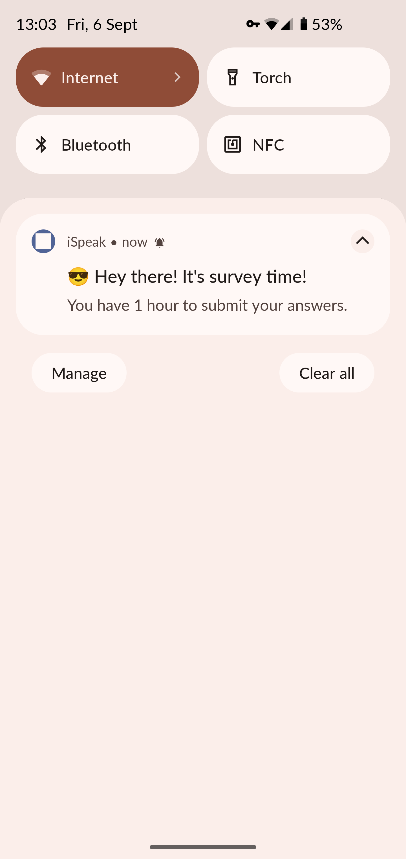
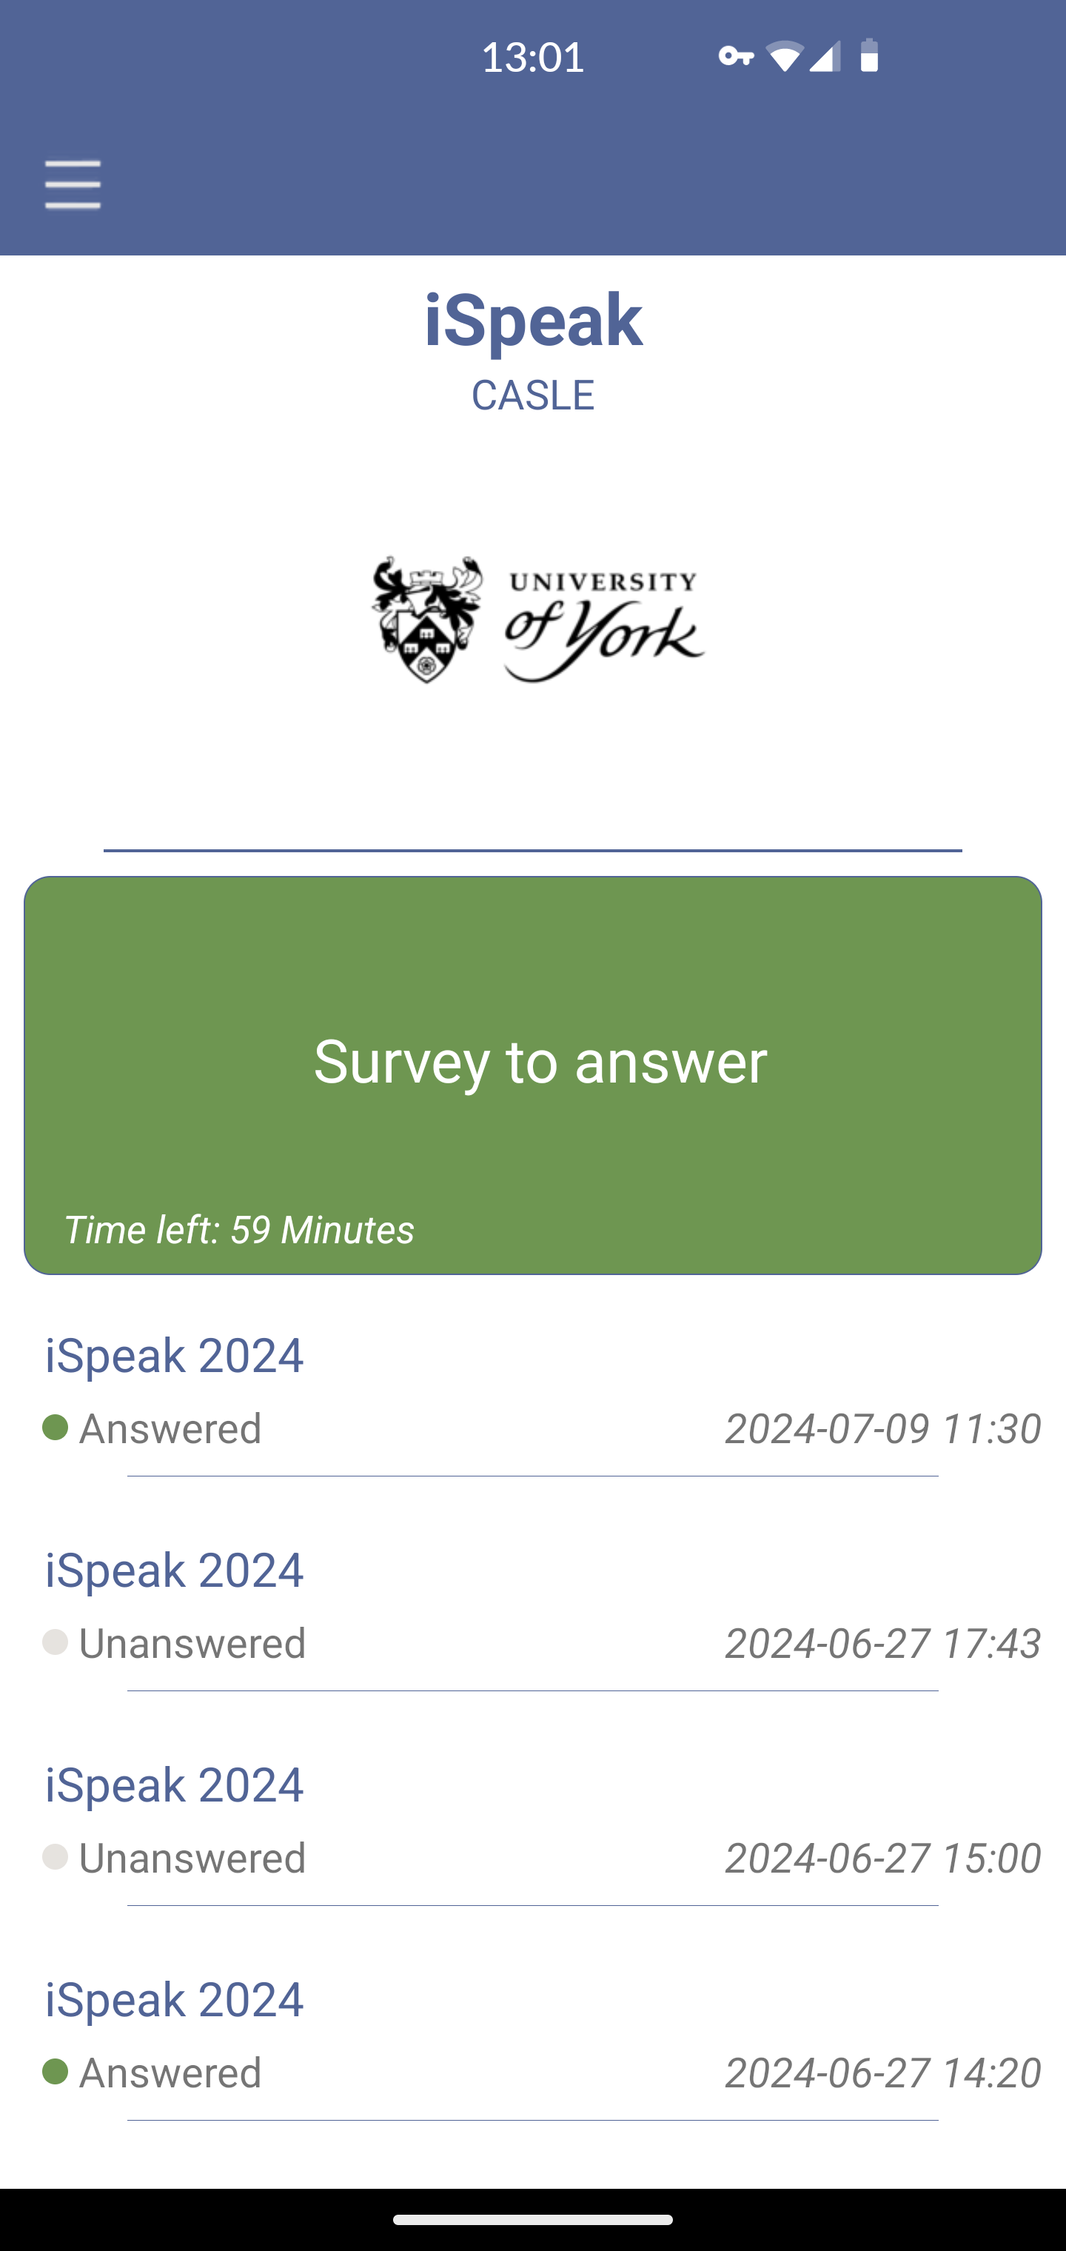

Slide 13
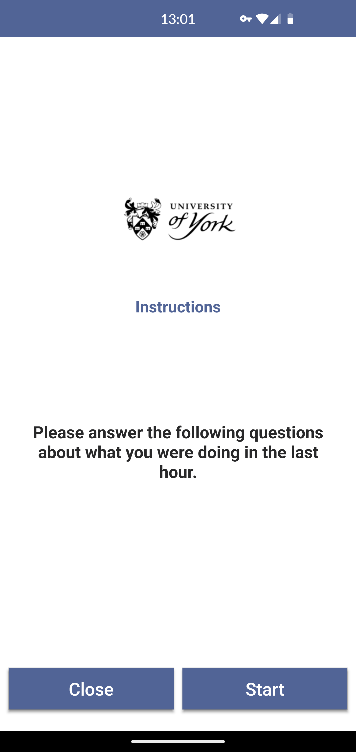
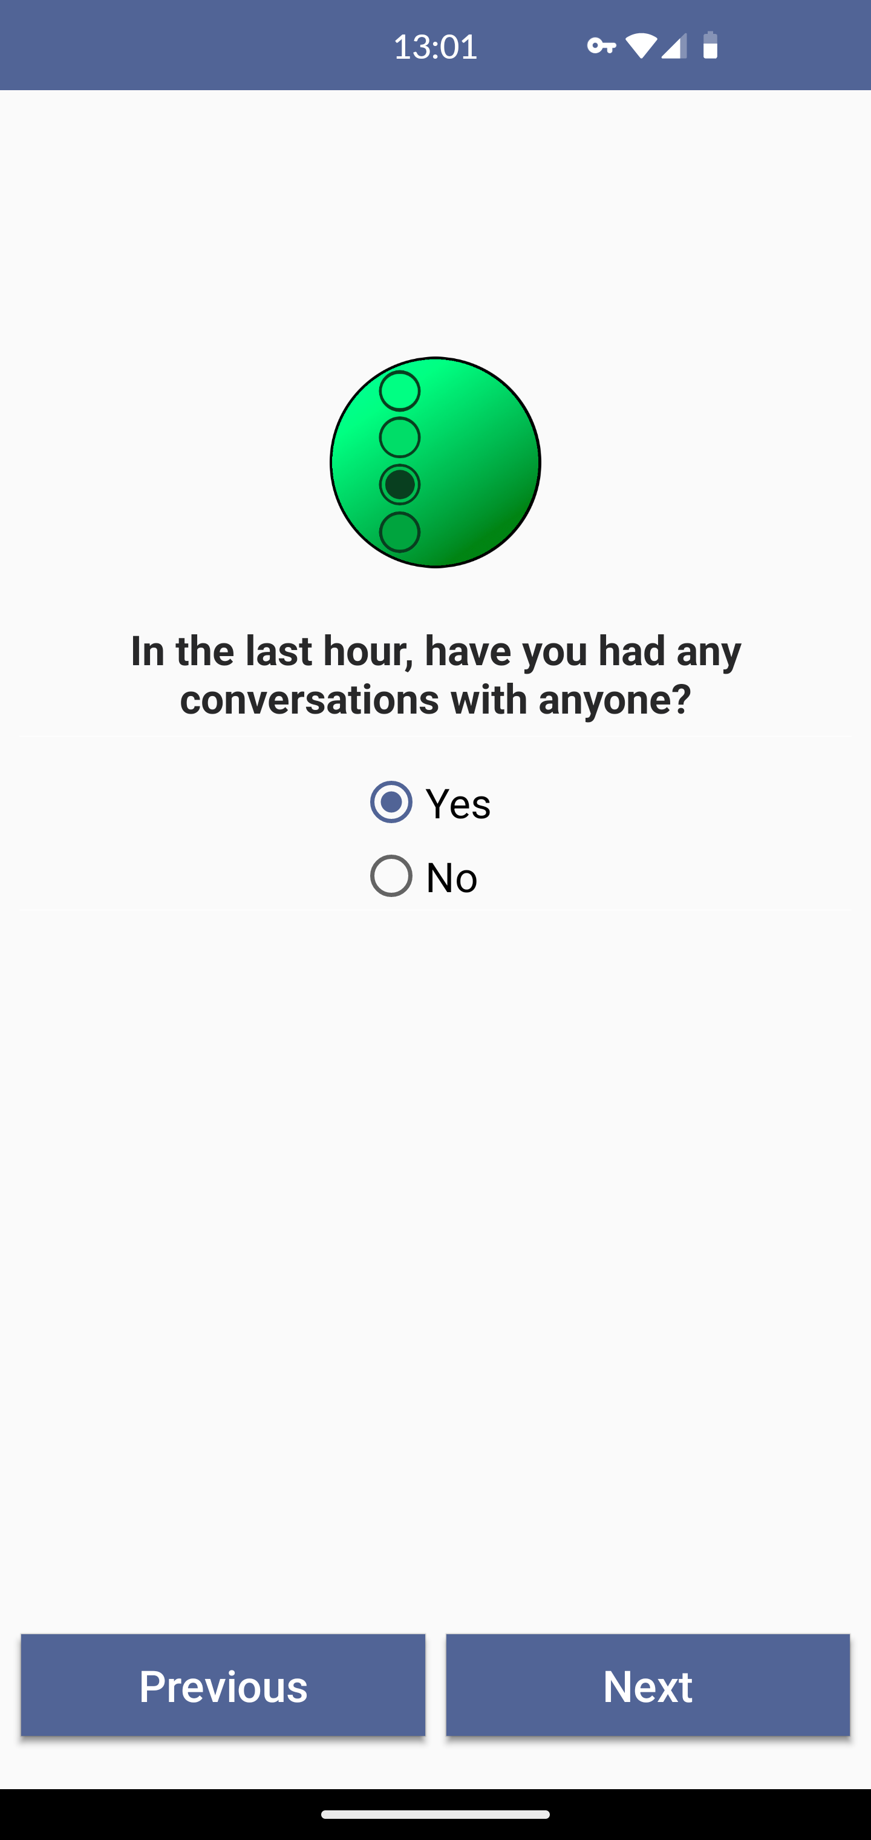
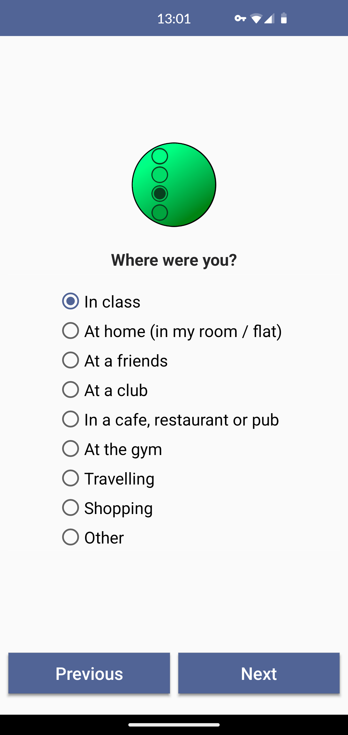
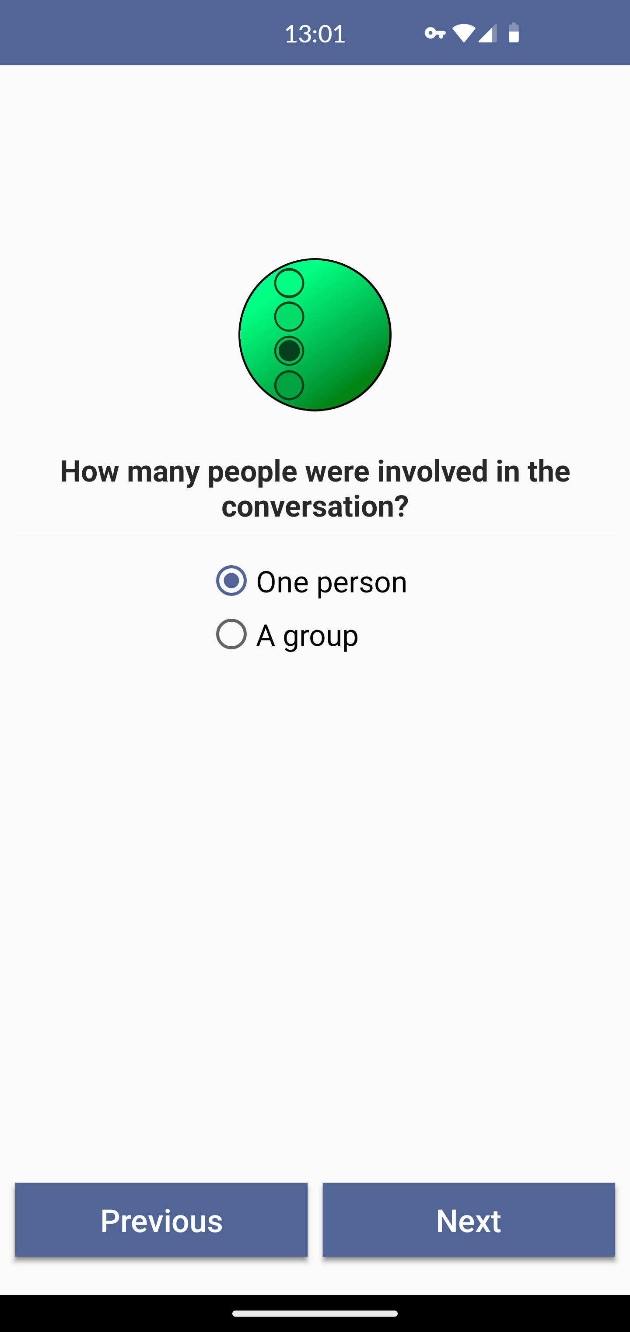

Slide 14
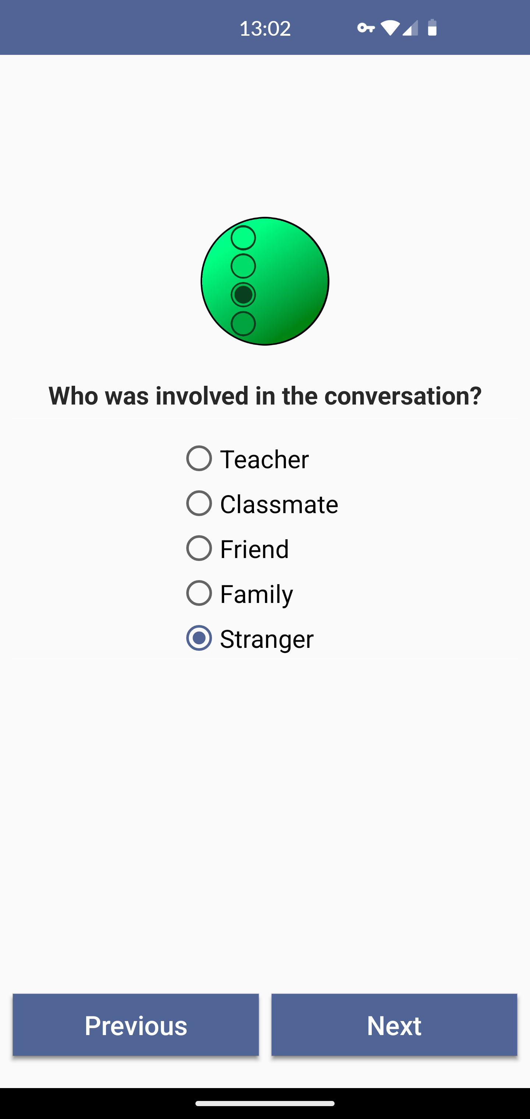
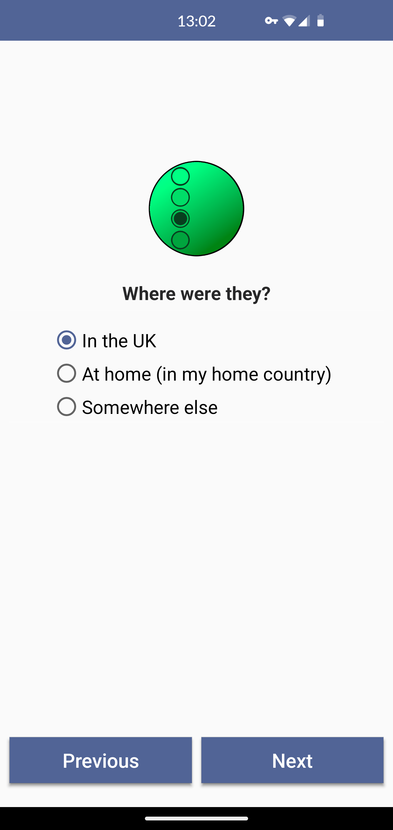
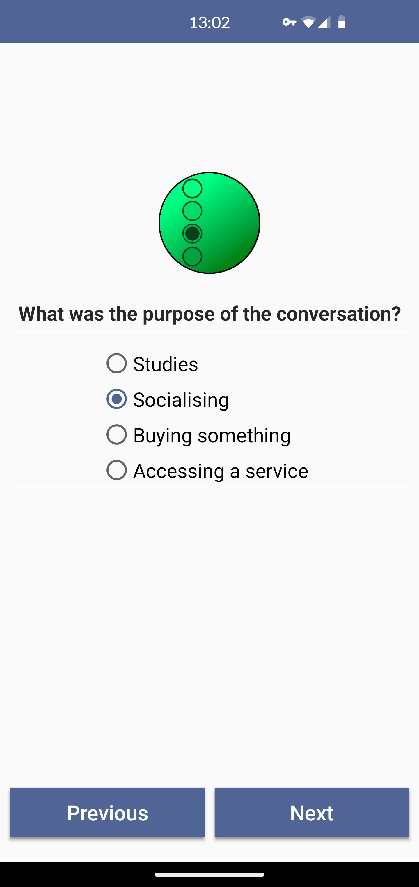
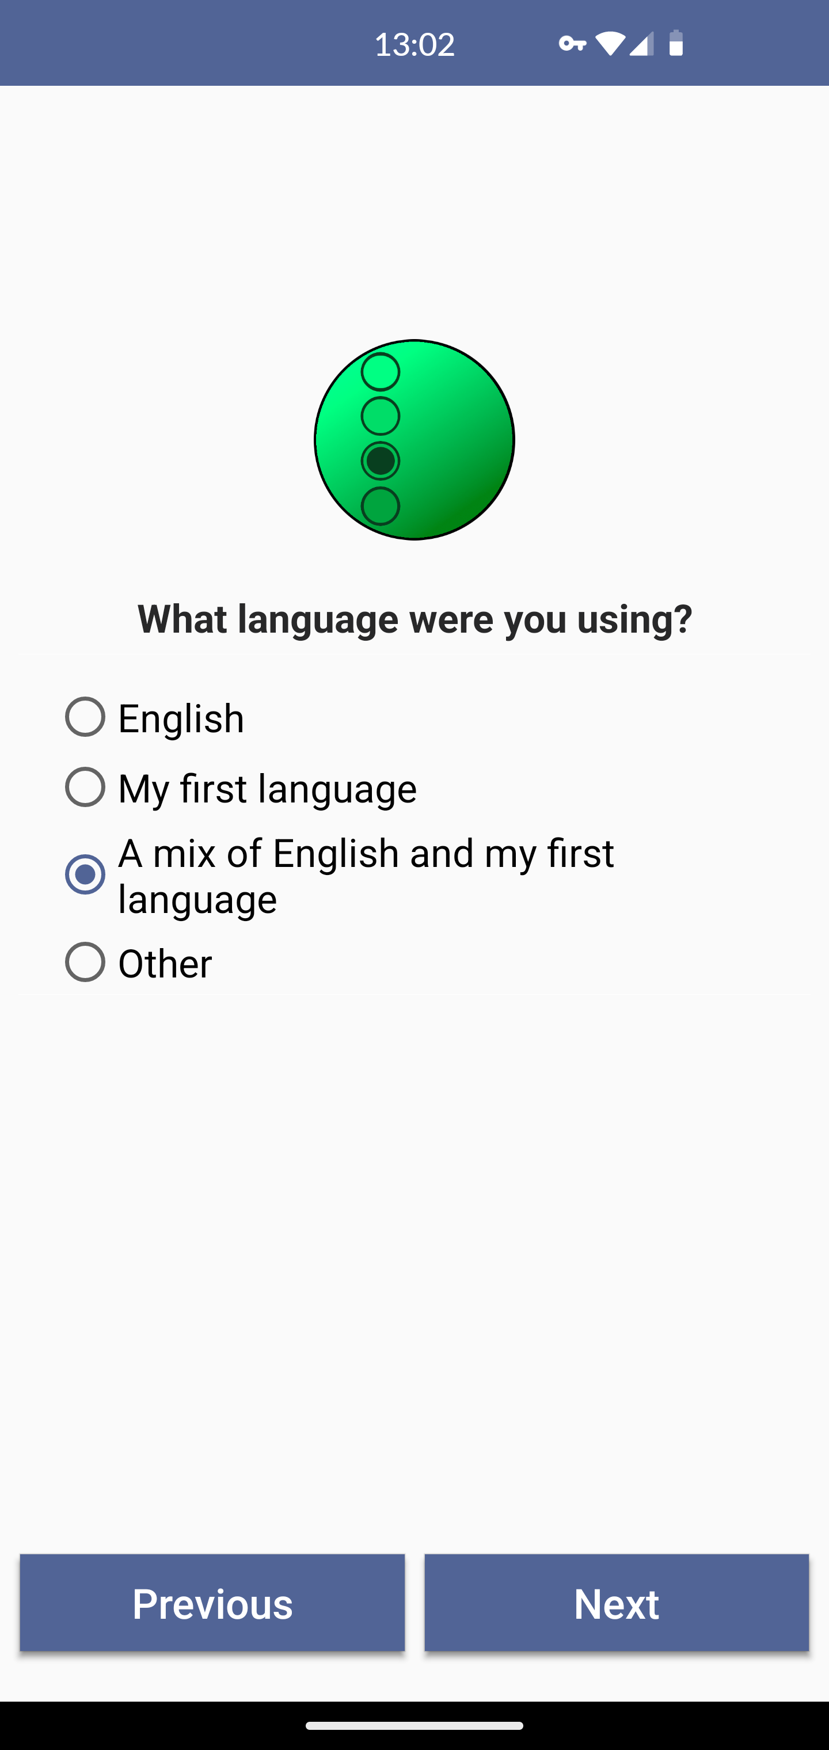

Slide 15
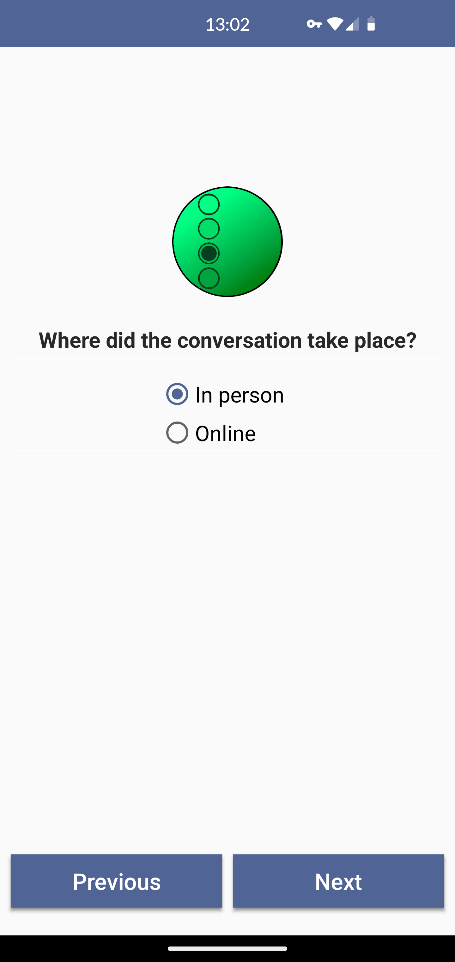
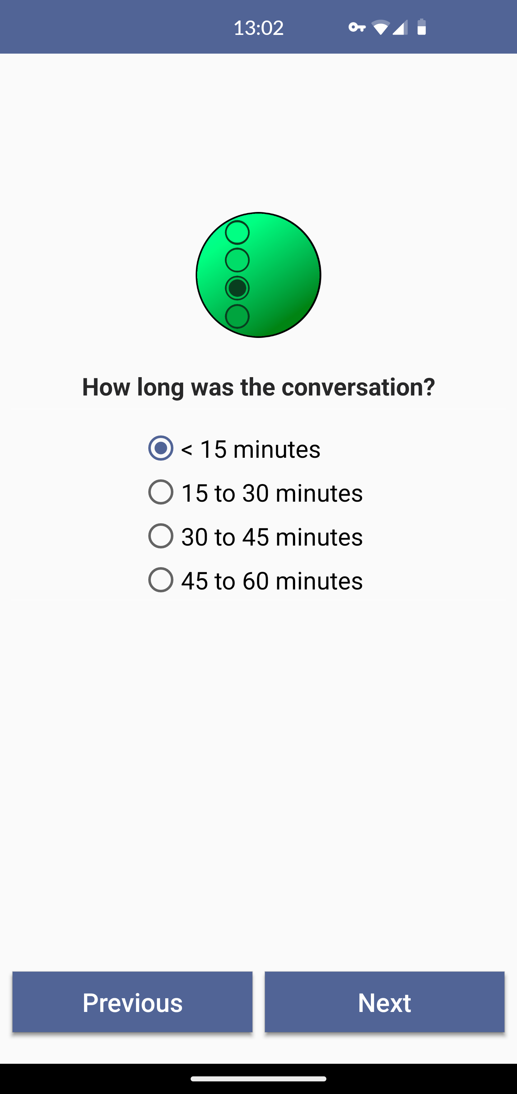
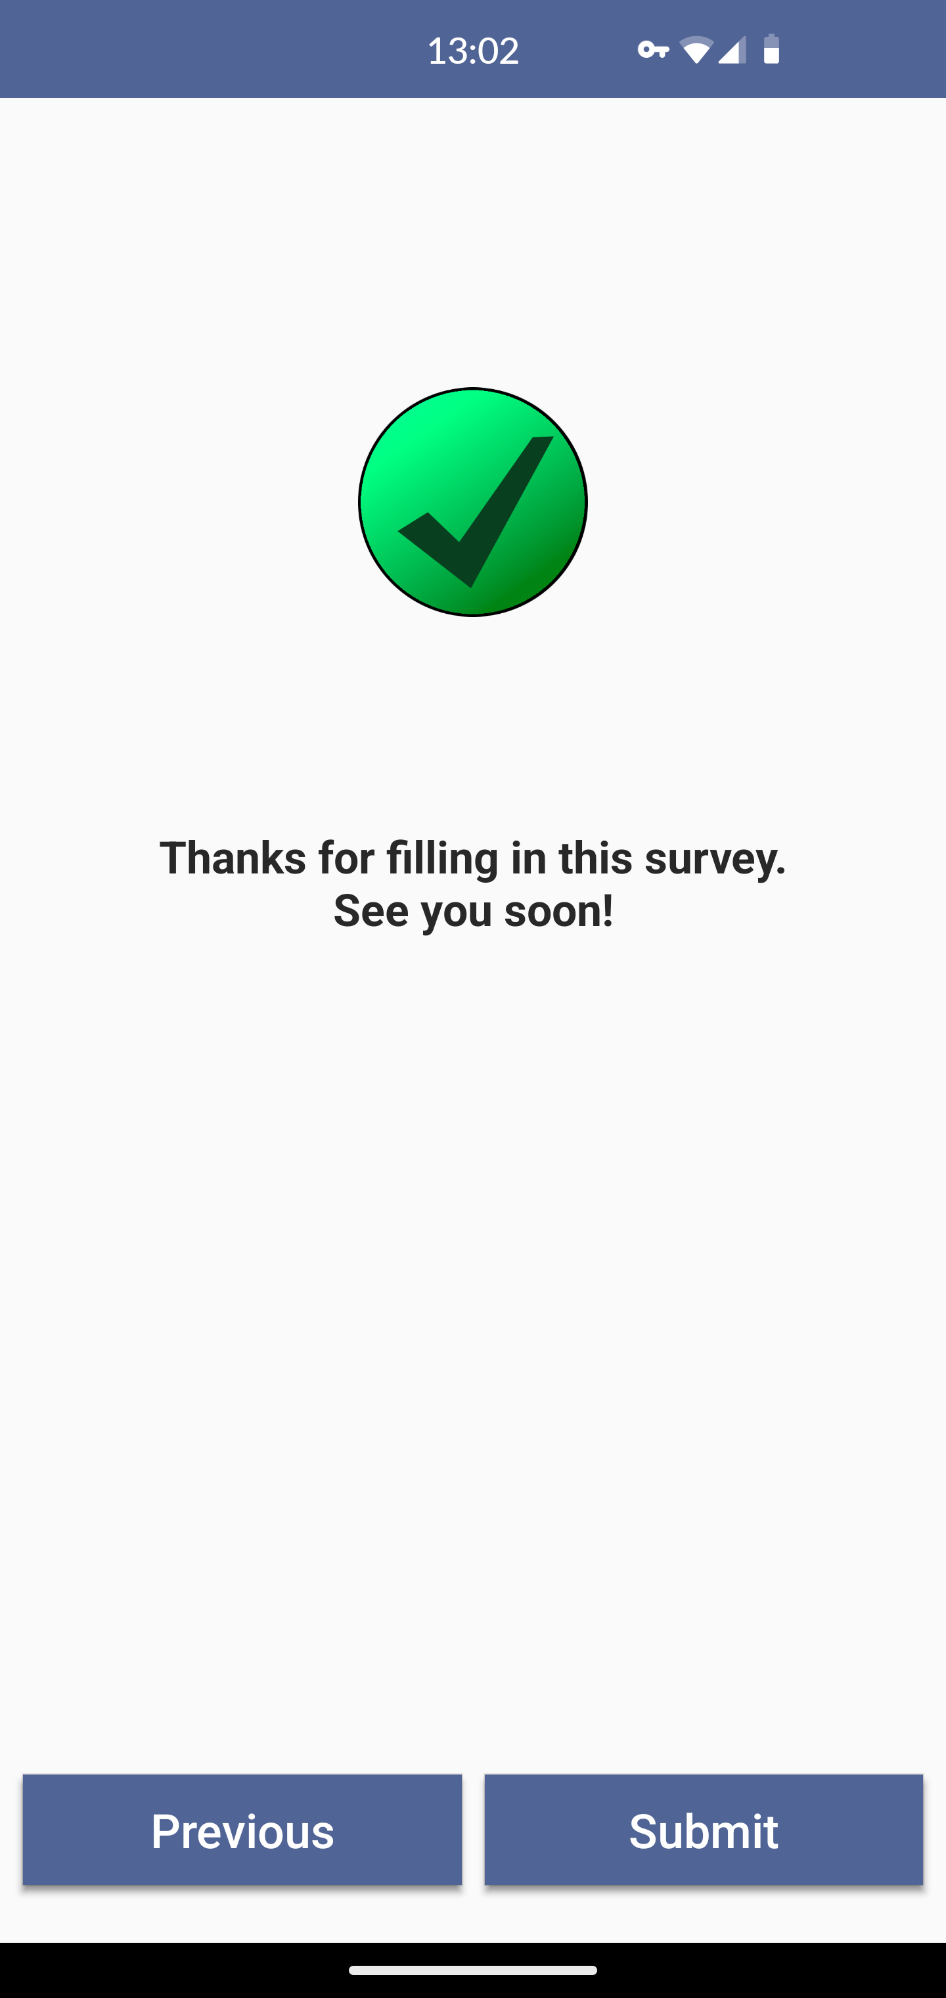

Slide 16
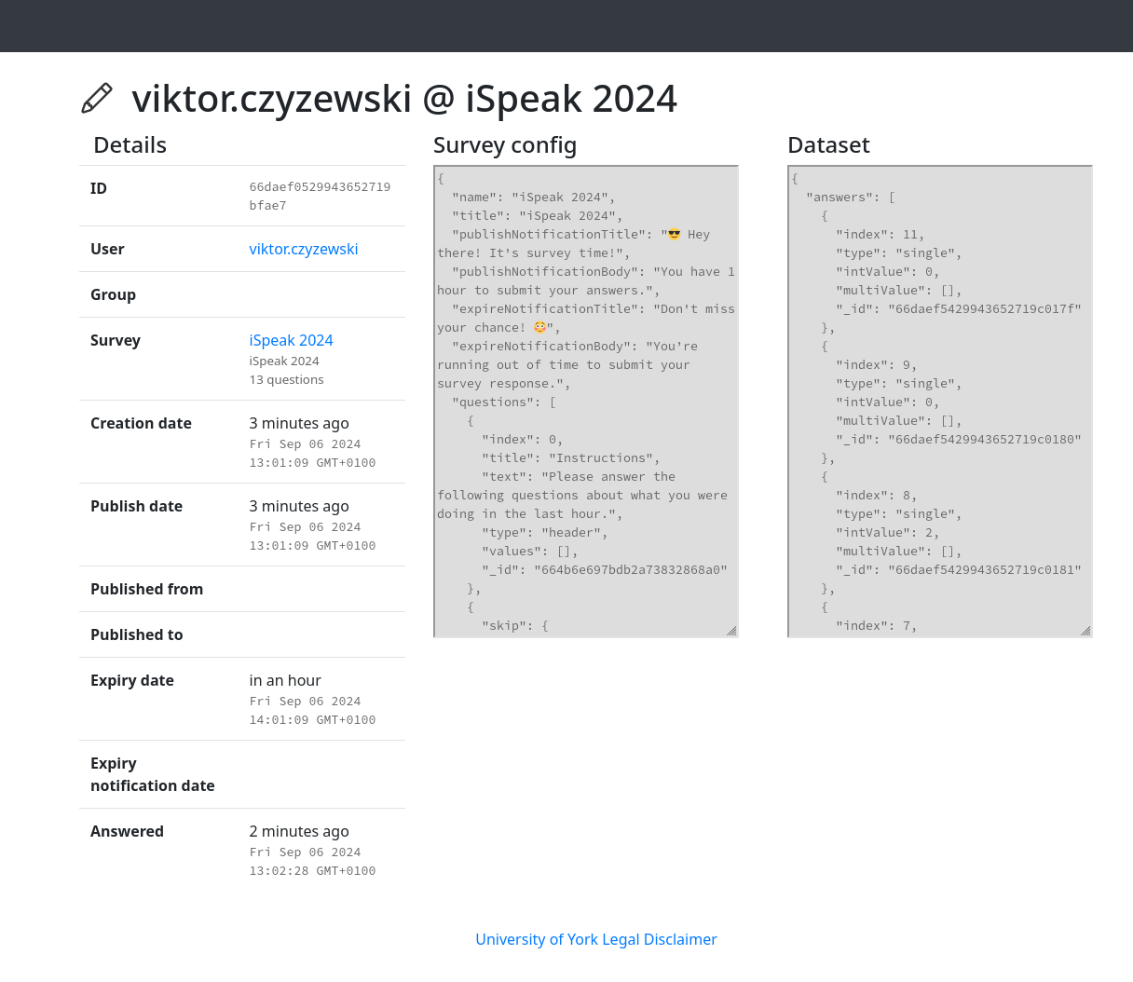
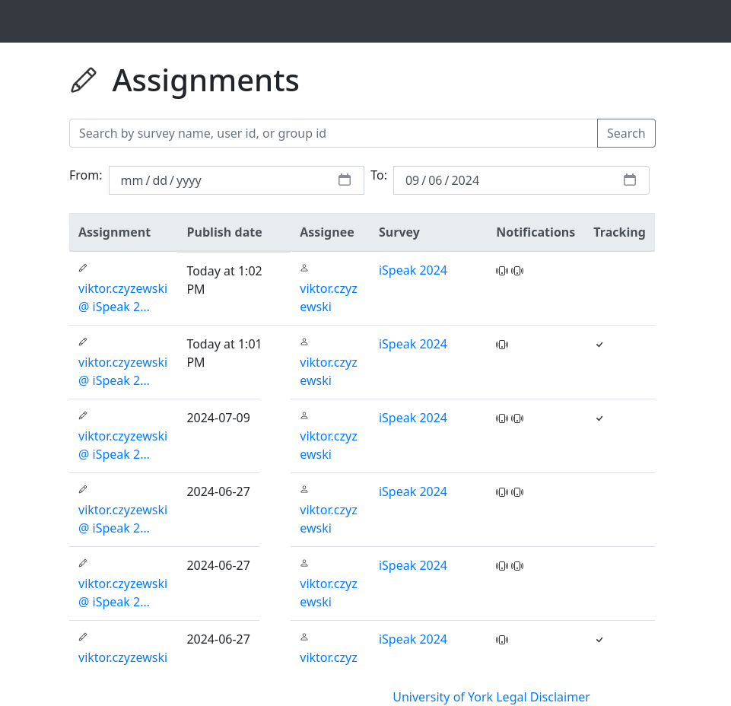
Completed Surveys

Slide 17
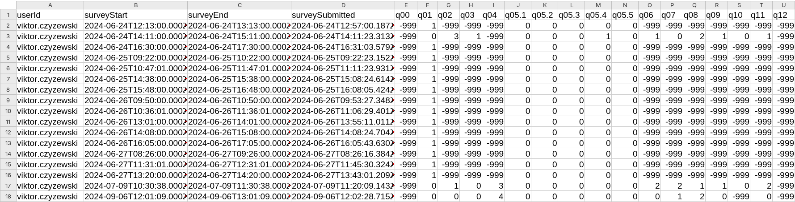
Downloadable CSV Results
-999 = missing data
0 = yes
1 = no
0 to 4 – depends on question type – multiple choice or Likert

Slide 18
Technical problems
Somewhat expected:
Incomplete documentation
Outdated mobile apps
Some parts difficult to extend - hardcoded
Submitting to app stores
Rebranding
  Changing name
  New logo
  Colours, fonts
Unexpected:
Time zones
  Daylight savings
Fixing data export
Server maintenance
  Low default VM storage size
  Database filling up
  Unused Docker images wasting space
  Big and cluttered log files

Slide 19
Approvals
Implementation and hosting
Ethical approval & Data Protection Impact Assessment
Cybersecurity and risk including password security audit
Permission to access University app store accounts
App store reviews (iOS and Android)

Slide 20
The iSpeak project: Research questions
Rationale
Study abroad provides the practice required to develop higher levels of language proficiency, in particular oral fluency
Computer-Medication Communication (CMC) and social media have fundamentally changed the way we communicate.
You can “talk” to anyone, anywhere, anytime
It’s easier to make and maintain friendships in the host country, but at the same time easier to maintain contact with friends and family at home
Research questions
  What conversations do international students with English as a second language have during study abroad?
  What is the relationship between their language use and linguistic and academic attainment?

Slide 21
The iSpeak Project: Methodology
Methodology
Variables
Self-report questionnaire
Experience sampling
  7 days, 4 surveys per day
Focus group interviews
    With whom? - friend, teacher, stranger
    In what language? – English, first language
    Where? – UK, in home country
    How? – In-person, online
    What modality? – spoken, written
    About what? – Food, hobbies, etc.

Slide 22
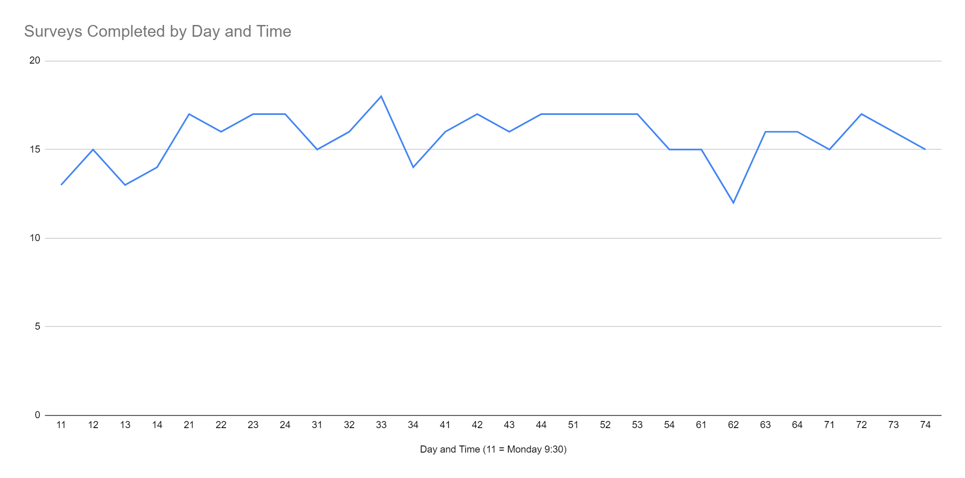
The iSpeak Project: Response Rate
Notes:
So what was our experience. 20 students volunteered to participate in the study. The response rate for the app administered surveys, so the experience sampling, ranged from 7 to 100% with an average of 83%. Two participants with very low response rates 7% and 36% respectively were excluded. The remaining participants had completed over 70% of the ESM surveys. Typical response rates in ESM studies is 70-80%.
The graph on this study plots response rates for the final sample of 18 participants across the week. It is interesting to note how the response rate steadily increased and that there was a clear dip on Saturday morning.

Slide 23
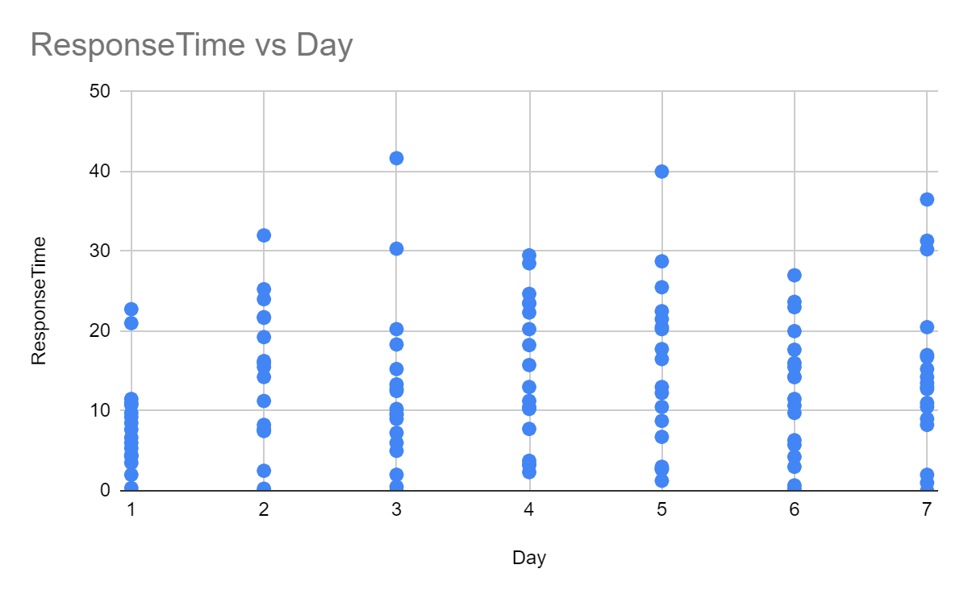
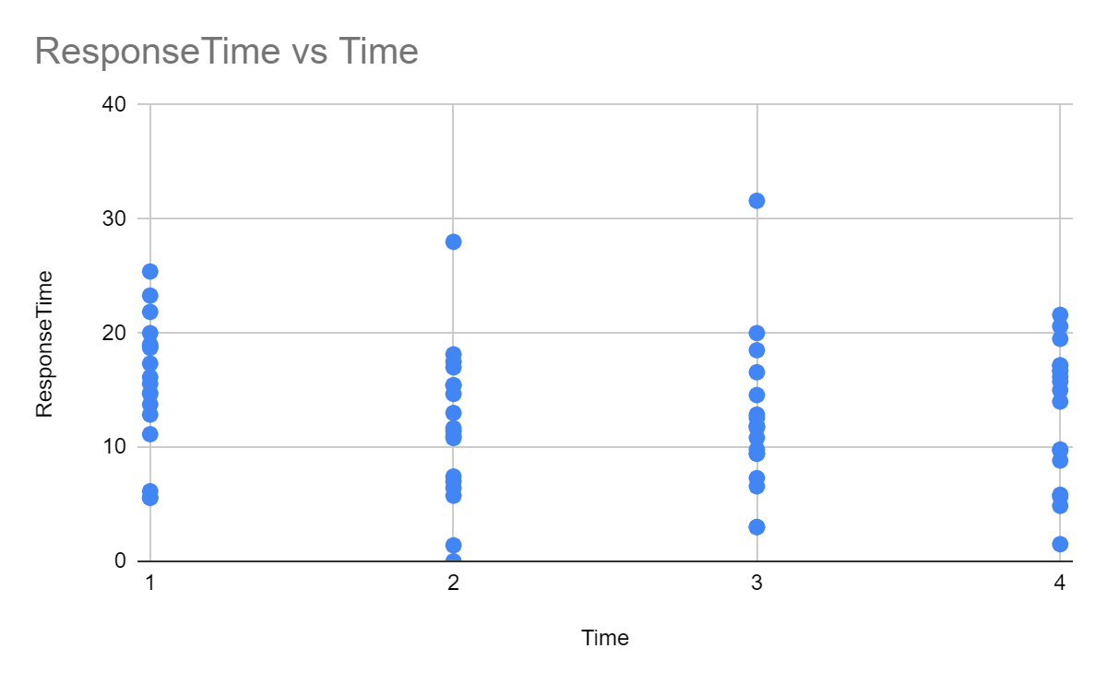
The iSpeak Project: Response Delay

Slide 24
The iSpeak Project: Feedback (1)
“It's really easy to use, and it won't take you a long time to do the survey just for several. Yeah, 3 or 4 min to do it.”
“Yes, there are still some technical issues when you use it. Like, I tried to open the app at that exact time, and then there's no content there. I have to refresh the page several times. So I think I skipped quite a few.”

Slide 25
The iSpeak Project: Feedback (2)
“it give out the survey randomly. It's not always on a specific time, so … Not so that useful, because if every day is different and I have to, sometime I have to interrupt, disrupt my I mean, or rechange my plan, or what, or stop what I'm doing now to finish it as soon. I know it has given us 1 h to finish that, but it still makes me kind of very nervous. I don't want to miss any of them.”
“App service that you guys had. Firstly, the idea of completing within 1 h was really like. I don't think it was quite practical like, how can you be awake at 9 am. And then fill up a form and a act that early in the morning you don't really talk to anyone.”
“I think one suggestion would be in future studies that you guys could have a end of the day survey for the whole day, and also have some more like, you know, extensive timeline for submitting those service.”

Slide 26
The iSpeak Project: Feedback (3)
“I think it's like a 7 day survey. Right? So after the 1st day, while doing the service on the app. Sometimes I just find I had so much less conversation with the others. Yeah. it's like Uhhuh. And and in English, you know it's like like in the last hour. Do you have conversation with others in English? Sometimes it's like, no more less than yeah, that that's what I found with the app”
“It reminds me, it reminds me to to have more conversation with others. And then I download the lingo, you know. Yeah, as an experience, a as an aspiration of this project. Yeah. So I try to try to learn more English or Japanese”

Slide 27
The iSpeak Project: Instruments
Questionnaire
ESM Survey
Item: Please indicate how many hours per day you typically spend engaging in conversations in English (speaking with or writing messages to other people):
  About your studies
  While Socializing
  To buy something
  To access services
Scale: 0 minutes, < 30 minutes, 30 – 60 minutes, 1 -2 hours, 2 – 4 hours, > 4 hours
In the last hour, have you had any conversations with anyone?
What was the purpose of the conversation? (Studies, socializing, buying something, accessing a service)
What language were you using? (English, L1, Mix)
How long was the conversation (< 15 minutes, 15 – 30 minutes, 30 – 45 minutes, 45 – 60 minutes)

Slide 28
The iSpeak Project: Validation (1)
 |  | Questionnaire |  |  |  |  |  |  | ESM
 |  | 0 | < 30 minutes | 30 - 60 minutes | 1 - 2 hours | 2 - 4 hours | > 4 hours | Avg (high) | Mean | Min | Max
Study | Eng | 0 | 7 | 5 | 2 | 6 | 1 | 117 | 18 | 0 | 109
 | L1 | 2 | 7 | 5 | 5 | 1 | 1 | 77 | 11 | 0 | 103
Socialize | Eng | 0 | 7 | 3 | 3 | 6 | 2 | 140 | 41 | 0 | 161
 | L1 | 0 | 2 | 3 | 10 | 5 | 1 | 146 | 73 | 6 | 135
Buy something | Eng | 1 | 17 | 1 | 2 | 0 | 0 | 14 | 6 | 0 | 51
 | L1 | 14 | 6 | 1 | 0 | 0 | 0 | 3 | 4 | 0 | 19
Access services | Eng | 3 | 15 | 2 | 0 | 0 | 1 | 29 | 12 | 0 | 58
 | L1 | 13 | 7 | 1 | 0 | 0 | 0 | 3 | 6 | 0 | 32

Slide 29
The iSpeak Project: Validation (2)
 |  | Questionnaire |  |  |  |  |  |  | ESM
 |  | 0 | < 30 minutes | 30 - 60 minutes | 1 - 2 hours | 2 - 4 hours | > 4 hours | Avg (low) | Mean | Min | Max
Study | Eng | 0 | 7 | 5 | 2 | 6 | 1 | 59 | 18 | 0 | 109
 | L1 | 2 | 7 | 5 | 5 | 1 | 1 | 39 | 11 | 0 | 103
Socialize | Eng | 0 | 7 | 3 | 3 | 6 | 2 | 70 | 41 | 0 | 161
 | L1 | 0 | 2 | 3 | 10 | 5 | 1 | 73 | 73 | 6 | 135
Buy something | Eng | 1 | 17 | 1 | 2 | 0 | 0 | 7 | 6 | 0 | 51
 | L1 | 14 | 6 | 1 | 0 | 0 | 0 | 1 | 4 | 0 | 19
Access services | Eng | 3 | 15 | 2 | 0 | 0 | 1 | 14 | 12 | 0 | 58
 | L1 | 13 | 7 | 1 | 0 | 0 | 0 | 1 | 6 | 0 | 32

Slide 30
The iSpeak Project: Language Use (1)
Cross-tabulation of language * mode * location
 |  | In person |  |  | Online |  |  | Grand Total
 |  | In the UK | At home | Somewhere else | In the UK | At home | Somewhere else
Language | English | 79 | 1 | 0 | 22 | 2 | 4 | 108
 | First language | 51 | 1 | 0 | 29 | 55 | 6 | 142
 | Mix | 32 | 0 | 1 | 6 | 6 | 4 | 49
Total |  | 162 | 2 | 1 | 57 | 63 | 14 | 299

Slide 31
The iSpeak Project: Language Use (2)
Cross-tabulation of language * medium (for online only)
 |  | Speaking | Writing | Total
Language | English | 8 | 20 | 28
 | First language | 42 | 48 | 90
 | Mix | 0 | 16 | 16
Total |  | 50 | 84 | 134

Slide 32
The iSpeak Project: Language Use (3)

Slide 33
The iSpeak Project: Language Use (4)

Slide 34
The iSpeak Project: Language Use (5)
 |  | In person | Online | Total
Language | English | 5 | 1 | 6
 | First language | 9 | 1 | 10
 | Mix | 6 | 0 | 6
Total |  | 20 | 2 | 22

Slide 35
The iSpeak Project: Language Use (6)

Slide 36
Conclusion
Despite some technical difficulties, participants found the software easy to use and enjoyed participating
Some found the survey interrupted their schedule and felt one survey per day would be sufficient
Questionnaire responses tended to overestimate the use of English to socialize and study, in particular
ESM data provides rich insights into students’ language use at a cohort and individual level
The app might be employed as an intervention to promote language use during study abroad

Slide 37
Over to you
Suggested discussion questions:
What questions could you explore using an experience sampling app like Lang Track?
What novel insights might experience sampling bring to your field of study?

Slide 38
Dr Zoe Handley, Dr Philip Harrison, and Viktor Czyzewski
The University of York
Experience Sampling for Social Research: Setting Up and Validating an Open Source App
THANK YOU!
Email: zoe.handley@york.ac.uk, phillip.Harrison@york.ac.uk, viktor.czyzewski@york.ac.uk

