Slide 1
Developing web-based cognitive functioning measures in the Understanding America Study
Arie Kapteyn, Jill Darling, Margaret Gatz, Bart Orriens,
Erik Meijer, Ying Liu, Tania Gutsche
Presenter: Stefan Schneider

Slide 2
The Understanding America Study (UAS)
Steadily growing online probability sample
Started in 2014
Currently about 9,000 panelists
Complete about 1 survey/month
Data freely available at https://uasdata.usc.edu/

Slide 3
Cognitive functioning tests in the UAS
  Fluid abilities/reasoning, verbal skills
  (verbal analogies, number series, picture vocabulary)
  Executive function (Stop and Go switching)
  Processing speed (Figure Identification)
  From Telephone Interview for Cognitive Status (TICS):
  Episodic memory (Word recall)
  Working memory/mental processing (serial 7s)
  Mental status (object naming, recall of today’s date,
  naming president and vice president)
  Use of paradata to infer cognitive functioning

Slide 4
Early tests: added in 2016
  From CogUSA
  Administered every 2 years in UAS
  Verbal analogies
  Number series
  Picture vocabulary: verbal skills
Summer is to Winter as Heat is to ___
4 | 6 | __ | 10
(name what is shown in the pictures)

Slide 5
Early tests
  Calibrated using Item Response Theory (IRT)
  normed to the general US population
  2 psychometrically equivalent parallel short forms per test,
  15 items each
.8 reliability

Slide 6
Age-sensitive cognitive tests
Stop and Go Switch task
Originally developed as part of the BTACT, telephone-administered
Programmed in the UAS for devices with (a) keyboards and
(b) touchscreens

Slide 7
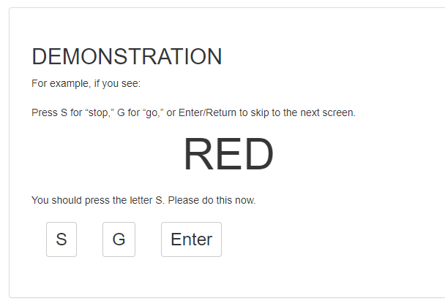
Executive functioning: Stop and Go Switch task
The respondent sees the word RED or GREEN and presses
[S] for “stop”
or [G] for “go”.

Slide 8
Executive functioning: Stop and Go Switch task
Baseline condition (10 Trials)
RED = STOP, GREEN = GO
Reverse baseline condition (10 Trials)
RED = GO, GREEN = STOP
Alternating condition (30 trials)
If “Normal” displayed: RED = STOP, GREEN = GO
If “Reverse” displayed: RED = GO, GREEN = STOP
Notes:
# of trials in each test:
10 baseline,
10 reverse baseline,
23 nonswitch
6 switch trials

Slide 9
Executive functioning: Stop and Go Switch task
Are the response times different when using…
A) a computer with keyboard
versus
B) a device with a touchscreen?
Randomized experiment
Participants do the task twice, using a device with keyboard vs. touchscreen, in randomized order
Notes:
# of trials in each test:
10 baseline,
10 reverse baseline,
23 nonswitch
6 switch trials

Slide 10
Executive functioning: Stop and Go Switch task
Initial tests showed pronounced mode effects
Several iterations
  Multiple practice trials
  Exact instructions about how to position fingers during task
  Minimize number of buttons needed: only keys needed are S (left index finger), G (right index finger) and space bar (thumb).
  Make sure that no scrolling is necessary regardless of screen size
Notes:
# of trials in each test:
10 baseline,
10 reverse baseline,
23 nonswitch
6 switch trials

Slide 11
Executive functioning: Stop and Go Switch task
Results before vs. after refinements:
Mode differences (Touchpad vs Keyboard)
diminished after refinements
Response latencies (in milliseconds) | Before refinements |  |  | After refinements
 | Keyboard | Touchpad | Diff | Keyboard | Touchpad | Diff
Baseline condition | 95 | 118 | +23 | 78 | 89 | +11
Reverse baseline condition | 103 | 119 | +16 | 93 | 97 | +4
Alternating - Nonswitch | 82 | 100 | +18 | 76 | 81 | +5
Alternating – Switch | 141 | 156 | +15 | 120 | 129 | +9
Notes:
# of trials in each test:
10 baseline,
10 reverse baseline,
23 nonswitch
6 switch trials

Slide 12
Age-sensitive cognitive tests
Processing speed: Figure Identification task
Originally developed for paper & pencil administration in the Dureman & Sälde battery
Programmed for keyboard and touchpad administration in the UAS

Slide 13
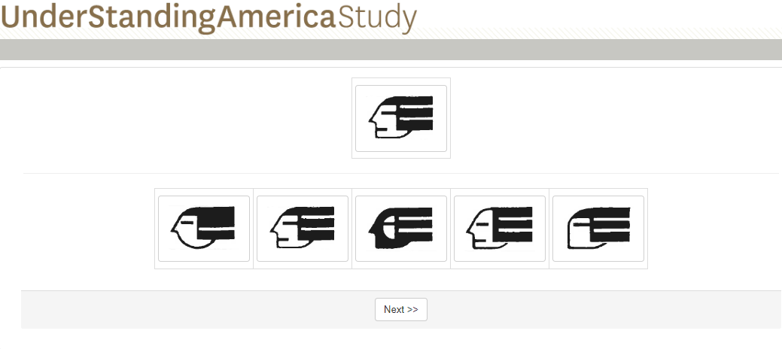
Figure identification task

Slide 14
Processing speed: Figure identification task
Major goals:
Compare keyboard vs. touchpad response times
Create norms and parallel short forms
Within-subject randomized experiment
Participants complete all 60 items twice (keyboard vs. touchscreen), in randomized order
Notes:
# of trials in each test:
10 baseline,
10 reverse baseline,
23 nonswitch
6 switch trials

Slide 15
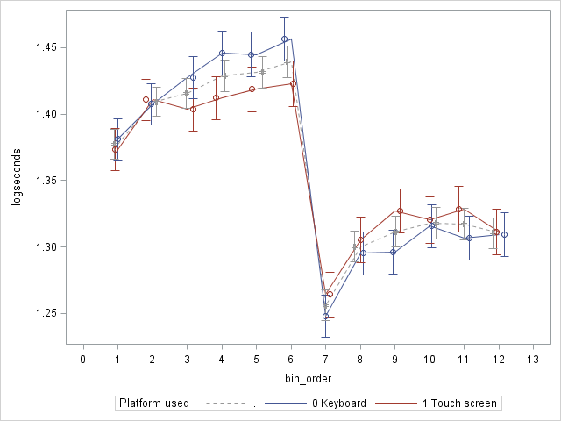
Processing speed: Figure identification task
Training effect
Fatigue effect
60 items, round #1 60 items, round #2
Notes:
# of trials in each test:
10 baseline,
10 reverse baseline,
23 nonswitch
6 switch trials

Slide 16
Developing cognitive categories
to classify dementia status in the UAS

Slide 17
Cognitive classification
  UAS administers components of the TICS (Telephone Interview for Cognitive Status) from HRS every two years
  HRS uses cutoffs to categorize respondents as:
    Cognitively normal
    Cognitively impaired – not demented (CIND)
    Demented
  Not a clinical diagnosis, but classification very useful for research with large samples

Slide 18
Cognitive classification
Goal: develop a classification system using categories and cutoffs based on those in the HRS
Barrier: HRS classification is based on telephone or
in person interviews

Slide 19
Approach
  Create a “cross-walk” between the HRS dementia categories and the UAS cognitive battery:
  Administer tests used for Langa-Weir categorization (episodic memory, serial 7s, backward counting) via telephone
  AND
  Administer UAS cognitive battery within 1 month
  (order randomized)

Slide 20
Deliverables
  Cognitive cutoffs in the UAS
  The resulting classification can be applied to other Internet studies using TICS items.
  Better understanding of mode effects: extent to which shifts to Internet administration impacts classification schemes of cognitive status

Slide 21
Use of paradata
as indicators of cognitive functioning

Slide 22
Why look at paradata?
  Paradata are stored alongside each survey response in the UAS.
  Completing surveys is a cognitively demanding task: involves information processing, comprehension, searching memory for relevant information, decision making, etc.
  Hope is that paradata could capture cognitive inefficiencies to some extent
  Could be useful to detect changes in cognitive functioning as a participant completes surveys over the years

Slide 23
Paradata
  5-year NIA-funded project
  Major goals:
  Which combination of paradata indicators best predicts cognitive status?
  Can paradata indicators be a useful early marker of mild cognitive impairment and dementia?

Slide 24
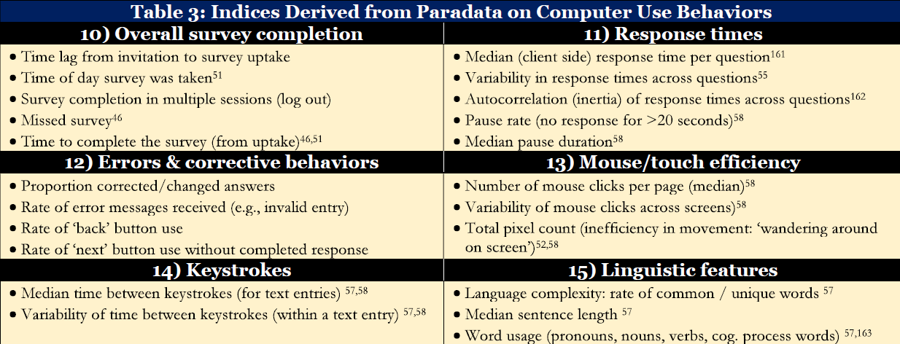
Paradata

Slide 25
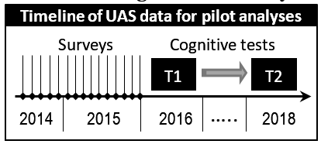
UAS pilot analysis
Focus on response times:
average time participant spent on a screen when completing surveys
Are response times in early surveys (2014-2015) prospectively associated with:
(a) cognitive functioning status in 2016
(b) decline in cognitive functioning from 2016 to 2018?

Slide 26
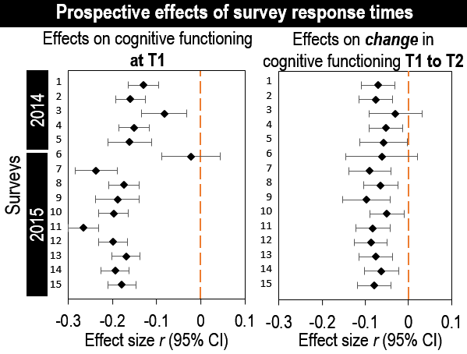
Results for verbal analogies test (age 50+)

