Slide 1
Developing self-completion instruments for the European Social Survey
Tim Hanson
Senior Research Fellow, ESS ERIC HQ
GenPop2 Event, 14 July 2021

Slide 2
2
Acknowledgements
ESS Core Scientific Team: Rory Fitzgerald, Eva Aizpurua, Elissa Sibley, Jennifer McGuiness, Siobhan O'Muircheartaigh, Niccolo Ghirelli, Wiebke Weber, Peter Lynn
ESS National Coordinators: Peter Grand (Austria); Vera Messing and & Bence Ságvári (Hungary); Dragan Stanojevic and Bojan Todosijević (Serbia)
Design consultants: Don Dillman, Emily Geisen
NatCen design and testing team: Charlie Ridley-Johnson, Victoria Ratti, Nadim Maatook, Emma Berteen, Amanda Gratwick
ESS ERIC General Assembly (Funders)

Slide 3
3
Topics covered in presentation
Introduction to ESS and response to the pandemic
Developing a self-completion approach for ESS
Key findings from piloting and user testing
Conclusions and next steps

Slide 4
Introduction to ESS and response to the pandemic
GenPopWeb2 Meeting – 14 July 2021

Slide 5
5
Introduction to the European Social Survey (ESS)
Academically-driven cross-national survey measuring attitudes and behaviour across Europe
Conducted every two years since 2002; nine rounds of fieldwork to date
38 countries have participated in total; 30 at Round 9
Fully face-to-face approach across all participating countries; consistency of methodology important
Central fieldwork specification and central planning/oversight – but decentralised fieldwork contracting and delivery
Random probability sampling; mix of sample frames across countries (individual/dwelling/address)
Interview length c. 1 hour
Alongside core survey methodology, conduct developmental/experimental work with online methods (e.g. CRONOS panels)

Slide 6
6
ESS Round 10 and COVID-19
Fieldwork for Round 10 of ESS was originally due to run from September 2020 to January 2021 using the usual face-to-face approach in all countries
But major concerns about feasibility of face-to-face fieldwork due to the pandemic, so adopted contingency plans:
  Extended deadline for Round 10 fieldwork to December 2021
  Adapting Round 10 specification but retaining face-to-face approach (our preferred approach)
  Planning alternative data collection approach (self-completion – web and paper) – to be adopted by any countries unable to deliver the round face-to-face

Slide 7
Developing a self-completion approach for ESS
GenPopWeb2 Meeting – 14 July 2021

Slide 8
8
Key challenges of a developing a self-completion approach for ESS
Internet penetration not high enough to support a web-only approach in most countries – paper option would also be needed (limitations/design considerations)
Length of ESS questionnaire – would people complete an hour-long survey without an interviewer?
How to keep the paper questionnaire as short as possible (in terms of pages)
Complexity of routing in some parts of the questionnaire – would respondents be able to follow this?
Detailed questions on education and employment – would respondents answer these (to sufficient detail) without an interviewer present?
No time for extensive adaptation of the questionnaire for self-completion – could the approach work without this?
(Other challenges relating to person selection, translations, and other logistical issues that I won’t focus on today)

Slide 9
9
Can we develop a self-completion version of ESS that includes the majority of content from the face-to-face survey (with limited adaptation) while delivering ‘acceptable’ response rates, sample composition and data quality?

Slide 10
10
Development stages for self-completion approach
Development of cut-down version of ESS questionnaire for self-completion
Cut-down version piloted in Austria, Hungary and Serbia (experiment 1)
Development of near full ESS self-completion instruments
User testing of paper self-completion questionnaire in the UK
Pilot of near full self-completion questionnaire (versus shorter versions) in Austria (experiment 2)
Instruments updated following findings from user testing/piloting

Slide 11
11
Summary of the self-completion approach
Push-to-web design with postal recruitment
Sequential approach: web first and paper questionnaire sent to non-responders with second reminder
Three mailings in total for experiment 1 (invitation and two reminders); additional reminder mailing added for experiment 2
Source instruments developed centrally – web survey in Qualtrics, paper questionnaire in InDesign
Approx. 20 minute questionnaire used for experiment 1 (16 pages on paper); experiment 2 compared (near) full version (c. 50 minutes / 36 pages) with two shorter versions

Slide 12
12
Differences / adaptation between modes
Limited adaptation from face-to-face survey – question wording and instructions updated to reflect self-completion format but question formats retained
Small number of questions removed or reworked for self-completion questionnaire – e.g. those where randomisation used (as not suitable for paper)
Sub-set of questions on COVID-19 pandemic moved to start of questionnaire for self-completion – importance to start with interesting/relevant questions
Differences in orientation of 0-10 scale questions between web (vertical) and paper (horizontal) – horizontal in face-to-face survey (using showcards)
‘Don’t know’ and ‘Refused’ codes excluded from self-completion – respondents instructed to skip any questions where they didn’t know the answer or didn’t want to answer
Design of web survey was mobile-optimised (incl. minimising the need for vertical scrolling); in most places one question per screen and no grids
Two-column design used for paper questionnaire

Slide 13
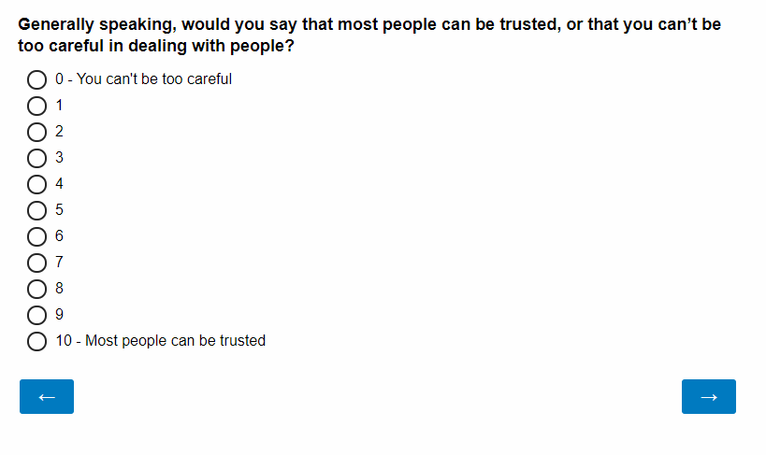
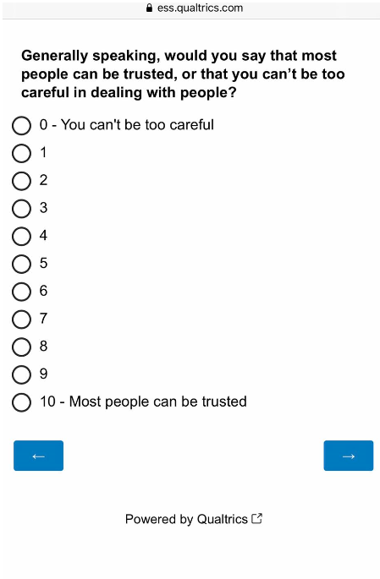
13
Example web survey screenshots
Desktop
Mobile

Slide 14
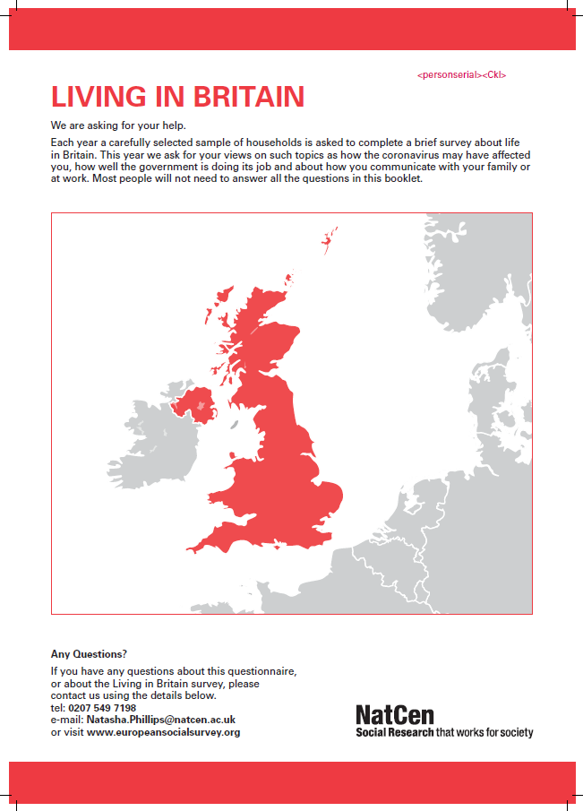
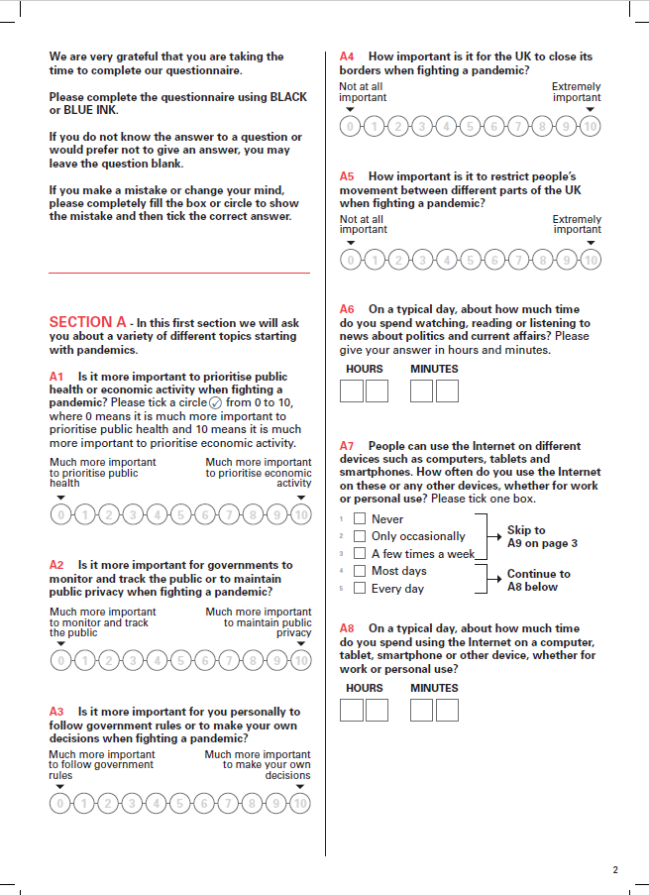
14

Slide 15
Key findings from piloting and user testing
GenPopWeb2 Meeting – 14 July 2021

Slide 16
16
Promising response rates achieved – better than expected?
In experiment 1 (with 20 minute questionnaire), response rates of 35-40% achieved
Similar response rates achieved between individual named sample (Hungary) and address sample (Austria, Serbia) countries
Not much drop-off in response when longer (near full) questionnaire tested in experiment 2

Slide 17
17
Response rates from experiment 1 (c. 20 minute self-completion questionnaire)
Country | Sample | Response rate | % of responses online
Austria | Self-completion | 38.7% | 76.7%
 | Round 9 F2F | 50.8% | n/a
Hungary | Self-completion | 40.8% | 70.4%
 | Round 9 F2F | 40.7% | n/a
Serbia | Self-completion | 36.4% | 62.0%
 | Round 9 F2F | 57.9% | n/a

Slide 18
18
Response rates from experiment 2 – comparing near full version with shorter lengths (Austria only)
Condition | Estimated length | Un-conditional incentive | Conditional incentive | Response rate | % of responses online
A | 20 minutes | €5 | €10 | 37.0% | 68.1%
B | 35 minutes | €5 | €10 | 36.9% | 71.8%
C | 35 minutes | €5 | €25 | 38.8% | 74.5%
D | 50 minutes | €5 | €10 | 33.8% | 73.1%
E | 50 minutes | €5 | €25 | 33.4% | 76.5%

Slide 19
19
Self-completion sample composition mostly good
Self-completion sample profile compared with Round 9 data (unweighted and weighted) and population statistics
No large differences between self-completion and R9 face-to-face regarding sex, age or years of education
Paper is important for bringing in older people – e.g. in experiment 2, 91% of 18-24 years olds responded online versus 58% of those aged 65+

Slide 20
20
Findings from user testing mostly positive
NatCen carried out user testing on paper questionnaire – 15 respondents pre-recruited, sent the questionnaire and asked to complete it; debrief call held to discuss experience / issues
Most feedback was positive – all completed the questionnaire and answered almost all questions they should have; most felt design was clear and easy to follow
Some routing instructions were missed by respondents
Also particular issues with highest level of education questions (especially for parents)
Need to be clearer over whether people should answer about how things are today or were before the pandemic

Slide 21
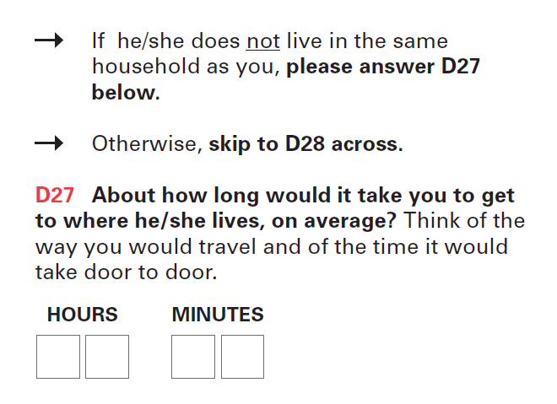
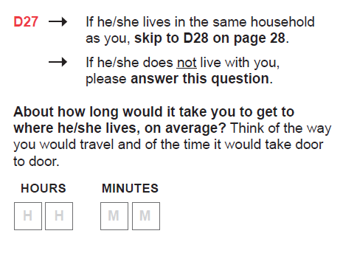
21
Routing instructions in paper questionnaire
Initial approach
Updated approach

Slide 22
22
No concerns with most data quality indicators but clear issues with item non-response for certain questions on paper
Low levels of straightlining and ‘contradictory’ responses
Very few unfeasibly short completion times for web survey
For most items, levels of item non-response not consistently / notably higher than in the face-to-face survey
But – very high levels of item non-response for some questions (especially on paper)
Item non-response highest for questions with ‘write-in’ response formats, (complex) routing instructions, and where knowledge may be lower

Slide 23
23
Question(s) | Item non-response (paper) | Item non-response (web) | Item non-response (Round 9 face-to-face)
Mother’s highest level of education | 49% | 26% | 2%
Father’s highest level of education | 46% | 26% | 4%
Number of employees (if self-employed) | 45% | 18% | 0.1%
Write-in occupation questions for partner | 22-41% | 9-17% | 1%
Write-in industry and occupation questions for respondent | 18-36% | 10-16% | 1-3%
Household income | 28% | 8% | 25%
Partner’s highest level of education | 27% | 9% | 1%
Whether partner did any paid work in last 7 days | 26% | 1% | 1%
Hours normally worked | 25% | 8% | 3%
Digital social contacts questions – children block | 11-21% | 1-7% | n/a
Party voted for in last election | 21% | 12% | 12%
Whether ever lived with a partner | 20% | 2% | 1%
Notes:
Some questions where there were particularly issues with routing or response instructions in the self-completion questionnaire. E.g. number of employees – wasn’t clear that if you have no employees you should enter 0, so have updated the questionnaire to confirm this. Also routing issues in places in the paper questionnaire – e.g. whether ever lived with a partner – routing particularly hard to follow around here so have tried to simplify it. Also added instructions that estimates are okay and even limited information is helpful in some places. Changes should help but it’s likely we’ll still get higher levels of item non-response in self-completion, especially from paper questionnaires.
It does seem clear that the questions on education and employment may be harder to answer without an interviewer present. We also slightly adapted our approach for these for the self-completion so we now have a list of qualifications for the respondent but a write-in/open questions for their partner and parents. This was mainly to save space in the paper questionnaire. We also decided to remove the questions for the mother’s and father’s highest level of education due to the very high levels of non-response in both the web and paper.

Slide 24
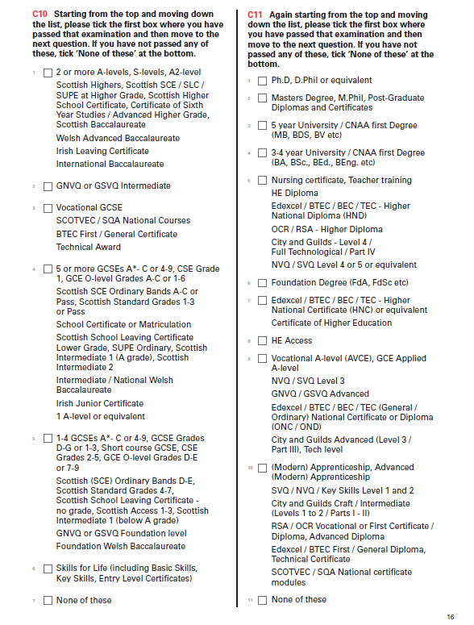
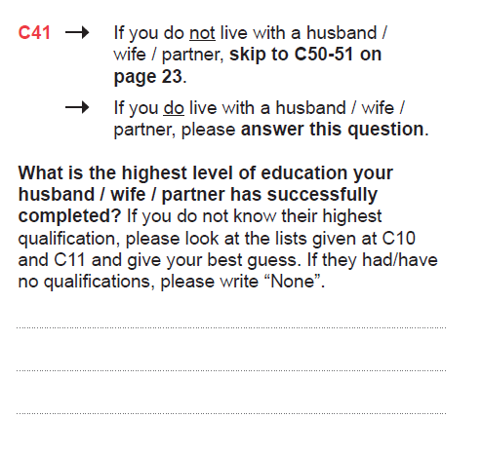
24
Notes:
Note for web survey have split into 4 questions.

Slide 25
25
Survey length underestimated in experiment 2
Near full version was estimated to take around 50 minutes to complete (communicated to respondents in the advance letter)
Median completion time was a little over 60 minutes, even after excluding outliers
Unclear how often people were completing in one go versus taking breaks; however, did not feel we could confidently say that the survey should take ‘about 50 minutes’ to complete; also unsure of impact of saying the survey would take an hour
Decision made to drop one section from the self-completion questionnaire (human values scale), in addition to parent education questions, and retain the 50 minute estimate

Slide 26
26
Breakoffs more common among those using smartphones
Almost three quarters of respondents (72%) completed on a PC/desktop/laptop, 24% on a smartphone and 4% on a tablet
Breakoffs higher among smartphones – 24% started but did not finish, compared with 9% on a PC and 18% on a tablet
No guidance given to respondents on which type of device to use for the survey

Slide 27
Conclusions and next steps
GenPopWeb2 Meeting – 14 July 2021
Notes:
Next steps – in addition to continue with our analysis of the experiments presented today

Slide 28
28
Conclusions
Can we develop a self-completion version of ESS that includes the majority of content from the face-to-face survey (with limited adaptation) while delivering ‘acceptable’ response rates, sample composition and data quality?
General conclusion from our testing/piloting is ‘yes’ – but with some caveats
Positive findings for response rates (though still likely to be lower than face-to-face in most countries), sample composition and some data quality indicators
But concerns about levels of item non-response for some items and especially whether we can collect data on education and employment to a standard close to that achieved for the face-to-face survey
Particular issues/limitations with a paper questionnaire

Slide 29
29
Next steps – ESS Round 10
Self-completion instruments updated following piloting/testing and source versions have now been released to countries using the self-completion approach
Expect around 7-8 countries to use self-completion for Round 10 (majority of countries are using a face-to-face approach)
Data collection to take place between September 2021 and January 2022
Data from self-completion will be released in a separate file from the face-to-face data

Slide 30
30
Next steps – beyond ESS Round 10
Plan to return to a fully face-to-face approach for ESS Round 11 (in 2023); however, options for future data collection approaches (incl. part of full switch to self-completion) being considered
Need to learn more about measurement differences between face-to-face and self-completion and implications for ESS time series – further testing being considered (incl. parallel runs)
Open question of whether we would need to (or should) more drastically redesign the ESS questionnaire for future self-completion – experiments have shown that reasonable outcomes can be achieved without this, though need to consider the more problematic areas of the questionnaire + respondent experience
Future role of an ‘electronic questionnaire device’ to remove / reduce the need for a paper questionnaire?

Slide 31
Thank you
tim.hanson@city.ac.uk

