Slide 1

UKDS data about work, employment and earnings
Pierre Walthéry, UK Data Service
DRTN Webinar - 9 December 2024
Copyright © 2024, UK Data Service.

Slide 2
This presentation
Focus on 'bread and butter', essential data frequently used by researchers
Plan
  About the UK Data Service
  Definitions
  The Labour Force Survey
  Finding data

Slide 3
1. The UK Data Service

Slide 4
What is the UK Data Service?
Who are we?
  Main repository of UK secondary social science data
  A provider of support, training and guidance
  Freely accessible, funded by the ESRC
Who are we for?
  Academic researchers and students
  Government analysts
  Charities and the voluntary sector
  Business consultants
  Independent research centres & think tanks

Slide 5
Data curation
UK surveys:
  Large-scale cross-sectional government surveys series
  Major longitudinal surveys (ie following individuals over time)
  One off academic studies
Multinational survey data and aggregate databanks
Census data – modern and historical
Business and administrative microdata
Range of multimedia qualitative data sources

Slide 6
Provision of support and training
Helpdesk for data-related queries
Webinars, drop-ins and workshops: datasets, methods and software focused
Online learning materials: data skills modules, guides
New forms of data ie computational social science.
Supporting data literacy among undergraduate students

Slide 7
2. Definitions

Slide 8
‘Work’ vs ‘Employment’ vs ‘Labour’
Employment
  A form of economic activity
  A legal relationship, with a formal definition
  Standardised statistics across the industrialised world
Work
  Either a specific form of employment ie job
  … Or the activities and circumstances that take place as part of the employment relationship
  All work is not employment
Broader aspects of work and employments
  Task definition and execution: ergonomics
  Views about one's work
  Job quality

Slide 9
Common employment related data
Economic activity (ILO definition)
  ie paid work, unemployment and economic inactivity
Employment status:
  ie self employed vs employed
Contractual work aspects:
  full-time vs part-time
Where to find them:
  Labour Force Survey
  Most social surveys include a version of these

Slide 10
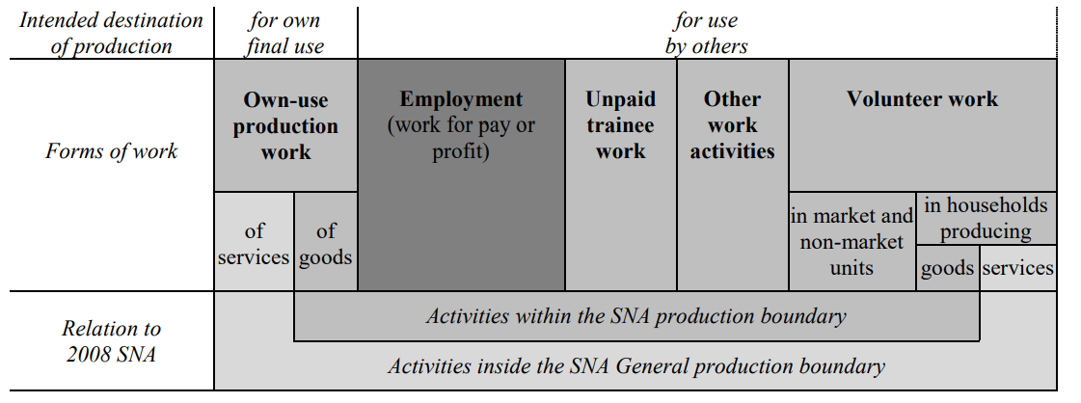
Source: International Labour Office

Slide 11
3. The Labour Force Survey

Slide 12
The LFS in one slide
First collected in 1973, yearly from 1981, continuously since 1991
Began as a requirement of the UK membership of the EU
Data collected by the Office for National Statistics
Mainstay of most labour market statistics in the UK
30,000 respondents interviewed each quarter
Re-interrogated at 4 subsequent quarters
Four main products:
  Quarterly LFS datasets: large sample, detailed variables
  2/5 Quarter Longitudinal datasets: smaller sample, fewer variables
  Annual Population Survey: very large sample, fewer variables
  LFS household datasets

Slide 13
Key LFS variables: working time
Typically weekly working time
Either:
  Actually worked during a reference week (ie last week )
  Usually worked during a stylised ‘typical’ week
May include those temporarily not working:
  Maternity/parental leave; temporarily sick
Alternative/related questions:
  Flexible/atypical work patterns: ie flexitime, on call etc
  Unsocial hours (ie weekend/evenings)
Little data on daily/monthly working time, rhythms and cycles

Slide 14
Key LFS variables: occupations
Formalisation of the notion of job
  tasks or duties carried out as part of the employment relationship.
Defined around skills level vs degree of specialisation
Standard Occupational Classification (SOC)
Latest revision: 2020
Traditionally exist in 4 versions:
  9 Major groups (ie 1 digit)
  Sub-major groups
  Minor groups
  Unit Group

Slide 15
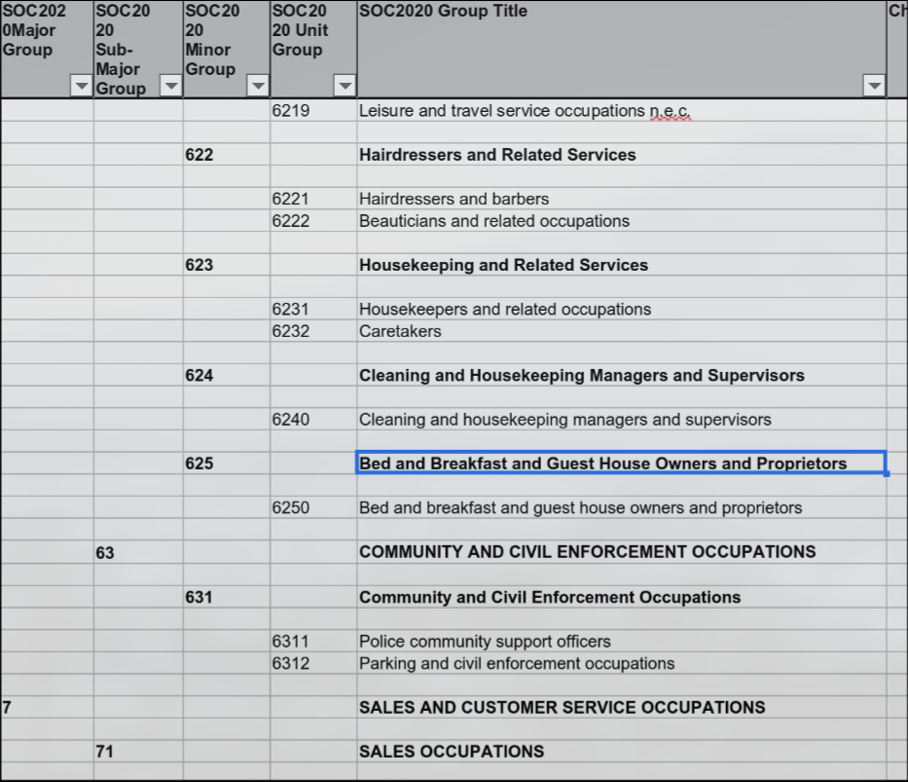
SOC occupations

Slide 16
Key LFS variables: Industry/sectors
Economic activity of the business/organisation where the respondent is employed
Standard Industrial Classification (SIC)
Last version 2007
Similar structure to SOC ie:
  Sections
  Divisions
  Groups
  Class

Slide 17
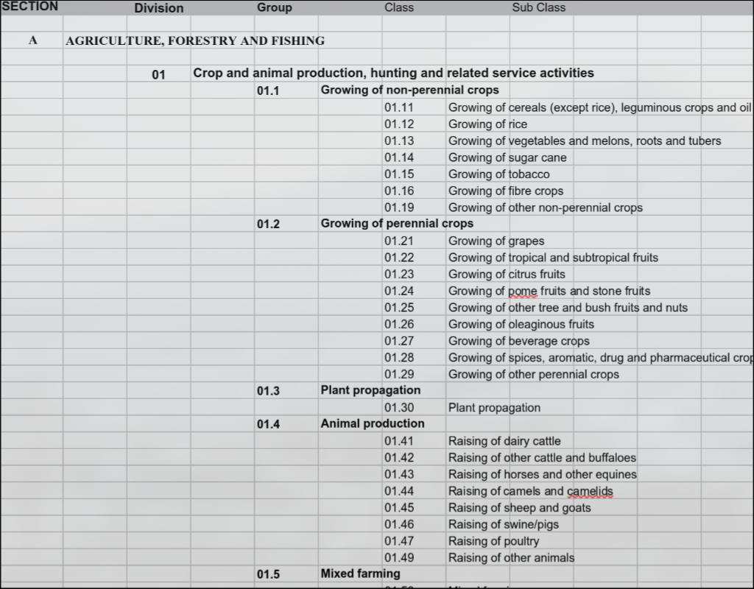
SIC industries

Slide 18
Key LFS variables: earnings
Commonly recorded as hourly, monthly earnings, less often yearly/weekly
The LFS asks people to provide an amount then the period of time covered, hourly and monthly equivalent are then derived
Questions are asked separately for gross vs net earnings; main and 2nd job
Variable pay; overtime
Pay bands
Other surveys may focus on a single ‘typical’ concept ie net monthly pay
Earnings are distinct from income: ie benefits, income from capita ie rent, investment

Slide 19
Other kind of survey data
Job satisfaction:
  European Working Conditions Survey
Fine grain working time, weekly work rhythms
  Time Use Survey
Other kind of incomes ie etc:
  Family Resources Survey, Annual Survey of Hours and Earnings (ASHE)
Long term employment trajectories and outcomes
  Understanding Society
Attitudinal data
  British Social Attitudes survey

Slide 20
Qualitative and deposited research data
No qualitative data equivalent to the major quantitative studies but…
ESRC grant holders are required to deposit data with UKDS
A growing treasure trove of qualitative (and quantitative ) research data on various topics, including work and employment
Most are freely accessible via ReShare on the UKDS website, sometimes authorisation of the grant holder is required

Slide 21
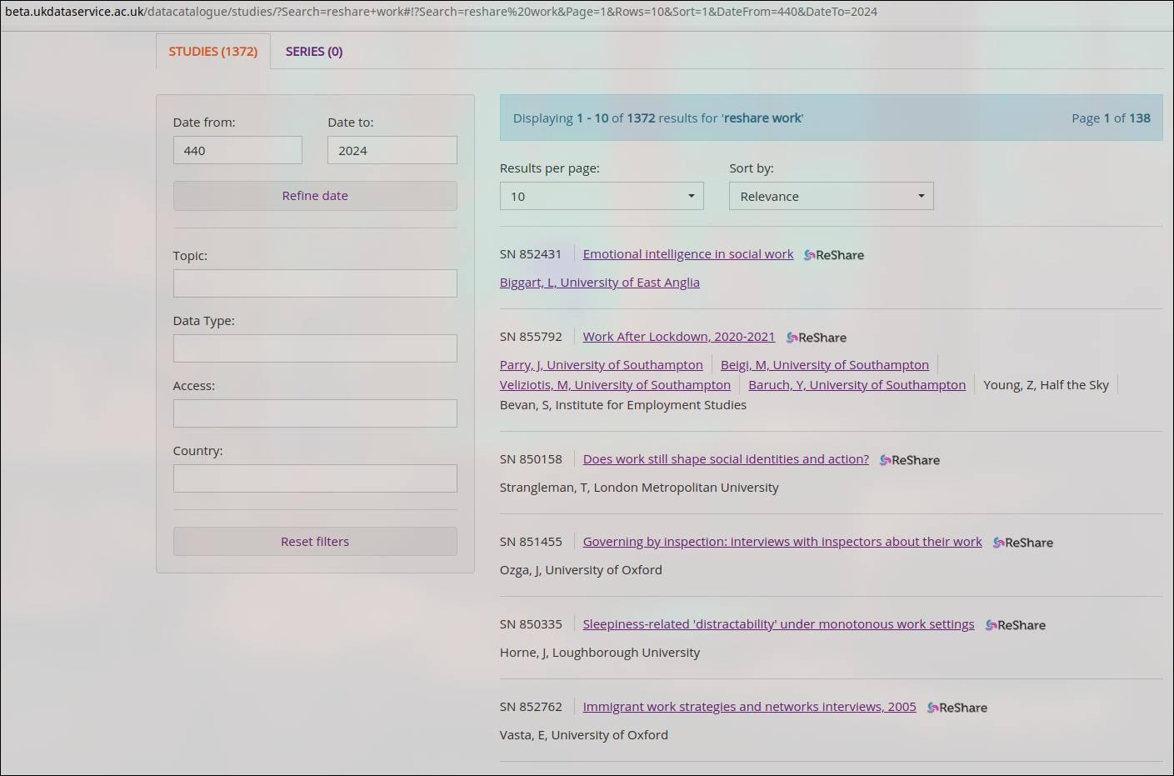

Slide 22
Data quality: essential questions to consider
What was the phrasing of the question?
Is the sample size large enough, what is the population of reference?
How recent is it?
What weights/survey design variables need to be used?
Is a special application required in order to access the variable you are interested in?

Slide 23
4. Searching for data

Slide 24
How to find and access data from the UKDS 5
Data catalogue, either via
  The search tool
  Browse data pages (themes, data type, Teaching data)
Variable and Question Bank (updated version available soon)
Qualibank
HASSET Thesaurus
Notes:
Finally, we have the HASSET thesaurus

Slide 25
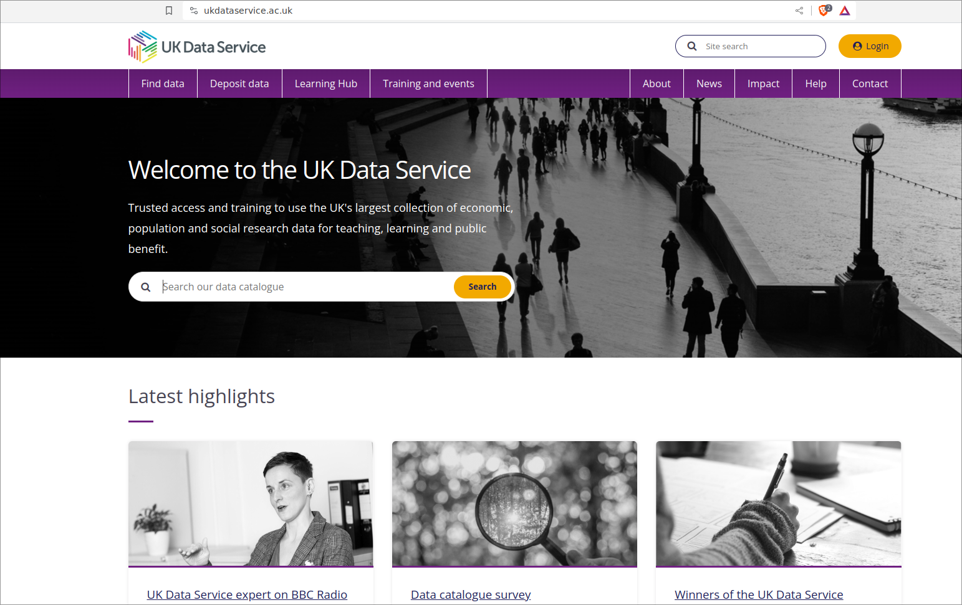
Searching the catalogue

Slide 26
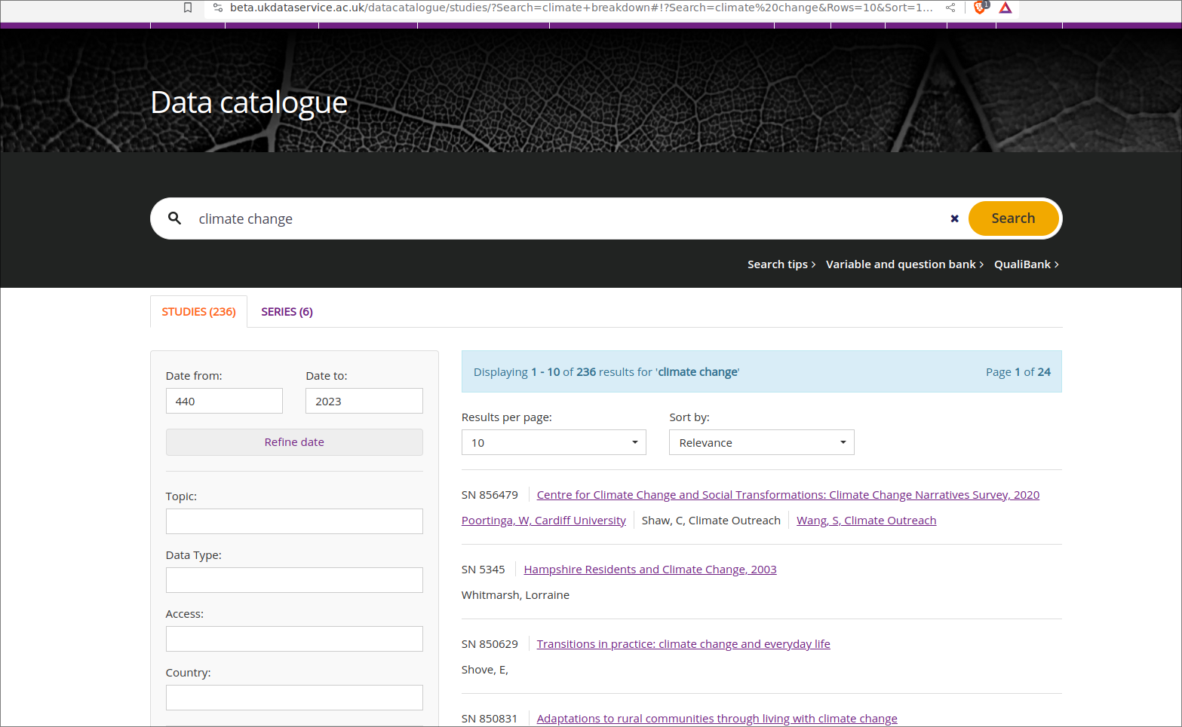
Searching the catalogue

Slide 27

Data Access Policy
Controlled data
Access via a Safe Room, SecureLab within the UK or the SafePod Network
Safeguarded data
End User Licence (< registration); Special Licence (< filling a form)
ReShare data
Access rights set by the data owner and can vary
Open data
No registration required
Notes:
And just a quick point on the different data access levels.
So we have controlled data, also called secure access data, one of the most restricted types, which can only be accessed through a Safe Room, SecureLab within the UK or the SafePod network.
Safeguarded data which is EUL and requires registration, and also under this we have special licence data which has additional requirements. There’s also ReShare data, which is self-depositied access controls vary.
And then open data, which I mentioned earlier can be accessed by anyone without the need to register.

Slide 28
How to register
Logging in via OpenAthens or Shibboleth
  UK Universities
  Some further education colleges
  Some UK Government departments
  Local authorities
UK Data Archive account
  International researchers
  Charities
  Think tanks
  Schools
  Personal researchers
  Commercial organisations
Notes:
Finally, most of the data in our collections can be accessed free of charge, you simply need to register using your institutional log in. Or if you don’t have one, you can apply to get a UKDA username.

Slide 29
Resources and references
UK Data Service website
ILO employment-related definitions
Labour Force Survey:
  Office for National Statistics website
  Labour market statistics
  Series page on the UKDS website
  Variables documentation
Other surveys on the UKDS website:
  Family Resources Survey
  British Social Attitudes Survey
  European Working Conditions Survey
  UK Time Use Survey
Notes:
Finally, most of the data in our collections can be accessed free of charge, you simply need to register using your institutional log in. Or if you don’t have one, you can apply to get a UKDA username.

Slide 30
Thank you for your attention
Pierre Walthéry, UK Data Service
pierre.walthery@manchester.ac.uk

