Slide 1
Past ONS research exploring occupational coding
Laura Wilson (co-investigator for GenPopWeb2)
Principal Social Researcher UK Government Data Quality Hub Lead in Best Practice and Impact Division
Email – laura.wilson@ons.gov.uk | Twitter – @lau_wils

Slide 2
Where are we now?
Quick update on ONS’ work to develop Industry (SIC) and Occupation (SOC) coding for self-completion questionnaires.

Slide 3
Today, share past work
Dual coding experiment
Free-text experiment
GenPopWeb2 network talk

Slide 4
(non)Spoiler alert…
Previous work found… “The questionnaire aspect that appeared to be the most problematic was the coding of Industry and Occupation information.”

Slide 5
1. Dual coding experiment
Face-to-face on the Opinions and Lifestyle Survey, 2010

Slide 6
Overview
Respondents were asked to self-code their answers to the Industry and Occupation coding questions that they had replied to in the course of the face-to-face interview.
How?
Respondents were handed the interviewer’s laptop and asked to read, record their response and follow the on-screen instructions to coding their response.

Slide 7
What happened next?
Interviewers did the same - they also separately coded the answers, either during the interview itself or at home, after the interview had been completed.
Why?
This dual coding was designed to assess the quality of the information coded by respondents, by allowing comparison of their coded responses against those coded by the interviewer.

Slide 8
Further insights
After the interview had been completed, interviewers were also asked to respond to a set of questions to measure how difficult respondents had found each coding frame task.
Interviewers were also required to make detailed notes of the type of issues encountered by respondents.

Slide 9
What did we find?

Slide 10
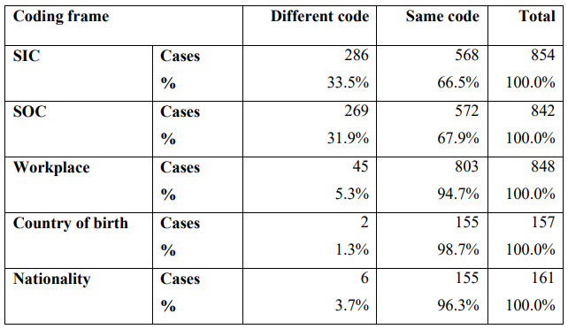
Data quality
Agreement rate - around a third of respondents selecting a different code than that used by the interviewer.
This proportion does not change significantly when only the respondents whom reported no problems with completing the coding frame were investigated.
! This finding highlights a potential implication for data quality should self-coded and interviewer-coded response be combined for analysis in mixed mode.

Slide 11
2. Free-text experiment
Online on the Opinions and Lifestyle Survey, 2010 Online on the Labour Force Survey, 2011

Slide 12
Overview
Post-data collection coding was attempted for online responses to the Industry and Occupation questions as a coding frame could not be programmed for these questions into the online questionnaire software.
How?
Therefore, respondents were requested to provide details about their Industry and Occupation where they were working as free text responses to two open-ended questions.

Slide 13
What happened next?
The information entered was then used to code the responses to the SIC and SOC coding frames once the data were received in the office.
Coding was initially attempted through Automatic Coding Text Recognition (ACTR), a tool which automatically assigns classification codes based on an input of text.
Cases that failed to be coded automatically were then coded out manually

Slide 14
What did we find?

Slide 15
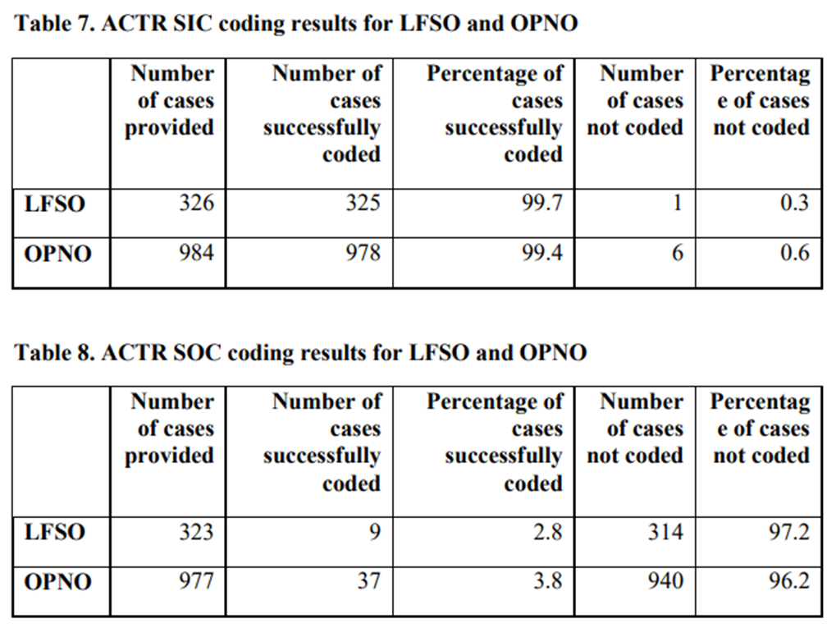
Viability
ACTR was much more successful at coding the SIC as opposed to SOC.
Note: The same test was also carried out on an online Labour Force Survey pilot, called “LFSO”.

Slide 16
Solution?
Expert coders in the ONS Coding Unit successfully coded all the cases to the occupational coding.
Coders’ feedback… Respondents often did not provide sufficient details or provided irrelevant information (often in large quantities), which made it difficult for them to accurately code the occupation.
! This has implications for on-screen advice and the size of text box provided for future online questionnaires.

Slide 17
Census 2021
Example of SOC free text collection

Slide 18
To support the coder comments…
NB: these are publicly shared images by the originator

Slide 19
Back to 201/11 work…Quality
LFSO sample was drawn from a previous final wave of the live LFS. We then compared the SIC and SOC codes for both surveys as the respondent was the same. For the ACTR-based SIC-coding, 49% of cases were assigned a SIC code, which was completely identical to that of the LFS wave 5 interview. Around 23.4% of respondents were assigned a SIC code completely different from that of wave 5.
For the ACTR-based SOC-coding, 57.4% of cases were assigned a SOC code, which was completely identical to that of the LFS wave 5 interview. Around 27.3% of respondents were assigned a SOC code completely different from that of wave 5.

Slide 20
Summary

Slide 21
What we explored…
Use of the frame as is by respondents and compared to interviewer codes
Respondent free text collection only, followed by in-house auto/manual-coding
Compared interviewer coded with respondent free text auto/manual-coded
…more work needed!

Slide 22
Discussion points
Mixed mode concerns around combining data from different collection approaches
Expert vs. amateur
Radical redesign approach to help respondents to provide us with the right information
More of a story approach?
Optimised for the mode – does this provide the same results?
Experiment needed here

Slide 23
Thank you – questions?
Survey Methodology Bulletin No. 70 - March 2012 report
Design, implementation and testing of Labour Force Survey (LFS) questionnaire features in an online mode – results from the 2010/11 internet pilots Martina Portanti and Laura Wilson

