Slide 1
Collecting Multiple Data Linkage Consents in a Mixed Mode Survey: Evidence from Next Steps Lisa Calderwood Marie Thornby (formerly University College London), Mehul Kotecha (NatCen), Kelsey Beninger (Kantar Public) and Alessandra Gaia (University of Milan) Darina Peycheva and George Ploubidis (University College London)

Slide 2
Outline
About Next Steps and the age 25 survey
Administrative records linkage
Key challenges for Next Steps
Linkages sought and linkage protocol
Optimising the linkage consent protocol for online collection of consents
Mainstage consent outcomes at age 25
Data linkage plans for age 32 survey
Discussion points
Notes:
Reduce items/combine

Slide 3
About Next Steps and the age 25 survey
Follows the lives of around 16,000 people in England born in 1989/1990
Began in 2004 (age 13/14), annual sweeps until 2010 (age 19/20) (sweeps 1-7)
Most recent sweep in 2015/2016 - age 25 survey (sweep 8)
Sequential mixed-mode design including web, telephone and face-to-face interviewing
Focus on transitions out of education and into early adulthood
Data linkage major element in the survey

Slide 4
Administrative record linkage
What is it? And why is it valuable?
Study participants asked for consent to add information about them, held in administrative records, to their survey data
Permission is either given or refused for participants’ administrative records to be linked to their survey data
Multiple factors impact consent
- including the design of the consent request and the supporting materials aimed at providing the necessary information to enable informed consent
Careful planning and testing of the consent request is essential to ensure that respondents understand what is involved, and are able to take informed decisions

Slide 5
Key challenges for Next Steps
Request for linking records from many different sources, on several different domains (health, education, economic, and criminal justice)
Retrospective and prospective nature of consent (request to add information from past, present and future records)
Data linkage protocol elicit informed decisions
Re-assure participant’s privacy and confidentiality concerns
Meet data holders and research ethics committee requirements
Implement data linkage consents in a mixed mode survey including web (i.e. no interviewer support provided)
Record consent directly within the survey instrument (consent ‘at the click of a button’)
Provide a record of consent for participants

Slide 6
Linkages sought
Domain | Data set / information | Government Department / Organisation
Education | National Pupil Database (NPD) Individualised Learner Records (ILR) University participation, attainment and destinations Student Loans Higher education applications and offers | Department for Education (DfE) Department for Business, Innovation and Skills (BIS) Higher Education Statistics Agency (HESA) Student Loans Company (SLC) University and College Admissions Service (UCAS)
Health | Hospital Episodes Statistics (HES) plus primary care data | NHS Digital
Economic | Benefit claims and employment programme Tax credits, NI contributions, income | Department for Work and Pensions (DWP) Her Majesty's Revenue and Customs (HMRC)
Crime | Police National Computer (PNC) | Ministry of Justice (MOJ)

Slide 7
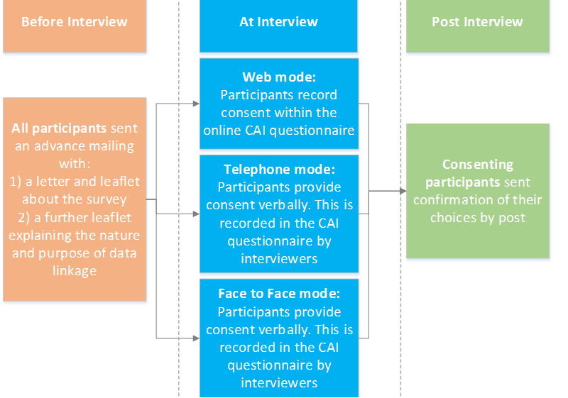
Linkage consent protocol

Slide 8
Optimising the linkage consent protocol for online collection of consents

Slide 9
How to optimise protocol for online consent collection?
Data linkage leaflet – need to be clear, comprehensive, engaging
Supplement data linkage leaflet with short video with key information
Consent questions in web instrument – need to be clear, incorporate confirmation screen, written record provided by post, placed at end of questionnaire
Embed hyper-links in web instrument to leaflet, FAQs and data holder websites
Acceptance from ethical committee and data holders for ‘consent at click of a button’ approach rather than ‘traditional’ paper forms

Slide 10
Development and testing of the linkage consent protocol
Qualitative study
20 interviews with young adults aged 23-27 years
Testing the consent materials and protocol, acceptability and feasibility of consent process
Interviews took place over a two week period in September 2014
Pilot study
Over 100 interviews with young adults aged 23-27 years, across three modes
Testing the consent protocol and the operational procedures as part of the live survey ‘journey’
Interviews took place in November 2014

Slide 11
Consent materials – key improvements
Overall findings – design appealing and content mostly clear and easy to understandable
Adapted consent materials to enhance participants understanding:
- Providing more information about the data holders, records held and specific information which will be linked
- Adding content to address participants concerns about use of the data and provide assurances
More visual content to help participants absorb key messages quickly
New content to describe benefits of data linkage to participants and wider society
Revised order of consents – from least to most sensitive - to facilitate understanding and mitigate against sensitivities
Notes:
Overall development work showed design was appealing and content was mostly clear - highlighted aspects for improvement and need to ensure leaflet was suitable for different reading styles

Slide 12
Data linkage leaflet:
Notes:
16 pages, A5?

Slide 13
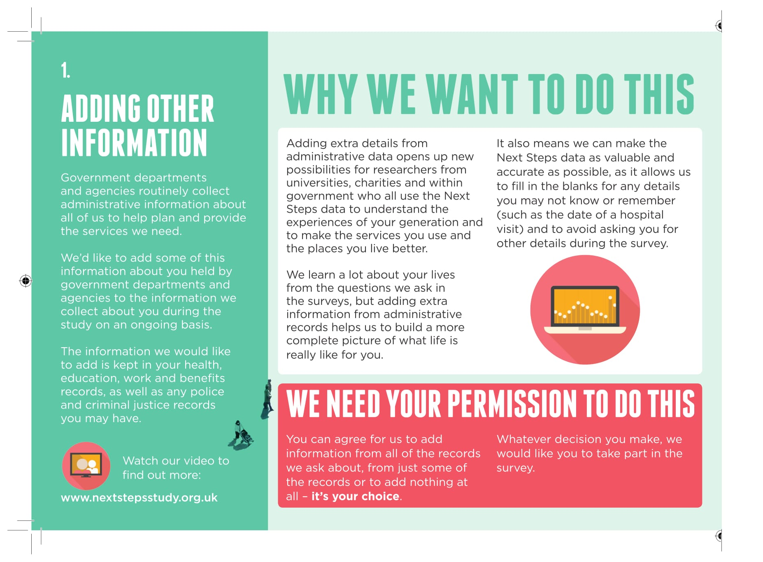
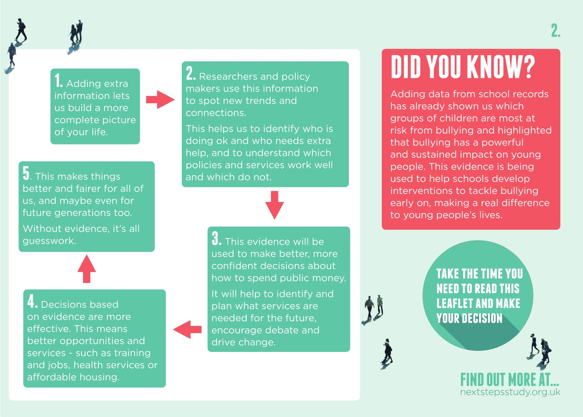
Data linkage leaflet:

Slide 14
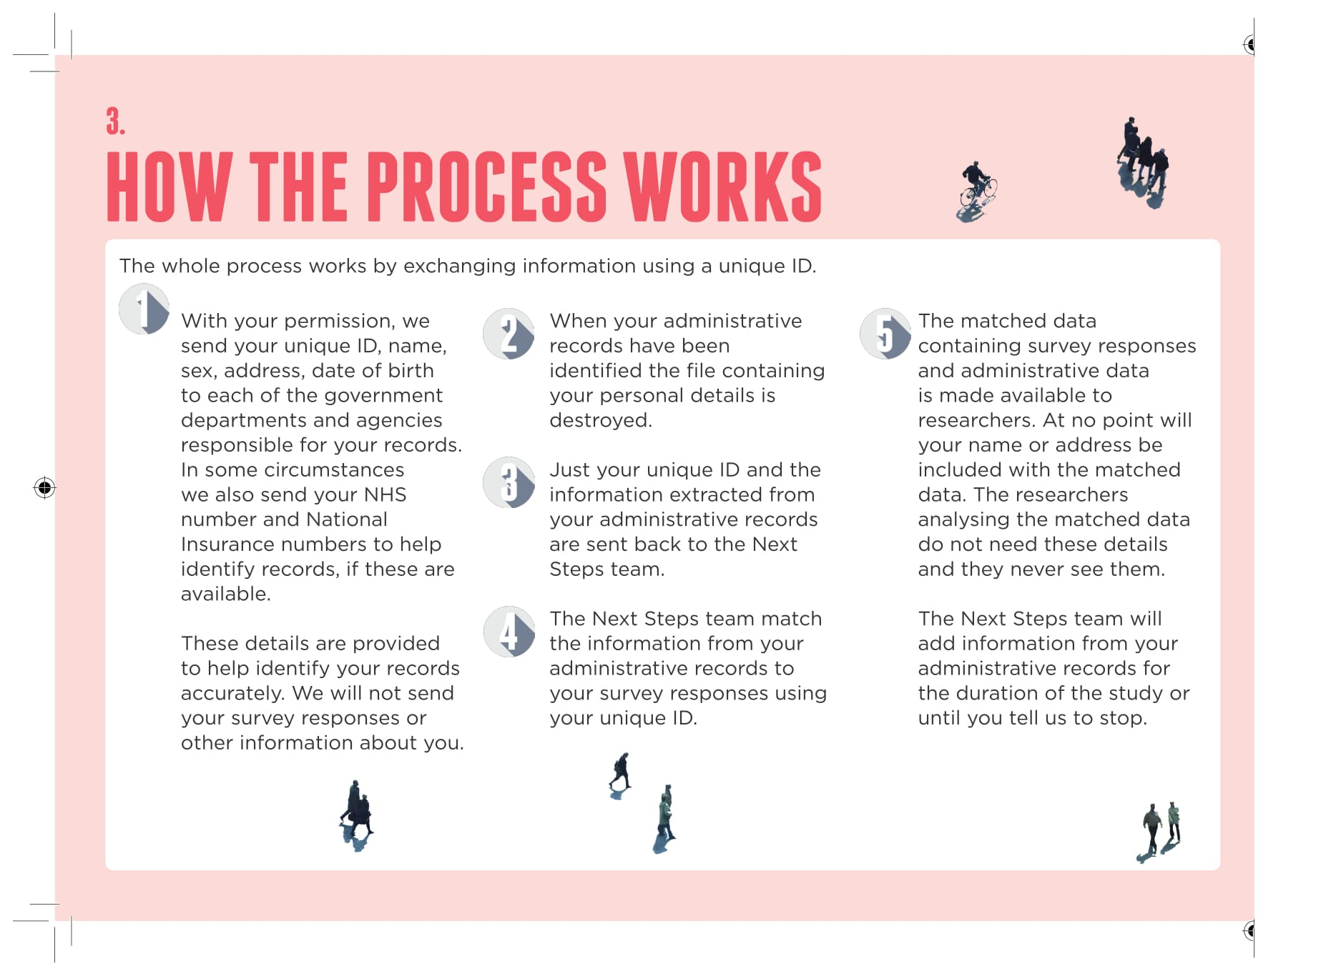
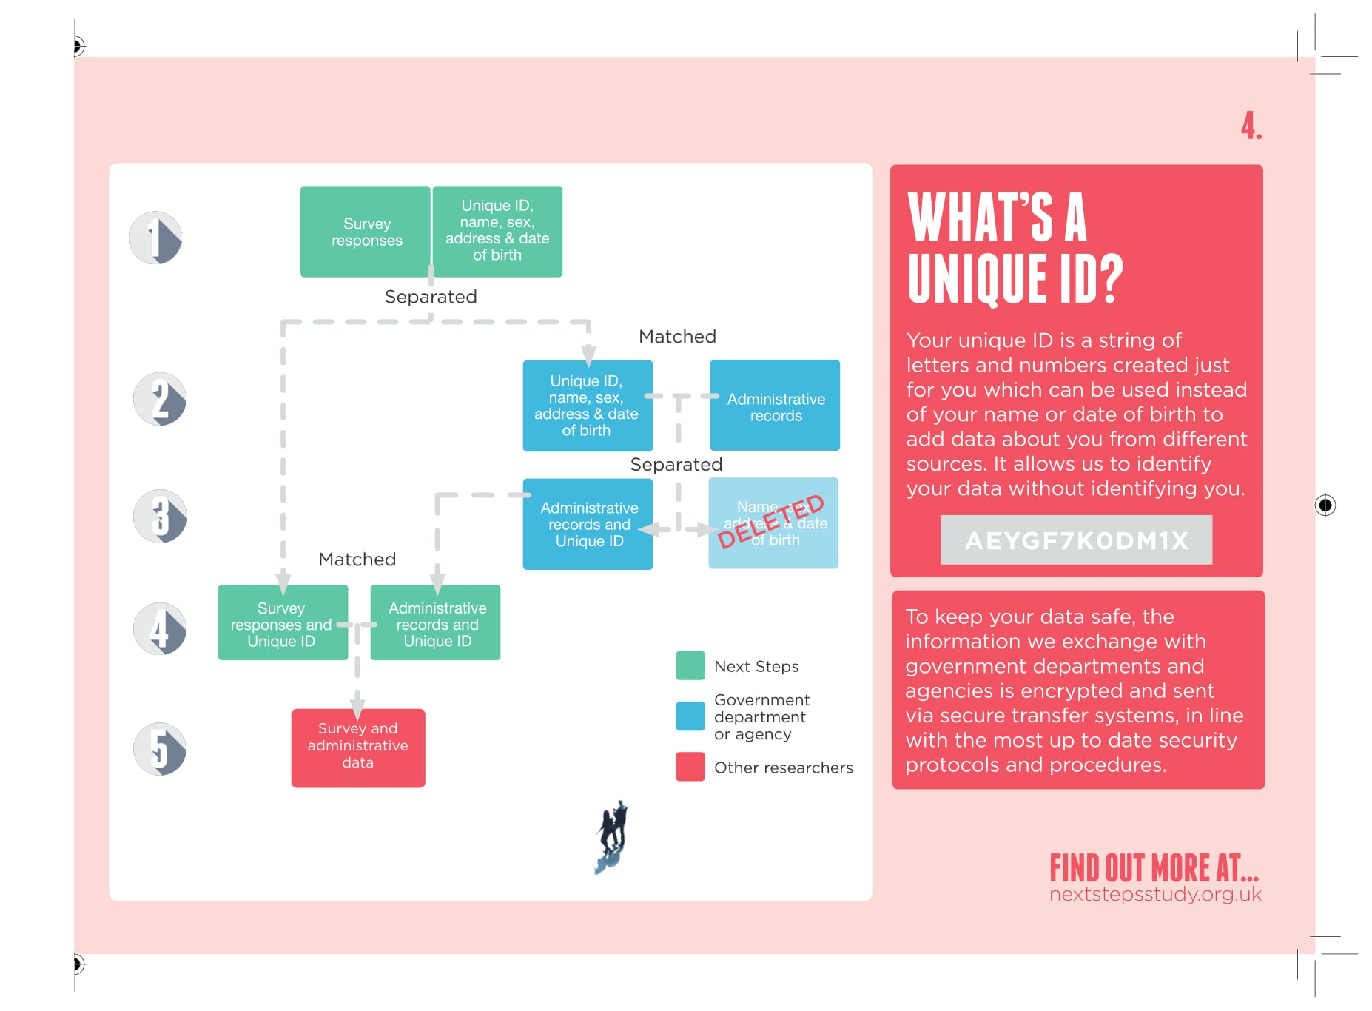
Data linkage leaflet:

Slide 15
Data linkage leaflet:

Slide 16
Data linkage leaflet (consent specific pages): Which records, what do they include, and why add this information?

Slide 17
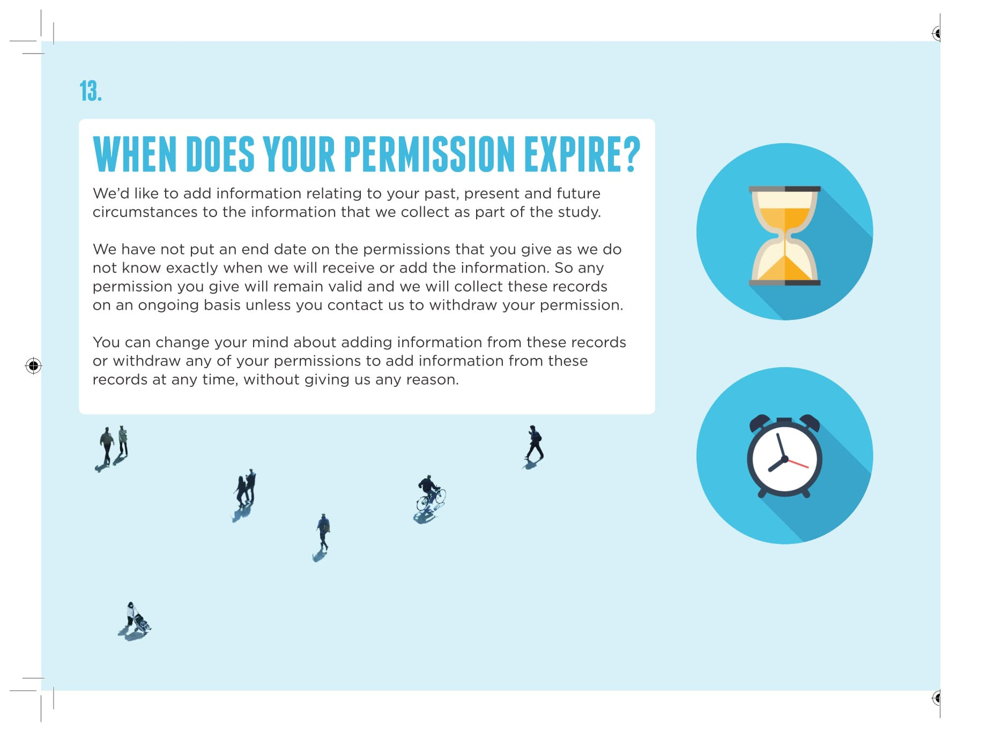
Data linkage leaflet :

Slide 18
Consent protocol – key findings and improvements
Mode of participation
- provide more support to web participants - additional helpscreens, embedded data linkage video, contact with study team, links to data holders websites
Consent at the click of a button
- added an additional page in CAI instrument to review and confirm consents
Consent confirmation
- confirmation letter understood and contained a good summary of what has been consented, decided to provide by letter to all (rather than email)
Acceptability and feasibility of consent process
- protocol not perceived burdensome and
- actual procedure (i.e. receiving an advance mailing, ticking ‘consent’ and receiving the confirmation of consent) not deemed complex

Slide 19
Consent screens (introduction)

Slide 20
Data linkage video

Slide 21
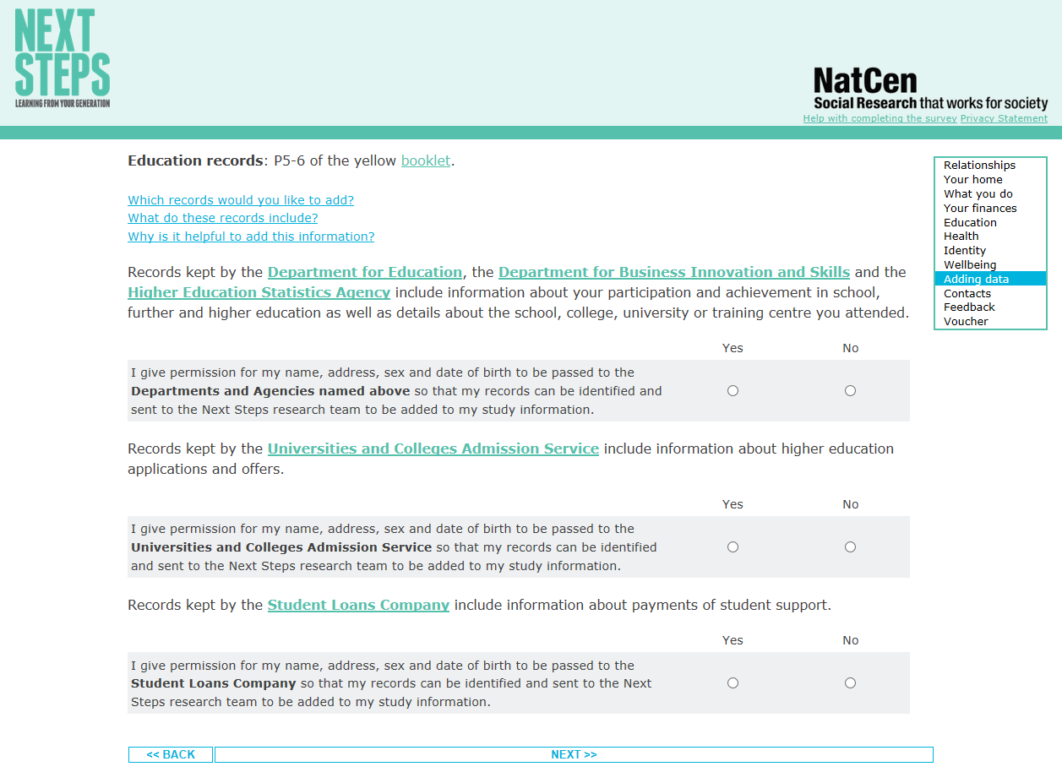
Consent screens (main: education records)

Slide 22
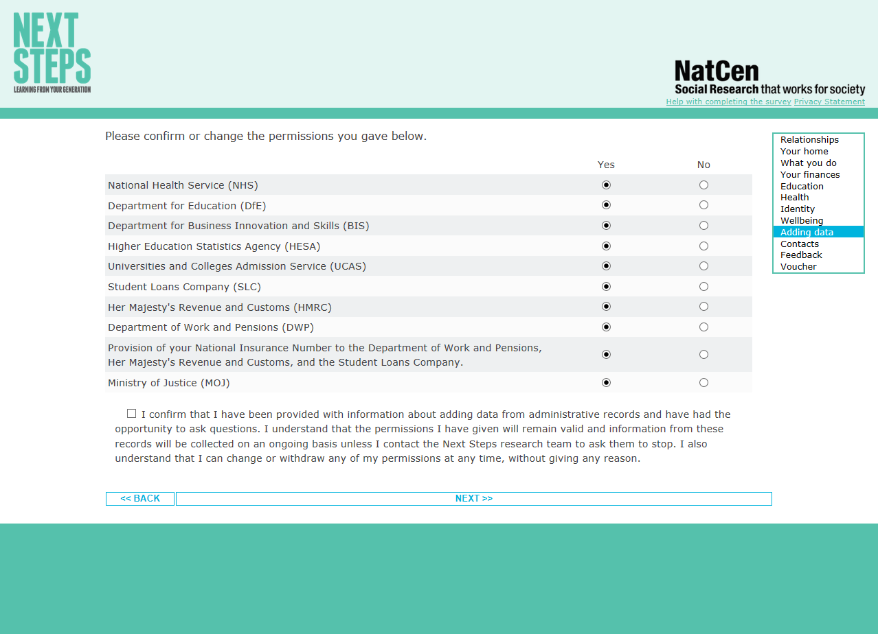
Consent screens (review and confirmation)

Slide 23
Consent rates and factors associated with giving consent

Slide 24
Mainstage consent outcomes by mode
Domain | Web (%) | Telephone (%) | F2F (%) | Overall (%)
Education (NPD, ILR, HESA) | 61 | 85 | 86 | 70
Education (UCAS) | 58 | 84 | 83 | 68
Education (SLC) | 50 | 74 | 77 | 60
Health (NHS) | 55 | 76 | 83 | 65
Economic (DWP) | 48 | 76 | 78 | 60
Economic (HMRC) | 46 | 71 | 76 | 57
Crime (MOJ) | 55 | 78 | 79 | 64

Slide 25
Potential for bias resulting from differential patterns of consent
CLS research on determinants of consent to linkage of health, crime, education and economic records among young adults (Peycheva et al., 2021)
Data-driven approach, looking at the widest possible range of potential predictors of consent (all data collected throughout the study)
Observed systematic differences between respondents who provide consent and those who do not: potential for over- or underrepresentation of population subgroups in survey data linked to administrative data
Consent across different record types could be determined by similar factors but also potential biases may differ according to the consent request
The observed differences go beyond demographic and socioeconomic characteristics
A range of attitudinal and behavioural characteristics, observed throughout the study, strongly related to consent
Correcting solely for sociodemographic characteristics of study members may not entirely remove bias in sample composition.
Greater range of attributes should be considered when handling missing data due to selective consent
Notes:
Mode of participation was strongly associated with consent; due to the large mode differences we retain mode in the analysis as a control variable.
For most of the record linkages males were more likely to provide consent than females, though males were no more likely than females to consent to criminal records linkage or to provide their NINO (among HMRC, DWP or SLC consenters). For all record types, white cohort members were more likely than all other ethnic groups to provide consent.
There was no evidence that participants’ economic activity was related to health records consent nor NINO provision (among consenters to HMRC, DWP, or SLC records), but it yielded a statistically significant relationship with all other records consents, where anyone unemployed, sick, or disabled was significantly less likely to consent to records linkage. Separated or divorced cohort members, noting the small subgroup size, gave permission for all records linkages at a higher rate, except for NINO (among HMRC, DWP, or SLC consenters).

Slide 26
Summary of Age 25 Survey findings
Overall, asking for administrative records linkage consent considered successful
Consent rates varied (notably) by domain and mode – much lower in web mode
Testing of consent protocol and materials – a major element in developing an effective consent request tools and procedures
Clear explanation of process, highlighting benefits and reassurances in relation to concerns are key in information leaflets
Visual design and layout also very important
Implementing data linkage consent in WEB (still) a challenge

Slide 27
Plans for Next Steps Age 32 survey (sweep 9)
Sequential mixed-mode design including web, face-to-face and telephone interviewing
Data linkage still a major element in the survey
Ask data linkage permissions not previously given
Health, education, economic, and criminal records
Ask data linkage permissions from cohabiting partner
Health and economic records
Online, following the cohort member interview, or in-person – if partner available during in-home visit
Data linkage protocol similar to Age 25 survey
Provide materials aimed to ensure informed decisions in advance (Data linkage leaflet) and throughout the consent process (Help screens, video, relevant web references)
Record permissions directly within the survey instrument (consent ‘at the click of a button’)
Provide a record of consent

Slide 28
How to further improve protocol for online consent collection to boost consent rates?
Telephone call-backs for non-consenters?
Remove consents from online instrument and complete via telephone follow-up?
Telephone protocol for those less likely to give consent? Can we identify and target effectively?
Replicate interviewers’ function in online surveys
‘live chats’ over messaging service or asking respondents to phone in for interviewer to talk them through consent process?
Automated functionality such as avatar or ‘chat bot’?

Slide 29
References
Thornby, M., Calderwood L., Kotecha M., Beninger K. & Gaia A. (2018). Collecting Multiple Data Linkage Consents in a Mixed-mode Survey: Evidence from a large-scale longitudinal study in the UK Survey Methods: Insights from the Field. Retrieved from https://surveyinsights.org/?p=9734
Peycheva, D., Ploubidis, G. and Calderwood, L. (2021, forthcoming). Determinants of Consent to Administrative Records Linkage in Longitudinal Surveys: Evidence from Next Steps in Lynn, P. (ed): Advances in Longitudinal Survey Methods, Wiley.

Slide 30
Thank you
Any questions?

Slide 31
Additional help-screens: How helpful..?
Help screen | N
Missing | 4765
EDUCATION: Which records would you like to add? | 1
EDUCATION: What do these records include? | 3
EDUCATION: Why is it helpful to add this information? | 3
ECONOMICS: What do these records include? | 2
ECONOMICS: Why is it helpful to add this information? | 2
CRIME: What do these records include? | 3
CRIME: Why is it helpful to add this information? | 1
HEALTH: Which records would you like to add? | 6
HEALTH: What do these records include? | 6
HEALTH: Why is it helpful to add this information? | 5
Total | 4797

